Slide 1
The Case for Validating SDN Inputs
Alexander Krentsel¹², Rishabh Iyer¹, Sylvia Ratnasamy¹², Isaac Keslassy³, Rob Shakir², Anees Shaikh²
¹UC Berkeley, ²Google, ³Technion

Slide 2
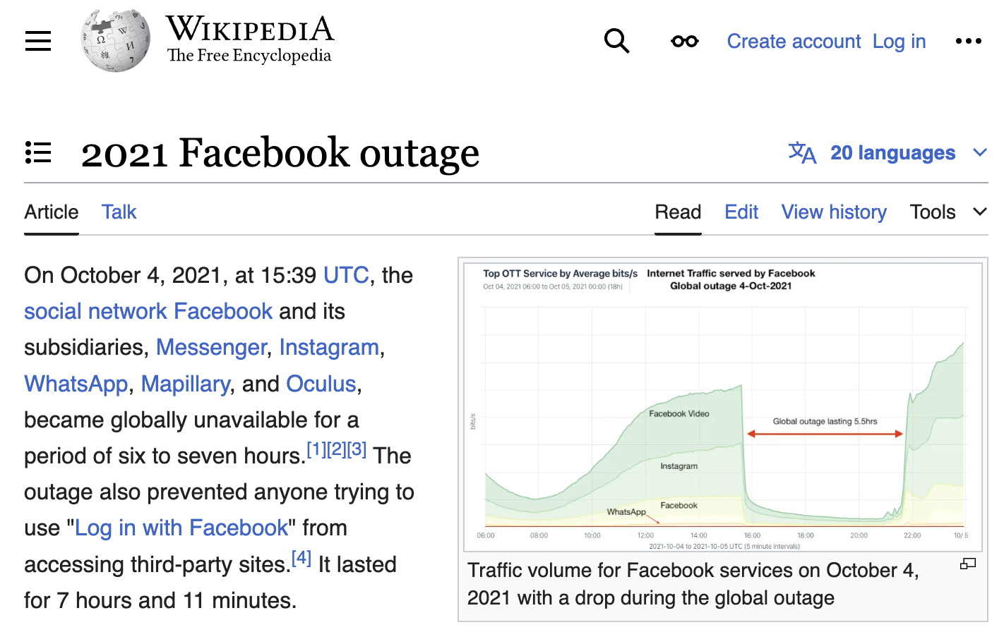
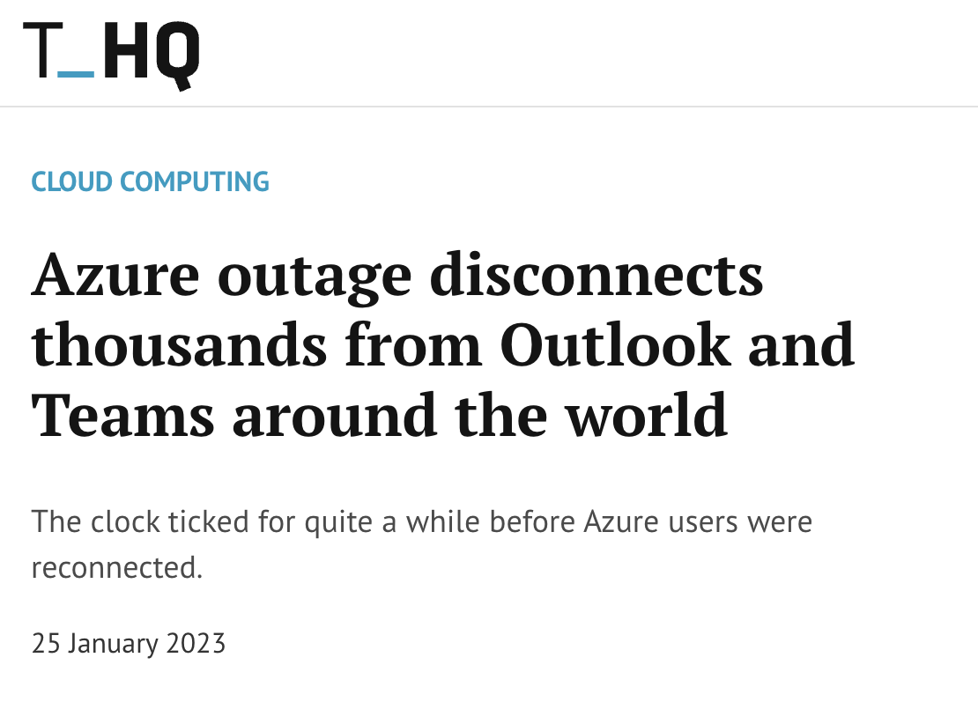
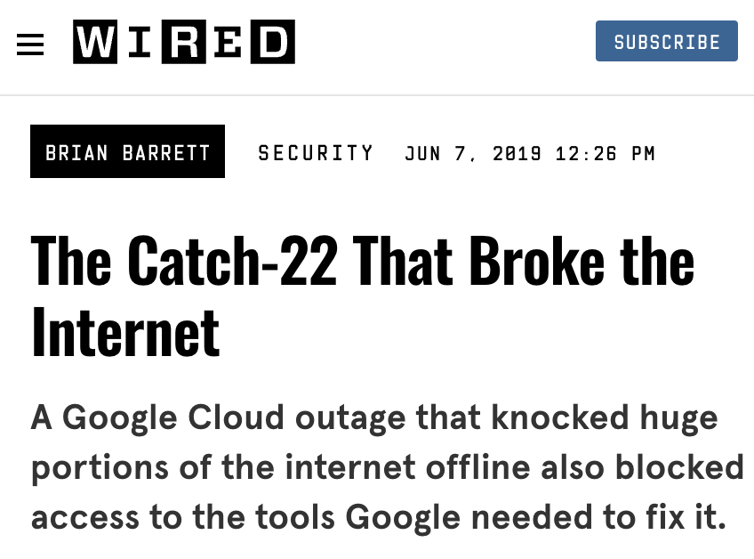
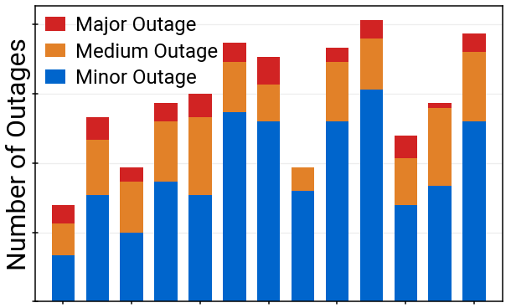
No end in sight for WAN outages
Outages continue despite decades of experience and vast literature of best practices:
Simulation/Emulation
SimBricks [SIGCOMM ’22]
CrystalNet [SOSP '17]
Mininet [HotNets ‘10]
Testing:
NetCastle [NSDI ‘24]
Ixia (Keysight)
Verification:
Batfish [NSDI ‘15]
Header Space Analysis [NSDI ‘12]
…
Time
From Decentralized SDN, SIGCOMM ‘24
Why do they continue?
1

Slide 3
Background
SDN Controller
B
C
A
2

Slide 4
Background
Low-level signals collected from routers and external input
interface up/down status
host per-destination sending rates
…
SDN Controller
Control Infrastructure
low-level signals
…
B
external input
C
A
Routers
2

Slide 5
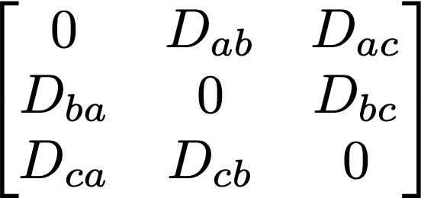
Background
Low-level signals collected from routers and external input
interface up/down status
host per-destination sending rates
…
Aggregated into abstract inputs
topology:
demand:
SDN Controller
abstract inputs
Control Infrastructure
A
B
C
low-level signals
…
B
external input
C
A
Routers
2

Slide 6
Background
Low-level signals collected from routers and external input
interface up/down status
host per-destination sending rates
…
Aggregated into abstract inputs
topology:
demand:
SDN controller computes new routes
Routes programmed back into routers
SDN Controller
abstract inputs
Control Infrastructure
A
B
C
low-level signals
…
B
external input
C
A
Routers
2

Slide 7
Key cause: incorrect inputs
Conducted analysis of high-impact SDN WAN outages over past 5 years…
SDN Controller
,
⇒ Over 1/3rd root-caused to incorrect inputs.
Control Infrastructure
…
B
C
incorrect: do not reflect reality
A
Routers
3

Slide 8
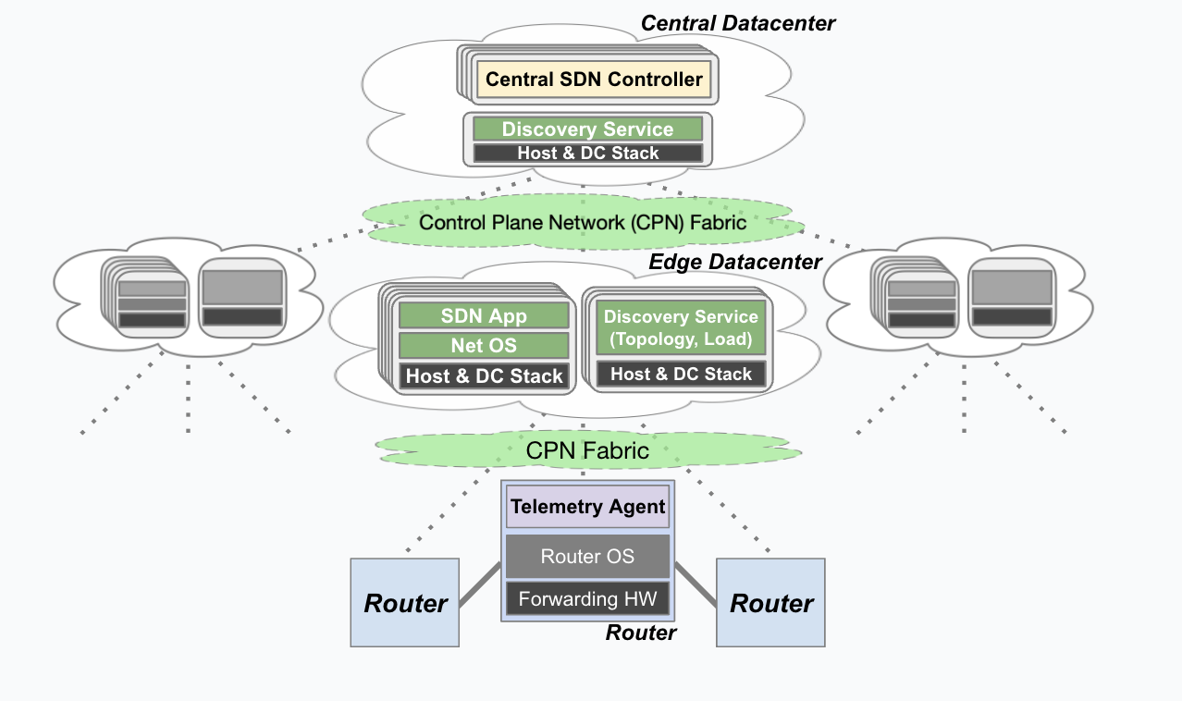
How can inputs be wrong?
Control system is conceptually simple, but practically complex…
SDN Controller
Control Infrastructure
…
B
Bugs can happen anywhere that lead to incorrect input produced.
C
A
Routers
Routers
4

Slide 9
Real world examples…
SDN Controller
Control Infrastructure
Demand Collection
Topology Collection
…
…
B
C
A
5

Slide 10
Real world examples…
Outage 1. Bug in demand instrumentation service led to demand collected incorrectly, resulting in partial demand fed to SDN controller. Severe congestion.
SDN Controller
Control Infrastructure
Demand Collection
Topology Collection
…
…
B
C
A
5

Slide 11
Real world examples…
Outage 1. Bug in demand instrumentation service led to demand collected incorrectly, resulting in partial demand fed to SDN controller. Severe congestion.
SDN Controller
Control Infrastructure
Outage 2. Bug causes topology instrumentation service to aggregate topology before all routers report, feeding partial topology to controller.
Demand Collection
Topology Collection
…
…
B
C
A
5

Slide 12
Real world examples…
Outage 1. Bug in demand instrumentation service led to demand collected incorrectly, resulting in partial demand fed to SDN controller. Severe congestion.
SDN Controller
Control Infrastructure
Outage 2. Bug causes topology instrumentation service to aggregate topology before all routers report, feeding partial topology to controller.
Demand Collection
Topology Collection
…
Outage 3. Overly-sensitive automatic drain signal gets triggered, incorrectly draining a significant number of perfectly-fine routers. Severe congestion.
Auto-drain
…
B
C
A
5

Slide 13
Real world examples…
Outage 1. Bug in demand instrumentation service led to demand collected incorrectly, resulting in partial demand fed to SDN controller. Severe congestion.
SDN Controller
Control Infrastructure
Outage 2. Bug causes topology instrumentation service to aggregate topology before all routers report, feeding partial topology to controller.
Demand Collection
Topology Collection
…
Outage 3. Overly-sensitive automatic drain signal gets triggered, incorrectly draining a significant number of perfectly-fine routers. Severe congestion.
…
B
C
A
(small) Outage 4. New router OS rollout for vendor X causes telemetry messages to oscillate between 0 and actual. Triggers flap protection drains.
5

Slide 14
Why is it not caught today?
Eng. teams check for outliers/anomalies
Eng. teams check for outliers/anomalies, but this misses the underlying issue:
…incorrect inputs are often possible values but not current values.
SDN Controller
Control Infrastructure
…
B
C
A
6

Slide 15
Why is it not caught today?
Eng. teams check for outliers/anomalies, but this misses the underlying issue:
…incorrect inputs are often possible values but not current values.
SDN Controller
, …
Control Infrastructure
No way to distinguish from input alone.
…
B
C
Requires an alternative approach…
A
6

Slide 16
Validating controller inputs
Goal: validate that the abstract inputs agree with reality.
SDN Controller
,
Control Infrastructure
What is reality?
Whatever we know is happening at the routers, “ground truth”
…
B
C
A
Reality
7

Slide 17
Rich view of reality
Many low-level signals available:
Interface byte counters
Packet drop counters
Forwarding entries
Bidirectional Forwarding Detection (BFD) link monitoring updates
Probes
…
SDN Controller
,
Control Infrastructure
…
B
C
Recursive problem: all sources complex, how can we trust the signals?
A
Reality
8

Slide 18
Making low-level signals trustworthy
Network signals are naturally interconnected.
→ Actions reflected in multiple measurements.
SDN Controller
Control Infrastructure
…
B
C
A
9

Slide 19
Making low-level signals trustworthy
Network signals are naturally interconnected.
→ Actions reflected in multiple measurements.
SDN Controller
Control Infrastructure
…
B
16
87
C
A
87
16
9

Slide 20
Making low-level signals trustworthy
Network signals are naturally interconnected.
→ Actions reflected in multiple measurements.
SDN Controller
Control Infrastructure
…
B
16
87
C
A
87
17
9

Slide 21
Making low-level signals trustworthy
Network signals are naturally interconnected.
→ Actions reflected in multiple measurements.
SDN Controller
Control Infrastructure
…
B
17
87
C
A
87
17
9

Slide 22
Making low-level signals trustworthy
Network signals are naturally interconnected.
→ Actions reflected in multiple measurements.
SDN Controller
Control Infrastructure
…
B
17
88
C
A
87
17
9

Slide 23
Making low-level signals trustworthy
Network signals are naturally interconnected.
→ Actions reflected in multiple measurements.
SDN Controller
Control Infrastructure
…
B
17
88
C
A
88
17
9

Slide 24
Making low-level signals trustworthy
Network signals are naturally interconnected.
→ Actions reflected in multiple measurements.
SDN Controller
Control Infrastructure
…
B
17
88
C
A
88
17
9

Slide 25
Making low-level signals trustworthy
Network signals are naturally interconnected.
→ Actions reflected in multiple measurements.
SDN Controller
Harden
Control Infrastructure
Use redundancy to check that reported network state agrees with itself, then even self-repair.
…
B
C
Practically: can collect all known signals, and catch & repair inconsistencies: “harden”
A
9

Slide 26
Input validation: agreement with high-level inputs
Once we have hardened signals, can use them to do input validation.
Check that expected relations hold between abstract inputs and low-level signals.
SDN Controller
Harden
Control Infrastructure
…
B
C
A
10

Slide 27
Input validation: agreement with high-level inputs
Once we have hardened signals, can use them to do input validation.
Check that expected relations hold between abstract inputs and low-level signals.
SDN Controller
Validation
Harden
Control Infrastructure
We present our system, Hodor, that performs continuous validation.
…
B
C
A
10

Slide 28
Hodor: (1) Hardening low-level signals
Many examples of redundancy in network data…
11

Slide 29
Hodor: (1) Hardening low-level signals
Many examples of redundancy in network data…
R1. Symmetry across two ends of link: bytes in = bytes out.
A
→ Bytes Sent
Bytes Received →
B
11

Slide 30
Hodor: (1) Hardening low-level signals
Many examples of redundancy in network data…
R1. Symmetry across two ends of link: bytes in = bytes out.
R2. Flow conservation across ports: sum in = sum out at a router.
Bytes Sent ←
Bytes Received →
A
→ Bytes Sent
← Bytes Received
Bytes Sent ←
Bytes Received →
11

Slide 31
Hodor: (1) Hardening low-level signals
Many examples of redundancy in network data…
R1. Symmetry across two ends of link: bytes in = bytes out.
R2. Flow conservation across ports: sum in = sum out at a router.
R3. Alternative signal substitutes: link down ⇒ intf count = 0.
A
Interface up:
Bytes Received: 0
B
11

Slide 32
Hodor: (1) Hardening low-level signals
Many examples of redundancy in network data…
R1. Symmetry across two ends of link: bytes in = bytes out.
R2. Flow conservation across ports: sum in = sum out at a router.
R3. Alternative signal substitutes: link down ⇒ intf count = 0.
R4. Manufactured signals: probe confirms link up/down.
A
Interface up:
B
Probe Success
11

Slide 33
Hodor: (1) Hardening low-level signals
Many examples of redundancy in network data…
R1. Symmetry across two ends of link: bytes in = bytes out.
R2. Flow conservation across ports: sum in = sum out at a router.
R3. Alternative signal substitutes: link down ⇒ intf count = 0.
R4. Manufactured signals: probe confirms link up/down.
…
75 →
75 →
A
→ 75
2 →
B
12

Slide 34
Hodor: (1) Hardening low-level signals
Many examples of redundancy in network data…
R1. Symmetry across two ends of link: bytes in = bytes out.
R2. Flow conservation across ports: sum in = sum out at a router.
R3. Alternative signal substitutes: link down ⇒ intf count = 0.
R4. Manufactured signals: probe confirms link up/down.
…
75 →
75 →
A
→ 75
2 →
B
12

Slide 35
Hodor: (1) Hardening low-level signals
Many examples of redundancy in network data…
R1. Symmetry across two ends of link: bytes in = bytes out.
R2. Flow conservation across ports: sum in = sum out at a router.
R3. Alternative signal substitutes: link down ⇒ intf count = 0.
R4. Manufactured signals: probe confirms link up/down.
…
75 →
75 →
A
→ 75
2 →
B
12

Slide 36
Hodor: (1) Hardening low-level signals
Many examples of redundancy in network data…
R1. Symmetry across two ends of link: bytes in = bytes out.
R2. Flow conservation across ports: sum in = sum out at a router.
R3. Alternative signal substitutes: link down ⇒ intf count = 0.
R4. Manufactured signals: probe confirms link up/down.
…
75 →
75 →
A
75 →
B
12

Slide 37
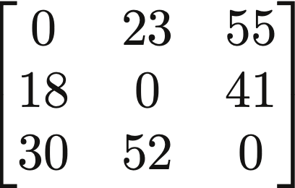
Hodor: (2) Agreement with high-level inputs
75 →
75 →
System expert can define relationships between low-level observations and high-level abstract inputs.
Ex: for validating demand, sum of demand to a node == egress interface count
A
B
C
A
B
C
A
D =
B
Hodor verifies that such relations hold for the given inputs and trusted snapshots.
C
13

Slide 38
Active questions
How do we build this?
Inconsistent data due to snapshot time skew
Alternative unsupervised learning approaches? Other strategies?
Masked autoencoders, symbolic regression
Right space of response actions?
How prevalent are incorrect inputs in other control systems?
Anecdotally, heard of similar problems for cloud tenant networks, datacenter networks
Alexander Krentsel – akrentsel@berkeley.edu
Paper Link

