Slide 1
Input

Slide 2
Nonlocal Means

Slide 3
Input

Slide 4
FoE

Slide 5
Input

Slide 6
Total Variation

Slide 7
Input

Slide 8
KSVD

Slide 9
Input

Slide 10
Multi-Layer Perceptron

Slide 11
Input

Slide 12
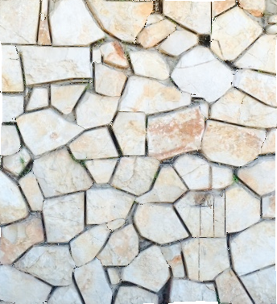
BM3D

Slide 13
Input

Slide 14
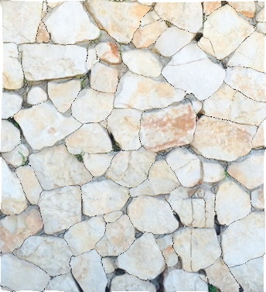
Total Variation

Slide 15
Input

Slide 16
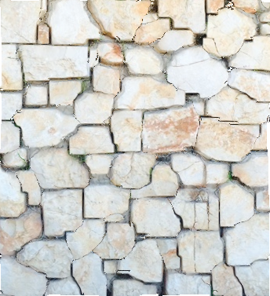
FoE

Slide 17
Input

Slide 18
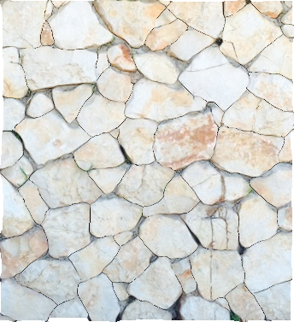
Nonlocal Means

Slide 19
Input

Slide 20
BM3D

Slide 21
Input

Slide 22
KSVD

Slide 23
Input

Slide 24
Cross-Scale Patch Recurrence

Slide 25
Input

Slide 26
Multi-Layer Perceptron

Slide 27
Input

Slide 28
Nonlocal Means

Slide 29
Input

Slide 30
FoE

Slide 31
Input

Slide 32
Total Variation

Slide 33
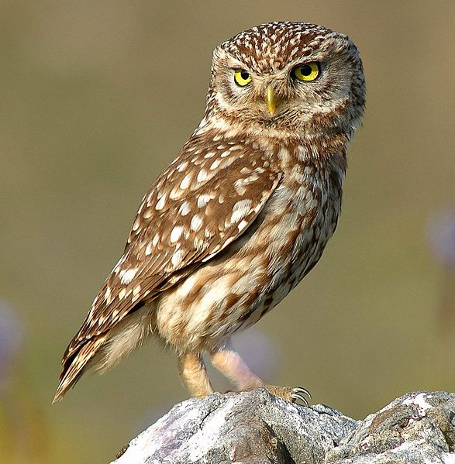
Input

Slide 34
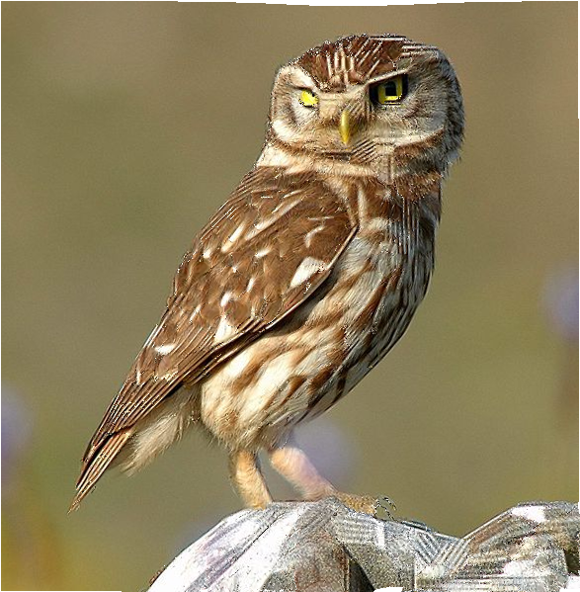
BM3D

Slide 35
Input

Slide 36
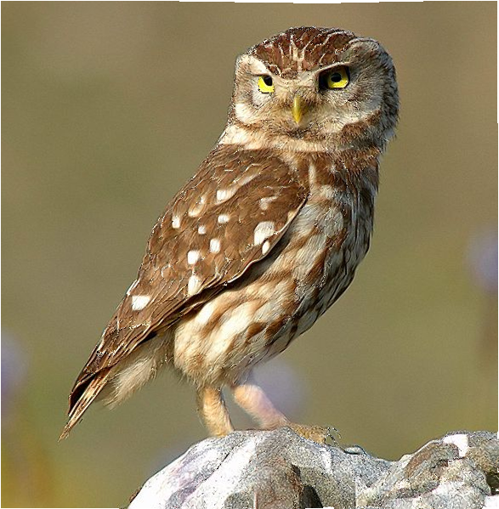
EPLL

Slide 37
Input

Slide 38
FoE

Slide 39
Input

Slide 40
BM3D

Slide 41
Input

Slide 42
Nonlocal Means

Slide 43
Input

Slide 44
FoE

Slide 45
Input

Slide 46
EPLL

Slide 47
Input

Slide 48
Total Variation

Slide 49
Input

Slide 50
BM3D

Slide 51
Input

Slide 52
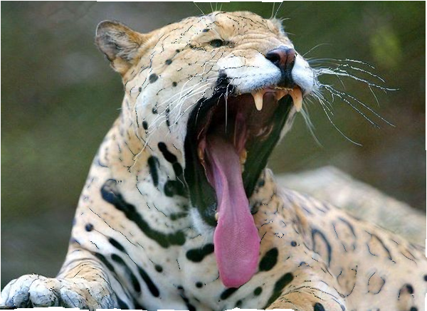
Total Variation

Slide 53
Input

Slide 54
Shrinkage Fields (Pairwise)

Slide 55
Input

Slide 56
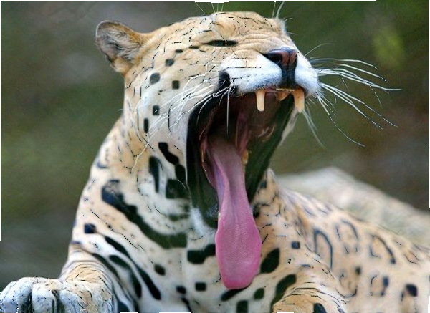
EPLL

Slide 57
Input

Slide 58
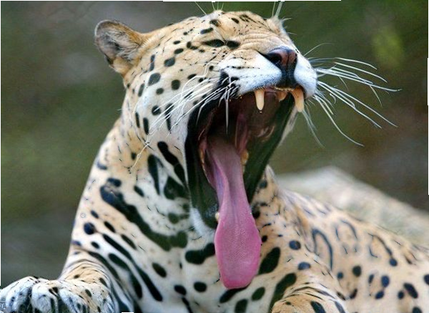
KSVD

Slide 59
Input

Slide 60
Multi-Layer Perceptron

Slide 61
Input

Slide 62
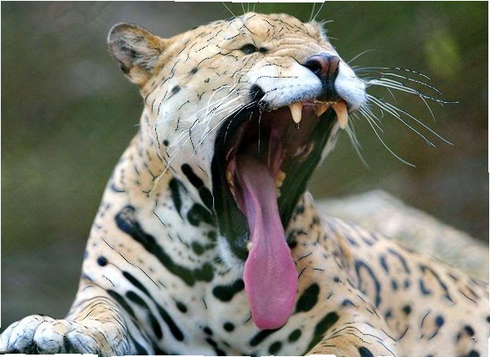
Nonlocal Means

Slide 63
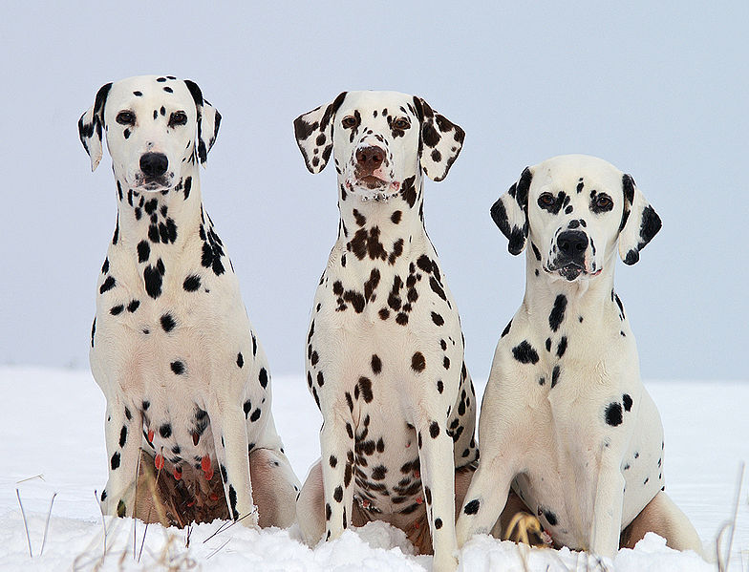
Input

Slide 64
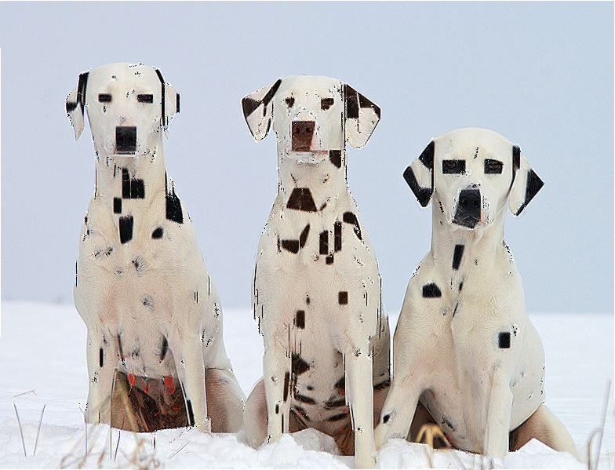
BM3D

Slide 65
Input

Slide 66
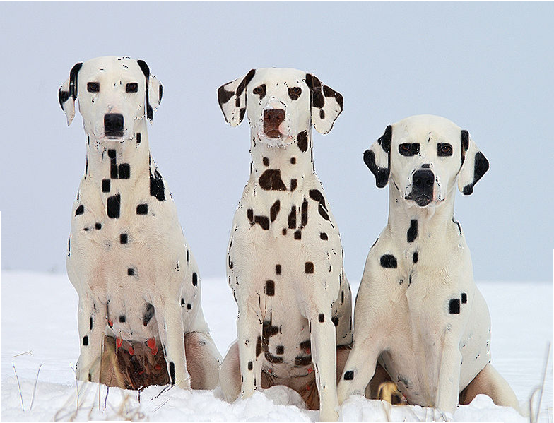
EPLL

Slide 67
Input

Slide 68
Nonlocal Means

Slide 69
Input

Slide 70
FoE

Slide 71
Input

Slide 72
Total Variation

Slide 73
Input

Slide 74
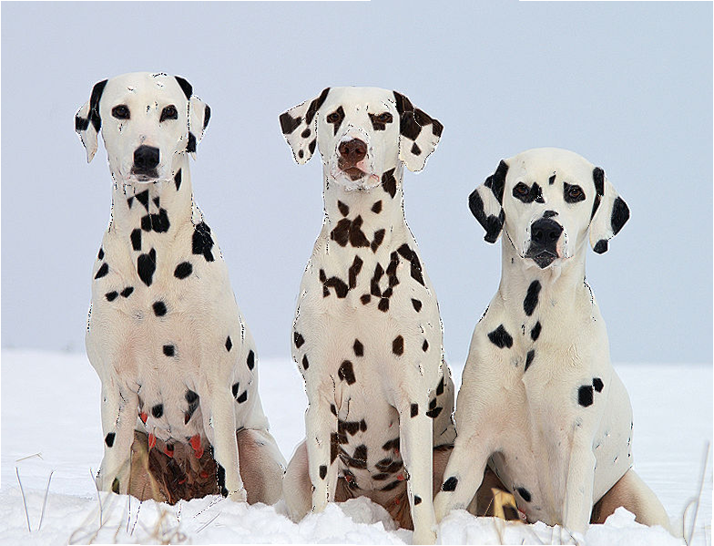
Cross-Scale Patch Recurrence

Slide 75
Input

Slide 76
Multi-Layer Perceptron

Slide 77
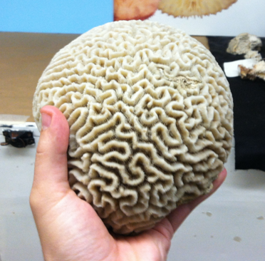
Input

Slide 78
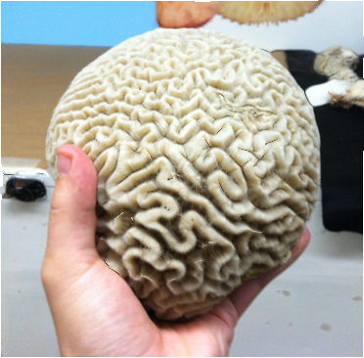
Nonlocal Means

Slide 79
Input

Slide 80
BM3D

Slide 81
Input

Slide 82
Total Variation

Slide 83
Input

Slide 84
EPLL

Slide 85
Input

Slide 86
Shrinkage Fields (Pairwise)

Slide 87
Input

Slide 88
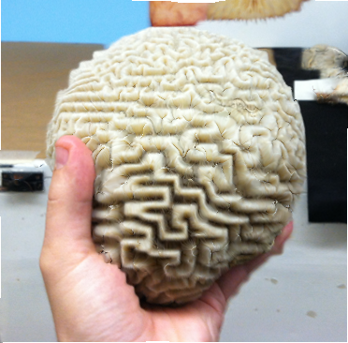
FoE

Slide 89
Input

Slide 90
Shrinkage Fields (7x7)

Slide 91
Input

Slide 92
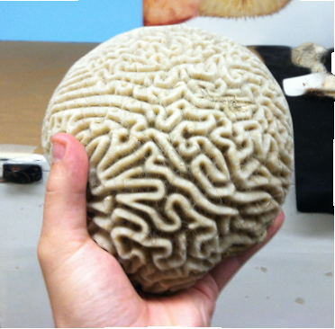
Multi-Layer Perceptron

Slide 93
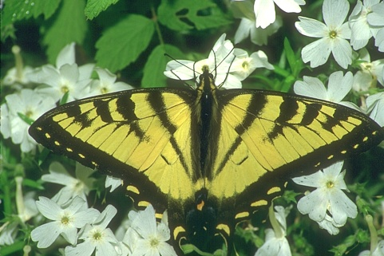
Input

Slide 94
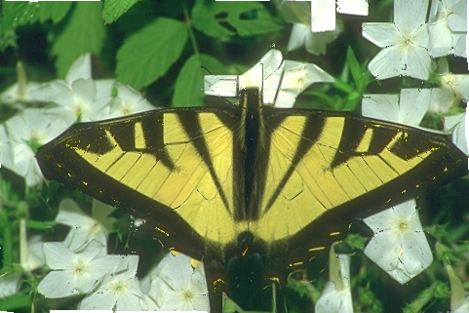
BM3D

Slide 95
Input

Slide 96
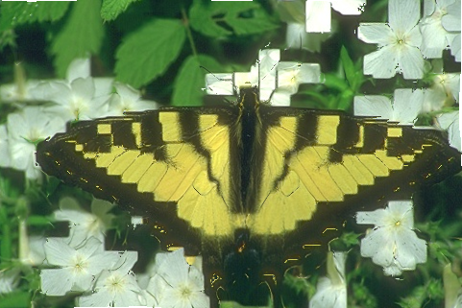
FoE

Slide 97
Input

Slide 98
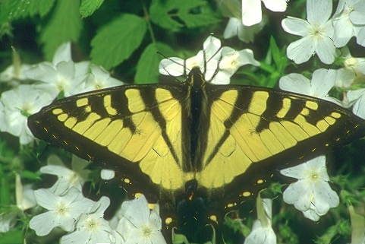
KSVD

Slide 99
Input

Slide 100
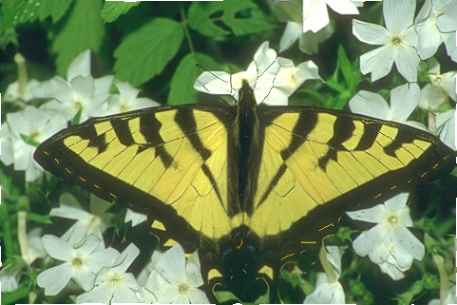
Cross-Scale Patch Recurrence

Slide 101
Input

Slide 102
Total Variation

Slide 103
Input

Slide 104
Multi-Layer Perceptron

Slide 105
Input

Slide 106
Nonlocal Means

Slide 107
Input

Slide 108
EPLL

Slide 109
Input

Slide 110
BM3D

Slide 111
Input

Slide 112
EPLL

Slide 113
Input

Slide 114
FoE

Slide 115
Input

Slide 116
Nonlocal Means

Slide 117
Input

Slide 118
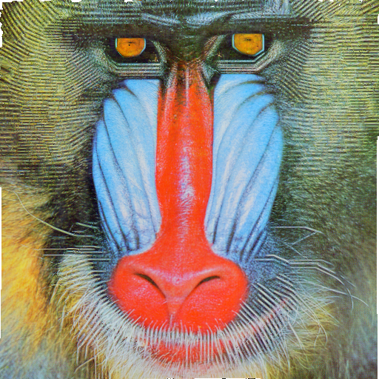
BM3D

Slide 119
Input

Slide 120
EPLL

Slide 121
Input

Slide 122
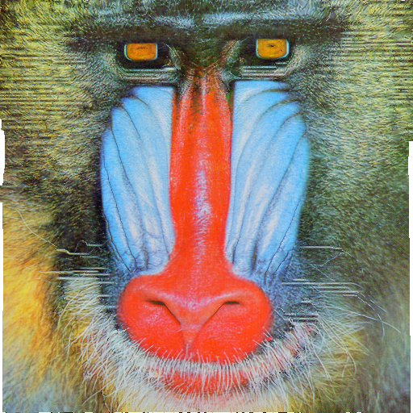
FoE

Slide 123
Input

Slide 124
Multi-Layer Perceptron

Slide 125
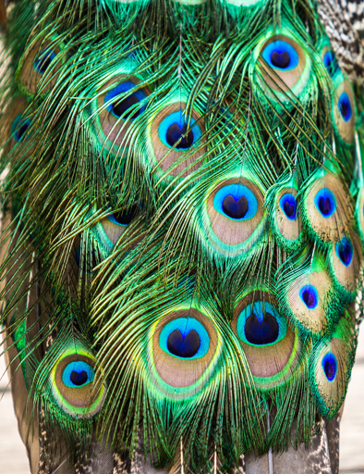
Input

Slide 126
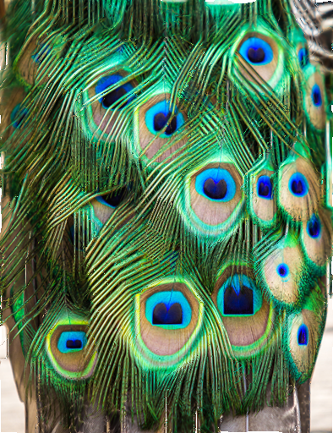
BM3D

Slide 127
Input

Slide 128
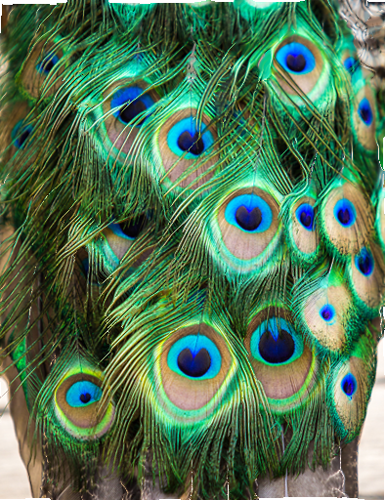
Nonlocal Means

Slide 129
Input

Slide 130
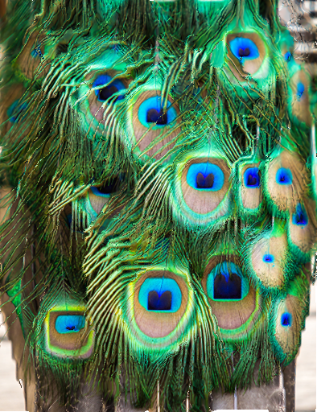
FoE

Slide 131
Input

Slide 132
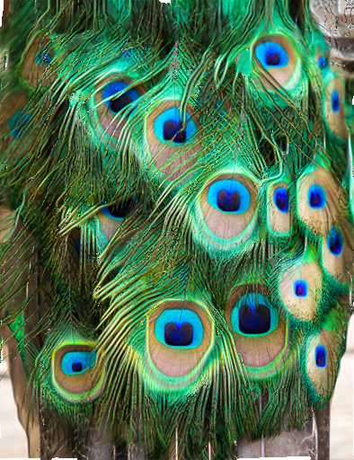
EPLL

Slide 133
Input

Slide 134
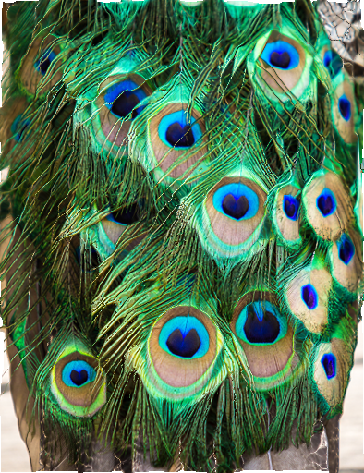
Cross-Scale Patch Recurrence

Slide 135
Input

Slide 136
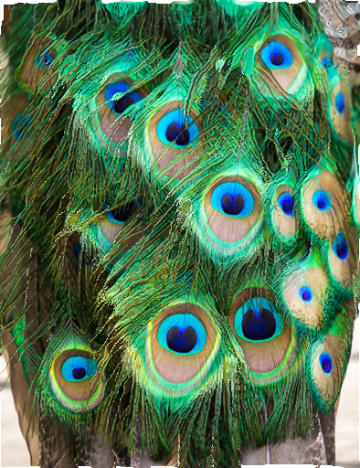
Total Variation

