Slide 1
Efficient Monte Carlo Simulation of Security Prices
By Darrell Duffie and Peter Glynn, Stanford University, 1995
Paper Review by:
Niv Nayman
Technion- Israel Institute of Technology
July 2015

Slide 2
Background
What are we going to speak about ?
The Paper
Brownian Motion
Wiener Process (SBM)
Stochastic Calculus (Itō’s Calculus)
Stochastic Integral (Itō’s Integral)
Stochastic Differential Equation (SDE)
Itō Process
Diffusion Process
Itō’s Lemma
Example : Geometric Brownian Motion (GBM)
Security Price Models
The Black-Scholes Model (1973)
The Heston Model (1993)
Introduction
Discretization Schemes
Euler
Milshtein (1978)
Talay (1984, 1986)
Motivation
Abstract
Assumptions
Theorem
Proof
Interpretation
Experiments
More to go

Slide 3
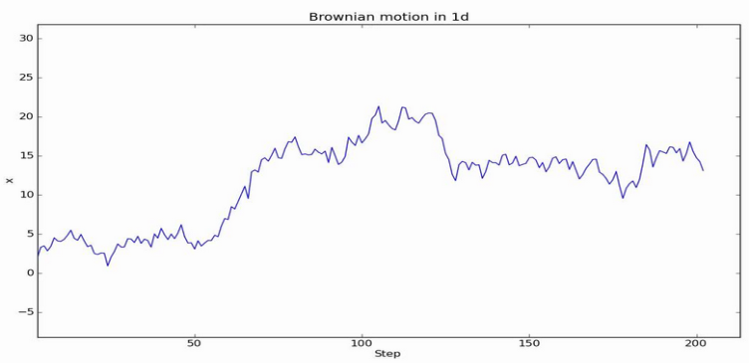
Brownian Motion
Definition. We say that a random process, , is a Brownian motion with parameters (µ,σ) if
1. For 0 < t1 < t2 < …< tn-1 < tn
are mutually independent.
2. For s>0,
3. Xt is a continuous function of t.
We say that Xt is a B (µ,σ) Brownian motion with drift µ and volatility σ
Remark. Bachelier (1900) – Modeling in Finance
Einstein (1905) – Modeling in Physics
Wiener (1920’s) – Mathematical formulation

Slide 4
Wiener Process
When µ=0 and σ=1 we have a Wiener Process
or a standard Brownian motion (SBM) .
We will use Bt to denote a SBM and we always assume that B0=0
Then,
Note that if Xt ~B (µ,σ) and X0=x then we can write
Where Bt is an SBM.
Therefore see that
Since,

Slide 5
Background
What are we going to speak about ?
The Paper
Brownian Motion
Wiener Process (SBM)
Stochastic Calculus (Itō’s Calculus)
Stochastic Integral (Itō’s Integral)
Stochastic Differential Equation (SDE)
Itō Process
Diffusion Process
Itō’s Lemma
Example : Geometric Brownian Motion (GBM)
Security Price Models
The Black-Scholes Model (1973)
The Heston Model (1993)
Introduction
Discretization Schemes
Euler
Milshtein (1978)
Talay (1984, 1986)
Motivation
Abstract
Assumptions
Theorem
Proof
Interpretation
Experiments
More to go

Slide 6
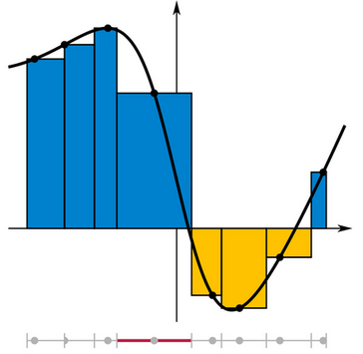
Itō Integral
Definition. A partition of an interval [0,T] is a finite sequence of numbers πT
of the form
Definition. The norm or mesh of a partition πT is the length of the longest of it’s subintervals, that is
Recall the Riemann integral of a real function µ
And the Riemann-Stieltjes integral of a real function µ w.r.t a real function gt=g(t)
Then the Itō integral of a random process σ w.r.t a SBM Bt
It can be shown that this limit converges in probability.

Slide 7
Stochastic Differential Equation
A stochastic differential equation (SDE) is of the form
Which is a short-hand of the integral equation
Where
Bt is a Wiener Process (SBM).
is a Riemann integral.
is an Itō integral.

Slide 8
Itō Process
An Itō process in n-dimensional Euclidean space is a process defined on a probability space and satisfying a stochastic differential equation of the form
Where
T > 0
Bt is a m-dimensional SBM
satisfies the Lipschitz continuity and polynomial growth conditions.
satisfies the Lipschitz continuity and polynomial growth conditions.
Such that
Where and .
These conditions ensure the existence of a unique strong solution Xt to the SDE (Øksendal 2003)
Existence and Uniqueness Conditions

Slide 9
Diffusion Process
A time-homogeneous Itō Diffusion in n-dimensional Euclidean space is a process defined on a probability space and satisfying a stochastic differential equation of the form
Where
Bt is a m-dimensional SBM
is Lipschitz continuous.
is Lipschitz continuous.
Meaning
Where and .
This condition ensures the existence of a unique strong solution Xt to the SDE (Øksendal 2003).
Existence and Uniqueness Conditions

Slide 10
Itō's Lemma
Suppose Xt is an Itō process satisfying the SDE
And f(t,x) is a twice- differentiable scalar function.
Then
In more detail
Sketch of proof
The Taylor series expansion of f(t,x) is
Recall that
Substituting and gives
As the terms and tend to zero faster.
Setting and we are done.
Sketch of Proof

Slide 11
Geometric Brownian Motion
Suppose Xt satisfies following SDE
With and
Thus the SDE turns into
Since is a twice- differentiable scalar function in (0,∞)
By Itō Lemma we have
Then
The integral equation
Finally
If X0 >0 then Xt > 0 for all t> 0

Slide 12
Geometric Brownian Motion
Definition. We say that a random process, , is a geometric Brownian motion (GBM) if for all t≥0
Where Bt is an SBM.
We say that Xt ~GBM (µ,σ) with drift µ and volatility σ
Note that
-a representation which we will later see that is useful for simulating security prices.

Slide 13
Expected Growth Rate of GBM
Define , where denotes the information available at time t.
Recall the moment generating function of
Suppose Xt ~GBM (µ,σ) , then
- So the expected growth rate of Xt is µ

Slide 14
Properties of GBM
Note that,
Thus
1. Fix t1 < t2 < …< tn-1 < tn . Then
are mutually independent.
2. Paths of Xt are continuous as a function of t, i.e. they do not jump.
3. For s>0,

Slide 15
Background
What are we going to speak about ?
The Paper
Brownian Motion
Wiener Process (SBM)
Stochastic Calculus (Itō’s Calculus)
Stochastic Integral (Itō’s Integral)
Stochastic Differential Equation (SDE)
Itō Process
Diffusion Process
Itō’s Lemma
Example : Geometric Brownian Motion (GBM)
Security Price Models
The Black-Scholes Model (1973)
The Heston Model (1993)
Introduction
Discretization Schemes
Euler
Milshtein (1978)
Talay (1984, 1986)
Motivation
Abstract
Assumptions
Theorem
Proof
Interpretation
Experiments
More to go

Slide 16
The Black-Scholes Model
The Black-Scholes equation is a partial differential equation (PDE) satisfied by a derivative (financial) of a stock price process that follows a deterministic volatility GBM, under the no-arbitrage condition and risk neutrality settings.
Starting with a stock price process that follows GBM
We represent the price of the derivative of the stock price process as
Where a twice- differentiable scalar function at St>K.
We apply the Itō lemma
The arbitrage-free condition serves to eliminate the stochastic BM component, leaving only a deterministic PDE.
Risk neutrality is achieved by setting µ = r
With we have the celebrated BS PDE:
r – interest rate
K- strick price

Slide 17
The Heston Model
A more elaborated model, dealing with a stochastic volatility stock price process that follows a GBM
Where , the instantaneous variance, is a Cox–Ingersoll–Ross (CIR) process
and are SBM with correlation ρ, or equivalently, with covariance ρdt.
μ is the rate of return of the asset.
θ is the long variance, or long run average price variance:
as t tends to infinity, the expected value of ν_{t} tends to θ.
κ is the rate at which ν_{t} reverts to θ.
σ is the volatility of the volatility.

Slide 18
Background
What are we going to speak about ?
The Paper
Brownian Motion
Wiener Process (SBM)
Stochastic Calculus (Itō’s Calculus)
Stochastic Integral (Itō’s Integral)
Stochastic Differential Equation (SDE)
Itō Process
Diffusion Process
Itō’s Lemma
Example : Geometric Brownian Motion (GBM)
Security Price Models
The Black-Scholes Model (1973)
The Heston Model (1993)
Introduction
Discretization Schemes
Euler
Milshtein (1978)
Talay (1984, 1986)
Motivation
Abstract
Assumptions
Theorem
Proof
Interpretation
Experiments
More to go

Slide 19
Monte Carlo Evaluation
Suppose is an Itō process satisfying the SDE
and one is interested in computing
Sometimes it is hard to analytically solve the SDE or to determine its distribution.
Although numerical computations methods are usually available
(i.e. the Kolmogorov backward equation (KBE) via some finite-difference algorithm),
in some cases it is convenient to obtain a Monte Carlo approximation
This requires simulation of the system.

Slide 20
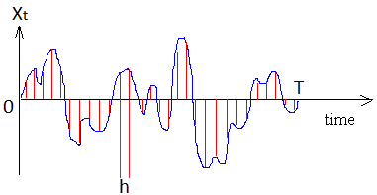
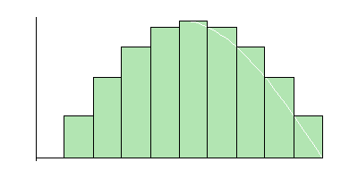
Discrete-time Simulation
The Monte Carlo realizations are done by simulating a discrete-time approximation of the continuous-time SDE.
The time interval [0,T] is sampled at periods of length h>0.
Denote as Xt evaluated at t=kh.
Thus is the discrete evaluation of XT.
Denote the approximation of by .
And the approximation error by .
It can be shown, under some technical conditions, that .
Definition. A sequence has order-k convergence if is bounded in h.

Slide 21
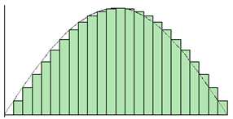
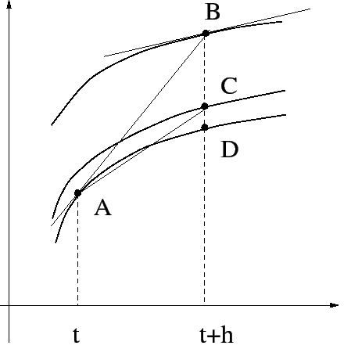
The Euler Approximation
The integral equation form of the SDE
The Euler method approximates the integrals using the left point rule.
With ε~N(0,1).
Thus, one can evaluate XT with by starting at and proceeding by
For k=0,…, T/h-1.
Where ε1,ε2,… are N(0,1) i.i.d.
Note. The processes Xt and are not necessarily defined on the same probability space (Ω,Σ,Ρ).

Slide 22
The Euler Approximation Error
Is said to be a first-order discretizaion scheme
In which eh has order-1 convergence.
There is an error coefficient s.t. has a order-2 convergence.
The error coefficient gives a notion of bias in the approximation.
Although usually unknown it can be approximated to first order by
Under the polynomial growth condition of f (Talay and Tubaro, 1990).

Slide 23
The Milshtein Scheme
The integral equation form of the SDE
The Milshtein method apply the Itō’s lemma on .
The integral form
Then the original SDE turns into

Slide 24
The Milshtein Scheme
As the terms and are ignored.
Thus
Applying the Euler approximation to the last term we obtain
Define and suggest a solution .
Indeed,
Thus,
and

Slide 25
The Milshtein Scheme
Thus
Then
Turns into the Milshtein discretization
With ε~N(0,1).
Thus, one can evaluate XT with by starting at and proceeding by
For k=0,…, T/h-1.
Where ε1,ε2,… are N(0,1) i.i.d.

Slide 26
The Milshtein Scheme
If the terms and are to be visible.
We have
Where
And
Remark. Euler and Milshtein deal with first and second-order discretization schemes respectively for 1-D SDE with .
as Talay (1984,1986) provides second-order discretization schemes for multidimensional SDE with .

Slide 27
Background
What are we going to speak about ?
The Paper
Brownian Motion
Wiener Process (SBM)
Stochastic Calculus (Itō’s Calculus)
Stochastic Integral (Itō’s Integral)
Stochastic Differential Equation (SDE)
Itō Process
Diffusion Process
Itō’s Lemma
Example : Geometric Brownian Motion (GBM)
Security Price Models
The Black-Scholes Model (1973)
The Heston Model (1993)
Introduction
Discretization Schemes
Euler
Milshtein (1978)
Talay (1984, 1986)
Motivation
Abstract
Assumptions
Theorem
Proof
Interpretation
Experiments
More to go

Slide 28
Discrete-time Monte Carlo Simulations
The Monte Carlo realizations are done by simulating a discrete-time approximation of the continuous-time SDE.
Denote,
as the i’th discrete-time simulation output.
as a discrete-time crude monte carlo approximation of .
as the approximation error .
The time required to compute is roughly proportional to .
Where n and T are fixed for a given problem.
This paper pursues the optimal tradeoff between N and h
given limited computation time.

Slide 29
Background
What are we going to speak about ?
The Paper
Brownian Motion
Wiener Process (SBM)
Stochastic Calculus (Itō’s Calculus)
Stochastic Integral (Itō’s Integral)
Stochastic Differential Equation (SDE)
Itō Process
Diffusion Process
Itō’s Lemma
Example : Geometric Brownian Motion (GBM)
Security Price Models
The Black-Scholes Model (1973)
The Heston Model (1993)
Introduction
Discretization Schemes
Euler
Milshtein (1978)
Talay (1984, 1986)
Motivation
Abstract
Assumptions
Theorem
Proof
Interpretation
Experiments
More to go

Slide 30
Abstract
This paper provides an asymptotically efficient algorithm for the allocation of computing resources to the problem of Monte Carlo integration of continuous-time security prices. The tradeoff between increasing the number of time intervals per unit of time and increasing the number of simulations, given a limited budget of computer time, is resolved for first-order discretization schemes (such as Euler) as well as second- and higher order schemes (such as those of Milshtein or Talay).

Slide 31
Background
What are we going to speak about ?
The Paper
Brownian Motion
Wiener Process (SBM)
Stochastic Calculus (Itō’s Calculus)
Stochastic Integral (Itō’s Integral)
Stochastic Differential Equation (SDE)
Itō Process
Diffusion Process
Itō’s Lemma
Example : Geometric Brownian Motion (GBM)
Security Price Models
The Black-Scholes Model (1973)
The Heston Model (1993)
Introduction
Discretization Schemes
Euler
Milshtein (1978)
Talay (1984, 1986)
Motivation
Abstract
Assumptions
Theorem
Proof
Interpretation
Experiments
More to go

Slide 32
Assumptions
f is and satisfies the polynomial growth condition.
as .
as (i.e. is uniformly integrable ).
as , where β≠0 and p>0.
The (computer) time required to generate is given the deterministic
as , where γ>0 and q>0.
If or as then
as .
If , where 0<c<∞, as then
as , where ε is N(0,1) and
Theorem
Given t units of computer time.

Slide 33
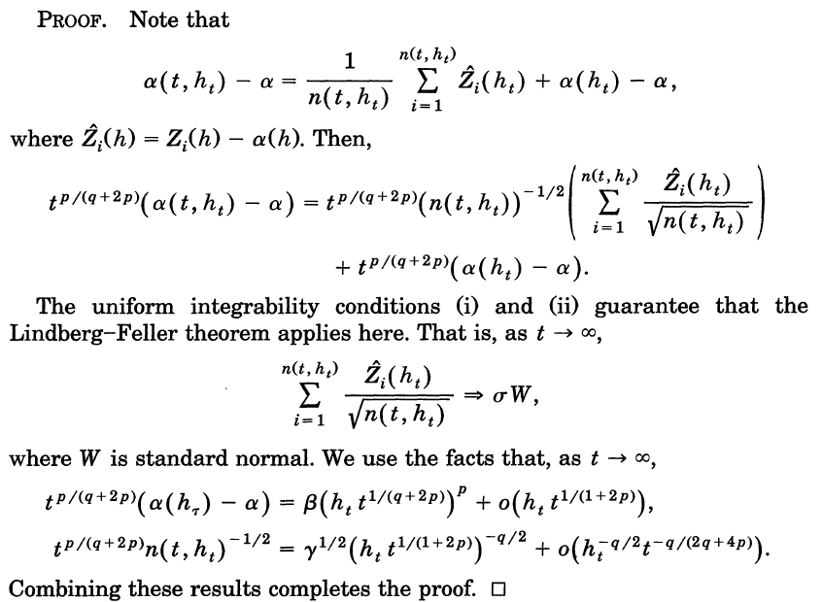
Proof

Slide 34
The Asymptotically Optimal Allocation
Assuming the discritization error alone has order-p convergence with h
As the computation budget t gets large
the period ht should have order-1/(q+2p) convergence with t.
Then the estimation error has order-p/(q+2p) convergence in probability with t.
If it the above does not hold, the estimation error does not converge in distribution to zero “as quickly” (i.e. not at this order ).
It follows that this rule is “Asymptotically Optimal”.

Slide 35
Interpertation
Informally, if then , where .
Thus,
Let be the number of time intervals, as ht is the period.
For the Euler scheme (p=1) :
For the Milshtein or Talay schemes (p=2):
For the asymptotically optimal allocation, if then
Thus
Thus,
As the root-mean-squared estimation error is and the error bias is β.
For the Euler scheme (p=1) :
For the Milshtein or Talay schemes (p=2):

Slide 36
Experiments - Settings
Consider the SDE with .
The diffusion process Xt>0 which satisfies the constant-elasticity-of-variance model (Cox,1975)
with , can be simulated by the Euler or Milshtein Schemes.
A European call option on the asset with strike price K and expiration date T is
, has we would try to estimate its initial price by .
For γ=1 we obtain the Black-Scholes model.
Technical Details.
For which f is and satisfies the polynomial growth conditions everywhere but at x=K.
Then it can be uniformly well approximated for above by .
If we take δ to be of order-2p convergence we preserve the quality of aproximation.
For we have as (Yamada, 1796 and dominated convergence).
Technical Details

Slide 37
Background
What are we going to speak about ?
The Paper
Brownian Motion
Wiener Process (SBM)
Stochastic Calculus (Itō’s Calculus)
Stochastic Integral (Itō’s Integral)
Stochastic Differential Equation (SDE)
Itō Process
Diffusion Process
Itō’s Lemma
Example : Geometric Brownian Motion (GBM)
Security Price Models
The Black-Scholes Model (1973)
The Heston Model (1993)
Introduction
Discretization Schemes
Euler
Milshtein (1978)
Talay (1984, 1986)
Motivation
Abstract
Assumptions
Theorem
Proof
Interpretation
Experiments
More to go

Slide 38
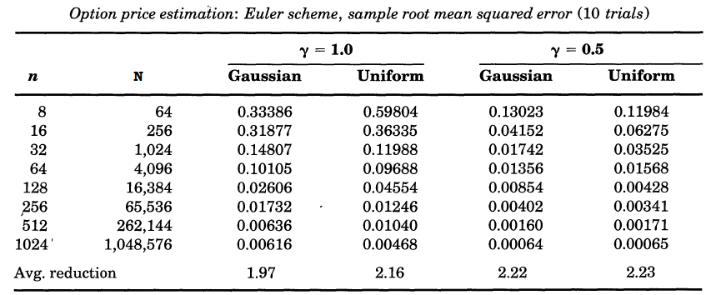
Experiments - Results
For the particular case:
We take
The following results are obtained,
Comments
For the Euler scheme (p=1) :
For the Milshtein scheme (p=2):
The assumption hold with other but normal i.i.d increments with zero mean and unit
variance uder technical conditions (Talay, 1984,1986).

Slide 39
Background
What are we going to speak about ?
The Paper
Brownian Motion
Wiener Process (SBM)
Stochastic Calculus (Itō’s Calculus)
Stochastic Integral (Itō’s Integral)
Stochastic Differential Equation (SDE)
Itō Process
Diffusion Process
Itō’s Lemma
Example : Geometric Brownian Motion (GBM)
Security Price Models
The Black-Scholes Model (1973)
The Heston Model (1993)
Introduction
Discretization Schemes
Euler
Milshtein (1978)
Talay (1984, 1986)
Motivation
Abstract
Assumptions
Theorem
Proof
Interpretation
Experiments
More to go

Slide 40
More to go
More monte carlo methods for asset pricing problems:
Boyle (1977,1988,1990)
Jones and Jacobs (1986)
Boyle, Evnine and Gibbs (1989)
An Alternative large deviation method for the optimal tradeoff :
chapter 10 of Duffie (1992).
Extensions
Path dependent security payoffs
Stochastic short-term interest rates (Duffie,1992)
A path dependent “lookback” payoff
Extension of the general theory of weak convergence for more general path-dependent functionals
More discretization schemes: Slominski (1993,1994), Liu (1993)
Adding a memory constraint

Slide 41
Thank you for listening

