Slide 1
Direct acquisition of volumetric scattering phase function
using speckle correlations
Marina Alterman, Evgeniia Saiko, Anat Levin
Department of Electrical & Computer Engineering, Technion
Notes:
Hallo everyone, today I am going to tell you about how to use the statistics of speckle patterns produced under coherent laser illumination to extract information about volumetric scattering materials.

Slide 2
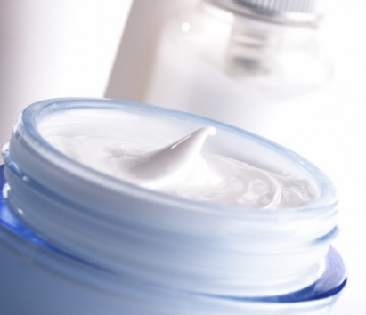
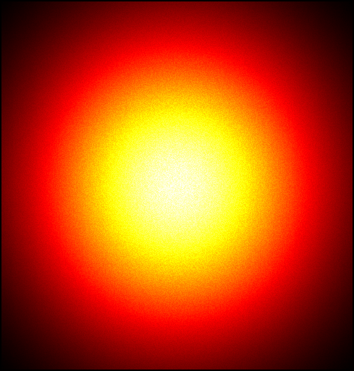
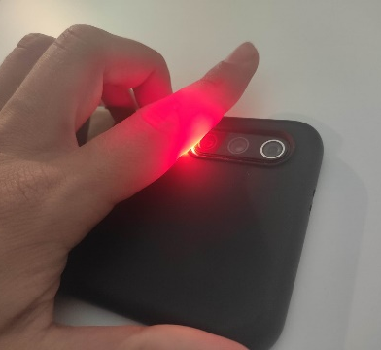
Scattering
In material acquisition, we want to infer the internal properties of materials from the way they scatter light.
Notes:
Scattering happens when light travels through a medium composed of small particles. (!) And when light meets these particles it changes its direction and scatters.
Many natural materials scatter light, for example, (!) clouds, tissue, minerals, cosmetics and industrial chemicals.
(!) In material acquisition, we want to infer the internal properties of materials from the way they scatter light.

Slide 3
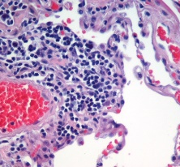
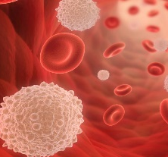
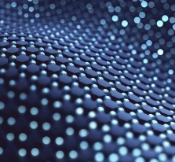
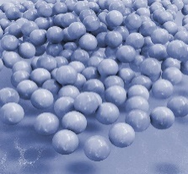
Material acquisition: applications
In material acquisition, we want to infer the internal properties of materials from the way they scatter light.
Tissue imaging: tumor detection and classification
Boas et al. 2001
Blood analysis: red and white counts
Berne and Pecora 2000; Durduran et al. 2010
Validate the fidelity of manufactured material samples
Sumin et al. 2019
Infer the chemical composition of nanodispersions
Pine et al. 1990
Notes:
This task is highly valuable in many applications.
(!) For example, in tissue imaging, it can be used to detect tumors and classify them as malignant or non-malignant.
(!) in blood analysis, to recover diagnostically important parameters such as red and white blood counts.
(!) In material science and fabrication applications, to validate the fidelity of manufactured material samples
(!) in flow cytometry and particle sizing applications, to infer the chemical composition of nanodispersions.
Let us make a closer look on the scattering process and the parameters that define it.

Slide 4
Scattering parameters
$$τ$$
$$σ_{t}$$
$$ρ(τ)$$
Extinction coefficient
Phase function
$$σ_{a}$$
Absorption coefficient
In this work: recover phase function (only)
Notes:
Given a volume with particles, we can explain scattering prosses as a (!) random walk that the light makes inside the volume.
To describe this random walk we need to specify the density and absorption governed by (!) extinction and absorption coefficients.
(!) When the light hits a particle it is scattered in different directions.
(!) The phase function of the particle defines how much energy goes in each direction.
This function is important because it carries information about the size, shape and refractive indices of the particles.
In some applications, people use simplified parametric models for this function such as a Henyey Greenstein model, but in this work, we are interested in the exact unrestricted profile of this function.
Usually, light scatters through (!) multiple particles before it emerges.
In material acquisition, we want to measure the intensity of the light scattered in different directions and (!) recover from it the scattering parameters
(!) In this work we will only talk about the estimation of the phase function rho, and not about sigma_t and sigma_a.

Slide 5
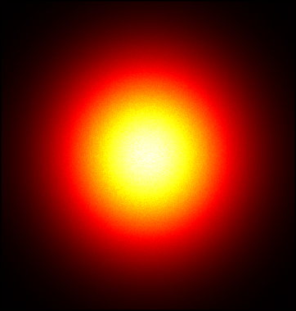
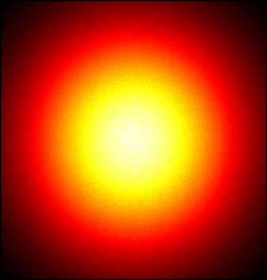
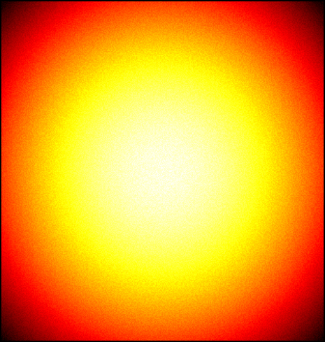
Scattering regimes
Single scattering
Modest scattering
Diffused scattering
Notes:
The literature usually considers 3 different cases of scattering.
(!) The single scattering regime assumes that the sample is optically thin and most photons are scattered only once.
(!) Then in the regime of modest scattering light paths scatter multiple times.
(!) And finally, when the material is very optically thick and paths scatter many-many times, the scattered light becomes diffused and propagates in all directions almost uniformly.

Slide 6
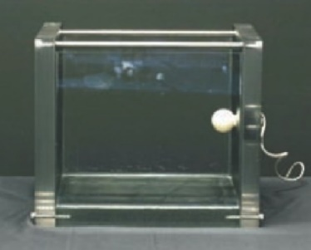
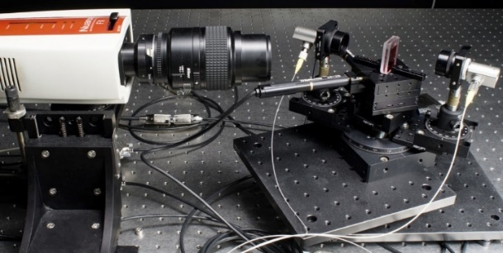
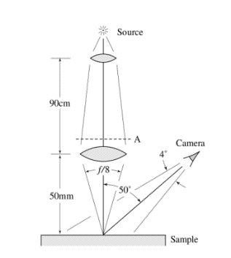
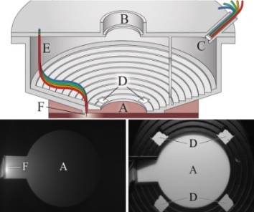
Scattering regimes
Material acquisition: previous work
Single scattering approximation
Differentiable rendering
Diffusion approximation
Single scattering
Modest scattering
Diffused scattering
Narasimhan et al.
2006
Gkioulekas et al.
2013
Jensen et al.
2001
Papas et al.
2013
Notes:
Previous algorithms for material acquisition can be roughly classified into three categories according to these 3 scattering regimes.

Slide 7
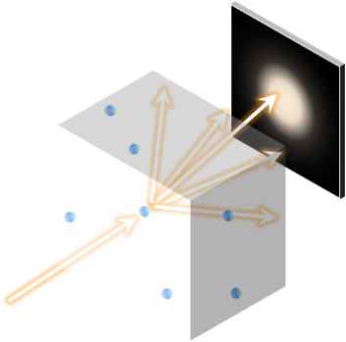
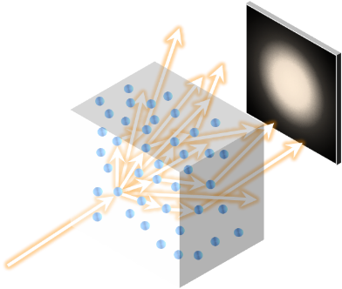
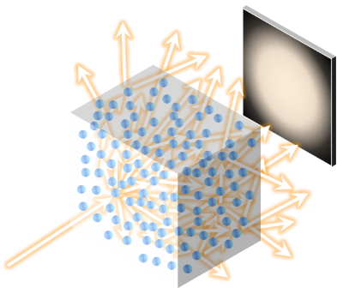
Material acquisition: previous work
Single scattering approximation
Differentiable rendering
Diffusion approximation
Narasimhan et al.
2006
Gkioulekas et al.
2013
Jensen et al.
2001
Papas et al.
2013
Closed-form
expression
No expression,
requires Monte Carlo
Closed-form
expression
Not every material can be diluted
Computationally
costly
Ambiguous to material parameters
Notes:
In the two extreme cases, where the material is very thin or very thick, (!) one can derive a closed form expression which relates the output intensity to the internal material parameters and hence by inverting this expression we can extract the parameters.
(!) To apply the single scattering model the material needs to be thin, or dilutable. (!) but since not every material can be diluted, there are cases which are not covered by this model.
(!) On the other hand, Diffusion approximation applies for thick materials, but it (!) introduces ambiguities between different parameters. In particular, one can only estimate a reduced scattering parameter and not the exact phase function.
(!) In a general case, between these two extremes, there is (!) no closed-form expression, and we need to use Monte-Carlo simulations. While it avoids approximations, (!) this class of techniques is computationally costly.

Slide 8
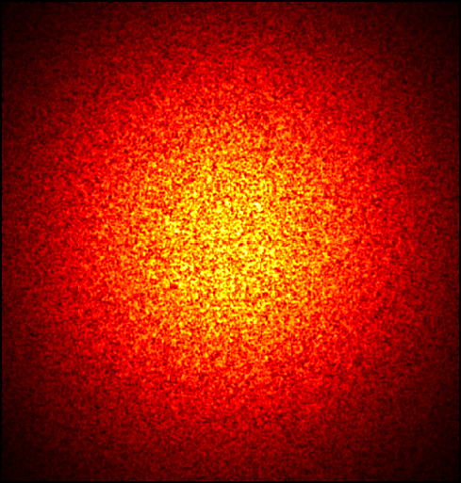
Coherent illumination
previous work: incoherent
our work: coherent
smooth
speckle
natural
light
laser
Notes:
Previous works have studied material acquisition under (!) incoherent illumination, which is typically produced under natural Illumination, and the scattering process results in smooth images.
In contrast, in this work, we use (!) coherent illumination sources such as lasers. In this case, we receive speckles, which appear as pseudo-random variations in the captured intensity.
We argue that speckles have interesting statistical properties that we can use for material acquisition.

Slide 9
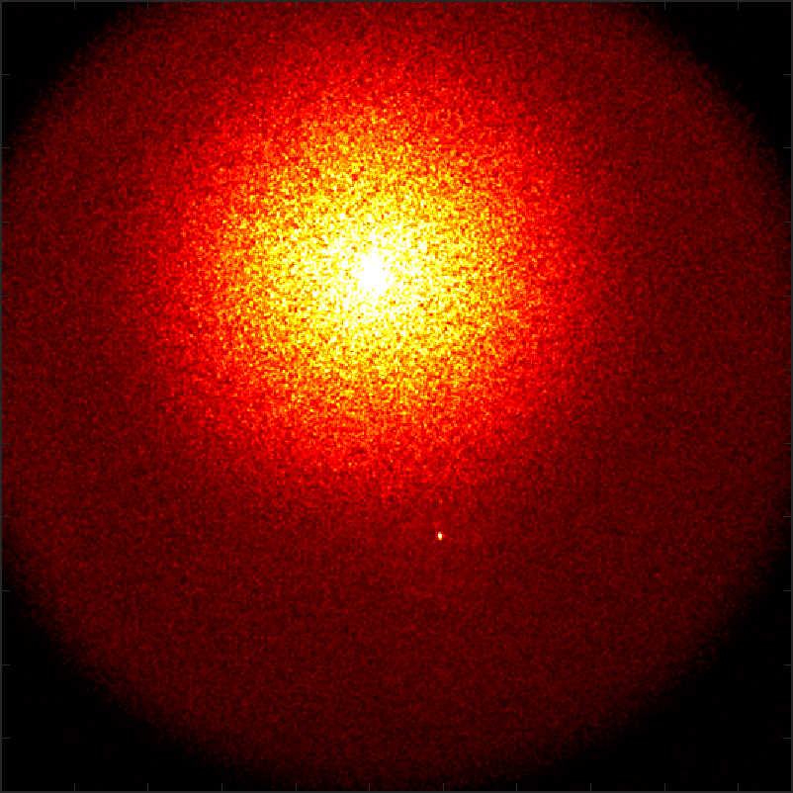
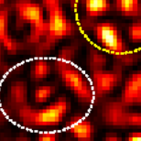
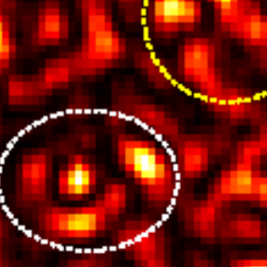
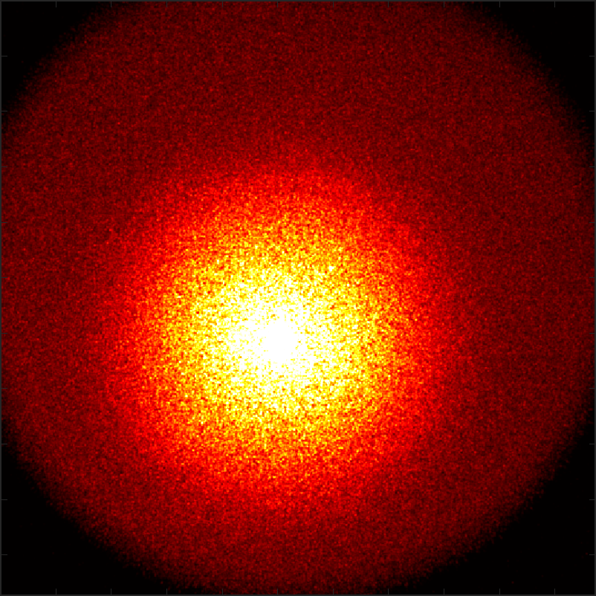
Coherent illumination: memory effect (ME)
Our contribution:
use ME correlation to extract the
phase function $ρ\left(τ\right)$
similar
ME = the speckles formed under nearby illuminations are correlated shifted versions of each other
Notes:
One such property is the memory effect, (!) meaning that speckles formed under nearby illuminations are correlated shifted versions of each other.
(!) For example here are two speckle images that we capture under two illumination directions.
(!) If we zoom in, we will see that the speckles are similar.
The Memory Effect property has been exploited in multiple settings, in particular, for seeing through scattering layers, bypassing heavy aberration.
In this work, we explore a very different, novel application of the memory effect.
(!) and we use Memory Effect correlation to extract the phase function.

Slide 10
Rendering speckle covariance
$$v_{1}$$
$$v_{2}$$
$$i_{2}$$
correlation
$$i_{1}$$
Notes:
Let us start with a review of how speckles are formed, and how their statistics can be simplified.
(!) First, we have two illuminations i1 and i2 that produce two images.
(!) Each pixel in those images corresponds to a viewing direction.
The sensor measures the field in (!) v1 under illumination i1, and the field in (!) v2 under illumination i2.
(!) We want to compute the correlation between the two fields.
The field in each of the views is created by a (!) large number of paths, when each path has a complex contribution with a phase proportional to the path length.

Slide 11
Rendering speckle covariance
Can explain correlation only with
single scattering paths.
[Bar et al. 2021]
$$v_{1}$$
$$v_{2}$$
$$i_{2}$$
correlation
$$i_{1}$$
Notes:
However, Bar et al have pointed out that for long paths the complex phases decorrelate very quickly, and the correlation between the two speckle fields can be explained by the (!) light paths that are scattered only once.
Although the volume is not thin and most paths scatter multiple times, the speckle correlation acts as a gating mechanism which allows us to isolate the single scattering paths.

Slide 12
Rendering speckle covariance
$$C\left(τ,Δ\right)∝ρ\left(|τ|\right)sinc\left(\frac{kL}{2}\left(Δ⋅τ\right)\right)$$
Can explain correlation only with
single scattering paths.
[Bar et al. 2021]
$$v_{1}$$
Illumination and viewing angles:
$$τ$$
We can read the phase function directly from the correlation
$$Δ=i_{2}−i_{1}=v_{2}−v_{1}$$
$$v_{2}$$
$$i_{2}$$
$$τ=v_{1}−i_{1}=v_{2}−i_{2}$$
$$τ$$
correlation
$$Δ$$
$$i_{1}$$
Notes:
The main advantage of this observation is that it allows us to approximate covariance in closed-form, without the need for numerical tools such as Monte Carlo rendering.
The expression for single-scattering covariance depends (!) on two angles:
(!) The angle delta between the two illumination directions;
(!) and the scattering angle tau between the illumination and viewing directions.
What do we understand from this formula?
(!) First, the correlation is proportional to the phase function. Therefore once we compute the correlation, we can (!) directly read the phase function from it. Note, that such direct acquisition of the phase function was previously possible only for very thin materials. In contrast, we will see next that the single scattering covariance approximation works for materials of modest thickness as well.
(!) Secondly, there is a sinc term that depends on the angle between tau and delta. We will return to this part later.

Slide 13
Correlation measurement
$$I^{1}$$
$$τ_{y}$$
$$v_{y}$$
$$i_{x,y}^{1}$$
$$I^{2}$$
$$τ_{x}$$
$$τ$$
Illumination and viewing angles:
$$v_{y}$$
$$Δ$$
$$τ_{y}$$
$$v_{x}$$
$$Δ=i_{2}−i_{1}=v_{2}−v_{1}$$
$$i_{2}$$
$$τ=v_{1}−i_{1}=v_{2}−i_{2}$$
$$τ$$
$$i_{x,y}^{2}$$
$$τ_{x}$$
$$v_{x}$$
$$Δ$$
$$i_{1}$$
Notes:
In this work, we have built an experimental setup to measure the phase function from speckle statistics. (!) For that, we capture two speckle images of the medium, by illuminating it from two nearby directions.
(!) The coordinates of the sensor are the viewing directions vx and vy.
(!) We mark the point i1xy, which is a projection of the illumination direction. At this point, we have a ballistic light that didn’t scatter. Though the scattered light goes in all directions, there is more light around the ballistic.
(!) taux and tauy define the scattering angle, which is effectively the difference between the viewing direction and the illumination direction.
(!) We move the illumination by delta and receive a second image I2.
(!) The point i2xy is a projection of the second illumination, (!) and the tau coordinates move correspondently.
(!) For the same scattering angle in the two images, we see that the speckles are correlated.

Slide 14
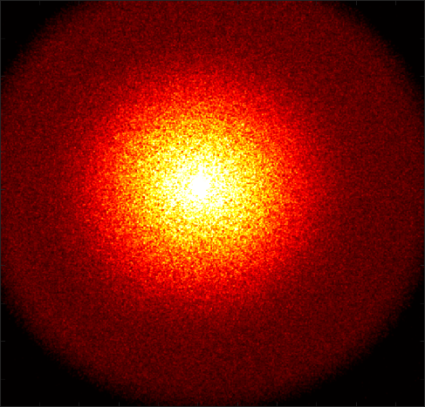
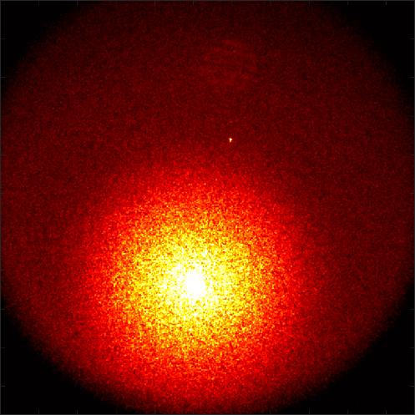
Correlation measurement
$$I^{1}$$
$$I^{2}$$
$$I^{1}$$
$$I^{2}$$
Notes:
Now, we take the two images and align the second image to match the first one.

Slide 15
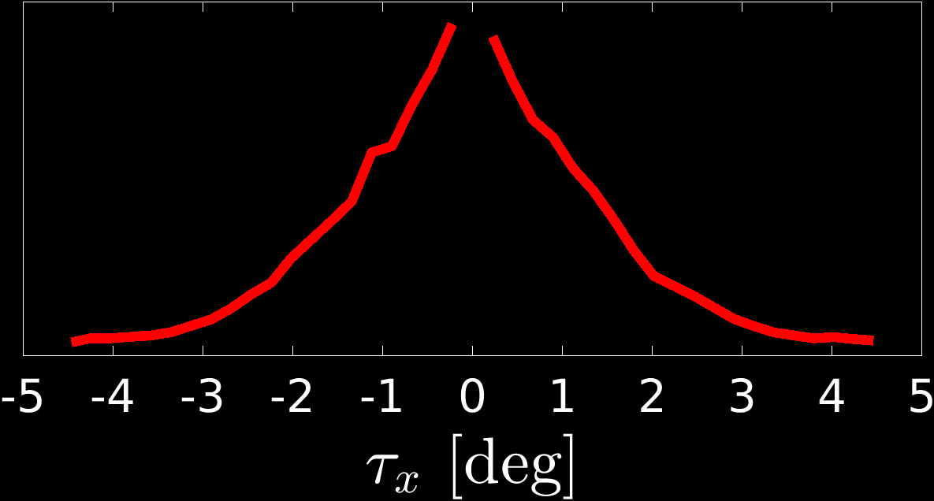
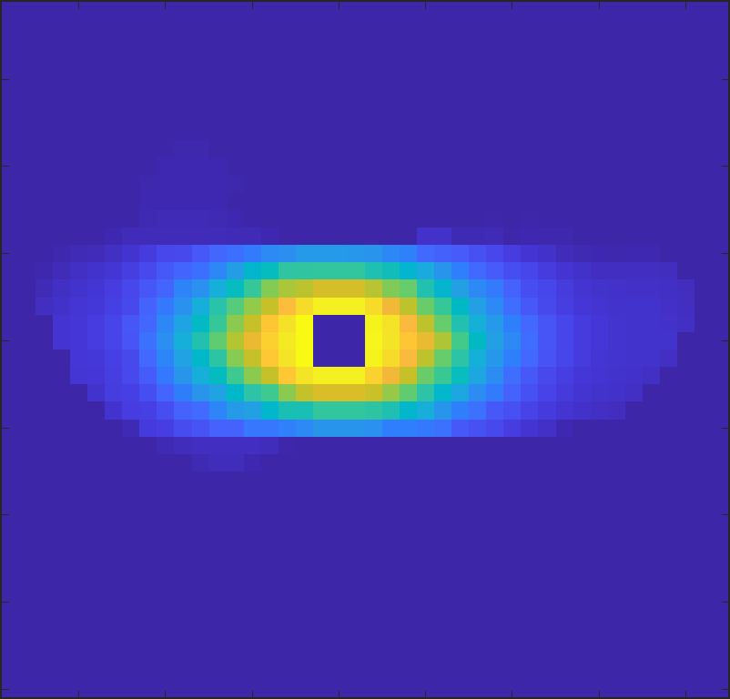
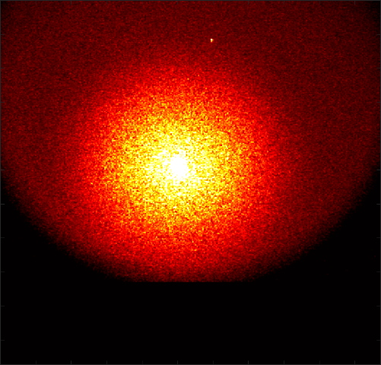
Correlation measurement
$$ρ\left(τ\right)$$
$$τ_{y}$$
$$C\left(τ,Δ\right)∝ρ\left(|τ|\right)sinc\left(\frac{kL}{2}\left(Δ⋅τ\right)\right)$$
correlation
shifted image
$$I^{2}$$
$$τ_{y}$$
$$I^{1}$$
$$I^{2}$$
$$E\left( \begin{matrix} & \\ & \\ & \end{matrix} \right)$$
$$∗$$
$$τ_{x}$$
$$Δ$$
Notes:
To compute the correlation at scattering angle τ , (!) we want to look at the local correlation around pixel tau. And to eliminate the noise we use (!) spatial averaging in windows of hundred by hundred pixels, (!) and estimate the 2D correlation in the tau coordinates.
Note, that the correlation that we get is not symmetrical in x and y directions. This result is predicted by the (!) single scattering correlation formula, where the sinc term defines the anisotropy of correlation.
Since (!) in our implementation delta is vertical, (!) delta dot tau equals tau_y, meaning that the correlation is multiplied by a sinc in the vertical direction. Along the horizontal axis the sinc term does not influence the correlation and it is simply proportional to the phase function.
Now, our goal is to extract the phase function, and we can simply read if (!) from the correlation values along the horizontal tau axis. Since phase function is symmetrical, we will further refer to the (!) positive angles only.
We do not measure the correlation at (!) the very small angles because in these pixels the ballistic light is dominant and cannot be separated from the scattering.

Slide 16
Lab prototype
Translating source
Lens
Scattering sample
Lens
Sensor
Notes:
We built a lab prototype for material acquisition. At the moment the maximal angle it can measure is limited by an eight degrees aperture, but this limitation can be alleviated by adding a rotating stage.
We demonstrate empirically that our simple model is accurate.

Slide 17
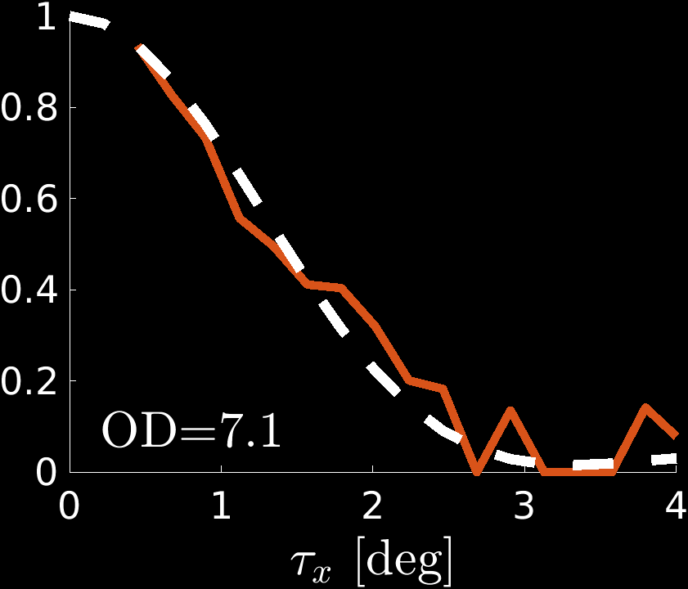
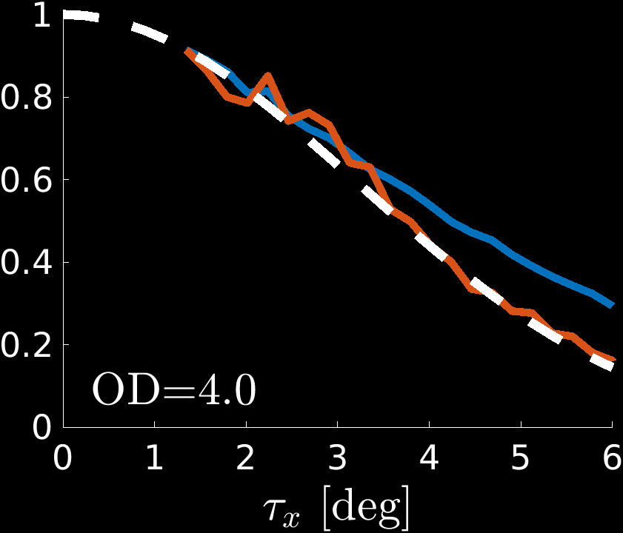
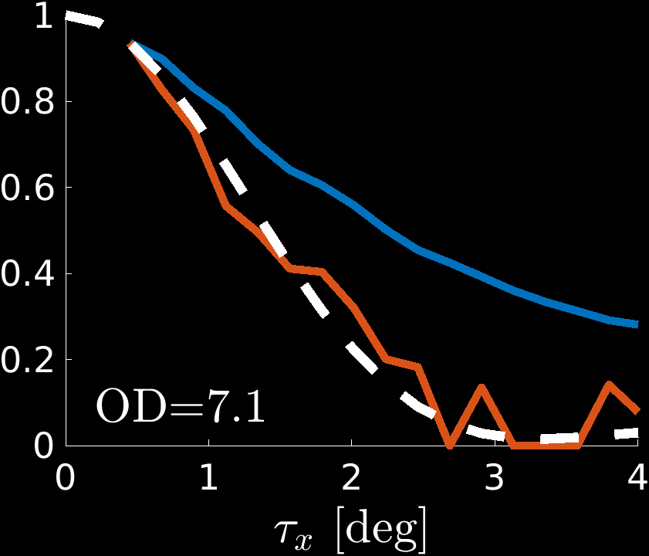
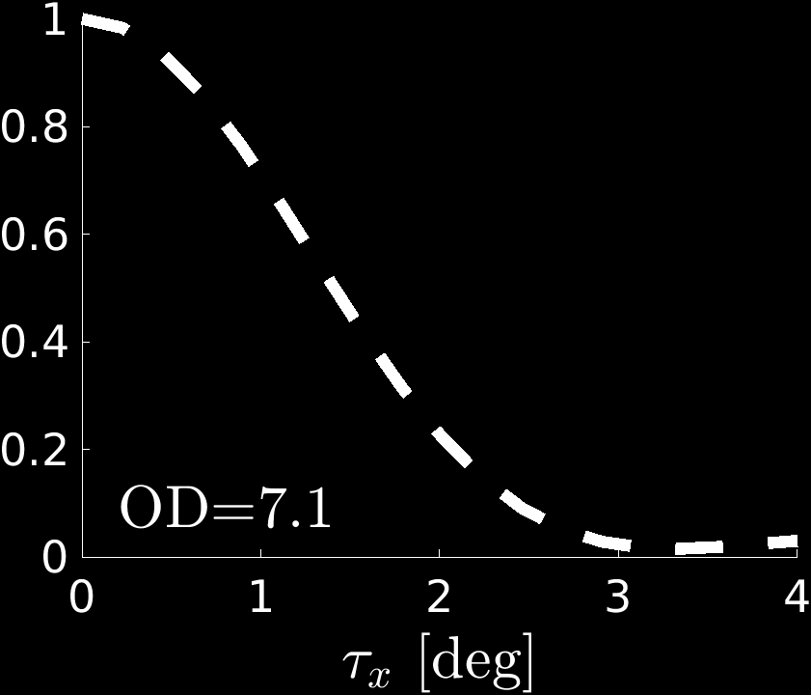
Direct acquisition: validation
GT phase function $ρ(τ)$:
Using Mie theory: particle diameter and refractive index are known
$10μm$
SiO2
beads
$$4μm$$
polystyrene
beads
intensity
intensity
correlation
$$ρ\left(τ_{x}\right)$$
$$ρ\left(τ_{x}\right)$$
GT
GT
correlation
Notes:
To validate our approach we generated (!) two scattering materials, by dispersing two types of micro-spheres in agarose: (!) In this case, we know the ground truth parameters.
and we can compute the ground truth phase function using Mie theory.
Here is the (!) ground truth phase function and (!) here is OUR estimate from the speckle correlation, and you can see the match very well.
(!) We also plot the overall intensity we measured at each direction. This is what people used in the past in material acquisition using the classical single scattering assumption. This is very different than the phase function, because the samples we used are thick and most light path scatter multiple times. For example, in the first sample (!) the optical depth is such that on average, each path scatters 7 times.
(!) The correlation matches the ground truth for the second validation material as well.

Slide 18
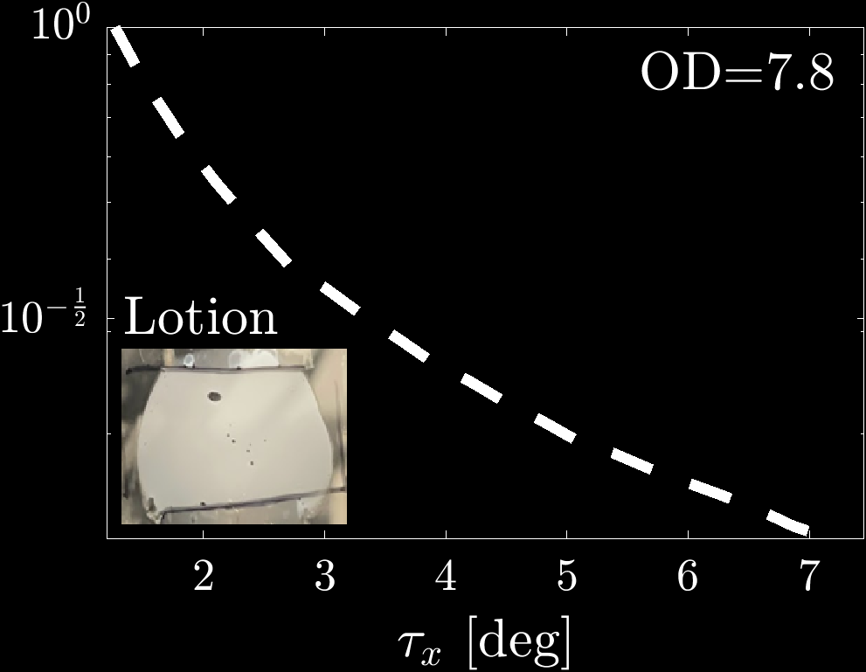
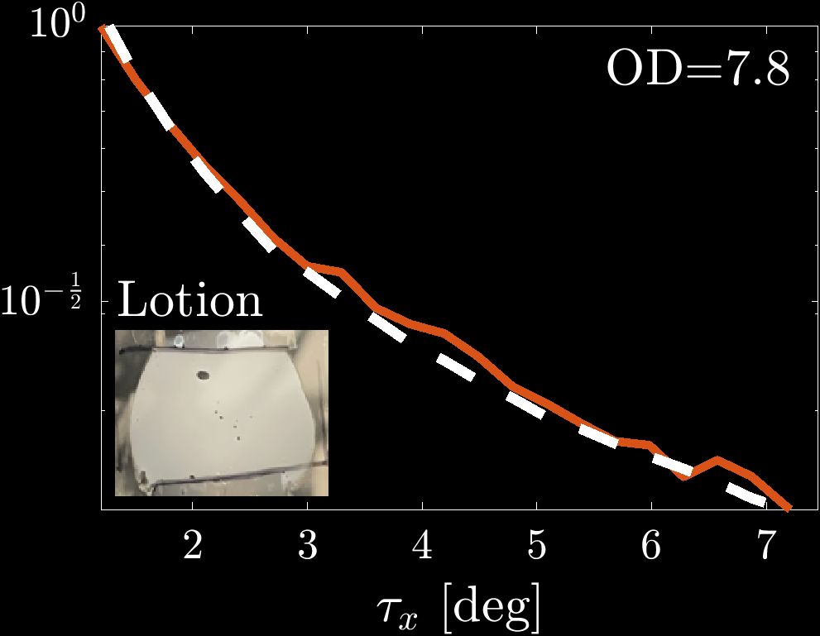
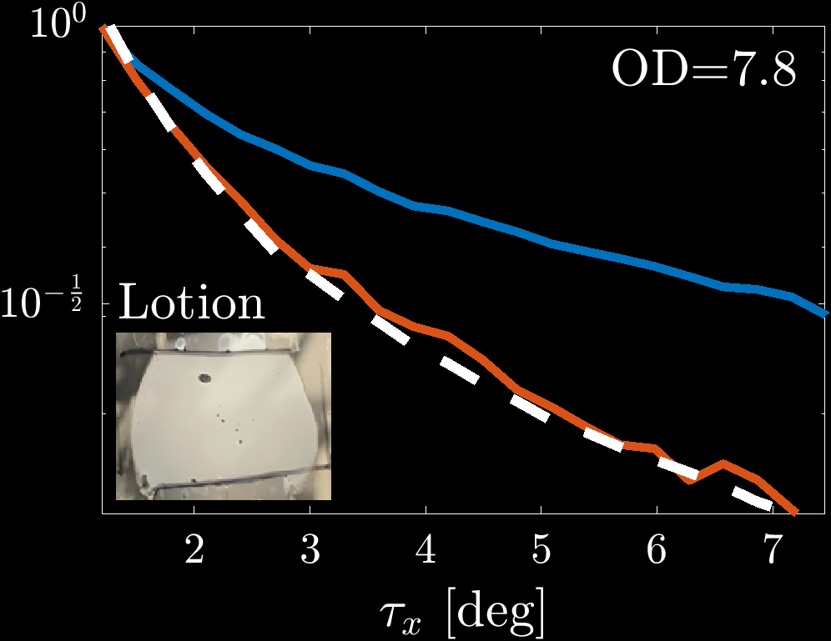
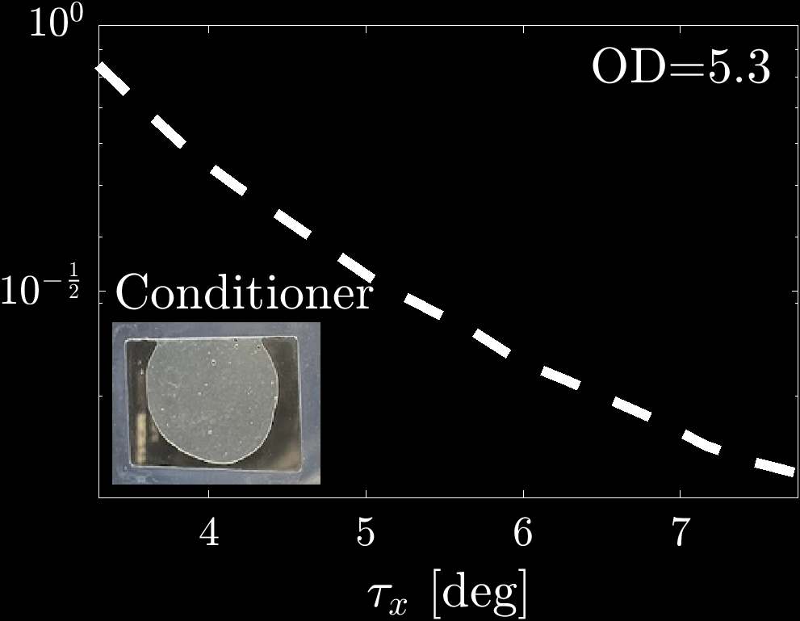
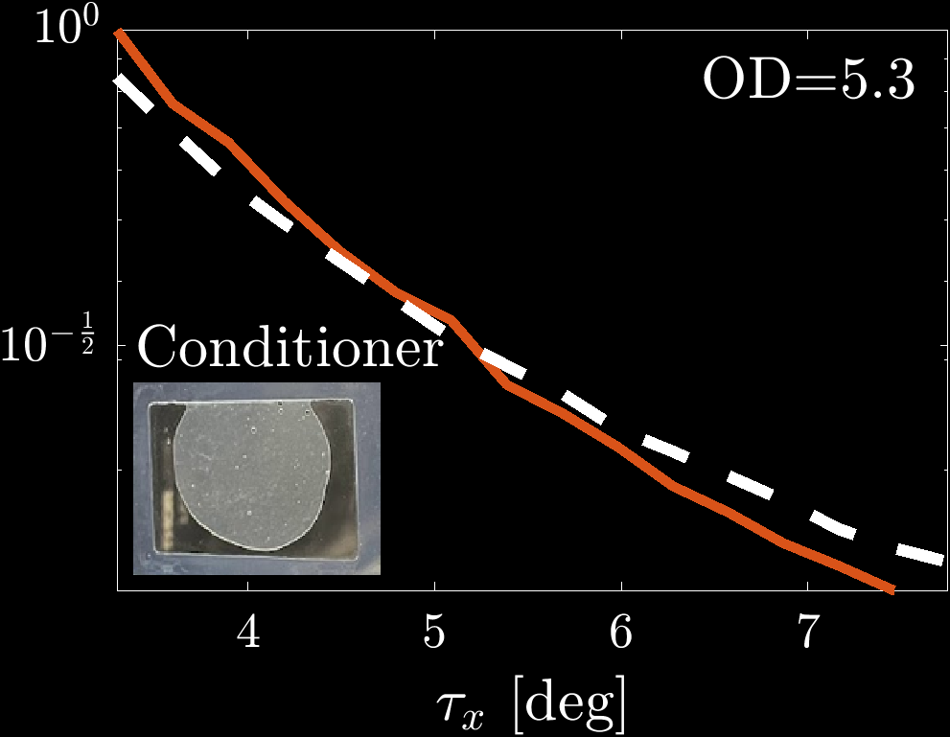
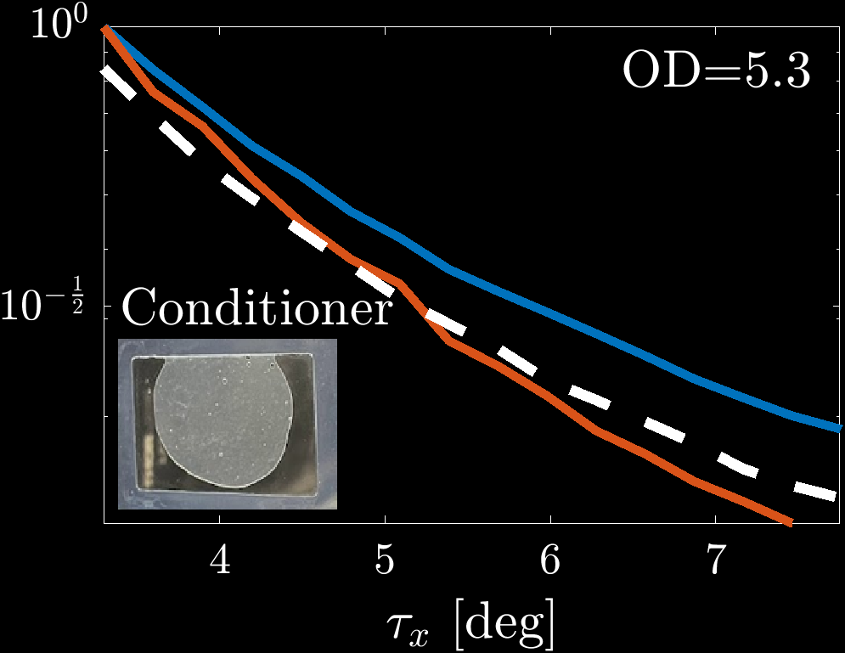
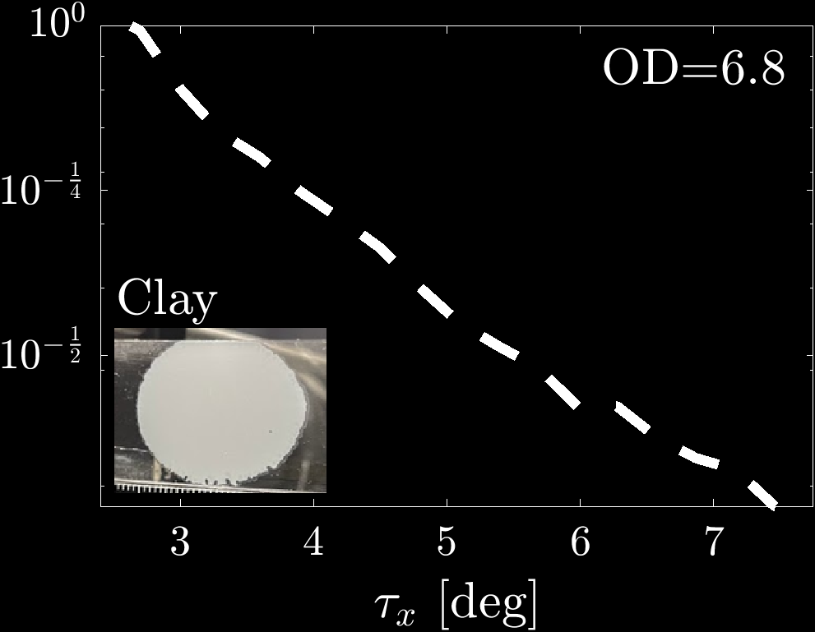
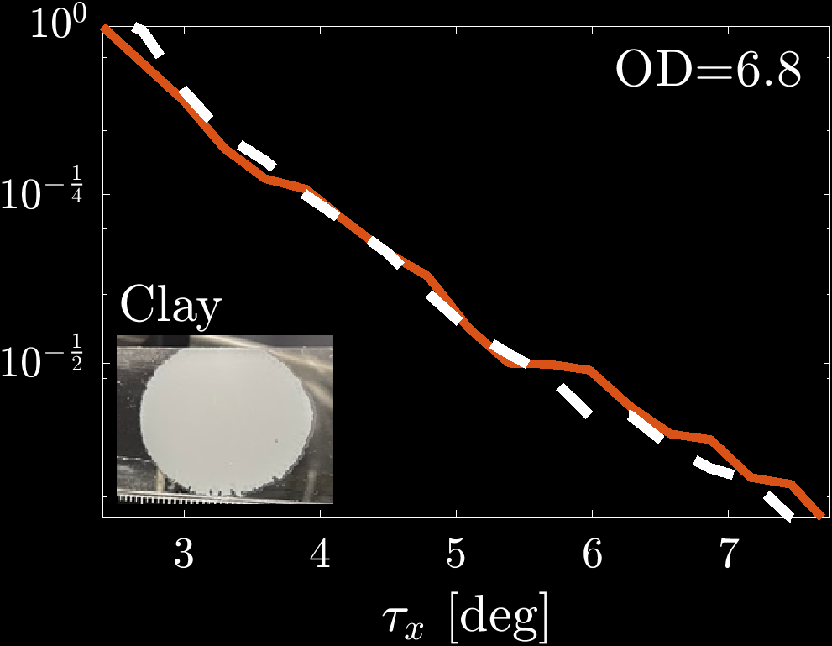
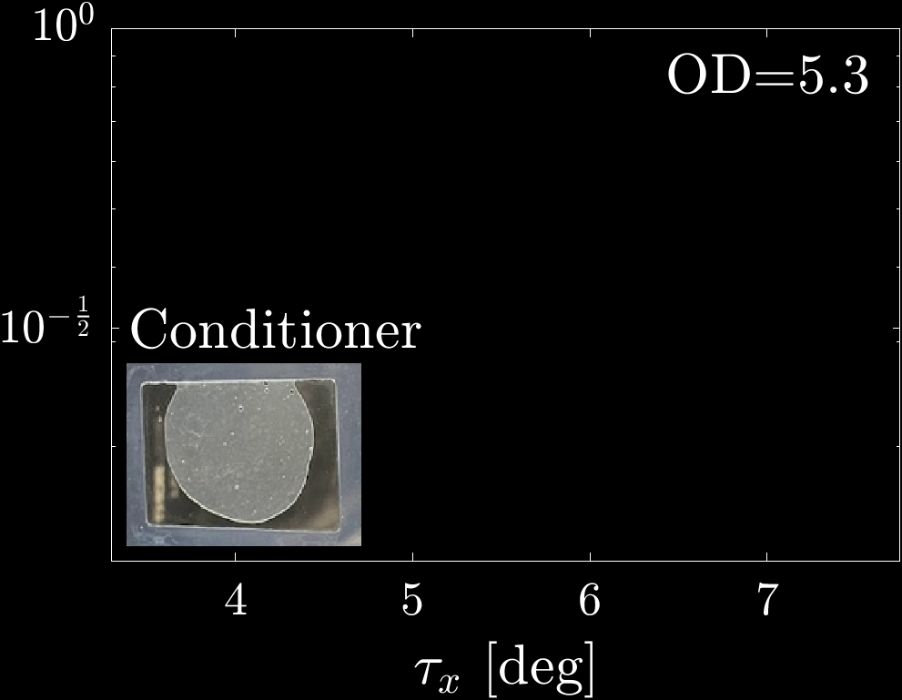
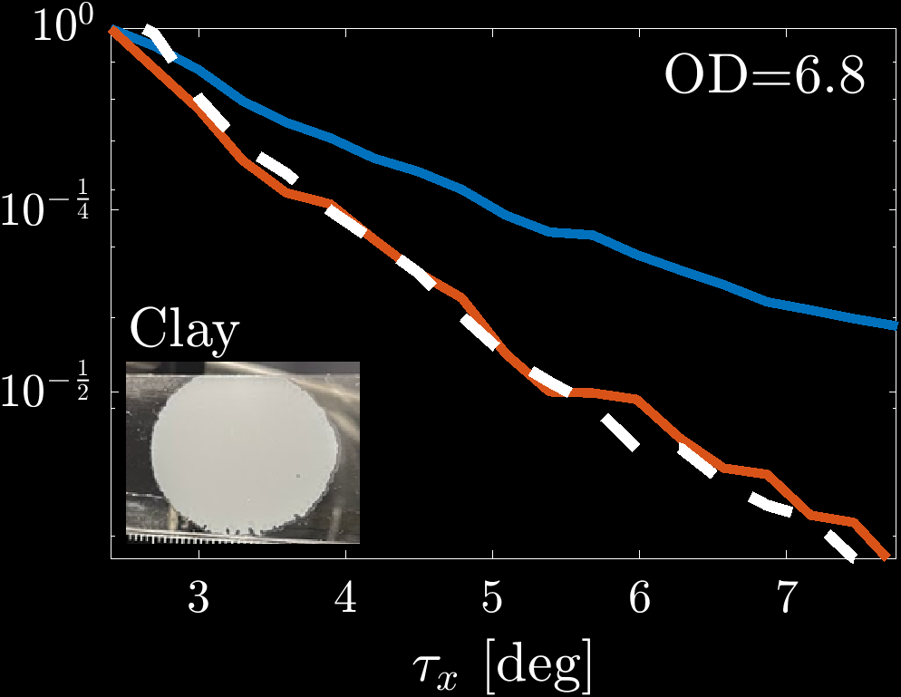
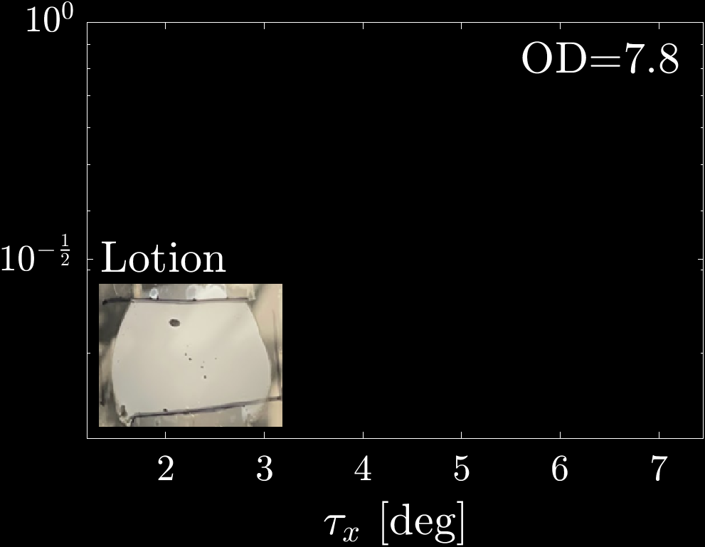
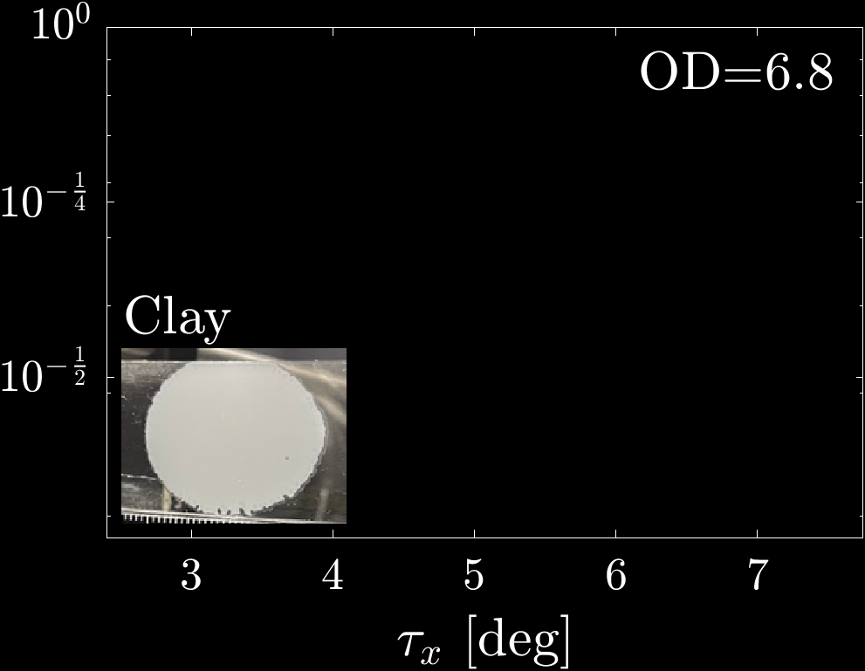
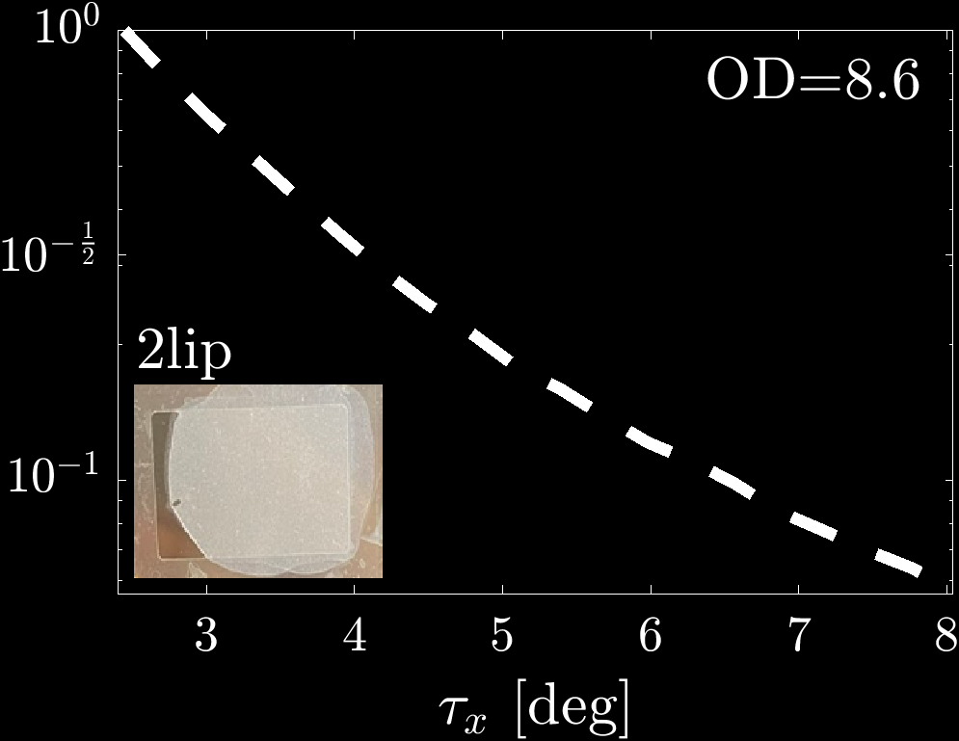
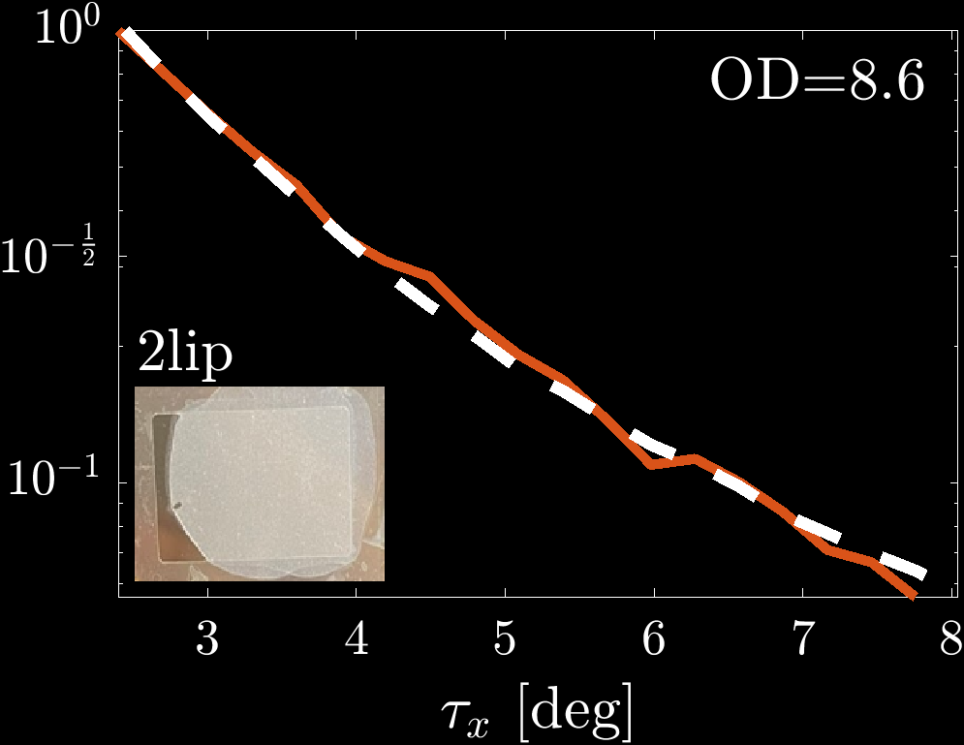
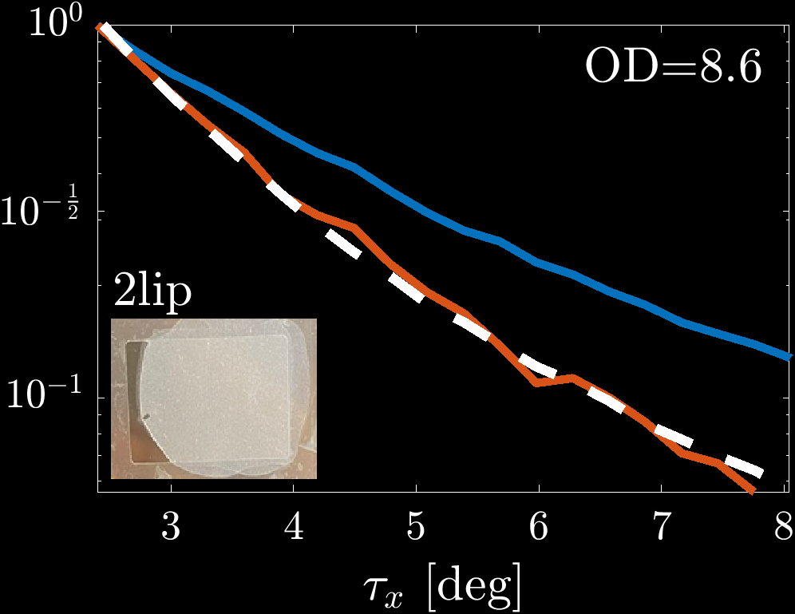
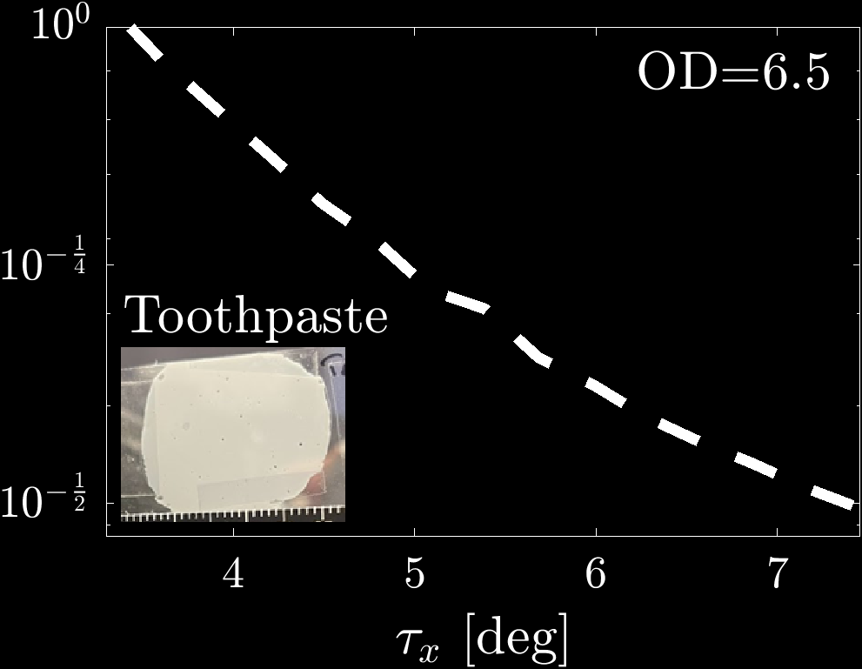
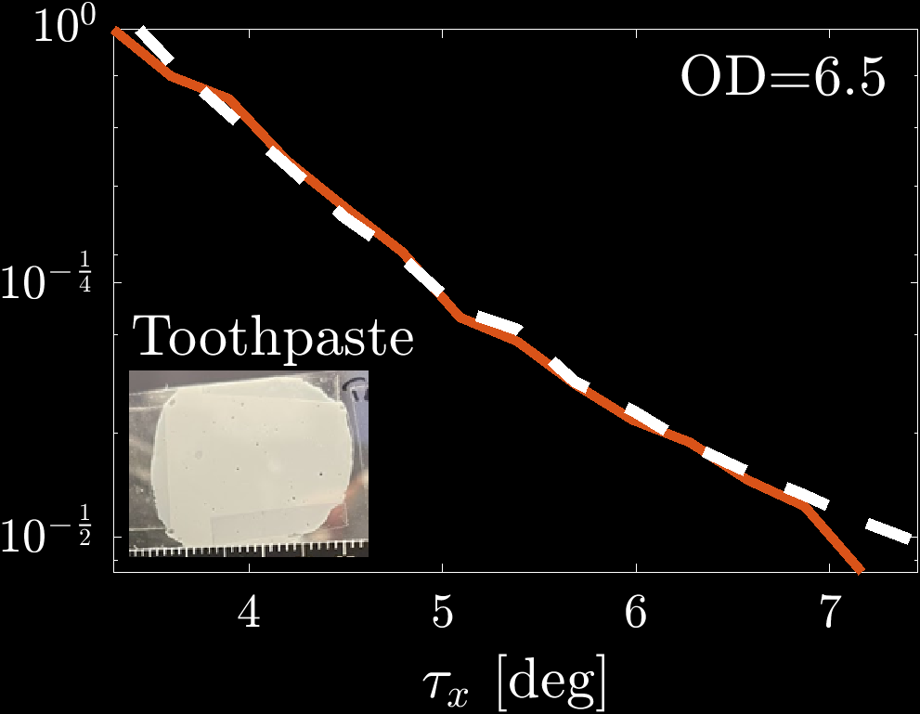
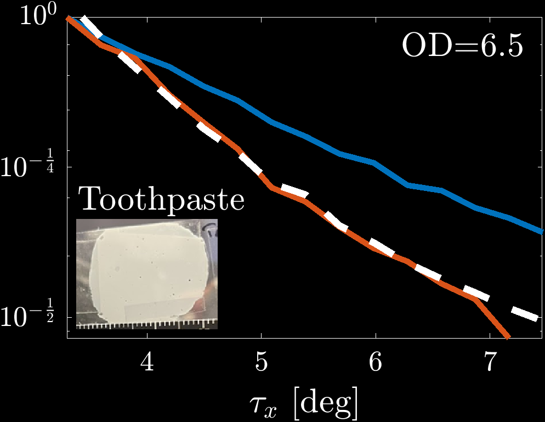
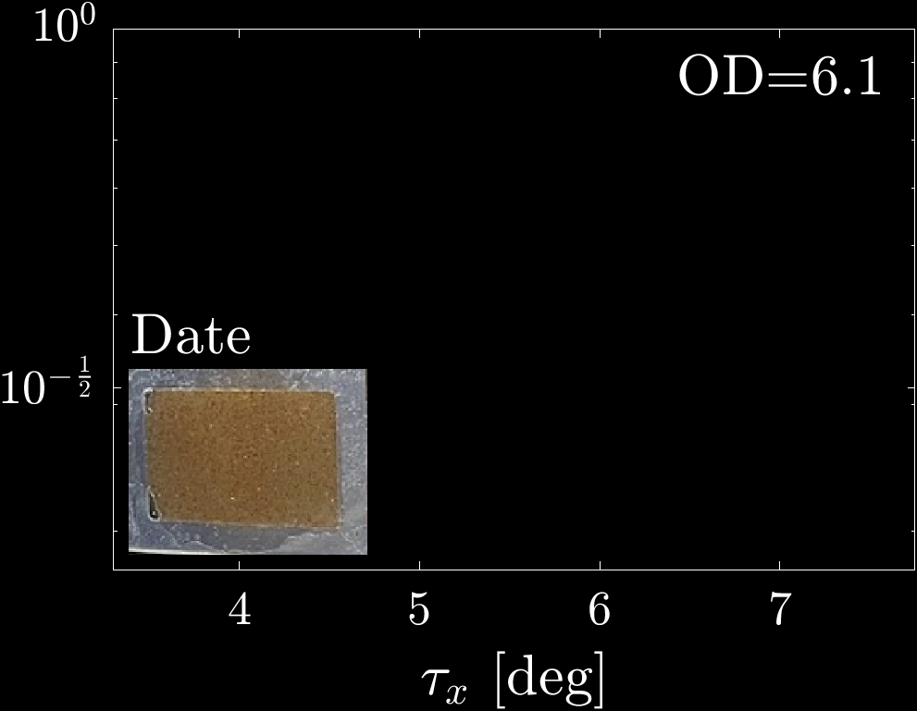
Direct acquisition: common materials
Thin sample
Thicker sample
$$ρ\left(τ_{x}\right)$$
$$ρ\left(τ_{x}\right)$$
$$ρ\left(τ_{x}\right)$$
$$ρ\left(τ_{x}\right)$$
$$ρ\left(τ_{x}\right)$$
$$ρ\left(τ_{x}\right)$$
Notes:
After validation, we used our approach for acquiring the phase function of various everyday materials. Here you can see some of them.
While we do not have ground truth, we prepared both a (!) thin and a thicker sample of the same material. We use the (!) thin sample as a reference for the phase function.
(!) The correlation we measured from the thicker sample agrees with this reference.
(!) The intensity of the thick sample is very different from the phase function, due to multiple scattering events.

Slide 19
Limitations
Applies only to viscous and solid materials
Limited angular range
Applies only to modest optical depth
Extracts phase function $ρ(τ)$ but not $σ_{t},σ_{a}$
$$OD≤8$$
Notes:
Our approach allows extracting the phase function of a material in closed-form. Despite its elegance, I would like to mention some limitations.
(!) The approach applies only to viscous and solid materials because it requires two successive images of the same material, without any Brownian motion of particles between them. However, since liquids can easily be diluted, solid materials are the main open challenge in material acquisition.
(!) Our current proof-of-concept implementation can measure only about 8 degrees of scattering angles, limited by the camera aperture. Capturing larger angles would require a more complex setup that can rotate the camera around the sample. Additionally, the very forward scattering angles are precluded by the ballistic light.
(!) Our model applies to modest optical depths. In the current implementation, we managed to measure materials of OD up to 8. For thicker materials, the correlation estimate is very noisy and cannot be used.
(!) Finally, this approach extracts the phase function but not sigma_t and sigma_a.

Slide 20
Summary
Measuring the phase function in closed form from speckle correlation
Avoids costly optimization
Applies for modest thickness materials where light paths scatter more than once.
Proof-of-concept acquisition setup
Validated against ground truth materials
Notes:
To summarise, (!) we presented a simple approach for reading the phase function in closed form from the correlation between speckle patterns. (!)This approach avoids costly optimization of previous approaches,
(!) even for thicker materials where light paths scatter more than once.
(!) We have built a proof-of-concept acquisition system, and (!) we validated it against ground truth materials, demonstrating accurate agreement.

Slide 21
Direct acquisition of volumetric scattering phase function
using speckle correlations
Marina Alterman, Evgeniia Saiko, Anat Levin
See paper for details
Try out our code and data
Notes:
The paper and the code are available in the following links.

