Slide 1
We claim – in our system all states are localized. Why?
ε
x

Slide 2
Few General Concepts
The physical scene we would be interested in

Slide 3
Creating electronic continuity
Wave-functions of first confined states
( probability to find electron at z = z₀)
( Energy level of the state )
P
E
0
E₁
Z
Spatial proximity leads to wave-function overlap.
(a)
(b)
E₁₂
E₁₁
E₁₂
(c)
E₁
E₁
E₁₁
The distance determines the strength of the overlap or ΔE=E₁₂-E₁₁.

Slide 4
E₁₂
E₁
E₁*
Two states are equally shared by the sites
(Two identical pendulum in resonance)
E₁₁
E₁₂
E₁
E₁*
E₁₁
Strong coupling overcomes minute differences (low disorder)
E₁₂
E₁
E₁*
E₁₁
E₁₂
E₁
Two states are separate
E₁*
(Very different pendulum do not resonate - stronger disorder)
E₁₁

Slide 5
Lifshitz Localization
r₁
E₀
+
E₀
E₀
r₂
E₀
+
E₀
E₀
r₂
r₃
r₁
E₀
+
E₀
+
E₀
+
E₀
E₁
+
E₃
E₄
No long range “resonance”
E₂
If there is a large disorder in the spatial coordinates → no band is formed and the states are localized.

Slide 6
Conjugation length
Long
Short
Varying chain distance
Strong coupling
Weak coupling
Coupling also affected by relative alignment of the chains (dipole)
parallel
shift
tilt

Slide 7
Localization in “Soft” matter

Slide 8
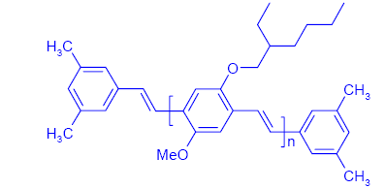

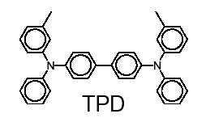
What are conjugated polymers?
Polymers: carbon based long repeating molecules
π-conjugation: double bond conjugation
poly[acetylene]
MEH-PPV
H
H
H
H
H
C
C
C
C
C
C
C
C
C
C
H
H
H
H
H
Molecular organic
Semiconductor

Slide 9
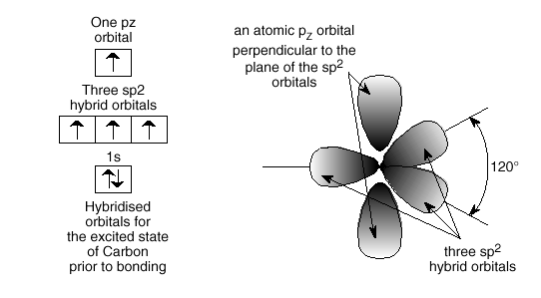
Conjugation

Slide 10
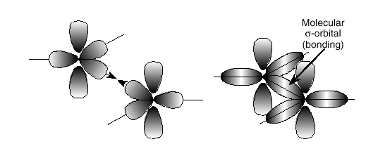

Slide 11
Z
Molecular π levels
p⁺
The phase of the
wave function
p⁻
Amplitude
Consider 2 atoms
+
+
p⁺
p⁻
-
-
=
Anti-bonding
π*
Less Stable state
p⁻
p⁺
+
-
+
p⁺
p⁺
-
=
Bonding
π
Stable state
p⁻
p⁻

Slide 12
4 atoms
LUMO
(Conduction)
HOMO
(Valence)
There is correlation between spatial coordinates and the electronic configuration!!

Slide 13
Energy
Configuration coordinate
Molecule’s
Length

Slide 14
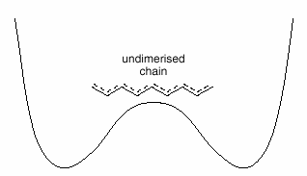
Another coordinate system
c
c
c
c
c
(a)
c
c
c
c
c
π
(b)
Sigma
Dimerised (1)
(c)
Dimerised (2)
(d)
Energy
Energy
(
(
b)
b)
Degenerate ground state
(
(
c)
c)
(
(
d)
d)
Bond Length

Slide 15
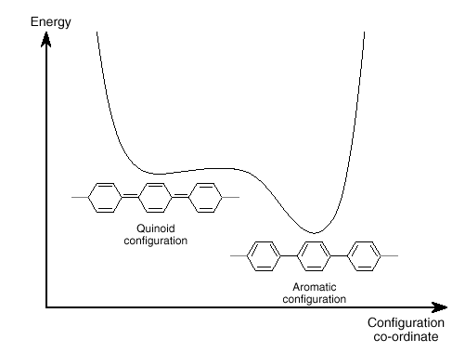
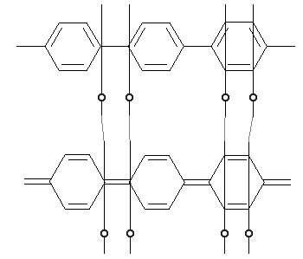
General or schematic configuration coordinate
Aromatic link
Quinoidal link

Slide 16
The potential at the bottom of the well is ~parabolic (spring like)

Slide 17

Spring Energy
Q₀
E_{0spring}
E=E₀+B(Q-Q₀)²

Slide 18
Simplistic approach
Elastic energy:
Squeezed
Equilibrium
Stretched

Slide 19
Adding a particle will raise the system’s energy by (m*g*h)
Q₀
E₀^{t}= E_{0spring}+E_{0elec}
Q
Here, the particle just entered the system (molecule) and we see the state before the environment responded to its presence (prior to relaxation)
The system relaxed to a new equilibrium state. In the process there was an increase in elastic energy of the environment and the electron’s energy went down. On the overall energy was released (typically) as heat.
On a 2D surface
The particle dug himself a hole
(self localization)

Slide 20
A
A*
Q₀
E_{0spring}
Q
A*
A
If the potential energy of the mass would not depend on its vertical position

Slide 21
A*
We’ll be interested in the phenomena arising from the relation between the length of the spring and the particle’s potential energy.
We’ll claim that due to this phenomenon there the system (electron) will be stabilized
Q
A*
A’
If the potential energy of the mass would not depend on its vertical position

Slide 22
Stretch mode
E_{n}
E_{n} +dE_{n}
L
L + dL
For small variations in the “size” of the molecule the electron phonon contribution to the energy of the electron is linear with the displacement of the molecular coordinates.
For π-conjugated the atomic displacement is ~0.1A and F=2-3eV/A.
The general formalism:
E_{e-ph}=-AQ

Slide 23
Linear electron-phonon interaction:
The system was stabilized by ΔE through electron-phonon interaction →
Polaron binding energy

Slide 24
What is λ ?
Molecule without e-ph relaxation
Molecule with e-ph relaxation
What is the energy change, at Q_{min}, due to reorganization?
“stretch” the molecule to the configuration associated with the e-ph relaxation and see how much is gained by the e-ph relaxation.

Slide 25
Why all this is relevant to charge transport?

Slide 26
Molecule without a charge
Molecule containing a charge
Transfer will occur when by moving the electron from one molecule to other there would be no change in total energy.
If the two molecules are identical and have the same E₀ →
The electron carries E_{n}+AQ₁ and replace it with E_{n}+AQ₂ →
Transfer is most likely to occur when Q₁=Q₂=Q
Total excess energy to reach this state:

Slide 27
Transfer will occur when Q₁=Q₂=Q
Total excess energy to reach this state:
To move an electron or activate the transport we need energy of:
Electron transfer is thermally activated process
Typical number is:

Slide 28
E
Q
E
E_{C}
Polaron Binding Energy

Slide 29
So far we looked into:
A → A*
Let’s look at the entire transport reaction:
A + D* → A* + D

Slide 30
Two separate molecules
E
E
Q1
Q2
One reaction or system
E
Q*

Slide 31
A system that is made of two identical molecules
As the molecules are identical it will be symmetric (the state where charge is on molecule A is equivalent to the state where charge is on molecule D)

Slide 32
λ
λ
W_{a}
If the reactants and the products have the same parabolic approximation:
λ=4W_{a}=2E_{b}

Slide 33
A system that is made of two identical molecules
6000
Reactants
Products
5000
4000
D
A
D
A
E
3000
2000
1000
W_{a}
0
-1000
Q*
As the molecules are identical it will be symmetric (charge on A is equivalent to charge on D)

Slide 34
Average
attempt frequency
Probability of electron to move (tunnel) between two “similar” molecules
Activation of the molecular conformation
Requires the “presence” of phonons.
Or the occupation of the relevant phonons should be significant

Slide 35
What is a Phonon?
Considering the regular lattice of atoms in a uniform solid material, you would expect there to be energy associated with the vibrations of these atoms. But they are tied together with bonds, so they can't vibrate independently. The vibrations take the form of collective modes which propagate through the material. Such propagating lattice vibrations can be considered to be sound waves, and their propagation speed is the speed of sound in the material.
The vibrational energies of molecules, e.g., a diatomic molecule, are quantized and treated as quantum harmonic oscillators. Quantum harmonic oscillators have equally spaced energy levels with separation ΔE = hυ. So the oscillators can accept or lose energy only in discrete units of energy hυ.
The evidence on the behavior of vibrational energy in periodic solids is that the collective vibrational modes can accept energy only in discrete amounts, and these quanta of energy have been labeled "phonons". Like the photons of electromagnetic energy, they obey Bose-Einstein statistics.

Slide 36
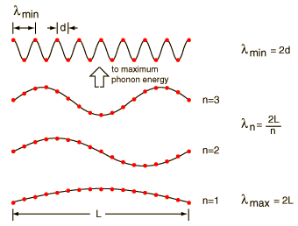

Considering a “regular” solid which is a periodic array of mass points, there are “simple” constraints imposed by the structure on the vibrational modes.
Such finite size (L) lattice creates a square-well potential with discrete modes.
Associating a phonon energy
v_{s} is the speed of sound in the solid

Slide 37
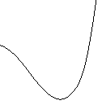
For a complex molecule with many degrees of freedom we use the configuration co-ordinate notation:
Energy
Energy
2
2
1
1
0
0
Q
Q
Configuration
Co-ordinate
Configuration
Co-ordinate
For the molecule to reach larger Q – higher energy phonons states should be populated

Slide 38
Bosons:
The relevance to our average attempt frequency:
What will happen if T<T_{phonon}/2
In the context of:

Slide 39
A system that is made of two identical molecules
6000
5000
4000
A
B
A
B
E
3000
2000
1000
W_{a}
0
-1000
Q
At low temperature the probability to acquire enough energy to bring the two molecules to the top of the barrier is VERY low.
In this case the electron may be exchanged at “non-ideal” configuration of the atoms or in other words there would be tunneling in the atoms configuration (atoms tunnel!).
[D. Emin, "Phonon-Assisted Jump Rate in Noncrystalline Solids," Physical Review Letters, vol. 32, pp. 303-307, 1974].
Would the electron transfer rate still follow exp(-qWa/kT)

Slide 40
High T regime:
~200k in polymers
Activation energy decreases with Temperature
[N. Tessler, Y. Preezant, N. Rappaport, and Y. Roichman, "Charge Transport in Disordered Organic Materials and Its Relevance to Thin-Film Devices: A Tutorial Review," Advanced Materials, vol. 21, pp. 2741-2761, Jul 2009.]

Slide 41
Are we interested in identical molecules?
(same A, B & E₀)
ε
Consider variations in E₀
x

Slide 42
Effect of disorder or applied electric field on the two molecule system:
λ
λ
ΔG¹
ΔG⁰
q_{R}
q_{c}
q_{P}

Slide 43
Energy activation for going to the lower site:
In the present case for going down in energy
For polaron transfer (λ=2|E_{b}|) :
In the present case for going down in energy

Slide 44
Energy activation for going to the lower site:
This term is usually negligible

Slide 45
Effect of disorder or applied electric field on the two molecule system:
λ
λ
ΔG¹
ΔG⁰=E_{i}-E_{j}
q_{i}
q_{c}
q_{j}

Slide 46
Let’s consider a system characterized by:
Gaussian Distribution of States
E
10¹⁸cm⁻³
10¹⁷cm⁻³
ε
x

Slide 47
Detailed Equilibrium
Another form:
P
V. Ambegaokar, B. I. Halperin, and J. S. Langer, "Hopping Conductivity in Disordered Systems," Phys. Rev. B, vol. 4, pp. 2612-&, 1971.
A. Miller and E. Abrahams, "Impurity Conduction at Low Concentrations," Phys. Rev., vol. 120, pp. 745-755, 1960.

Slide 48
Under which circumstances can we use:
μ and D are statistical quantities
  A. Statistics has to be well defined
  B. Variation in the structure/properties are slow compared to the length scale we are interested in
Gaussian Distribution of States
E
Density and spatial regime
Carrier sampling DOS
10¹⁸cm⁻³
10¹⁷cm⁻³

