Slide 1

Organic semiconductors
Solar Cells & Light Emitting Diodes
Lior Tzabari, Dan Mendels, Nir Tessler
Nanoelectronic center, EE Dept., Technion

Slide 2
Outline
Macroscopic View of recombination P3HT:PCBM
or – Exciton Annihilation as the bimolecular loss
Microscopic description of transport
  Implications for recombination

Slide 3
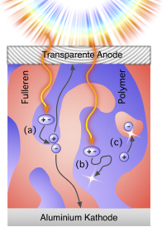
What about recombination in P3HT-PCBM Devices
Let’s take a macroscopic look and decide on the relevant processes.
Picture taken from:
http://blog.disorderedmatter.eu/2008/06/05/picture-story-how-do-organic-solar-cells-function/ (Carsten Deibel)

Slide 4
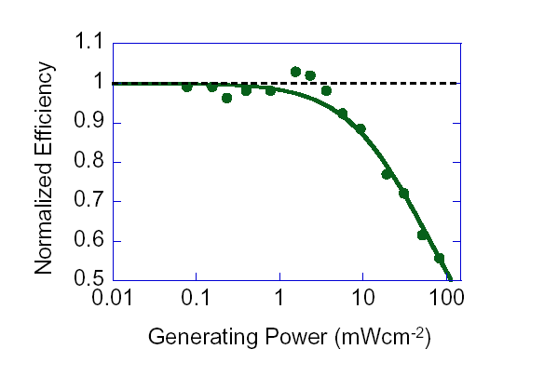
The Tool/Method to be Used
QE as a function of excitation power
Charge generation rate
Photo-current
Signature of Loss
due to
Langevin Recombination
No re-injection
Langevin recombination-current
N. Tessler and N. Rappaport, Journal of Applied Physics, vol. 96, pp. 1083-1087, 2004.
N. Rappaport, et. al., Journal of Applied Physics, vol. 98, p. 033714, 2005.

Slide 5
What can we learn using simple measurements
(intensity dependence of the cell efficiency)
SRH (trap assisted)
LUMO
dEt
Bimolecular
Mid
gap
HOMO
Monomol
P doped → Traps already with holes
Intrinsic (traps are empty)
Nt – Density of traps.
dEt - Trap depth with respect to the mid-gap level.
Cn- Capture coefficient
L. Tzabari, and N. Tessler, Journal of Applied Physics 109, 064501 (2011)

Slide 6
What can we learn using simple measurements
(intensity dependence of the cell efficiency)
Bi- Molecular
SRH (trap assisted)
L. Tzabari, and N. Tessler, Journal of Applied Physics 109, 064501 (2011)

Slide 7

Recombination in P3HT-PCBM
1
4 min
Anneal
0.95
4min
1.5e-12 | K_{b}[cm³/sec]
0.9
0.85
K_{b} – Langevin bimolecular
recombination coefficient
In practice detach it from its physical origin and use it as an independent fitting parameter
0.8
Normalized QE
0.75
0.7
0.65
, - Experiment
, - Model
0.6
0.55
190nm of P3HT(Reike):PCBM (Nano-C)(1:1 ratio, 20mg/ml) in DCB
PCE ~ 2%
-2
0
2
10
10
10
Intensity [mW/cm²]
Notes:
צריך קבוע יותר גדול – הגיוני כי הניידות גדלה.
אבל!!! מצד שני שינוי הניידות בלבד יביא לתוצאות הפוכות מאחר והגדלת הניידות מגדילה גם את יכולת האיסוף – וברגע שיכולת האיסוף גדלה כמות נושאי המטען האפקטיבית בהתקן קטנה ומנגנוני האיבוד נכנסים מאוחר יותר.
=> יכול להיות שינוי תלוי מורפולוגיה בלבד.

Slide 8

Recombination in P3HT-PCBM
4 min
10min | 4min
8e-12 | 1.5e-12 | K_{b}[cm³/sec]
10 min
, - Experiment
, - Model
Notes:
צריך קבוע יותר גדול – הגיוני כי הניידות גדלה.
אבל!!! מצד שני שינוי הניידות בלבד יביא לתוצאות הפוכות מאחר והגדלת הניידות מגדילה גם את יכולת האיסוף – וברגע שיכולת האיסוף גדלה כמות נושאי המטען האפקטיבית בהתקן קטנה ומנגנוני האיבוד נכנסים מאוחר יותר.
=> יכול להיות שינוי תלוי מורפולוגיה בלבד.

Slide 9
Shockley-Read-Hall Recombination
LUMO
dEt
4 min
Mid gap
10 min
HOMO
Intrinsic (traps are empty)
, - Experiment
, - Model
I. Ravia and N. Tessler, JAPh, vol. 111, pp. 104510-7, 2012. (P doping < 10¹²cm⁻³)
L. Tzabari and N. Tessler, "JAP, vol. 109, p. 064501, 2011.

Slide 10
Shockley-Read-Hall + Langevin
The dynamics of recombination at the interface is both
SRH and Langevin
10min | 4min
1.2e17 | 1.9e17 | Nt [1/cm³]
0.371 | 0.435 | dEt [eV]
0.5e-12 | 0.5e-12 | Kb[cm³/sec]
4 min
10 min
, - Experiment
, - Model
LUMO
dEt
Mid
gap
HOMO

Slide 11
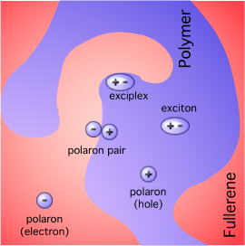
Exciton Polaron Recombination
Neutrally excited molecule (exciton) may transfer its energy to a charged molecule (electron, hole, ion).
As in any energy transfer it requires overlap between the exciton emission spectrum and the “ion” absorption spectrum.
M. Pope and C. E. Swenberg, Electronic Processes in Organic Crystals., 1982.
A. J. Ferguson, et. al., J Phys Chem C, vol. 112, pp. 9865-9871, 2008 (Kep=3e-8)
J. M. Hodgkiss, et. al., Advanced Functional Materials, vol. 22, p. 1567, 2012. (Kep=1e-8)

Slide 12

Exciton Polaron Recombination
Sensitivity | 10min | 4min
0 | 1.05e17 | 1.9e17 | Nt [1/cm^3]
0.015 | 0.365 | 0.435 | dEt [eV]
1.08e-8 | 1.6e-8 | 1.6e-8 | Kep[cm^3/sec]
4 minutes
10 minutes
Nt – Density of traps.
dEt - trap depth with respect to the mid-gap level.
Kep – Exciton polaron recombination rate.
Kd– dissociation rate
1e9-1e10 [1/sec]
, - Experiment
, - Model
A. J. Ferguson, et. al., J Phys Chem C, vol. 112, pp. 9865-9871, 2008 (Kep=3e-8)
J. M. Hodgkiss, et. al., Advanced Functional Materials, vol. 22, p. 1567, 2012. (Kep=1e-8)

Slide 13
Traps or CT states are stabilized during annealing
4 minutes
Sensitivity | 10min | 4min
0 | 1.05e17 | 1.9e17 | Nt [1/cm^3]
0.015 | 0.365 | 0.435 | dEt [eV]
1.08e-8 | 1.6e-8 | 1.6e-8 | Kep[cm^3/sec]
10 minutes
T. A. Clarke, M. Ballantyne, J. Nelson, D. D. C. Bradley, and J. R. Durrant, "Free Energy Control of Charge Photogeneration in Polythiophene/Fullerene Solar Cells: The Influence of Thermal Annealing on P3HT/PCBM Blends," Advanced Functional Materials, vol. 18, pp. 4029-4035, 2008. (~50meV stabilization)

Slide 14
Bias Dependence
10 minutes anneal

Slide 15
Charge recombination is activated

Slide 16
Obviously we need to understand better the recombination reactions
Let’s look at the Transport leading to…

Slide 17
Electronic Disorder
Modeling Solar Cells based on material with
E
High Order
E
Band
x
Density of states
Low disorder
E
E
Band
Tail states (traps)
x
Density of states
High disorder
E
E
Density of localized states
x
Density of states

Slide 18

Disordered hopping systems
are
degenerate semiconductors
Y. Roichman and N. Tessler, APL, vol. 80, pp. 1948-1950, Mar 18 2002.
To describe the charge density/population one should use
Fermi-Dirac statistics and not Boltzmann
The notion of degeneracy or degenerate gas is not unique to semiconductors.
Actually it has its roots in very basic thermodynamics texts.
White Dwarf

Slide 19
Degenerate Gas
White Dwarf
When the Gas is non-degenerate the average energy of the particles is independent of their density.
When the Gas is degenerate the average energy of the particles depends on their density.
Enhancing the density of a degenerate electron gas requires substantial energy (to elevate the average energy/velocity)
→ this stops white dwarfs from collapsing (degeneracy pressure)

Slide 20
Degenerate Gas
White Dwarf
Enhancing the density of a degenerate electron gas requires substantial energy (to elevate the average energy/velocity)
Relation to Semiconductors
The simplest way:
Enhanced random velocity = Enhanced Diffusion
(Generalized Einstein Relation)
But what about localized systems?
Can we relate enhanced average energy to enhanced velocity?
Wetzelaer et. al., PRL, 2011
GER Not Valid

Slide 21
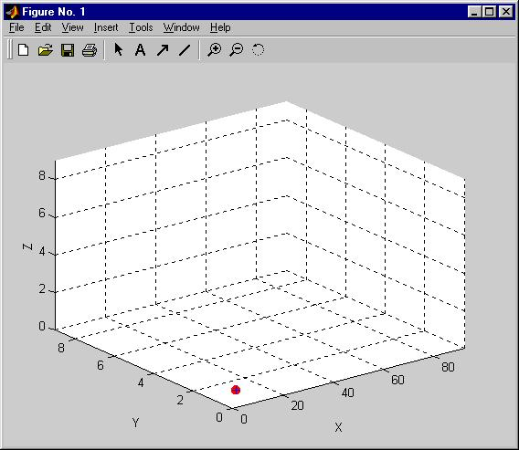
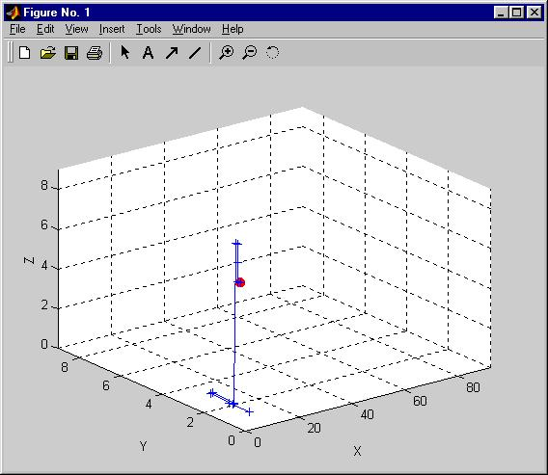
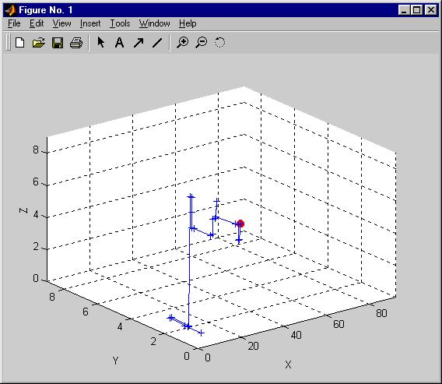
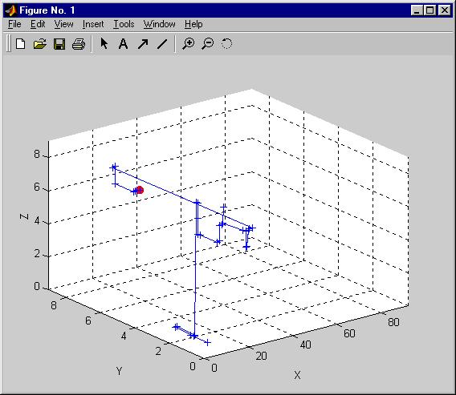
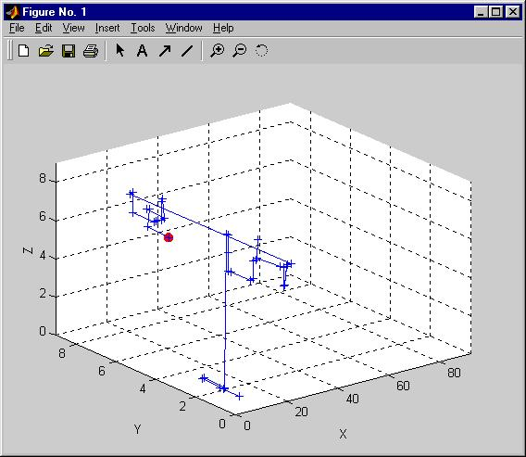
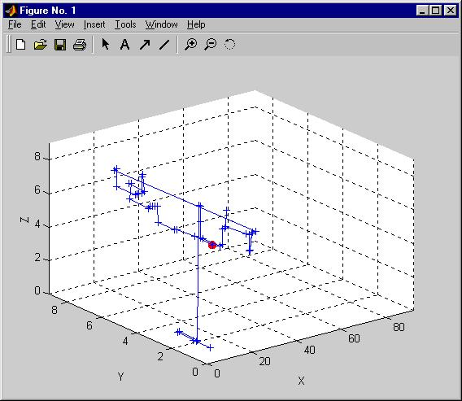
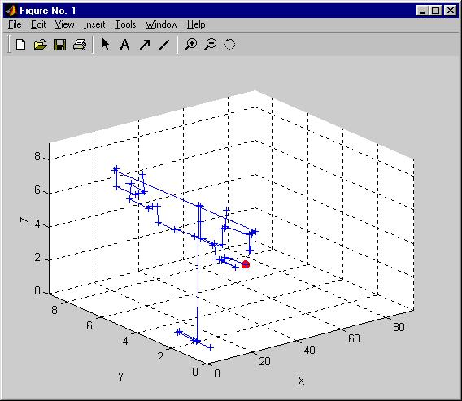
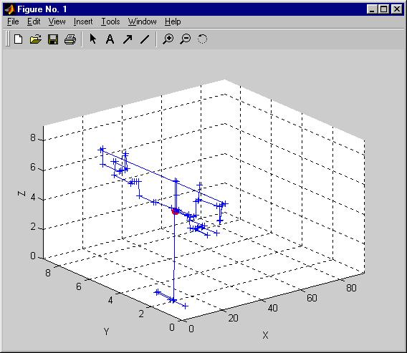

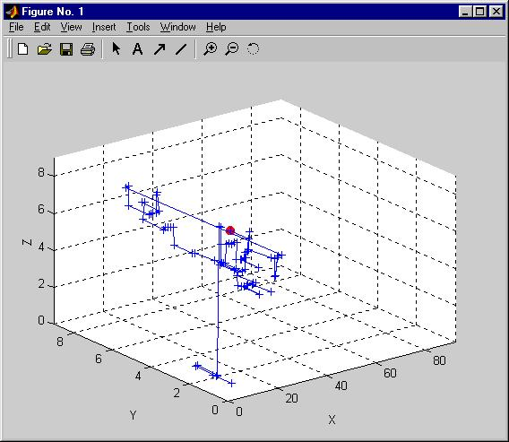
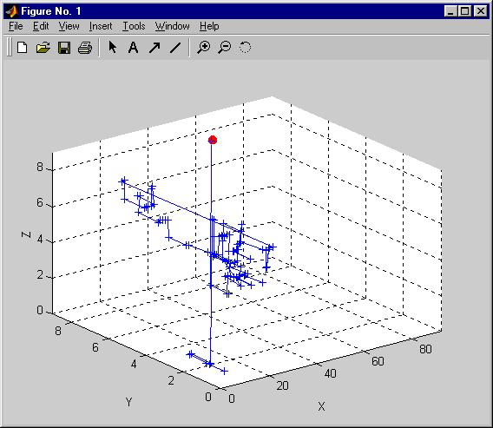
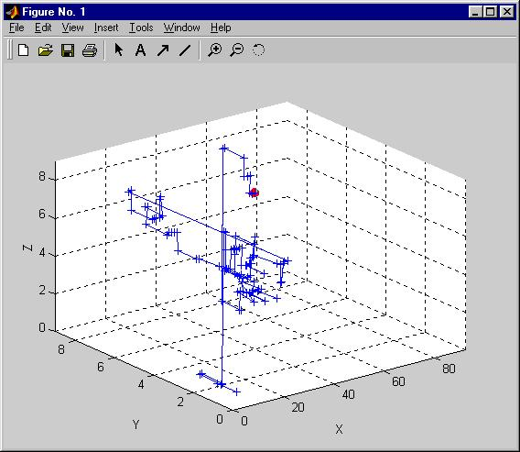

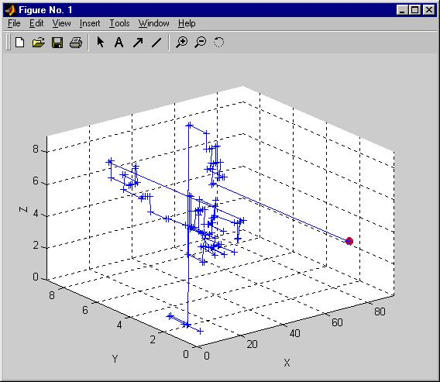
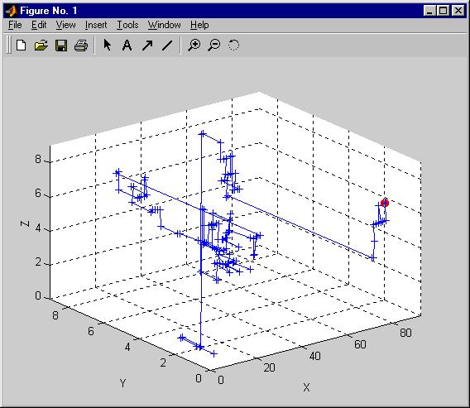
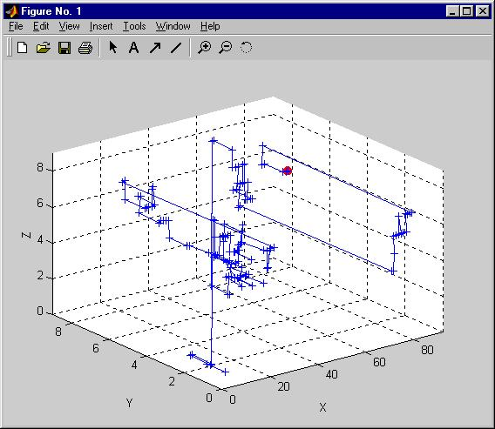
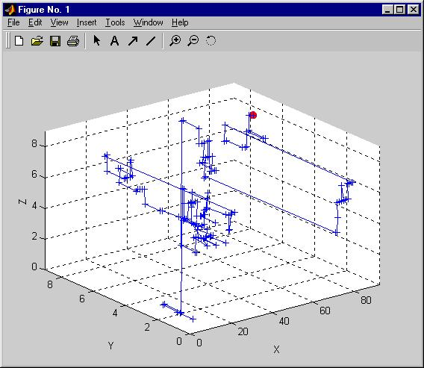
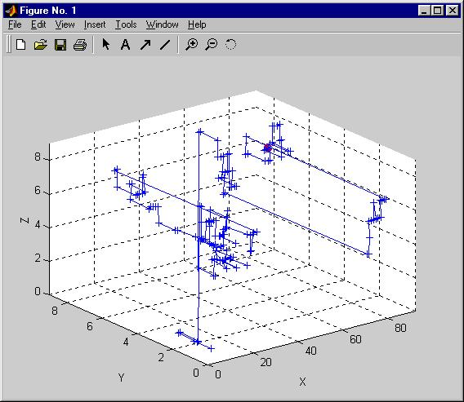
Monte-Carlo simulation of transport
Standard M.C. means uniform density
G.E.R.
Monte-Carlo
Y. Roichman and N. Tessler, "Generalized Einstein relation for disordered semiconductors - Implications for device performance," APL, 80, 1948, 2002.

Slide 22
Comparing Monte-Carlo to
Drift-Diffusion & Generalized Einstein Relation
Implement contacts as in real Devices
qE
qE
GER Holds for real device Monte-Carlo Simulation

Slide 23
Where does most of the confusion come from
D →The intuitive Random Walk
The coefficient describing
Generalized Einstein Relation is defined ONLY for
J. Bisquert, Physical Chemistry Chemical Physics, vol. 10, pp. 3175-3194, 2008.

Slide 24
What is Hiding behind
E
E
There is an Energy Transport
X
X
Charges move from high density region to low density region
Charges with High Energy move from high density region to low density

Slide 25
Degenerate Gas
White Dwarf
Enhancing the density of a degenerate electron gas requires substantial energy (to elevate the average energy/velocity)
Relation to Semiconductors
The fundamental way:
Density Energy Density Gradient Energy Gradient
Driving Force
Enhanced “Diffusion”

Slide 26
All this work just to show that the Generalized Einstein Relation
Is here to stay?!
Enhanced “Diffusion”
degenerate
There is transport of energy even in the absence of Temperature gradients
is
There is an energy associated with the charge ensemble
And we can both quantify and monitor it!
D. Mendels and N. Tessler, The Journal of Physical Chemistry C, vol. 117, p 3287, 2013.

Slide 27
How much “Excess” energy is there?
E_{F}
150meV
σ=78meV (3kT)
DOS = 10²¹cm⁻³
N=5x10¹⁷cm⁻³=5x10⁻⁴ DOS
Low Electric Field
B. Hartenstein and H. Bassler, Journal of Non - Crystalline Solids 190, 112 (1995).

Slide 28
Ensembles’ Energy
There is an Energy associated with the charge ensemble
And we can both quantify and monitor it!
Transport
&
Recombination
are reactions
We should treat the relevant reactions by considering the
Ensembles’ Energy
D. Mendels and N. Tessler, The Journal of Physical Chemistry C, vol. 117, p 3287, 2013.

Slide 29
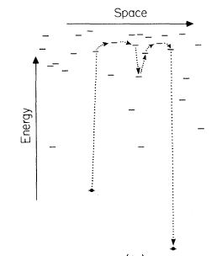
Think Ensemble
ε
Mobile Carriers
Center of Carrier Distribution
Density Of States
Charge Distribution
The Single Carrier Picture
D. Monroe, "Hopping in Exponential Band Tails," Phys. Rev. Lett., vol. 54, pp. 146-149, 1985.

Slide 30
Think Ensemble
ε
Mobile Carriers
Center of Carrier Distribution
1) This is similar to the case of a band with trap states
2) There is an extra energy available for recombination.
Mathematically, the “activation” associated with this energy is already embedded in the charge mobility

Slide 31
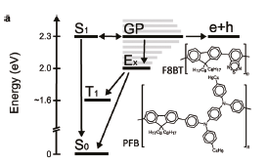

The operation of Solar Cells is all about balancing nergy
Think “high density” or “many charges” NOT “single charge”
There is extra energy embedded in the ensemble
(CT is not necessarily bound!)

Slide 32
The High Density Picture
Mobile and Immobile Carriers
Jumps distribution
Is it a BAND?
E_{F}
σ=3kT
DOS = 10²¹cm⁻³
N=5x10¹⁷cm⁻³=5x10⁻⁴ DOS
Low Electric Field
Mobile Carriers
Transport is carried by high energy carriers

Slide 33
Summary
The Generalized Einstein Relation is rooted in basic thermodynamics
Holds also for hopping systems
Think Ensemble
Energy transport (unify transport with Seebeck effect)
There is “extra” energy in disordered system [0.15 – 0.3eV]
Why some systems exhibit Langevin and some not?
Why some exhibit bi-molecular recombination?
Why some exhibit polaron induced exciton quenching
Is this important in/for P3HT:PCBM based solar cells (probably)
Langevin is less physically justified compared to SRH
At the high excitation regime:
Polaron induced exciton annihilation is the bimolecular loss

Slide 34
Thank You
Ministry of Science, Tashtiyot program
Helmsley project on Alternative Energy of the Technion, Israel Institute of Technology, and the Weizmann Institute of Science
Israeli Nanothecnology Focal Technology Area on "Nanophotonics for Detection"

Slide 36
Original Motivation
Measure Diodes I-V
Extract the ideality factor
Y. Vaynzof et. al. JAP, vol. 106, p. 6, Oct 2009.
The ideality factor
Is the Generalized Einstein Relation
The Generalized Einstein Relation is NOT valid for
organic semiconductors
G. A. H. Wetzelaer, et. al., "Validity of the Einstein Relation in Disordered Organic Semiconductors," PRL, 107, p. 066605, 2011.

Slide 37
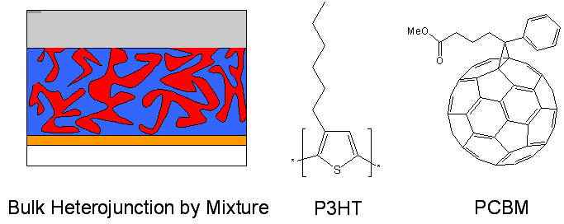
How do they work?
Donor
Acceptor
P3HT
PCBM
Immediately after illumination
LUMO of PCBM
HOMO of P3HT

Slide 38
How do they work?
Donor
Acceptor
P3HT
PCBM
LUMO of PCBM
HOMO of P3HT

