Slide 1
Venus: Verification for Untrusted Cloud Storage
Alex Shraer
Christian Cachin Idit Keidar, Asaf Cidon, Yan Michalevsky, Dani Shaket
IBM Research Zurch Technion, Israel
1
Notes:
1
1

Slide 2







The benefits of cloud computing
Clients
Cloud provider
The cloud enables clients to:
  Obtain resources on demand
  Pay only for what they actually use
  Benefit from economies of scale
Cloud storage
  Outsource the storage
  Replace or combine with in-house storage

Slide 3

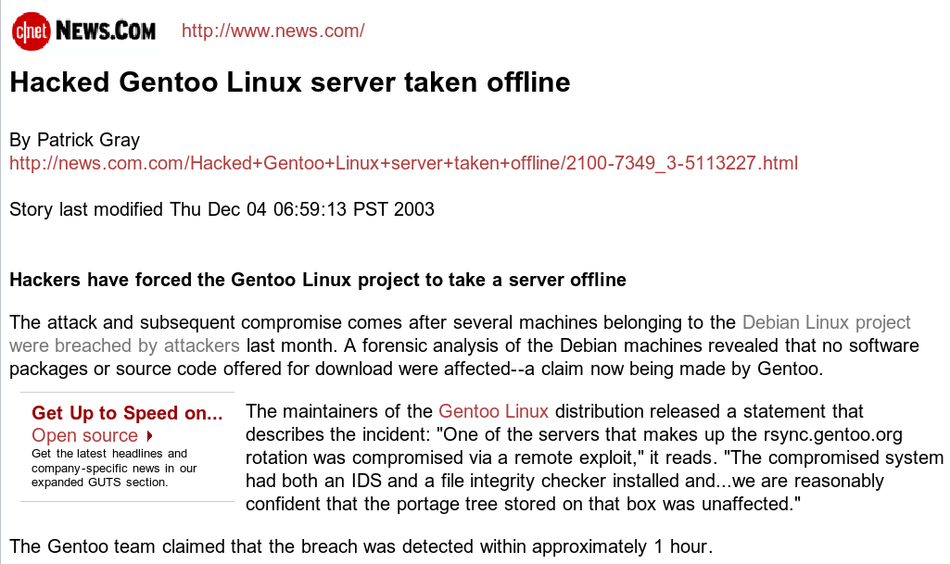

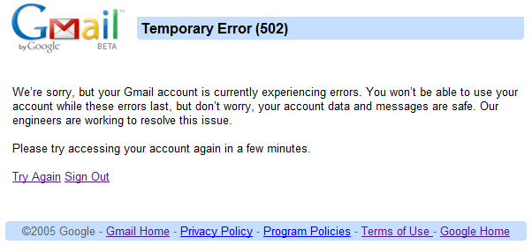
But can we trust the cloud?
Software bugs, hardware malfunction, network partition, misconfiguration, hacker attack, provider outsources to save money, ....
More in [Cachin, Keidar, Shraer, SIGACT News 09]
“Early on the West-coast morning of Friday, January 31st (2009), Ma.gnolia experienced every web service’s worst nightmare: data corruption and loss. For Ma.gnolia, this means that the service is offline and members’ bookmarks are unavailable, both through the website itself and the API. As I evaluate recovery options, I can’t provide a certain timeline or prognosis as to to when or to what degree Ma.gnolia or your bookmarks will return; only that this process will take days, not hours.”
Amazon S3, 2008, silent data corruption:
“We’ve isolated this issue to a single load balancer …
under load, it was corrupting single bytes in the byte stream...”

Slide 4


Our Goal
Guarantee integrity and consistency to users of remote storage
even when the storage is faulty
and detect failures

Slide 5
Consistency
Semantics guaranteed when accessing shared data
Some applications require strong consistency
  Credit/medical records, meta-data for a distributed file system
  Updates should be immediately visible to readers
    enforce a credit limit, change patient’s treatment, revoke user access
For others, weaker semantics might be good enough
  Collaborative document editing
    wiki, Google docs, MS Sharepoint, version control
  Clear semantics are necessary for programmers/users

Slide 6

Can we guarantee strong consistency?
Impossible to guarantee atomicity (linearizability)
  Unless clients communicate directly before ending each operation…
  Also impossible: sequential-consistency [Cachin, Shelat, Shraer, PODC 07]
What can be guaranteed ??
ACK
X = ┴
write (X, 7)
X
X
7
┴
┴
read (X)

Slide 7
“Fork” linearizability
Faulty server may present different views to clients
  “Fork” their views of the history
  Each branch looks linearizable
Views are forked ever after (no "Joins")
  can be detected using client-to-client messages
Different flavors and implementations
  [Mazières & Shasha PODC 02] [Li et al., OSDI04] [Li & Mazières, NSDI 2007] [Oprea & Reiter, DISC 2006] [Cachin, Shelat, Shraer, PODC 07]
start (X= ⊥)
write(X, 7)
read(X) → ⊥
read(X) → 7
read(X) → ⊥

Slide 8

Usual flow of “forking” algorithms
SUBMIT read/write operation
REPLY: operation context
(op1, op2, … were scheduled before you)
[For read operation also:
value, signed context of corresponding write]
Client
COMMIT op (signed context)
Server
“Joins”, and how to prevent them
My context is: start
(I am the first operation)
C₂ is forked from C₁
A Join – not allowed with fork linearizability
write(X, 7)
C₁
C1
read(X) → ⊥
read(X) → 7
C₂
Something is wrong!
My context is: start
(I am the first operation)

Slide 9
Problems with “forking”
  Blocking
    We proved: all previously defined “forking” conditions hamper system availability when the storage is correct
Too complicated
  Too different from conventional consistency / memory models
Remote storage must execute the “forking” protocol
  Can’t use with commodity cloud storage

Slide 10
Venus Design Principles
  Defenses should not affect normal case
  Never block clients when the storage is correct
Simple, meaningful semantics
  Eventual consistency
  Fail awareness – clients learn of every consistency/integrity violation
    post-attack method
    checks if server behaved correctly (application specific)
    doesn’t require trusted hardware / synchrony
Deploy on standard cloud storage

Slide 11
Eventual Consistency
First used in Bayou (SOSP 95)
  Today in commercial systems, e.g., Amazon’s Dynamo (SOSP 07)
Client operations complete optimistically
Client notified when its operation is known to be consistent
  But may invoke other operations without waiting for these notifications
Resembles Futures, Promises, etc.
  Future<T>: result of an asynchronous computation
  Concept exists since late 70s
  java.util.concurrent.Future in Java, Parallel Extensions library for C#, Sub::Future in Perl, pythonfutures for Python, etc.
Notes:
11

Slide 12

Venus Architecture
May be hosted and distributed
Verifier
Verifier
May crash, or temporarily disconnect
Commodity Storage Service
May disconnect, but majority don’t crash
Using e.g., email
When joining or suspecting failure
client-side
library
core set

Slide 13
Venus Semantics
When storage is correct, operations are wait-free
An operation is Yellow when it completes
  Guarantee: integrity and weak (causal) consistency
It later becomes Green
  Implies that all preceding ops of this client are also Green
  Guarantee: all clients observe Green operations in the same order
  (two conflicting operations cannot both become Green)
Every Yellow operation eventually becomes Green,
or failure is detected
Notes:
13

Slide 14
Venus Basics
Clients read/write data directly from storage
Separately store meta-data on verifier
  Optimistically parallelized with storing the data
  Meta-data: pointer to storage, hash, and context info
Operation becomes yellow when it completes
  If integrity/causality violated, operation doesn’t complete, failure notification is issued
Operation becomes green when enough
context info is collected
  Periodically retrieve context info from verifier
  If no new info for long enough, contact a core client directly
Did core set clients observe my op as I did ?
Notes:
14

Slide 15
Venus Implementation & Evaluation
Amazon S3 used as the storage service
Location of verifier:
  same LAN as clients @ Technion
  over WAN connection, on a public computer @ MIT
Clients join with id = email address
  Clients (rarely) send automated emails to each other (SMTP & IMAP)
  Supports offline clients, clients behind firewalls, etc.
GnuPG was used for authentication
Tested using micro-benchmarks & simulated attacks
Notes:
15
Since S3 is sloooow, this is insignificant
Attestation vs. Fail-Awareness
Attestation: Is the server in a correct state?
Fail-Awareness: Does the server behave correctly?
Application specific
Fail-Awareness possible without synchrony or trusted hardware

Slide 16
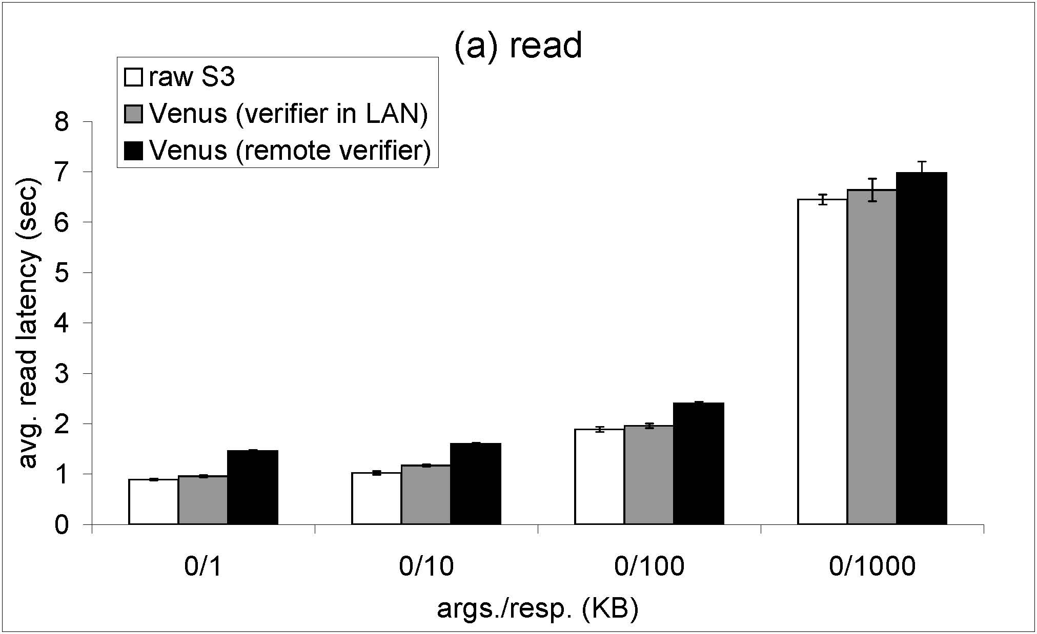
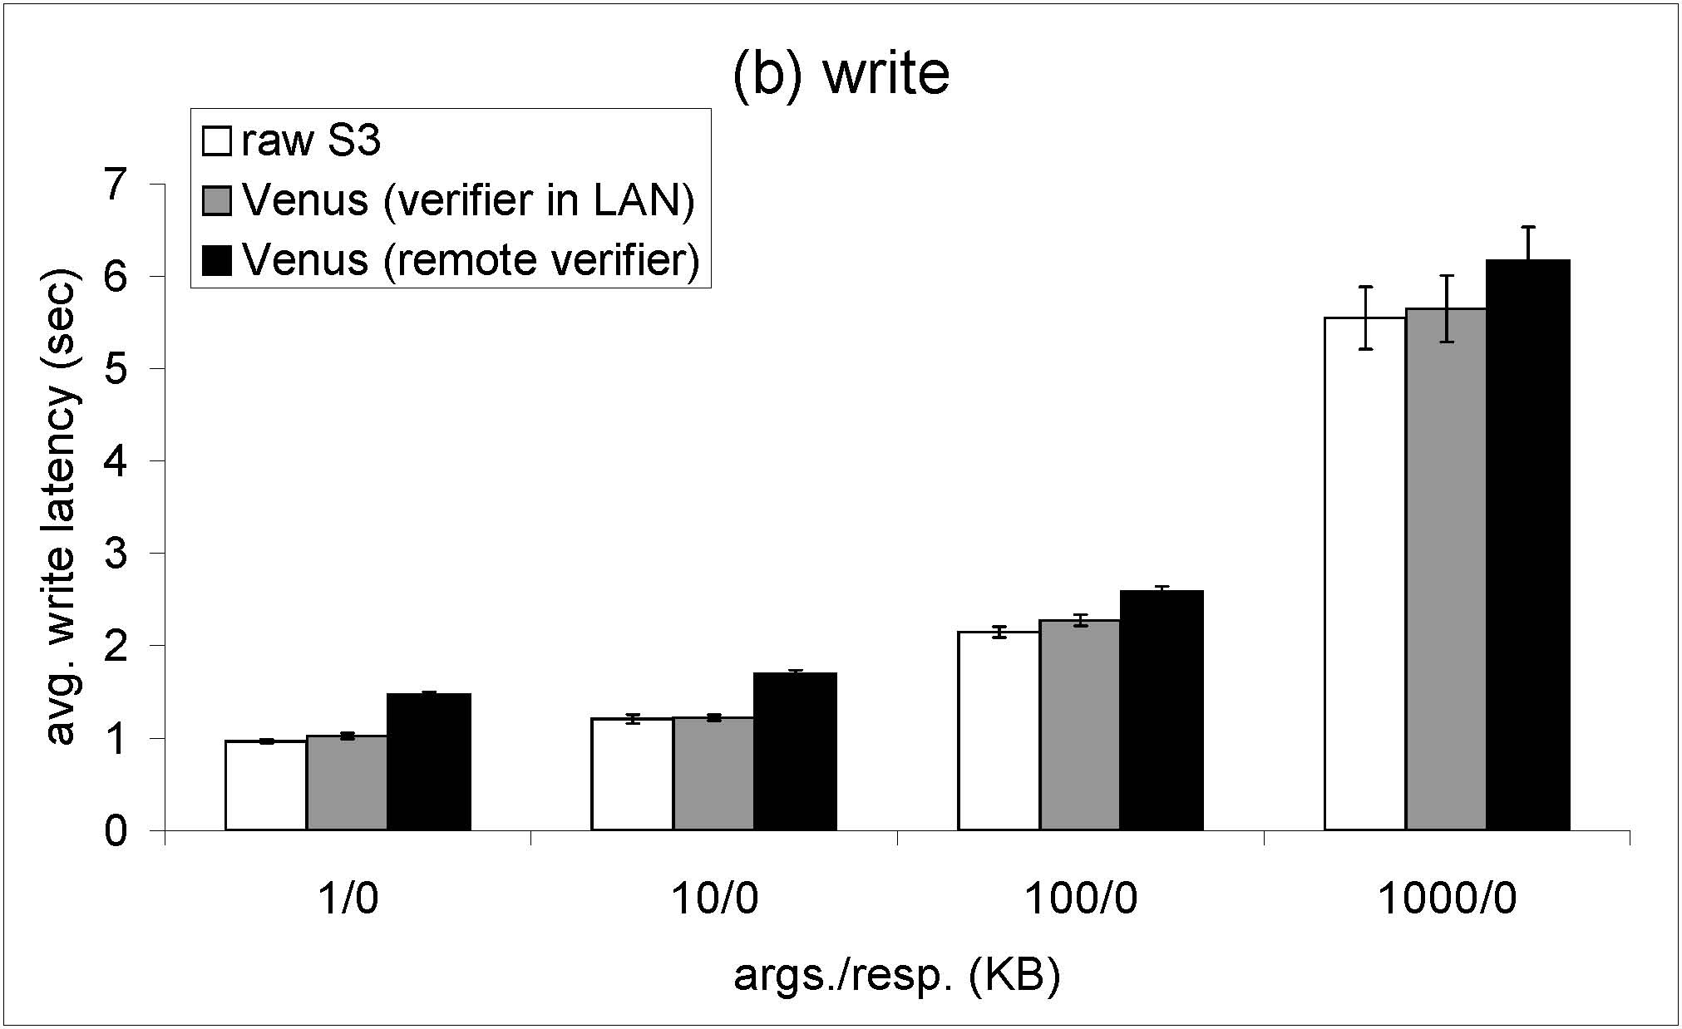
Venus Compared to “raw” S3
Notes:
16

Slide 17
Conclusions
Venus offers simple yellow/green semantics
  Augments storage read/write interface with green&failure notifications
  Eventual consistency + Fail-Awareness
Provides consistency & integrity, even when storage is faulty
No additional trusted components
Normal flow unaffected: client ops complete independently
Works with unmodified cloud storage, evaluated with S3

Slide 18

Questions?

