Slide 1
SALSA: Scalable and Low-synchronization NUMA-aware Algorithm for Producer-Consumer Pools
Elad Gidron, Idit Keidar,
Dmitri Perelman, Yonathan Perez

Slide 2
New Architectures – New Software Development Challenges
Increasing number of computing elements
Need scalability
Memory latency more pronounced
Need cache-friendliness
Asymmetric memory access in NUMA multi-CPU
Need local memory accesses for reduced contention
Large systems less predictable
Need robustness to unexpected thread stalls, load fluctuations
Notes:
Explain NUMA – important because of bandwidth rather then latency

Slide 3
Producer-Consumer Task Pools
Put(Task)
Get()
Task Pool
Producers
Consumers
Ubiquitous programming pattern for parallel programs

Slide 4
Typical Implementations I/II
FIFO queue
Producers
Consumers
Tn
..
T2
T1
Inherently not scalable due to contention
FIFO is about task retrieval, not execution
Get (T1)
Exec(T1)
Consumer 1
Get (T2)
Exec(T2)
Consumer 2

Slide 5
Typical Implementations II/II
Multiple queues with work-stealing
Producers
Consumers
Consumers always pay overhead of synchronization with potential stealers
Load balancing not trivial

Slide 6
And Now, to Our Approach
Single-consumer pools as building block
Framework for multiple pools with stealing
SALSA – novel single-consumer pool
Evaluation

Slide 7
Building Block: Single Consumer Pool
Produce()
Consume()
Producers
SCPool
Owner
Steal()
Other consumers
Possible implementations:
FIFO queues
SALSA (coming soon)

Slide 8
System Overview
Produce()
Consume()
SCPool
Consumers
Producers
SCPool
Steal()
SCPool

Slide 9
Our Management Policy
NUMA-aware
Producers and consumers are paired
Producer tries to insert to closest SCPool
Consumer tries to steal from closest SCPool
CPU1
CPU2
Memory 1
Memory 2
interconnect
SCPool 1
cons 1
prod 1
prod 3
cons 3
SCPool 3
SCPool 2
cons 2
prod 2
prod 4
cons 4
SCPool 4
Prod 2 access list:
cons2, cons1, cons3, cons4
Cons 4 access list :
cons3, cons1, cons2

Slide 10
SCPool Implementation Goals
Goal 1: “Fast path”
Use synchronization, atomic operations only when stealing
Goal 2: Minimize stealing
Goal 3: Locality
Cache friendliness, low contention
Goal 4: Load balancing
Robustness to stalls, load fluctuations

Slide 11
SALSA – Scalable and Low Synchronization Algorithm
SCPool implementation
Synchronization-free when no stealing occurs
Low contention
Tasks held in page-size chunks
Cache-friendly
Consumers steal entire chunks of tasks
Reduces number of steals
Producer-based load-balancing
Robust to stalls, load fluctuations

Slide 12
SALSA Overview
prod₀
idx=4
idx=2
idx=-1
owner=c1
owner=c1
. . .
idx=0
0
TAKEN
0
task
chunkLists
1
TAKEN
1
task
2
TAKEN
2
┴
owner=c1
3
3
0
TAKEN
task
┴
Prod_{n-1}
4
task
4
┴
1
task
steal
2
task
3
┴
Chunk owned by one consumer – the only one taking tasks from it
4
┴
Tasks kept in chunks, organized in per-producer chunk lists
Notes:
no contention among producers
if another process wants to take a task from the chunk, it should first steal it.

Slide 13
SALSA Fast Path (No Stealing)
Producer:
Put new value
Increment local index
Consumer:
Increment idx
Verify ownership
Change chunk entry to TAKEN
No strong atomic operations
Cache-friendly
Extremely lightweight
idx=0
idx=1
owner=c1
0
TAKEN
Task
1
TAKEN
2
Task
prod local index
3
Task
┴
4
┴

Slide 14
Chunk Stealing
Steal a chunk of tasks
Reduces the number of steal operations
Stealing consumer changes the owner field
When a consumer sees its chunk has been stolen
Takes one task using CAS,
Leaves the chunk

Slide 15
Stealing
Stealing is complicated
Data races
Liveness issues
Fast-path means no memory fences
See details in paper

Slide 16
Chunk Pools & Load Balancing
Chunks stolen
Producers avoid inserting tasks
Slow
Consumer
Small
chunk pool
Automatic load balancing
Where do chunks come from?
Pool of free chunks per consumer
Stolen chunks move to stealers
If a consumer's pool is empty, producers go elsewhere
Same for slow consumers
Chunk stealing
Producers can insert tasks
Fast
consumer
Large
chunk pool
Automatic load balancing

Slide 17
Getting It Right
Liveness: we ensure that operations are lock-free
Ensure progress whenever operations fail due to steals
Safety: linearizability mandates that Get() return Null only if all pools were simultaneously empty
Tricky

Slide 18
Evaluation - Compared Algorithms
SALSA
SALSA+CAS: every consume operation uses CAS (no fast path optimization)
ConcBag: Concurrent Bags algorithm [Sundell et al. 2011]
Per producer chunk-list, but requires CAS for consume and stealing granularity of a single task.
WS-MSQ: work-stealing based on Michael-Scott queues [M. M. Michael M. L. Scott 1996]
WS-LIFO: work-stealing based on Michael’s LIFO stacks [M. M. Michael 2004]
Notes:
MSQ not here, because not scalable at all
Setup.

Slide 19
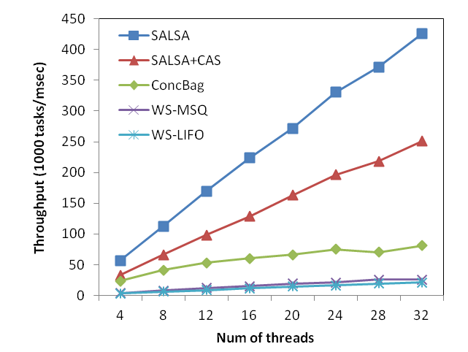
System Throughput
Balanced workload
N producers/N consumers
linearly scalable
x5 faster than state-of-the-art concurrent bags
Throughput
x20 faster than WS with MSQ

Slide 20
Highly Contended Workloads: 1 Producer, N Consumers
Effective load balancing
Throughput
CAS per task retrieval
Other algorithms suffer throughput degradation
High contention among stealers

Slide 21
Producer-Based Balancing in Highly Contended Workload
50% faster with balancing
Throughput

Slide 22
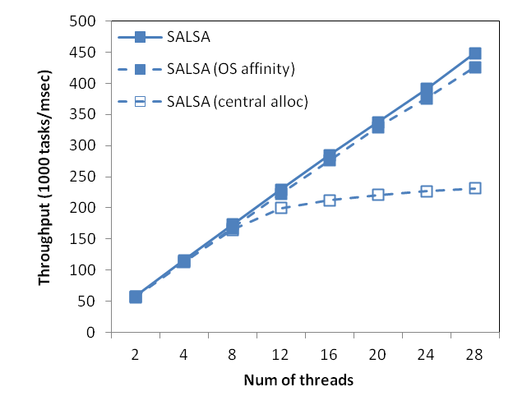
NUMA effects
affinity hardly matters as long as you’re cache effective
Throughput
memory allocations should be decentralized
Performance degradation is small as long as the interconnect / memory controller is not saturated

Slide 23
Conclusions
Techniques for improving performance:
Lightweight, synchronization-free fast path
NUMA-aware memory management (most data accesses are inside NUMA nodes)
Chunk-based stealing amortizes stealing costs
Elegant load-balancing using per-consumer chunk pools
Great performance
Linear scalability
x20 faster than other work stealing techniques, x5 faster than state-of-the art non-FIFO pools
Highly robust to imbalances and unexpected thread stalls

Slide 24
Backup

Slide 25
Chunk size
The optimal chunk size for SALSA is 1000.
This is about the size of a page.
This may allow to migrate chunks from one node to another when stealing.

Slide 26
Chunk Stealing - Overview
Point to the chunk from the special “steal list”
Update the ownership via CAS
Remove the chunk from the original list
CAS the entry at idx + 1 from Task to TAKEN
Consumer c1
Consumer c2
prod0
idx=1
prod0
idx=1
prod1
prod1
owner=c1
steal
owner=c2
steal
owner=c2
TAKEN
TAKEN
TAKEN
TAKEN
TAKEN
TAKEN
task
task
task
┴
┴

Slide 27
Chunk Stealing – Case 1
Original consumer (c1)
idx++
Verify ownership
If still the owner, then take task at idx without a CAS
Otherwise take task at idx with a CAS and leave chunk
Stealing consumer (c2)
Change ownership with CAS
i ← original idx
Take task at i+1 with CAS
idx=1
idx=0
Take task 1
i=1
owner=c1
owner=c2
TAKEN
Take task 2
Task
Task
┴
┴
Notes:
This shows why CAS must be used for both consumers

Slide 28
Chunk Stealing – Case 2
Original consumer (c1)
idx++
Verify ownership
If still the owner, then take task at idx without a CAS
Otherwise take task at idx with a CAS and leave chunk
Stealing consumer (c2)
Change ownership with CAS
i ← original idx
Take task at i+1 with CAS
idx=1
idx=0
Take task 1
i=0
owner=c1
owner=c2
TAKEN
Take task 1
Task
Task
┴
┴
Notes:
This shows why CAS must be used for both consumers

Slide 29
Chunk Lists
The lists are managed by the producers, empty nodes are lazily removed
When a producer fills a chunk, it takes a new chunk from the chunk pool and adds it to the list
List nodes are not stolen, so the idx is updated by the owner only
Chunks must be stolen from the owner’s list, to make sure the correct idx field is read
prod₀
idx=4
idx=2
idx=-1
owner=c1
owner=c1
0
TAKEN
0
task
1
TAKEN
1
task
2
TAKEN
2
┴
3
task
3
┴
4
task
4
┴

Slide 30
NUMA – Non Uniform Memory Access
Systems with large number of processors may have high contention on the memory bus.
In NUMA systems, every processor has its own memory controller connected to a memory bank.
Accessing remote memory is more expensive.
CPU1
CPU2
Interconnect
Memory
Memory
CPU3
CPU4
Memory
Memory

