Slide 1


Distributed Data Classification in Sensor Networks
DE: Verteilte Daten-Klassifikation in Sensor-Netzwerken
FR: Classification distribuée de données dans des réseaux de capteurs
IT: Classificazione distribuita di dati nelle reti del sensore
Ittay Eyal, Idit Keidar, Raphi Rom
Technion, Israel
PoDC, Zurich, July 2010

Slide 2
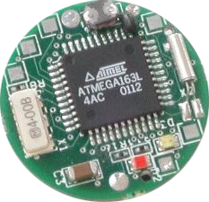

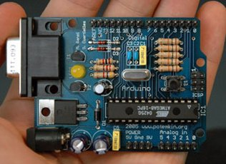

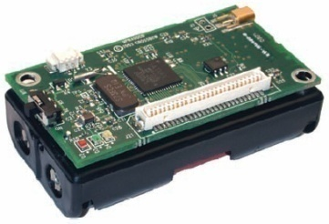
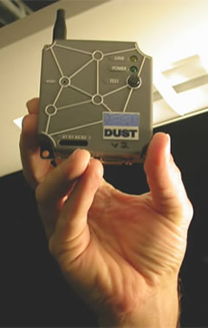


Sensor Networks Today
2
Temperature, humidity, seismic activity etc.
Data collection and analysis is easy – small (10s of motes) networks.
Notes:
לא לדבר על התמונות

Slide 3
Sensor Networks Tomorrow
3
Scale out
Thousands of lightweight sensors (e.g. fire detection)
Lots of data to be analyzed (too much for motes)
Centralized solution is not feasible.
And also:
Wide area, limited battery → non-trivial topology
Failures

Slide 4
The Goal
4
Model:
A large number of sensors
Connected topology
Problem:
Each sensor takes a sample
All learn the same classification of all sampled data

Slide 5
Classification
5
Classification:
Partition
Summarization
Classification Algorithm: Finds an optimal classification
(Centralized solutions e.g. k-means, EM: Iterations)
Example – k-means:
Minimize the sum of distances between samples
and the average of their component
R. O. Duda, P. E. Hart, and D. G. Stork. Pattern Classiﬁcation. Wiley-Interscience, 2nd edition, 2000.

Slide 6
The Distributed Challenge
6
-5º
-4º
-6º
120º
-11º
98º
-12º
-10º
Each should learn: Two components, averages 109 and -8.
D. Kempe, A. Dobra, and J. Gehrke. Gossip-based computation of aggregate information. In FOCS, 2003.
Nath,Gibbons,Seshan,Anderson. Synopsis diffusion for robust aggregation in sensor networks. SenSys‘04.
S. Datta, C. Giannella, and H. Kargupta. K-means clustering over a large, dynamic network. In SDM, 2006.
W. Kowalczyk and N. A. Vlassis. Newscast EM. In NIPS, 2004.

Slide 7
Our Contributions
7
Generic distributed classification algorithm
  Multidimensional information
    E.g., temperature, humidity, location
  Any classification representation & strategy
    E.g., k-means, GM/EM
Convergence proof of this algorithm
  All nodes learn the same classification

Slide 8
The Algorithm – K-means example
8
Each node maintains a classification - a weighted set of averages
Gossip – fast propagation, low bandwidth
Closest averages get merged

Slide 9
The Algorithm – K-means example
9
Original samples
-12
-11
-10
-6
-5
-4
98
120
Classification 1
-12
-11
-10
-6
-5
-4
109
Classification 2
-8
109
Notes:
להגיד: בין שתי הקומות התחתונות אפשר להתייחס למעבר כ-merge

Slide 10
The Algorithm – K-means example
10
Initially: Classification based on input
1
5
5
Occasionally, communicate and smart merge (limit k)
a
Before
During
After
b
Notes:
להסביר באופן יסודי. זה שקף חשוב.
שימור מסה, k קבוע, החלטת איחוד על בסיס מרחק
להגיד: מעט מידע, עומד במגבלות רוחב הפס.

Slide 11
But what does the mean mean?
11
Gaussian B
Gaussian A
New Sample
Mean A
Mean B
The variance must be taken into account

Slide 12
The Algorithm – GM/EM example
12
a
Merge (EM)
b

Slide 13
The Generic Algorithm
13
Classification is a weighted set of summaries
Asynchronous, any topology, any gossip variant
Merge rule – application dependent
Summaries and merges respect axioms (see paper)
Connected topology, weakly fair gossip
Quantization – no infinitesimal weight
Notes:
במלים: מגדירים מרחב גיאומטרי עליו ממוקמות התמציות, משתמשים בטריגו וחדו"א כדי להראות איך התמציות מתכנסות, ובכלים ממערכות מבוזרות כדי להראות איך כולם לומדים בסופו של דבר אותה קלאסיפיקציה

Slide 14
Convergence?
14
Challenge:
Non-deterministic distributed algorithm
Asynchronous gossip among arbitrary pairs
Application-defined merges
  Different nodes can have different rules
Proof:
In R^{n} space
Some trigo
Some calculus
Some distributed systems
Notes:
במלים: מגדירים מרחב גיאומטרי עליו ממוקמות התמציות, משתמשים בטריגו וחדו"א כדי להראות איך התמציות מתכנסות, ובכלים ממערכות מבוזרות כדי להראות איך כולם לומדים בסופו של דבר אותה קלאסיפיקציה

Slide 15
Summary
15
Distributed classification algorithm for sensor networks
  Generic
    Summary representation
    Classification strategy
    Asynchronous and any connected topology
  Implementations
    K-means
    Gaussian mixture
Convergence proof – for the generic algorithm:
All nodes reach a classification of the sampled values.
Ittay Eyal, Idit Keidar, Raphael Rom. Distributed Data Classification in Sensor Networks, PoDC 2010.

Slide 16
Convergence Proof
16
System-wide collection pool
Collection genealogy:
  Collections are the descendants of the collections they were formed by.
  Samples’ mass is mixed on every merge, and split on every split operation.
Mixture space:
  A dimension for every sample.
  Each collection is a vector.
Vectors (i.e. collections) are eventually be partitioned.

Slide 17
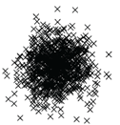

It works where it matters
17
Not Interesting
Easy
Notes:
להסביר את מקור הנתונים (synthetic)

Slide 18
It works where it matters
18
No outlier detection
Error
With outlier detection
Error
Notes:
hotDepSimBimodalHits01.m

