Slide 1
Oak:
a Scalable Off-Heap Allocated Key-Value Map
Hagar Meir, Dmitry Basin, Edward Bortnikov, Anastasia Braginsky, Yonatan Gottesman, Idit Keidar, Eran Meir, Gali Sheffi, Yoav Zuriel
Yahoo Research

Slide 2
OAK (Off-heap Allocated Keys)
Concurrent In-memory Off-heap Key-Value Map for Big Data:
Written in Java, but causes no JVM Garbage Collection (GC) activity
more performance
less memory
☞ Preamble
Motivation
Background
Contribution
Data Organization
https://github.com/yahoo/Oak
Open
Source
Library

Slide 3
Big Data goes Off-Heap
Preamble
☞ Motivation
Background
Contribution
Data Organization

Slide 4
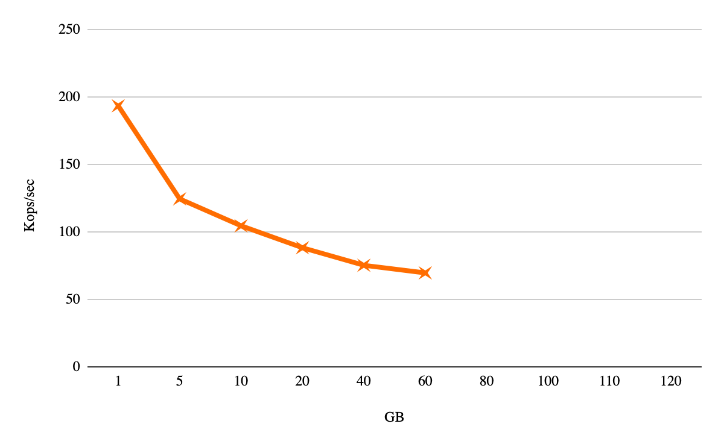
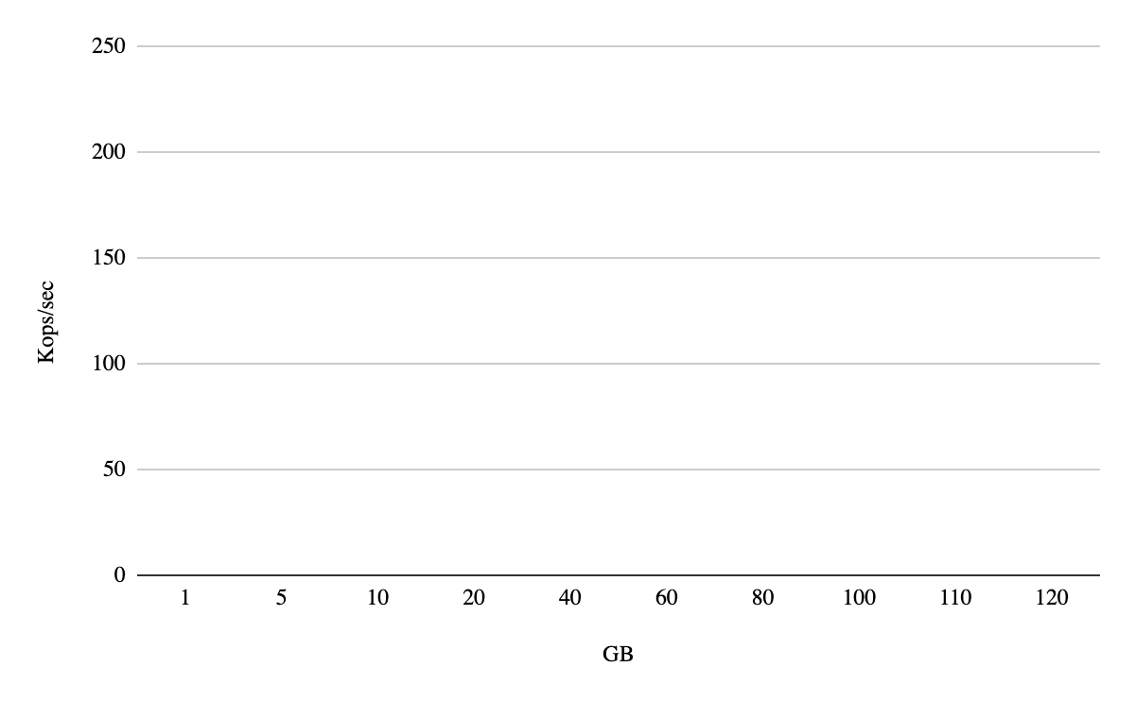
How can you use 128GB RAM?
Preamble
☞ Motivation
Background
Contribution
Data Organization
only 60GB of data, out of 128GB RAM
1 thread, Throughput
Push data (1KB quantas) till OutOfMemory
Java’s ConcurrentSkipListMap (CSLM)
G1 GC

Slide 5
Quickly about Off-Heap Memory
Preamble
Motivation
☞ Background
Contribution
Data Organization
ZeroCopy API
Managed by JVM GC
Not managed by JVM GC
Java Process Address Space
Heap Memory
Off-Heap Memory
DirectByteBuffer
object
DirectByteBuffer bytes

Slide 6
Off-Heap Memory Pros and Challenges
Preamble
Motivation
☞ Background
Contribution
Data Organization
ZeroCopy API
No JVM GC costs
No object headers
Quicker access
How to reuse memory?
Need to (de)serialize
How to access it concurrently?

Slide 7
OAK
Motivation
Background
☞ Contribution
Data Organization
ZeroCopy API
Concurrency
Fast perfor-
mance
⤴
Keys & Values Off-Heap
Lean in
memory
Rethinking ordered map data structure and algorithm, to minimize on-heap and maximize off-heap usage
Off-Heap
New Zero-Copy API
Real
world
deploy
Rethinking ordered map API, to minimize deserialization and give user direct memory access
⤵
⤴
2-way Scan
Zero-Copy
Open
source
library
Fast 2-way Scans
⤵
Concurrency
Rethinking how an ordered map can be traversed backward, without complicating concurrency or using additional memory
⤵
New concurrent algorithm
Rethinking the internal concurrency of a map to suit new challenges, with Formal Proof!
Scales
better

Slide 8
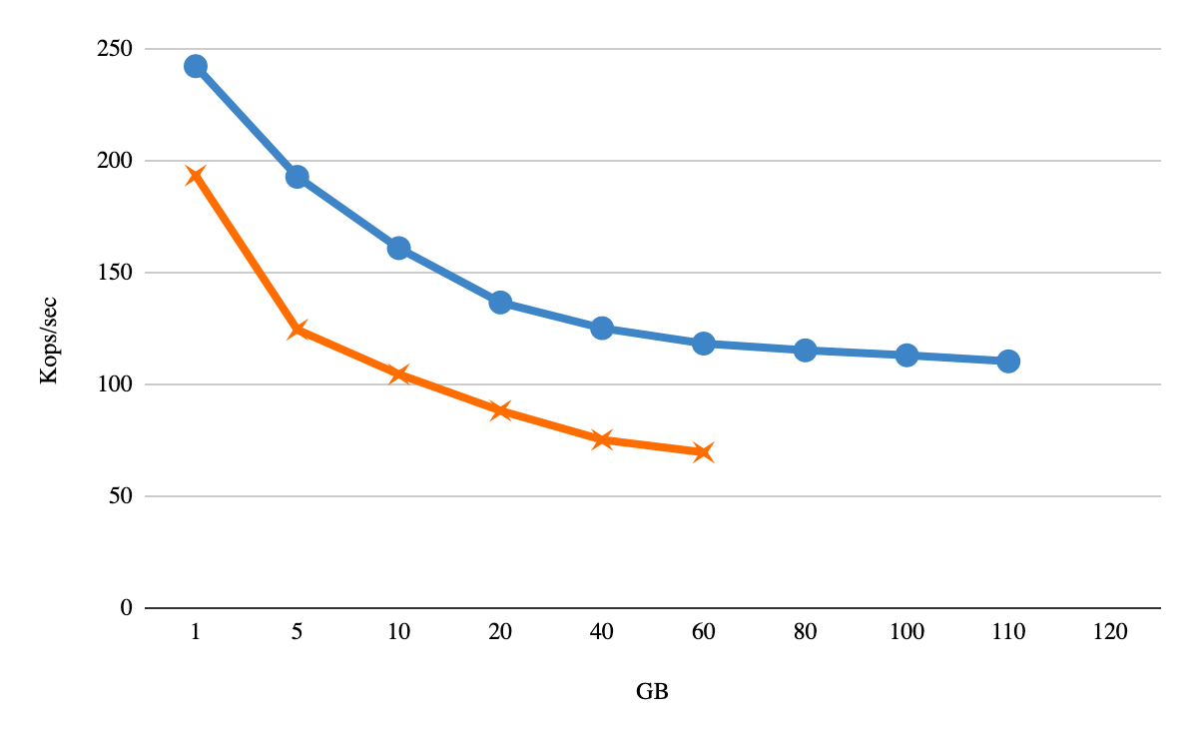
How can you use 128GB RAM?
Preamble
☞ Motivation
Background
Contribution
Data Organization
Oak
Push data till OutOfMemory
Java’s ConcurrentSkipListMap (CSLM)

Slide 9
Big Data Map Design Approach
On
He
ap
Off-Heap Memory
As less metadata as possible.

Slide 10
Big Data Map Design Approach
✓
✗
✗
int
As less metadata as possible.
Java objects and their headers are not efficient. Better primitives array

Slide 11
Big Data Map Design Approach
Maintenance in batches:
preallocate off-heap
manage on-heap in chunks of memory
Big values: write and copy on demand only
Let the user access the raw data, but be on guard
As less metadata as possible.
Java objects and their headers are not efficient. Better primitives array

Slide 12
Oak’s Data Organization
Contribution
☞ Data Organization
ZeroCopy API
Concurrency
Chunks are contiguous, ordered key ranges
Keys are variable size, unique & immutable
Chunk A
Chunk B
entries:
Chunk C
Ordered array
Binary search applied
Ephemeral
On-Heap
Off-Heap

Slide 13
Oak’s Data Organization
Contribution
☞ Data Organization
ZeroCopy API
Concurrency
Index key→ chunk
Chunk A
Chunk B
entries:
Chunk C
OakRBuffer
OakWBuffer
OakRBuffer
Ephemeral
On-Heap
Off-Heap
Off-Heap Memory
Arena:
Key ”A”
Key “C”
H
Value “B”
H
Value “D”
Arena:
Key ”E”
Key “F”
H
Value “G”
synch+delete

Slide 14
Zero-Copy API: OakMap<K,V>
Contribution
Data Organization
☞ ZeroCopy API
Concurrency
ZeroCopyConcurrentNavigableMap (Legacy) ConcurrentNavigableMap
OakRBuffer get(K) V get(K)
Return reference to shared memory
Return either ready object or its copy
Thread 1
Thread 2

Slide 15
Zero-Copy API: OakMap<K,V>
Contribution
Data Organization
☞ ZeroCopy API
Concurrency
ZeroCopyConcurrentNavigableMap (Legacy) ConcurrentNavigableMap
OakRBuffer get(K) V get(K)
Set⟨OakRBuffer⟩ keySet() / keyStreamSet() Set⟨K⟩ keySet()
boolean putIfAbsentComputeIfPresent(K, V, CreateFunction(OakWBuffer), ComputeFunction(OakWBuffer))
Return reference to shared memory
Return either ready object or its copy
Thread 1
Thread 2

Slide 16
Oak Concurrency
ZeroCopy API
☞ Concurrency
Evaluation
Druid (real-world)
Data Structure Internal:
Lock-Free
Separation of concerns!
Index key→ chunk
Chunk A
Chunk B
entries:
Chunk C
OakRBuffer
OakWBuffer
User Level External:
Pluggable, example lock-based
Off-Heap Memory
Key ”A”
Key “C”
Value “B”
Value “D”
Arena:
HEADER
Value “G”
Arena:
Key ”E”

Slide 17
Evaluation
Concurrency
☞ Evaluation
Druid (real-world)
Conclusions
Machine
AWS instance m5d.16xlarge
utilizing 32 cores (with hyper-threading disabled)
on two NUMA nodes
Experiment Parameters
Keys size 100B
Value size 1KB
Limit to 32GB (Inserting 12GB raw data)

Slide 18
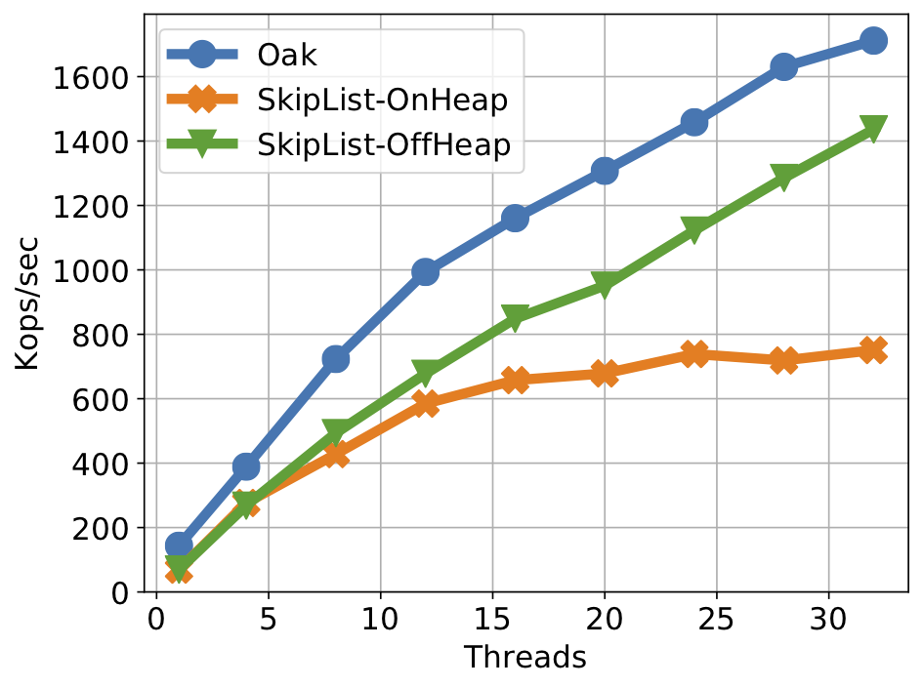
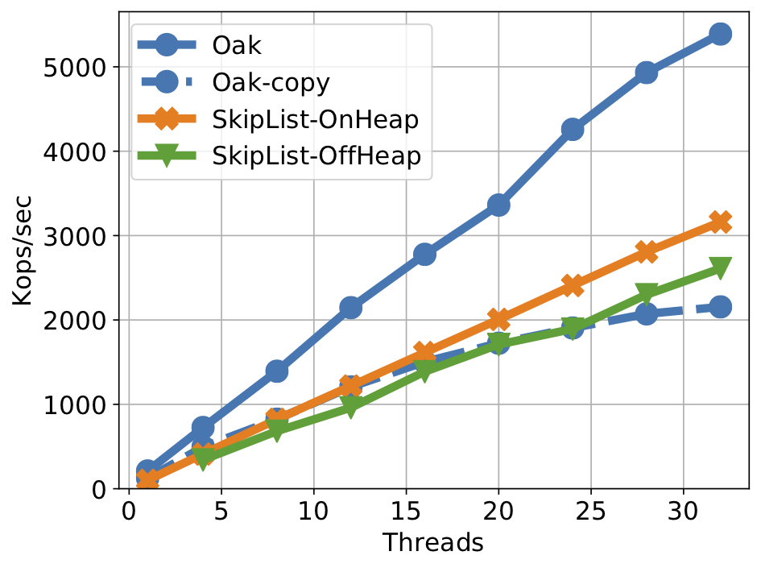
Scaling with Parallelism (11M KV-pairs)
Put
Get

Slide 19
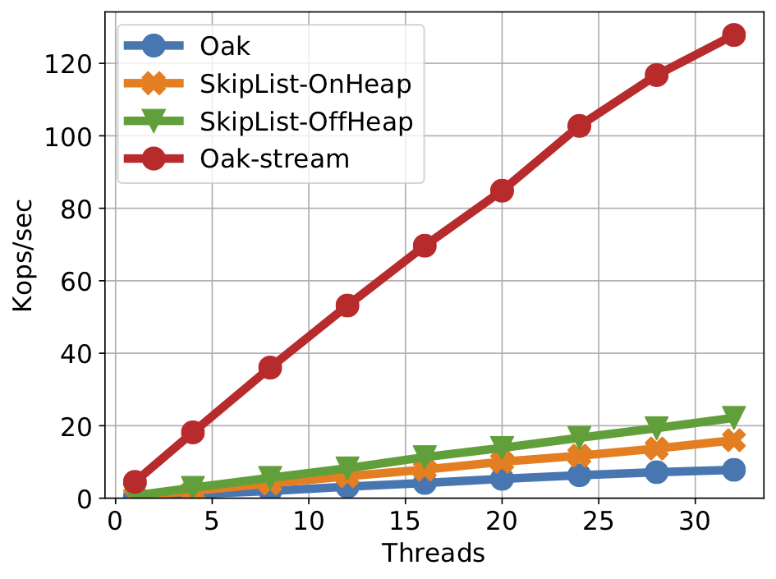
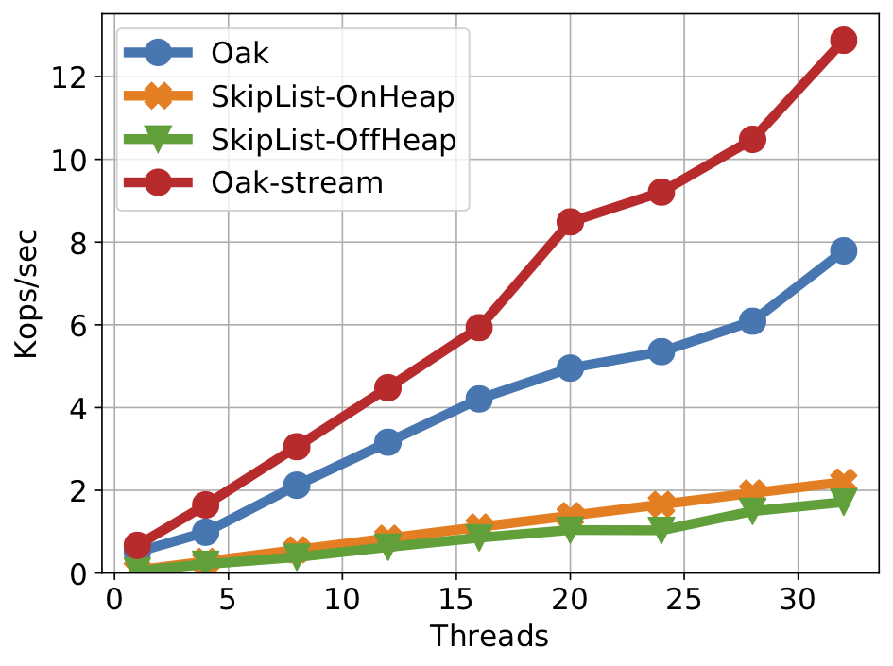
Scaling with Parallelism (11M KV-pairs)
Ascending scan , 10K pairs/scan
Descending scan, 10K pairs/scan

Slide 20
OAK
✓
Motivation
Background
☞ Contribution
Data Organization
ZeroCopy API
Concurrency
Fast perfor-
mance
⤴
Keys & Values Off-Heap
Lean in
memory
Rethinking ordered map data structure and algorithm, to minimize on-heap and maximize off-heap usage
Off-Heap
New Zero-Copy API
Real
world
deploy
Rethinking ordered map API, to minimize deserialization and give user direct memory access
⤵
⤴
2-way Scan
Zero-Copy
Open
source
library
Fast 2-way Scans
⤵
Concurrency
Rethinking how an ordered map can be traversed backward, without complicating concurrency or using additional memory
⤵
New concurrent algorithm
✓
Rethinking the internal concurrency of a map to suit new challenges, with Formal Proof!
Scales
better

Slide 21
Oak in Apache Druid
Re-implement Druid’s centerpiece Incremental Index (I²) component around Oak
OakIncrementalIndex
Decreasing memory consumption
Faster Ingestions
a popular open-source real-time analytics database

Slide 22
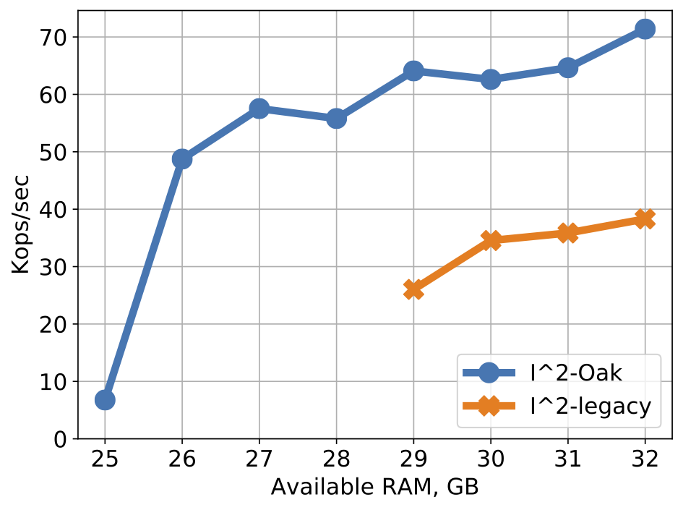
Druid Ingestion - Scaling with RAM
Ingesting 7M tuples
Tuple size 1.25KB
RAM scaling 25GB to 32GB

Slide 23
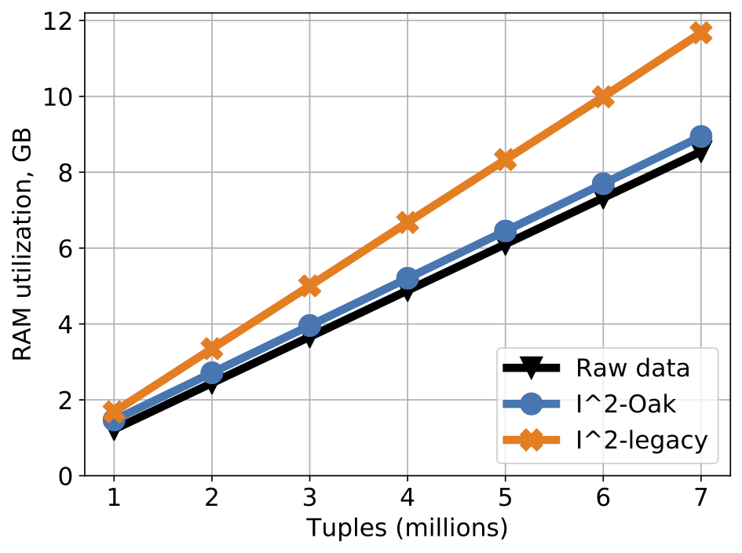
Druid Ingestion - RAM overhead

Slide 24
OAK
✓
Motivation
Background
☞ Contribution
Data Organization
ZeroCopy API
Concurrency
Fast perfor-
mance
⤴
Keys & Values Off-Heap
✓
Lean in
memory
✓
Rethinking ordered map data structure and algorithm, to minimize on-heap and maximize off-heap usage
Off-Heap
New Zero-Copy API
Real
world
deploy
Rethinking ordered map API, to minimize deserialization and give user direct memory access
⤵
⤴
2-way Scan
Zero-Copy
Open
source
library
Fast 2-way Scans
⤵
✓
Concurrency
Rethinking how an ordered map can be traversed backward, without complicating concurrency or using additional memory
⤵
New concurrent algorithm
✓
Rethinking the internal concurrency of a map to suit new challenges, with Formal Proof!
Scales
better

Slide 25
Oak: a concurrent ordered KV-map with...
Questions?
anastas@verizonmedia.com
Concurrency
Evaluation
Druid (real-world)
☞ Conclusions
First off-heap managed memory data structure
off-heap data vs on-heap metadata
managed programming experience
Novel Zero-Copy API
minimize deserialization
Novel Concurrent Algorithm
conditional and unconditional update-in-place
fast 2-ways scans
Fast && Lean compared to CSLM
2.5% metadata
up to x2 faster than CSLM
Real world application
Druid
Open Source Library: https://github.com/yahoo/Oak
Fast perfor-
mance
⤴
Real
world
deploy
Lean in
memory
⤴
Off-Heap
⤵
2-way Scan
Zero-Copy
⤵
Concurrency
Scales
better
Open
source
library
⤵

Slide 26
Thank you!

