Slide 1
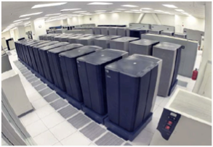
Distributed Storage
Fundamentals
Idit Keidar, Technion

Slide 2









Where Are Your Files?

Slide 3
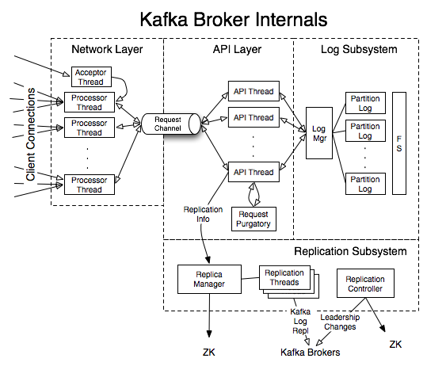

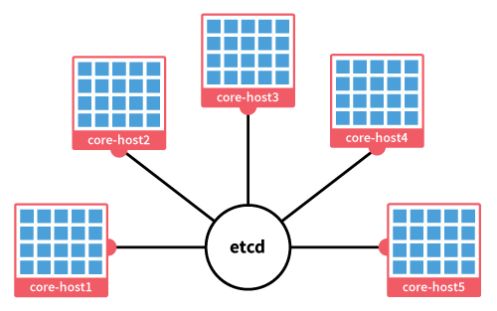
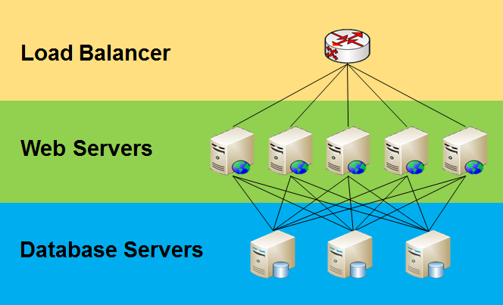
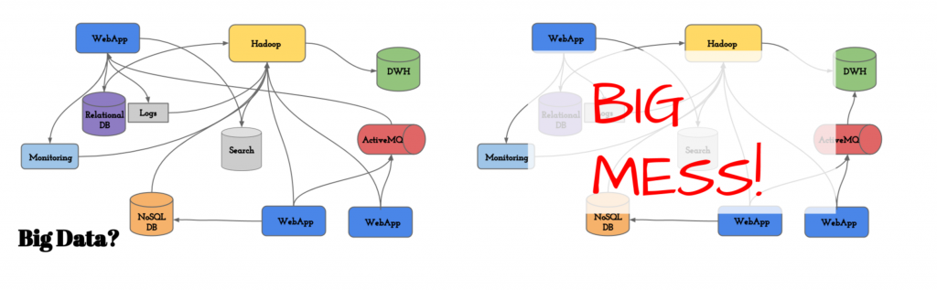
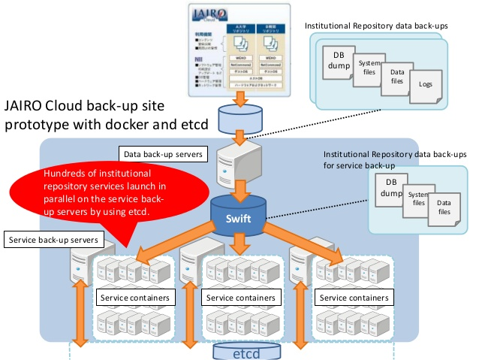
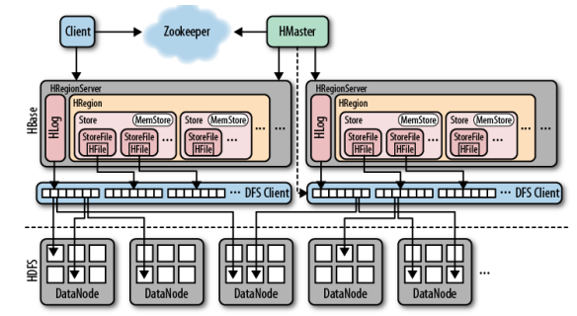
Where’s your data?

Slide 4
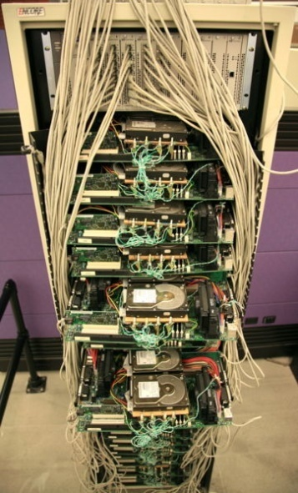
Distributed Storage
Scales
Cost-effective: can even be made up of many cheap, low-reliability
storage nodes
Provides reliability via redundancy
Google’s 1st server
Notes:
Cloud can complement in-house

Slide 5
Failures Happen
Nodes (storage/compute) crash
  Sometimes recover
Processes are unresponsive (asynchronous)
  E.g., due to GC stalls
Networks delay/drop messages (async., lossy)
  Buffer overflows, config errors, bad NICs
Networks go down for periods
  Routing loops, router failures, net maintenance

Slide 6
Anecdotal Evidence
Microsoft: 40.8 link failures/day
  5 min to one week long
  Path redundancy reduces loss by 43%
Google: in cluster’s 1st year
  5 racks see 50% packet loss
  8 net maintenance/year, 30 min loss in 4
  3 router failures/year
Companies report partition post-mortems
  Netflix, Github, AWS, ….
  Resulted in split brain

Slide 7
Asynchrony
Unresponsive node indistinguishable from crashed one
  Timeout without making sure it’s dead
Delays indistinguishable from drops
Perfect failure detection impossible
  “false suspicions” inevitable

Slide 8

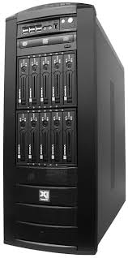
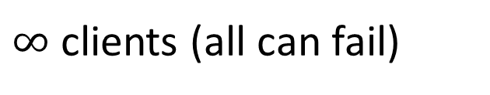
Fault-Tolerant Distributed Storage Model
$∞$clients (all can fail)
f can fail (crash)
asynchronous
n servers

Slide 9

Fault-Tolerance 101
Replication
  Multiple copies (e.g., 3) of each data item
  Copies on distinct storage nodes
Disaster recovery
  Copies geographically dispersed

Slide 10
Emulating Shared Memory
Can we provide the illusion of reliable atomic shared-memory in a message-passing system?
In an asynchronous system?
Where clients and servers can fail?

Slide 11
Shared Memory Emulation
Clients (processes)
Object’s API
Reliable emulation
f < n can crash
n servers
Notes:
Suppose you have

Slide 12
Simple Read/Write Emulation
Clients (processes)
Read/Write
Reliable register emulation
f < n can crash
n servers
Notes:
Suppose you have

Slide 13
Register
Holds a value
Can be read
Can be written
Interface:
  int read(); // returns last written value
  void write(int v); // returns ack

Slide 14
Atomic (Linearizable) Register
Each API call should –
  “Take effect”
    Effect defined by the sequential specification
  Instantaneously
    Take 0 time
  Between its invocation and response
    Real-time order
    A pending call (invocation and no response) can either occur after its invocation or not at all

Slide 15
Example 1
linearizable
write(0)
write(1)
read(0)
write(1)
time
time

Slide 16
Example 2
write(0)
read(1)
write(1)
read(0)
write(1)
time
time

Slide 17
Example 2
write(1) happened after write(0)
not linearizable
write(0)
read(1)
write(1)
read(0)
time
time

Slide 18
Liveness: Wait-Freedom
Wait-free
  Every operation by a correct process p eventually completes
  In a finite number of p’s steps
  Regardless of steps taken/not taken by other processes

Slide 19
Emulating A Register
Can we emulate a wait-free atomic shared register?
In an asynchronous system?
Where clients and servers can fail?

Slide 20
Take I: Failure-Free Case
(No server failures)
Each server keeps a local copy of the register
Let’s try state machine replication
Using atomic broadcast:
  broadcast(m)
  deliver(m)
  Messages are delivered in the same order at all servers

Slide 21
Emulation with Atomic Broadcast (Failure-Free)
Upon client request (read/write)
  Broadcast the request
Upon deliver write request
  Write to local copy of register
  If from local client, return ack to client
Upon deliver read request
  If from local client, return local register value to client
linearizable

Slide 22
What If Processes Can Crash?
Does the same solution work?
FLP says: no consensus/state machine replication
  In asynchronous network
  With crash failures
  But consensus with eventual synchrony/failure detectors possible (Paxos, ZooKeeper, Raft)
Notes:
Problem: FLP -> no ABCAST

Slide 23
Take II: 1-Reader 1-Writer (SRSW)
Single-reader – there is only one process that can read from the register
Single-writer – there is only one process that can write to the register
The reader and writer are just 2 processes
  The other n-2 processes are there to help
For simplicity, we eliminate the distinction between clients and servers for now

Slide 24
Trivial Solution?
Writer simply sends message to reader
  When does it return ack?
  What about failures?
We want a wait-free solution:
  If the reader (writer) fails, the writer (reader) should be able to continue writing (reading)
Notes:
Rule out trivial solutions:
Writer sends to reader, returns ack immediately; non-linearizable
Writer sends to reader, waits for ack; not wait-free – blocks writer
Writer writes locally, reader queries to read; not wait-free – blocks reader
Write/read to/from server; not wait-free – blocks both

Slide 25
ABD: Fault-Tolerant Emulation
[Attiya, Bar-Noy, Dolev 95]
Assumes up to f<n/2 processes can fail
Main ideas:
  Store value at majority of processes before write completes
  read from majority
  read intersects write, hence sees latest value

Slide 26

Example: Reliable Storage Emulation
Can’t wait forever
f can fail

Slide 27
Example: Reliable Storage Emulation
Write to n-f,
i.e., majority

Slide 28
Example: Reliable Storage Emulation

Slide 29
Example: Reliable Storage Emulation
Read from n-f,
i.e., majority

Slide 30
Example: Reliable Storage Emulation
Every two majorities intersect
Notes:
Three problems:
Space.
Reconfiguration.
Primitives.

Slide 31

Example: Reliable Storage Emulation
Write to majority

Slide 32
Example: Reliable Storage Emulation
?
Read from majority
Notes:
Three problems:
Space.
Reconfiguration.
Primitives.

Slide 33
Example: Reliable Storage Emulation
Use timestamps
1
1
2
2
2

Slide 34
Example: Reliable Storage Emulation
Return value with biggest timestamp
1
1
2
2
2
Notes:
Three problems:
Space.
Reconfiguration.
Primitives.

Slide 35
SRSW Algorithm: Variables
At each process:
  x, a copy of the register
  t, initially 0, unique tag associated with latest write
Notes:
All n processes, not just reader and writer

Slide 36
SRSW Algorithm: Write
write(x,v)
  choose tag > t
  set x ← v; t ← tag
  send (“write”, v, t) to all
Upon receive (“write”, v, tag)
  if (tag > t) then set x ← v; t ← tag fi
  send (“ack”, v, tag) to writer
When writer receives (“ack”, v, t) from majority (counting an ack from itself too)
  return ack to client
Notes:
If (tag>t) needed if links are non-FIFO and for multi-writer alg. we’re building up to

Slide 37
SRSW Algorithm: Read
read(x,v)
  send (“read”) to all
Upon receive (“read”)
  send (“read-ack”, x, t) to reader
When reader receives (“read-ack”, v, tag) from majority (including local values of x and t)
  choose value v associated with largest tag
  store these values in x,t
  return x

Slide 38
Does This Work?
Only possible overlap is between read and write
  why?
When a read does not overlap any write –
  It reads at least one copy that was written by the latest write (why?)
  This copy has the highest tag (why?)
What is the linearization order when there is overlap between read and write?
What if 2 reads overlap the same write?
Notes:
1-reader 1-writer
majorities intersect
monotonic tags
R before W iff R’s chosen return value has a smaller tag than written by W
See next slide

Slide 39
Example
finds a copy that was written
does not find a written copy
but local copy written by read
linearizable
read(1)
read(?)
write(1)
write(1) already happened
time
time
Notes:
The line “store these values in x,t” is crucial

Slide 40
Wait-Freedom
Only waiting is for majority of responses
There is a correct majority
All correct processes respond to all requests
  Respond even if the tag is smaller

Slide 41
Take III: n-Reader 1-Writer (MRSW)
n-reader – all the processes can read
Does the previous solution work?
What if 2 reads by different processes overlap the same write?

Slide 42
Example
does not find a written copy,
returns 0
finds a copy that was written
read(?)
not linearizable
read(1)
write(1)
write(1) already happened
time
time

Slide 43
MRSW Algorithm
Extending the Read
When reader receives (“read-ack”, v, tag) from majority
  choose value v associated with largest tag
  store these values in x,t
  send (“propagate”, x, t) to all (except writer)
Upon receive (“propagate”, v, tag) from process i
  if (tag > t) then set x ← v; t ← tag fi
  send (“prop-ack”, x, t) to process i
When reader receives (“prop-ack”, v, tag) from majority (including itself)
  return x
Notes:
Blue line is different from previous case

Slide 44
The Complete Read
read()
return
S1
S1
S1
S1
S1
S2
S2
(“read”)
.
.
.
.
.
.
(“read-ack”,v, t)
(“prop-ack”)
(“propagate”, v, t)
Sn
Sn
Phase 1: Read
Phase 2 : Write-Back
Multi-reader only

Slide 45
Take IV: n-Reader n-Writer (MRMW)
n-writer – all the processes can write to the register
Does the previous solution work?

Slide 46
Playing Tag
What if two writers use the same tag for writing different values?
Need to ensure unique tags
  That’s easy: break ties, e.g., by process id
What if a later write uses a smaller tag than an earlier one?
  Must be prevented (why?)
Notes:
Would violate real-time…. Note that liveness is not violated because ack is sent regardless of whether over-written or not.

Slide 47
MRMW Algorithm
Extending the Write
To perform write(x,v)
  send (“query”) to all
Upon receive (“query”) from i
  send (“query-ack”, t) to i
When writer receives (“query-ack”, tag) from majority (counting its own tag)
  choose unique tag > all received tags
  continue as in 1-writer algorithm
What if another writer chooses a higher tag before write completes?
Notes:
No problem, because its write is concurrent and can be ordered later.

Slide 48
The Complete Write
write(v)
ack
S1
S1
S1
S1
S1
S2
S2
(“query”)
.
.
.
.
.
.
(“query-ack”, t)
(“write”, v, t)
(“ack”)
Sn
Sn
Phase 1: Read
Multi-writer only
Phase 2: Write

Slide 49
Can We Emulate Every Atomic Object the Same Way?
We only emulated a read/write object
Think of a general object type, with some data members and some methods
  Queue, stack, counter, …
Can we support it the same way?
Notes:
No, that would give us consensus
Consensus object sequential spec: initially bot, first access sets value, all accesses return post-value

Slide 50
R/W Registers vs. Consensus
ABD works even if the system is completely asynchronous
In consensus (e.g., Paxos), there is no progress when there are multiple leaders
Here, there is always progress – multiple writers can write concurrently
  One will prevail (which?)
Notes:
Highest tag

Slide 51
Disk Paxos

Slide 52
Consensus in Shared Memory
A shared object supporting a method decide_{i}(v_{i}) returning a value d_{i}
Satisfying:
  Agreement: for all i and j d_{i}=d_{j}
  Validity: d_{i}=v_{j} for some j
  Termination: decide returns

Slide 53
Solving Consensus in/with
Shared Memory
Assume asynchronous shared memory system with atomic R/W registers
Can we solve consensus?
  Consensus is not solvable if even one process can fail (shared-memory version of [FLP])
  Yes, if no process can fail
  Yes, with eventual synchrony or failure detectors

Slide 54
Shared Memory (SM) Paxos
Consensus
  In asynchronous shared memory
  Using wait-free regular R/W registers
    As emulated by ABD
  And leader-election failure detector Ω
Wait-free
  Any number of processes may fail (t < n)
    Unlike message-passing model

Slide 55
Leader Election Failure Detector
Ω – Leader
  Outputs one trusted process
  Stable from some point on:
  All correct procs. trust the same correct proc.
Is the weakest for consensus
[Chandra, Hadzilacos, Toueg 96]

Slide 56
Regular Registers
SM Paxos can use registers that provide weaker semantics than atomicity
SWMR regular register: a read returns
  Either a value written by an overlapping write
  or
  The register’s value before the first write that overlaps the read

Slide 57
Regular versus Atomic
Regular can
return 0
read(0)
not linearizable
read(1)
write(0)
write(1)
write(1) already happened
time
time

Slide 58
Variables
Paxos variables are:
  BallotNum, AcceptVal, AcceptNum
SM version uses shared regular registers:
  x_{i} = ⟨ bal, val, num, decision ⟩_{i} for each process i
  Initially ⟨ ⟨0,0⟩, ⊥, ⟨0,0⟩, ⊥ ⟩
  Writeable by i, readable by all (SWMR)
Each process keeps local variables b, v, n
  Initially ⟨ ⟨0,0⟩, ⊥ , ⟨0,0⟩ ⟩

Slide 59
SM Paxos: Phase I
Only b changed in this phase
if leader (by Ω) then
b ← choose new unique ballot
write ⟨ b, v, n, ⊥ ⟩ to x_{i}
read all x_{j}’s
  if some x_{j}.bal > b then start over
  if all read x_{j}.val’s = ⊥ then
  v ← initial value
  else v ← read val with highest num
Write is like sending to all
Read instead of waiting for acks
No ack: someone moved on!

Slide 60
Phase I Summary
Classical Paxos:
  Leader chooses new ballot, sends to all
  Others ack if they did not move on to a later ballot
  If no majority, try again
  Otherwise, move to Phase 2
SM Paxos:
  Leader chooses new ballot, writes its variable
  Leader reads to check if anyone moved on to a later ballot
  If any one moved on, try again
  Otherwise, move to
  Phase 2

Slide 61
SM Paxos: Phase II
Leader Cont’d
Like sending “accept” to all
n ← b
write ⟨b,v,n ,⊥⟩ to x_{i}
read all x_{j}’s
if some x_{i}.bal > b then start over
write ⟨b,v,n,v⟩ to x_{i}
return v
v,n changed in this phase
Read to see if all would have accepted this proposal
When don’t they?
Decide
Notes:
We can’t ask them all to accept but we’ll check that they would have.
When don’t they? When their ballot number is too high.

Slide 62
Why Read Twice?
decides
write(b’>b)
read
write
read
doesn’t decide
write(b)
read
write
read
write(b’) did not complete
read does not see b’

Slide 63
Adding The Non-Leader Code
while (true)
if leader (by Ω) then
[ leader code from previous slides ]
else
read x_{ld} ,were ld is leader
if x_{ld}.decision ≠ ⊥ then
return x_{ld}.decision
start over means go here

Slide 64
Liveness
The shared memory is reliable
The non-leaders don’t write
  They don’t even need to be “around”
The leader only fails if there is contention
  Another leader competes with it
  By Ω, eventually only one leader will compete
  In shared memory systems, Ω is called a contention manager

Slide 65
Validity
By induction
Leader always proposes its own value or one previously proposed by an earlier leader
  Regular registers suffice
Notes:
Safe registers don’t!

Slide 66
Agreement “By Example”
write(b)
read
write(v)
read
write decision
no write(b’) for b’>b completed
read does not see any b’>b
write(b’>b)
read
write
read sees b,v
writes v
Notes:
Note that we only use regularity

Slide 67
Agreement Proof Idea
Look at lowest ballot, b, in which some process decides v
By uniqueness of b, no v’≠ v is decided with b
Prove by induction that every decision with b’>b is v

Slide 68
Termination
When one correct leader exists
  It eventually chooses a higher b than all those written before
  No other process writes a higher ballot
  So it does not start over, and hence decides
Any number of processes can fail
Notes:
Not in shared memory model.
The persistent shared memory of failed processes compensates for their failure.

Slide 69
Optimization
The first write (of b) does not write consensus values
A leader running multiple consensus instances can perform the first write once and for all and then perform only the second write for each consensus instance

Slide 70
Leases
We need eventually accurate leader (Ω)
  But what does this mean in shared memory?
We would like to have mutual exclusion
  Not fault-tolerant!
Lease: fault-tolerant, time-based mutual exclusion
  Live but not safe in eventual synchrony model

Slide 71
Using Leases
A client that has something to write tries to obtain the lease
  Lease holder = leader
  May fail…
Example implementation:
  Upon failure, backoff period
Leases have limited duration, expire
Notes:
After GST in eventual synchrony model

Slide 72
Lock versus Lease
Lock | Lease
Blocking Using locks is not wait-free If lock holder fails, we’re in trouble | Non-blocking Expires regardless whether holder fails
Always safe Never two lock-holders | Unsafe Two lease-holders possible due to asynchrony OK for algorithms like Paxos

Slide 73
Disk Paxos
Consensus using n ≥ 2t+1 fault-prone disks
  Disks can incur crash failures
Solution combines:
  m-process shared memory Paxos and
  ABD-like emulation of shared registers from fault-prone ones

Slide 74


Disk Paxos Data Structures
1
2
3
n disks
(storage nodes)
1
x₂
⟨b,v,n,d⟩
⟨b,v,n,d⟩
⟨b,v,n,d⟩
2
m processes
3
4
5
Process i can write block[i][j] in each disk j,
can read all blocks

Slide 75
Read Emulation
In order to read x_{i}
  Issue read block[i][j] for each disk j
  Wait for majority of disks to respond
  Choose block with largest b,n
Is this enough?
How did ABD’s read emulation work?
Notes:
Yes, because we need regular registers
ABD’s read also wrote-back

Slide 76
One Read Round Enough for Regular
does not find a written copy,
returns 0
returning 0 is OK for regular
finds a copy that was written
read(0)
read(1)
write(0)
write(1)
time
time

Slide 77
Write Emulation
In order to write x_{i}
  Issue write block[i][j], for each disk j
  Wait for majority of disks to respond
Is this enough?
Notes:
Yes, because we need single-writer registers
Note that our b,n pairs are monotonically increasing

Slide 78
Summary
ABD: Emulate reliable shared memory
  In asynchronous system
  Using fault-prone storage nodes (minority)
SM Paxos: Solve consensus
  In asynchronous reliable shared memory
  Using leader-election failure detector
  Tolerate any number of client failures
Disk Paxos: Combine the two

Slide 79
Additional Challenges
& New Results
Reconfiguration
Codes to Mitigate Storage Blow Up

Slide 80
Reconfiguration
Limited availability: always need C, D, and E
After removing A, B, need two of {C,D,E}
A
B
C
D
E

Slide 81
The Challenge
A
B
C
D

Slide 82

The Challenge
Majority of {A,B,C}
Majority of {A,B,C,D,E}
Split Brain!
Add E
Remove D
A
B
C
D
E

Slide 83
Dynamic Reconfiguration: Abstraction and Optimal Asynchronous Solution
A. Spiegelman, I. Keidar, and D. Malkhi, DISC 2017

Slide 84


Dynamic Reliable Objects
ChangeConfig(-S₁,+S₄)
Object’s API
Extend API with reconfig operation
Reliable emulation
s₄
s₃
s₂
s₁

Slide 85


What Now?
ChangeConfig(-S₁,+S₄)
When can I shut S1 down?
Object’s API
Reliable emulation
s₄
s₃
s₂
s₁
Notes:
Previous works have some conditions but nobody except an outside viewer (god) could verify them..

Slide 86
Contributions
Clean model for dynamic objects
  API, failure condition, complexity metrics
General abstraction for reconfiguration
Optimal asynchronous register emulation
  see paper
Notes:
After talking about failure condition: ,which in turn allow us to talk about complexity (it is clear now when operations complete).
Demonstrate it on dynamic register and dynamic max register
Provide the first optimal implementation. Unfortunately, I will not have time to talk about it today
Maybe say it at the end.
Our algorithm is not very complicated, but still too complicated to fit in a short presentation, so I will not speak here about the details. You are welcome to read the paper for details, it uses some nice set containment ideas.

Slide 87
Storage Blow Up

Slide 88






k-of-n Erasure Codes
$$D/k$$
$$D$$
encode
$$n$$
decode
$$k$$
Notes:
לפצל.
שתי פונקציות

Slide 89

Why Codes?
To tolerate one failure
With replication
With erasure codes
Notes:
f+1 → full replica
f+k → codded block

Slide 90




Reliable Storage Example
  $n=2f+k$
decode
$$k=2$$
$$f=1$$
$$n=4$$

Slide 91

Write
Notes:
Talk about timestamp

Slide 92
Write
Generate
timestamp
Notes:
Talk about timestamp

Slide 93
Write
Generate
timestamp
encode
Notes:
Talk about timestamp

Slide 94
Write
Generate
timestamp
encode
Notes:
Talk about timestamp

Slide 95
Write
Generate
timestamp
encode
Notes:
Talk about timestamp

Slide 96
Write
Can’t wait forever
Notes:
Talk about timestamp

Slide 97
Write
Wait for n-f
replies
Notes:
Talk about timestamp

Slide 98

Read
Notes:
Talk about timestamp

Slide 99
Read
Notes:
Talk about timestamp

Slide 100

Read
Wait for n-f
replies
Notes:
Talk about timestamp

Slide 101
Read
decode
Notes:
Talk about timestamp

Slide 102
What About Concurrency?

Slide 103
Write
Notes:
What if read and write concurrent?

Slide 104

Write
Notes:
What if read and write concurrent?

Slide 105
Write
Notes:
What if read and write concurrent?

Slide 106
Write
Overwrite?
Notes:
What if read and write concurrent?

Slide 107
Write
Overwrite?
Suppose yes, if timestamp is bigger
Notes:
What if read and write concurrent?

Slide 108

Write
Notes:
What if read and write concurrent?

Slide 109
Write
Read
Notes:
What if read and write concurrent?

Slide 110
Write
Read
Notes:
What if read and write concurrent?

Slide 111
Write
Read
No written value can be restored!
Notes:
What if read and write concurrent?

Slide 112
Write
Read
Forever!
Notes:
What if read and write concurrent?

Slide 113
What About Replication?

Slide 114
Write
Read
No problem!
Notes:
The green and the orange can be returned.

Slide 115
Write
Read
No problem!
Notes:
The green and the orange can be returned.

Slide 116
Back to Coding …

Slide 117

Notes:
Important: green is the last completed write.

Slide 119
Overwrite?
No!
Notes:
We already sow !
Overwrite completed writes is forbidden

Slide 120




Slide 121


Slide 122
Overwrite
Green?
Notes:
We saw that the last completed write cannot

Slide 123
Overwrite Yellow?
Notes:
Maybe one of the concurrent write?

Slide 124

Suppose
yes
Notes:
Maybe one of the concurrent write?

Slide 125
Notes:
Maybe one of the concurrent write?

Slide 126
Notes:
Maybe one of the concurrent write?

Slide 127

Notes:
Maybe one of the concurrent write?

Slide 128

Notes:
Maybe one of the concurrent write?

Slide 129
Notes:
Maybe one of the concurrent write?

Slide 130



Read
cannot be restored!

Slide 131
What can be overwritten?
Nothing!

Slide 132


Slide 133







Slide 134








Slide 135
Distributed Storage: Space Bounds
Spiegelman et al. PODC 2016: Ω(D⋅min(f,c))
  Lock-free multi-writer
  f failures,
  c concurrent writes
  Value size D
Berger et al. DISC 2018: Ω(k⋅min(2^{D},R))
  k-out-of-n coding
  R visible readers; R infinite with invisible readers
  Value size

