Slide 1

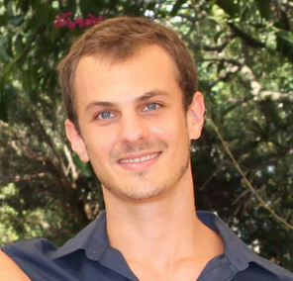



CSR: Core Surprise Removal in Commodity Operating Systems
Noam Shalev
Technion
Eran Harpaz
Technion
Hagar Porat
Technion
Idit Keidar
Technion
Yaron Weinsberg
IBM Research
  April 6, 2016 ASPLOS 2016 Atlanta, Georgia.

Slide 2
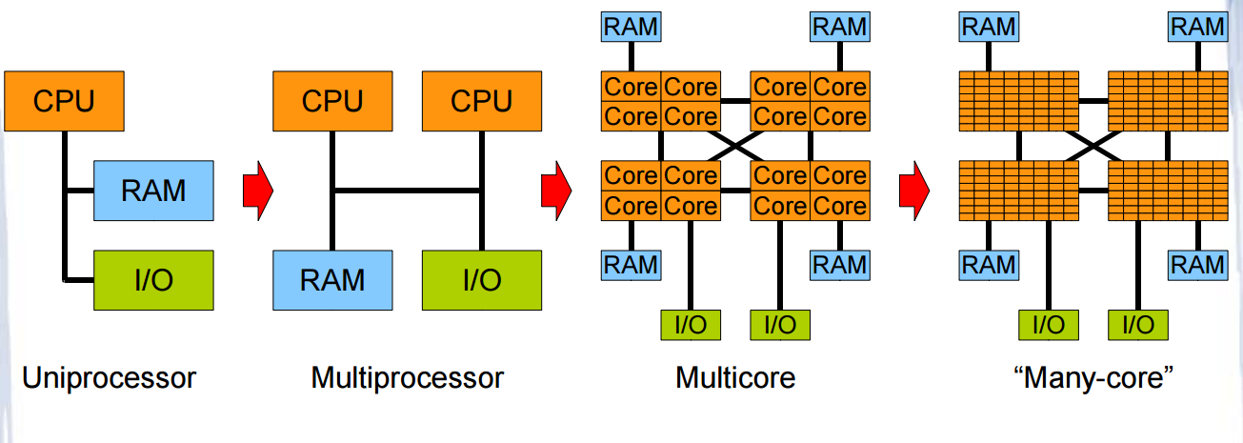

Motivation
  Technology scaling
  Many-core architecture is here
  Machines with a thousand cores are subject to research [TERAFLUX, 2014]

Slide 3
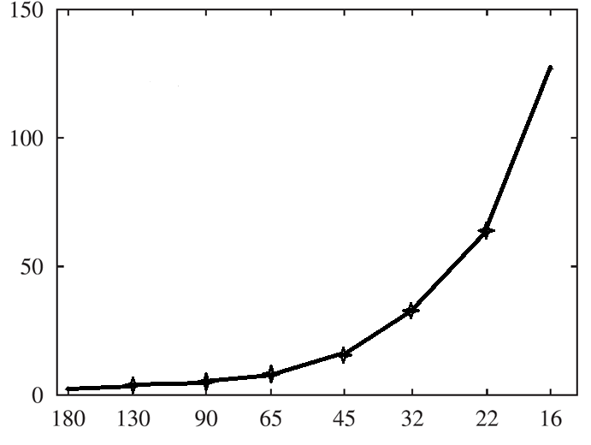
Motivation
  Technology scaling
    Nano scale phenomena
    Hardware reliability decreases [Radetzki et al., 2013]
    Faults more likely
Relative Failure Rate
Technology Node (nm)

Slide 4

Motivation
  Core failures can no longer be ruled out [Srinivasan et al. 2004]
More
Cores
Less
Reliability

Slide 5

Motivation
What happens today?

Slide 6

Contributions
A strategy for overcoming Core Surprise Removal (CSR)
  Objective – keep the system alive following a core fault
  Easily integrate into existing operating systems

Slide 7
Contributions
A strategy for overcoming Core Surprise Removal (CSR)
  Objective – keep the system alive following a core fault
  Easily integrate into existing operating systems
Implementation in the Linux kernel.
Use Hardware Transactional Memory to cope with
failures in critical kernel code
Provide a proof of concept on a real system.
CSR

Slide 8
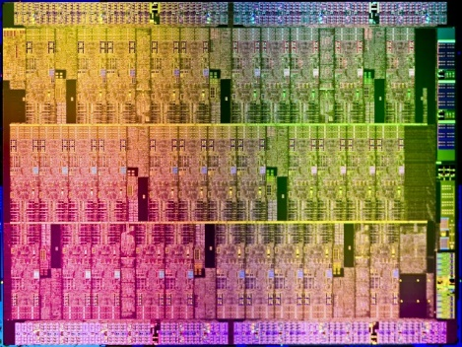

Fault Model (1/2)
Chip Multi-Processor System
  Reliable shared memory
Fault-prone cores
Reliable Failure Detection Unit (FDU) [Weis et al. ,2012]
  Halts execution of the faulty core
  Flush L1 upon failure detection
  Reports to OS.

Slide 9

Fault Model (2/2)
Fail-Stop Model
  Faulty core stops executing from some point onward
  Registers and buffers are unavailable
  L1 Cache data is flushed upon failure [Giorgi et al., 2014].
Core
Core
Core
Core
Core
Core
Core
Core
L1
L1
L1
L1
L1
L1
L1
L1
L2 Cache
L2 Cache
L2 Cache
L2 Cache
L3 Cache
Reliable Shared Memory

Slide 10

CSR – Recovery Strategy
Flag as faulty
  Treat it as offline, and never Hot-plug it again
Reset interrupt affinities
  Handle lost interrupts, migrate IPI queue
Migrate tasklets, work-queues
Update kernel services
  RCU subsystem, performance events, etc.
Terminate the running process
  Free its resources
Migrate processes.
CSR
OS dependent

Slide 11


CSR – Recovery Strategy
Flag as faulty
Reset interrupt affinities
Migrate tasklets, work-queues
Update kernel services
Terminate the running process
Migrate processes.
What about
cascading failures?

Slide 12
CSR – Recovery Strategy
Mark Faulty
Reset Interrupts
Migrate Tasklets
Migrate Workqueues
Update Services
Close Task
Migrate Processes

Slide 13
CSR – Recovery Strategy
Mark Faulty
Reset Interrupts
Migrate Tasklets
Migrate Workqueues
Update Services
Close Task
Migrate Processes

Slide 14
CSR – Recovery Strategy
Tasklet Queue
Recovery Workqueue
Mark Faulty
Close Task
Reset Interrupts
Migrate Workqueues
Migrate Tasklets
Update Services
Queue Work
Migrate Processes

Slide 15
CSR – Recovery Strategy
FDU
Triggered
Recovery Ops
Tasklet Queue
Recovery Workqueue
Queue Tasklets
Mark Faulty
Close Task
Verify Visibility
Reset Interrupts
Migrate Workqueues
Ack
Inform FDU
Migrate Tasklets
Update Services
Resume
Queue Work
Migrate Processes

Slide 16
Cascading Failures Support
Use tasklets and work-queues to execute the recovery process
In a cascading failure case:
  FDU chooses a new core
  The third tasklet migrates the remaining operations.
Tasklets Queue
Recovery Workqueue
Queue Tasklets
Mark as faulty
Close Task
Verify Visibility
Reset Interrupts
Migrate Workqueues
Inform FDU
Migrate Tasklets
Migrate Tasklets
Update Kernel Services
Execute Tasklets
Queue Work
Migrate Tasks
Executing core
Executing core
Any Core

Slide 17





CSR – Interim Summary
Designed to integrate into commodity operating systems
No overhead when the system is correct
Tolerates cascading failures
Scalable
Recovery guarantees?
17

Slide 18
Evaluation – Take 1
But… How?

Slide 19
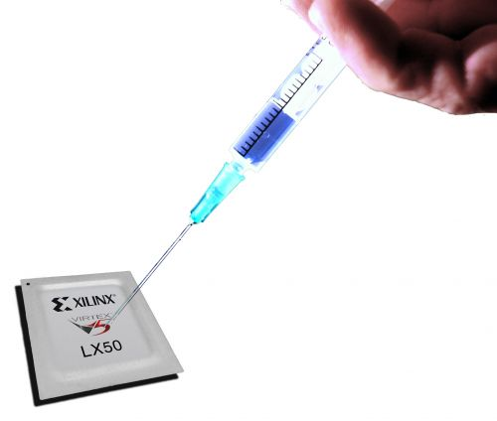



Virtualized Environment
Modified QEMU
  Crashes a random core at random time
  Distinguish between idle, user and kernel mode
Run different workloads
  Postmark, Metis and SPEC CPU2006 benchmarks
Recovery validation
  By creating a file and flushing it to the disk using sync

Slide 20

Results
Idle mode success rate: 100% ☺
User mode success rate: 100% ☺
Meaning that the system is protected ALL the time,
except for….
Kernel mode
    Well… It’s complicated.

Slide 21


Critical Kernel Sections
Fault during critical kernel section execution
  Deadlock
  Cannot kill kernel space
  Reclaim lock by keeping ownership?
    No – inconsistent data.
Core#0
Core#1
Core#2
Core#3

Slide 22
Results – Kernel Mode Fault Injections

Slide 23
Results – Kernel Mode Fault Injections
System crashes always
happen due to a held lock

Slide 24


Critical Kernel Sections - Solution
Solution: Use Hardware Transactional Memory to execute kernel critical sections
  TxLinux [Rossbach et al. SOSP 07’]
    For reliability purposes
  Does not use locks
    Prevent deadlocks
  Execute atomically
    Prevent inconsistent data

Slide 25
Contributions
A strategy for overcoming Core Surprise Removal (CSR)
  Objective – keep the system alive following a core fault
  Easily integrate into existing operating systems
Implementation in the Linux kernel
Use Hardware Transactional Memory to cope with failures in critical kernel code
Provide a proof of concept on a real system.
HTM
CSR

Slide 26
Integrating Intel TSX® with Linux
Replace scheduler locks with lock elision code
TSX is a best effort HTM
  Transactions are not guaranteed to commit
    Retry
  Not all instructions can commit transactionally
    Resort to regular locking
  Too large sections
    Split
Energy Saving | Performance Gain | Commit Rate | Workload
4% | - | 100% | Idle
1% | 0% | 99.9% | 16-threads
3% | 3% | 99.9% | 32-threads
2% | 4% | 99.8% | 64-threads

Slide 27
Evaluation – Take 2
But again… How?

Slide 28
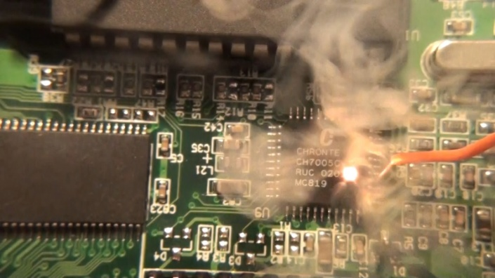
Fault Injection on a Real System
Crash simulation on a real system
  Executed in kernel mode
interrupts_disable(); //unresponsive
If (fault_injection()==smp_processor_id())
while(TRUE); //”stops” executing

Slide 29
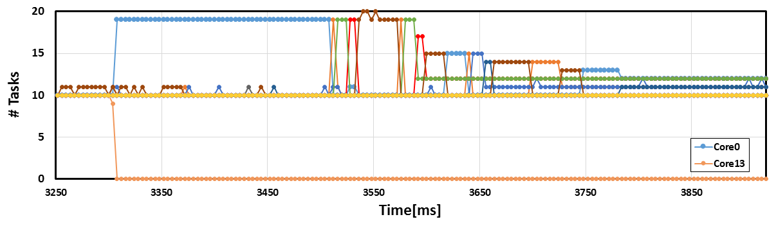
Evaluation – Recovery Timeline (Real System)
Tasks migrated to core #0
Load is balanced
Failure is detected
Core #13 has no tasks
64-core server, only 0-15 are presented.
10 tasks are affined to each core.

Slide 30




Evaluation – Cloud Setting
Real Time: 7:58
Real Time: 8:00
Crash!
Crash!
Crash!
Crash!
Initial correct state cloud setting
After a crash, original kernel

Slide 31

Evaluation – Cloud Setting
Real Time: 7:58
Real Time: 8:00
Alive
Alive
Alive
Crash!
Initial correct state cloud setting
After a crash, CSR on host

Slide 32
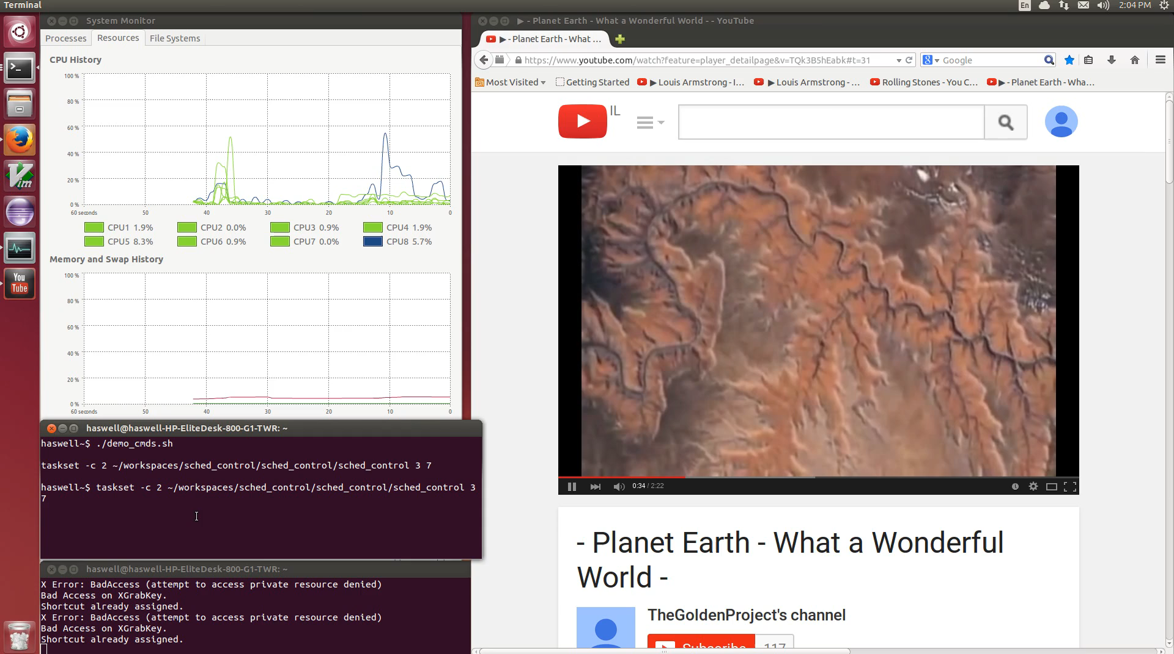

Slide 33
Thank You!
Questions?

