Slide 1



CAFÉ: Scalable Task Pool with Adjustable
Fairness and Contention
Dmitry Basin, Rui Fan, Idit Keidar, Ofer Kiselov, Dmitri Perelman
Technion, Israel Institute of Technology

Slide 2
Task Pools
Shared Memory
Producers
Task Pool
Consumers
Exist in most server applications:
  Web Servers, e.g., building block of SEDA Architecture
  Handling asynchronous requests
Ubiquitous programming pattern for parallel programs
Scalability is essential!

Slide 3
Typical Implementation: FIFO Queue
Has inherent scalability problem
Shared Memory
contention points
Do we really need FIFO ?
In many cases no!
We would like to:
  Relax the requirement
  Control the degree of relaxation

Slide 4

CAFÉ: Contention and Fairness Explorer
Ordered list of scalable bounded non-FIFO pools
Java VM
TreeContainer
TreeContainer
TreeContainer
garbage
collected
TreeContainer size controls contention-fairness trade-off
More fairness
More contention
Less fairness
Less contention
0
Tree height
Pure FIFO

Slide 5
TreeContainer (TC) Specification
Bounded container
A put operation can fail if no free space found
A get operation returns a task or null if TC is empty
Randomized algorithms for put and get operations

Slide 6

TreeContainer Data Structure
Complete binary tree
Left sub-tree has tasks
Right sub-tree doesn’t contain tasks
Used node without a task
Occupied node containing a task
Free node

Slide 7
Get/Put Operations
Step 1: find target node
  By navigating the tree
Step 2: perform put/get on that node
  Need to handle races
Step 3: update routes
  Update meta-data on path to node – tricky!

Slide 8

Get() Operation
TreeContainer
Get():
Start from the root
Task
Close to the root updates are rare
Step1: Navigate to a task by random walk on arrows graph
CAS
Step3: Update routes up to the root
Step 2: Extract the task.

Slide 9
Put() Operation
TreeContainer
Task
Every level of the tree
implemented by array of nodes
put():
Random node
Level 0
occupied
Random node
Level 1
occupied
Random node
Level 2
occupied
Random
node
Level 3
√ free

Slide 10
Put() Operation
TreeContainer
Task
put():
Level 0
Step 2: occupy the free node
CAS operation
Level 1
Finished Step 1: found free node
Go to the highest free predecessor
Level 2
Random
node
Level 3
√ free

Slide 11
Put() Operation
TreeContainer
put():
true
Close to the root, updates are rare
Update routes
Notes:
Add step 3

Slide 12
When Put() Operation Fails
TreeContainer
put():
false
Level 0
Level 1
Level 2
Random
node
Last Level
k trials fail

Slide 13
Races
Concurrency issues are not trivial :)
Challenge:
  guarantee linearizability
  avoid updating all the metadata up to the root upon each operation
See the paper

Slide 14
TreeContainer properties
TreeContainer
Put/Get operations are
  linearizable
  wait-free
Under the worst-case thread scheduling:
  Good step complexity of puts
    When N nodes occupied - O(log²N) whp
    Does not depend on TC size
  Good tree density (arbitrarily close to 2^{h} whp)

Slide 15
CAFÉ Data Structures
GT
PT
TC
TC
TC

Slide 16
CAFÉ Data Structures
GT
PT
TC
TC
TC
TC
TC.Put(task)→ false
TC.Put(task)→ true
Allocate and connect new TC

Slide 17
CAFÉ:get() from Empty TC
GT
PT
TC
TC
TC
TC
TC
TC.Get→null
TC.Get→task
Garbage collected

Slide 18
CAFÉ: Races
GT
PT
The task is lost for consumers
TC
TC
TC
TC
Suspended producer thread

Slide 19
CAFÉ: Handling Races – Try 1
Check if GT bypassed TC
GT
PT
Move GT back
TC
TC
TC
TC

Slide 20
CAFÉ: Races (2)
GT
PT
Task is lost
Consumers can access the task → can terminate
Going to move GT forward
TC
TC
TC
TC
TC.Get → null
TC.Put(task) → true
Consumer thread
Producer thread

Slide 21
CAFÉ: Handling Races – Try 2
GT
PT
Read prev,
If empty read curr
<prev
cur>
TC
TC
TC
TC
Lock-Free. To make it wait-free we do additional tricks.

Slide 22
CAFÉ: Properties
Safety:
  Put()/Get() operations are linearizable
Wait-freedom:
  Get() operations are deterministically wait-free
  Put() operations are wait-free with probability 1
Fairness:
  Preserves order among trees

Slide 23
Evaluation Setup
Compared pools:
  LBQ: Java 6 FIFO blocking queue
  CLQ: Java 6 FIFO non-blocking queue (M&S)
  EDQ: non-FIFO Elimination-Diffraction Tree Queue
Evaluation server:
  8 AMD Opteron quad-cores → total 32 cores

Slide 24
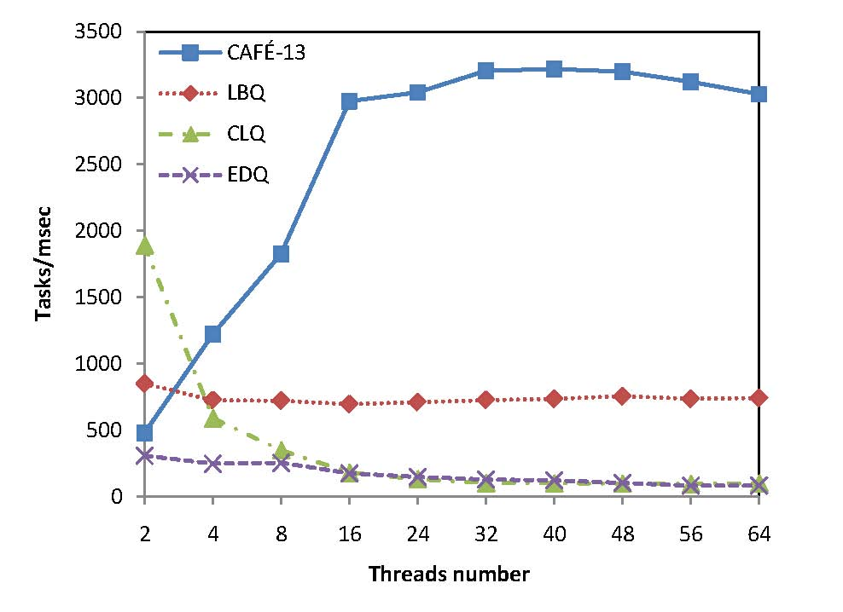
CAFÉ evaluation
Throughput
CAFÉ-13: CAFÉ with tree height 13
LBQ: Java 6 FIFO blocking queue
CLQ: Java 6 FIFO non-blocking queue (M&S)
EDQ: non-FIFO Elimination-Diffraction Tree Queue
Throughput as a function of thread number
factor of 30
over lock-free implementations

Slide 25
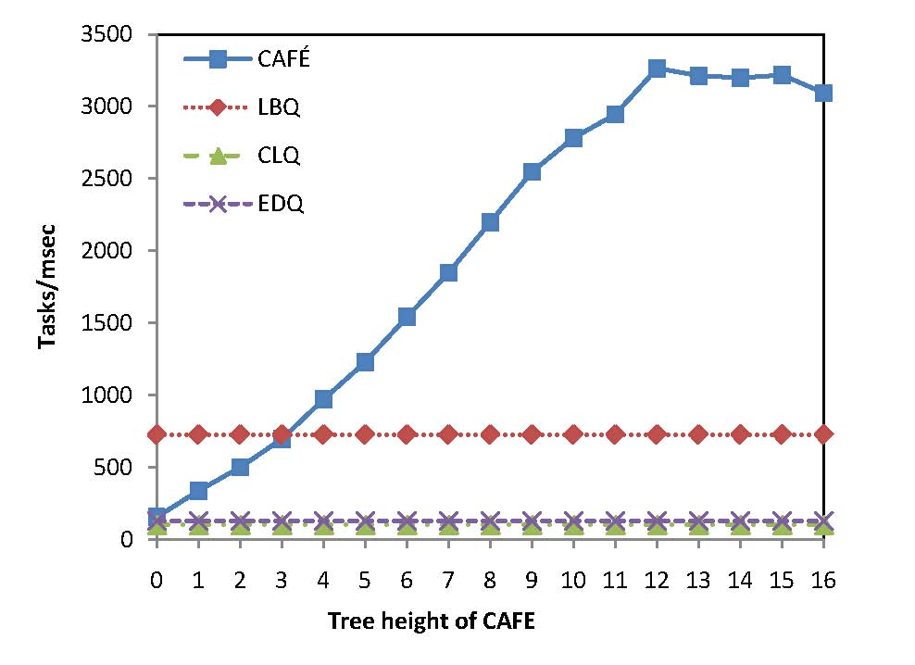
CAFÉ evaluation
Throughput
CAFÉ: CAFÉ queue
LBQ: Java 6 FIFO blocking queue
CLQ: Java 6 FIFO non-blocking queue (M&S)
EDQ: non-FIFO Elimination-Diffraction Tree Queue
  .
CAFÉ throughput as a function of TreeContainer height

Slide 26
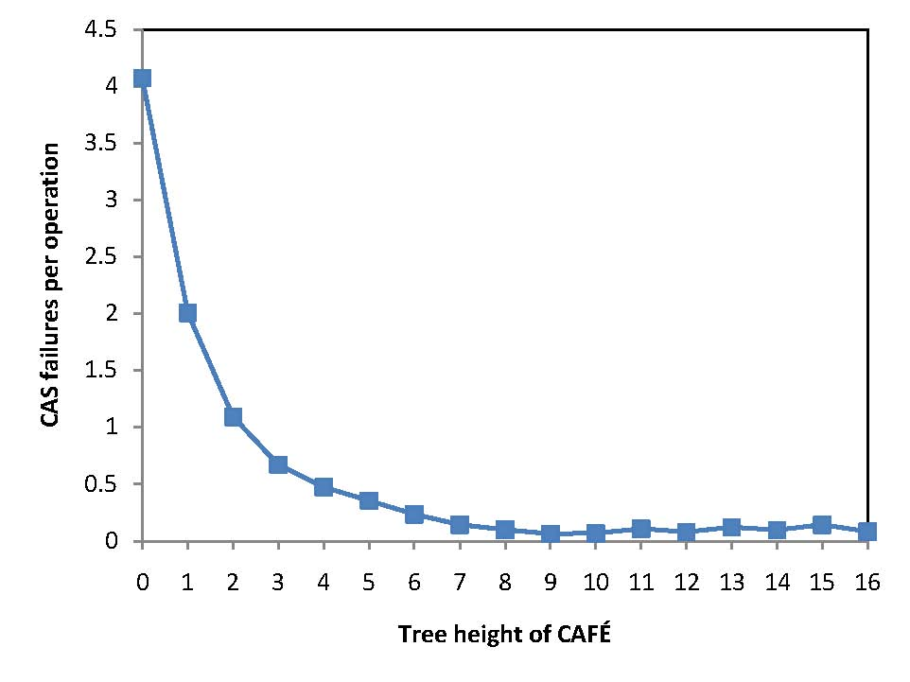
CAFÉ evaluation
CAS-failures
CAS failures per operation as a function of TreeContainer height

Slide 27
Summary
CAFÉ:
  Efficient
  Wait-Free
  With adjustable fairness and contention
Thank you

