Slide 1
Leveraging Application-Level Requirements in the Design of a NoC for a 4G SoC – a Case Study
Rudy Beraha, Isask’har (Zigi) Walter, Israel Cidon, Avinoam Kolodny
Technion – Israel Institute of Technology
Qualcomm Corp. Research and Development, San Diego, California
March, 2010

Slide 2
Outline
Network on-Chip (NoC)
  Introduction
  Design Process
NoC Design
  A Case Study

Slide 3
Why Network on-Chip?
  Buses scale badly
  Power, area, performance
  Testability, verification, timing closure, …
Networks are replacing system buses
  Higher parallelism
  Spatial reuse
  Unicast
Low area
Low power
Better scalability

Slide 4
NoC Architecture Basics
Router
Link
Grid topology
Packet-switched
XY Routing
Wormhole flow-control
R
R
R
R
R
Module
Module
Module
Module
Module
R
R
R
R
R
Module
Module
Module
Module
Module
R
R
R
R
R
Module
Module
Module
Module
Module
R
R
R
R
R
Module
Module
Module
Module
Module
R
R
R
R
R
Module
Module
Module
Module
Module

Slide 5
NoC Design Flow
R
R
R
R
R
R
R
inter-module traffic
Module
R
R
Module
Module
Module
Module
R
R
R
R
R
R
R
Module
Module
Map modules
R
R
R
R
R
Module
R
R
R
R
Module
Module
Module
Module
R
R
R
R
R
R
R
Module
Allocate link capacities
Module
Module
R
R
R
R
R
R
R
R
Module
Module
Evaluate QoS and cost
Synthesize+P&R

Slide 6
NoC Design Flow
R
R
R
R
R
R
R
inter-module traffic
Module
R
Module
Module
Module
Module
Module
Module
Module
R
R
R
R
Module
Module
Module
Module
Map modules
R
R
R
R
R
Module
R
R
R
R
R
Module
Module
Module
Module
Module
Module
Module
Module
Module
R
R
R
R
R
R
R
R
Module
Module
Allocate link capacities
Module
Module
R
R
R
R
Module
Module
Module
Module
Evaluate QoS and cost
  Goal:
    Design a NoC for a 4G SoC
    Study design alternatives
Synthesize+P&R

Slide 7
Why is Mapping Important?
Typical modeling
  Latency and dynamic power proportional to distance
  Dynamic power consumed by the NoC:
Cost of mapping π

Slide 8
Example
PE1
PE2
PE3
30
100
PE4
PE5
PE6
Mapping π₁
Mapping π₂

Slide 9
Outline
Network on-Chip (NoC)
NoC Design – a Case Study
  Mapping
  Link capacity allocation
  Results

Slide 10

A Case Study…
Approached by Qualcomm R&D
  Got a real, 4G Modem SoC design to analyze!
    Very few NoCs for real systems are described in the literature

Slide 11
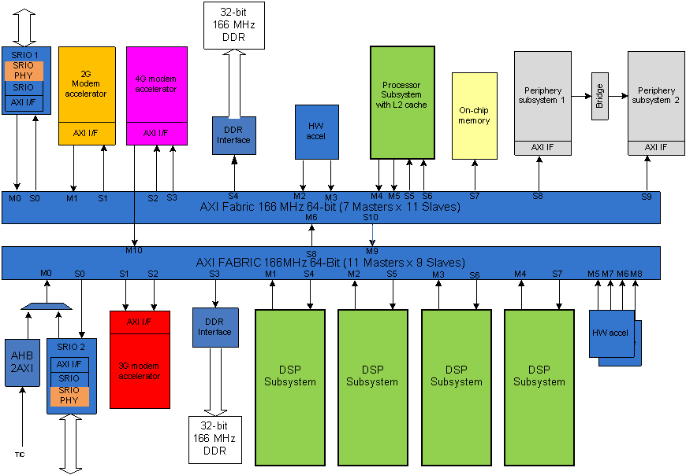
Challenge: a Bus-Based 4G SoC
34 Modules, ~100 flows
2 AXI buses
Several modes of operation (Data, voice, data+voice, etc.)

Slide 12
Design Flow
Given:
  Traffic pattern
Optimize:
  Mapping
  Link capacities
Synthesize+place&route
Step A
Step B

Slide 13
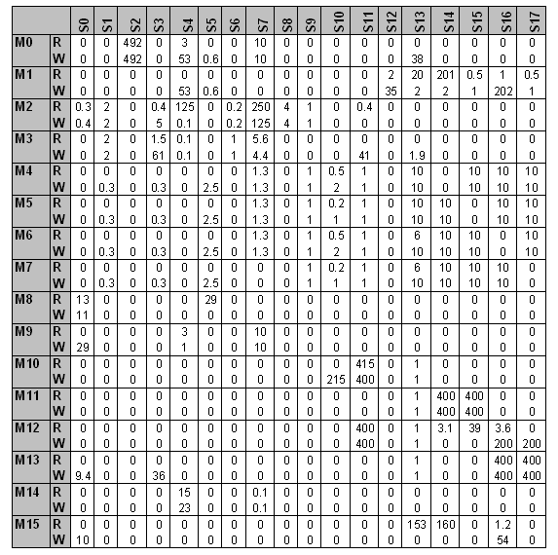
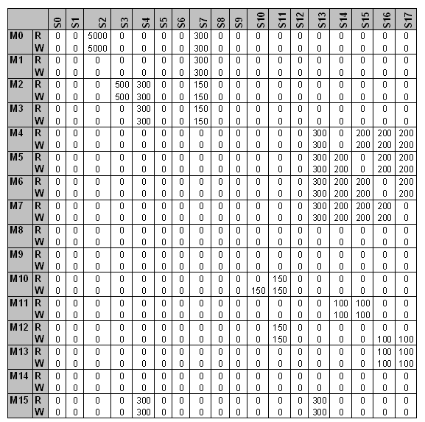
Input Data – Traffic Pattern
Bandwidth demands [Mb/s]
Point-to-point timing requirements [nSec]
'R' is for read operations, 'W' is for write operations
Traditional P2P traffic requirements

Slide 14
Mapping Optimization - Goal
  Minimize power subject to performance constraints
  Captures dynamic power and area (static power)
Static power
Dynamic power

Slide 15
Mapping Alternatives
Scheme 1: Ignore timing requirements
  Account for them in subsequent design phases
Scheme 2: Use P2P timing requirements
  Discard solutions that violate any requirement
Scheme 3: Use application-level requirements
New!
IO
CPU
DSP
MEM
Latency | Dst | Src
T₁ | CPU | IO
T₂ | DSP | CPU
T₃ | MEM | DSP
Latency | Dst | Src
T₁+ T₂+ T₃ | MEM | IO

Slide 16
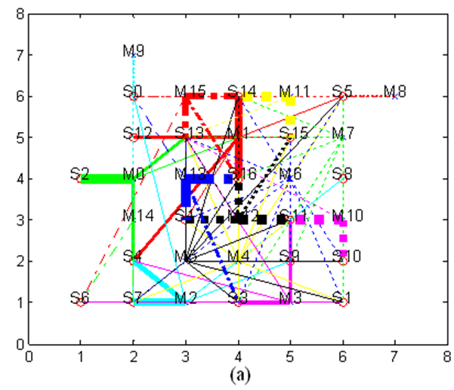
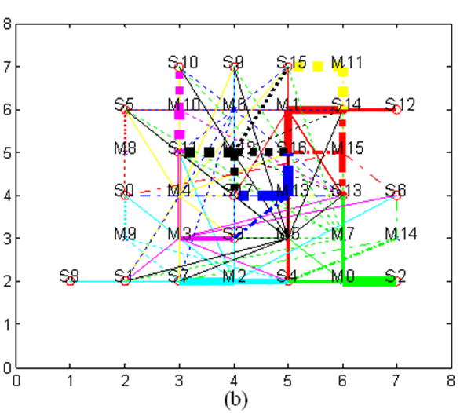
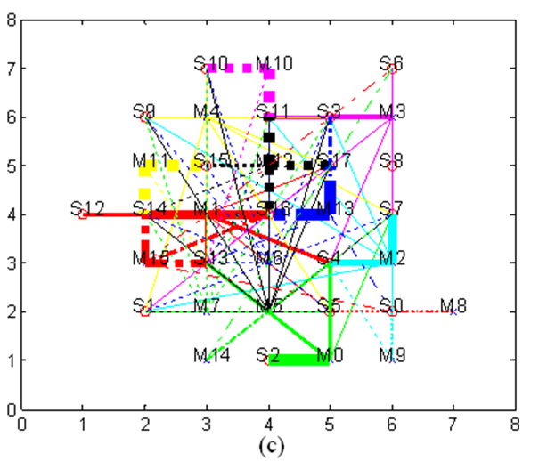
Solving the Mapping Problem
Assumption: latency ∝ hop distance
NP-hard
  Use heuristic algorithm
    Simulated annealing
Scheme 1
Scheme 2
Scheme 3
Power optimized
Power and point-to-point
timing requirements
Power and end-to-end
timing requirements

Slide 17
Step 2: Setting Link Capacities
Find minimal “NoC capacity” such that all timing requirements are met
  Account for run-time effects
    finite router queues, backpressure mechanism, virtual channel multiplexing, network contention, etc.
  Too much capacity: waste of resources
  Too little capacity: insufficient performance

Slide 18
Link Capacity and Wormhole
More difficult than off-chip networks
Cannot set link capacity independently
IP2
Interface
Interface
IP1

Slide 19
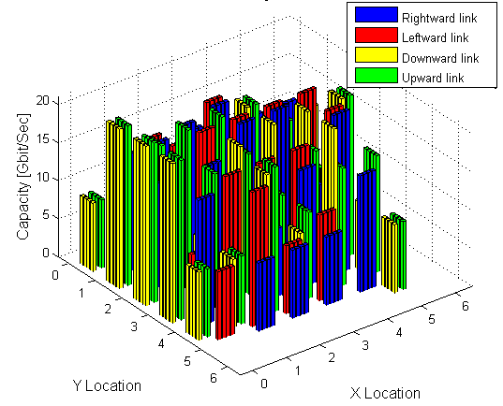
Capacity Allocation Alternatives
Scheme 1: Uniform link capacity
  Simulation based
Scheme 2: Individually tuned, heuristic-based
  Simulation based
Result: 12 NoCs to compare
(3 mappings)*(2 allocation schemes)*(2 VC configurations)

Slide 20
Outline
Network on-Chip (NoC)
NoC Design – a Case Study
  Mapping
  Link capacity allocation
  Results

Slide 21
Results: Total NoC Capacity
Scheme 1
(Power only)
Scheme 2
(Power+P2P Latency)
Scheme 3
(Power+ETE Latency)
Total Capacity Requirements [Gbps]
Using E2E requirements during the design process reduces the total capacity
  Both for uniform and non-uniform link capacity allocation

Slide 22
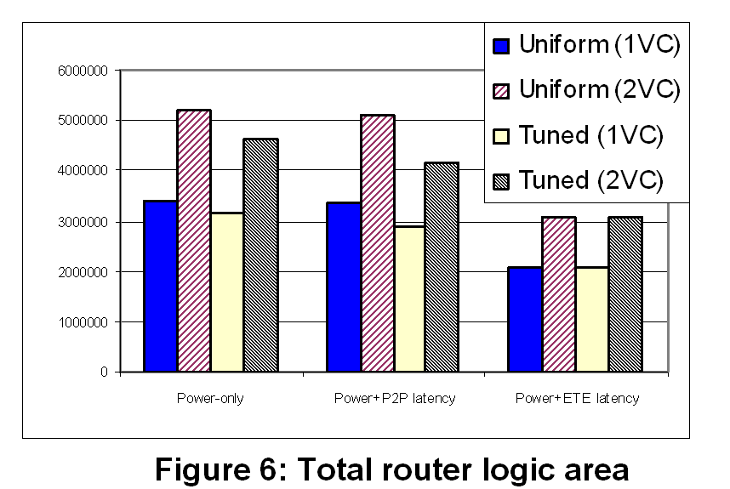
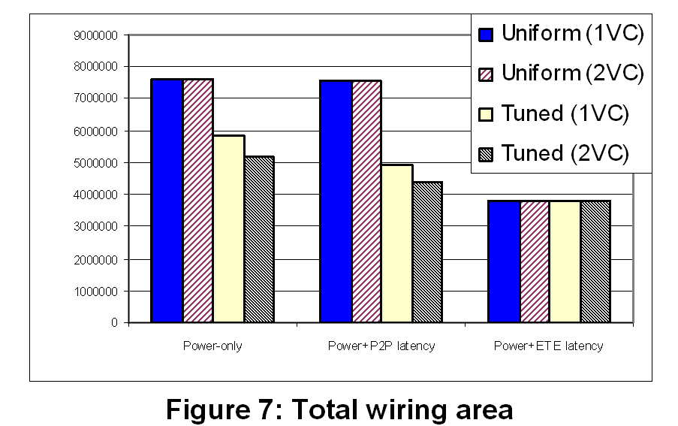
Synthesis Results
Up to 40% savings!
Up to 49% savings!
Scheme 1
Scheme 2
Scheme 3
Scheme 1
Scheme 2
Scheme 3
Total router area
Total wiring area
Mapping scheme 1: Ignore timing requirements during mapping
Mapping scheme 2: map using P2P timing requirements
Mapping scheme 3: map using application-level requirements

Slide 23
Conclusions and Future Work
Evaluated the benefit of mapping using application-level requirements
  Rather than P2P constraints
Using two link capacity allocation schemes
Real application
  Meaningful savings
To do
  Analyze place&route results
  Compare to a bus-based implementation

Slide 24
Leveraging Application-Level Requirements in the Design of a NoC
Thank you!
Questions?
zigi@tx.technion.ac.il
QNoC
Research
QNoC
Group
Research
Group

