Slide 1
Nonparametric
Canonical Correlation Analysis
Tomer Michaeli

Slide 2

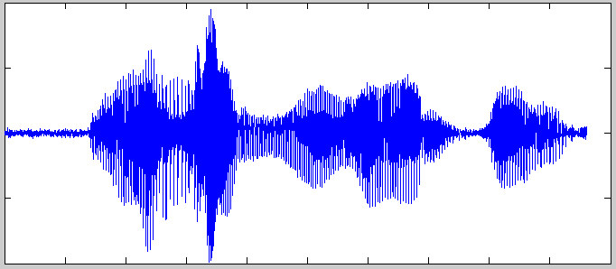
Multi View Dimensionality Reduction
View 1
View 2
View 1
View 2
Previous methods:
  CCA
  Kernel CCA
  Deep CCA
  …
f(x)
g(y)
Our approach:
  Nonparametric CCA

Slide 3
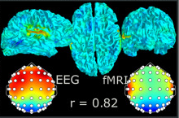
Multi View Dimensionality Reduction
View 1
View 2
View 1
View 2
View 1
View 2
f(x)
g(y)

Slide 4
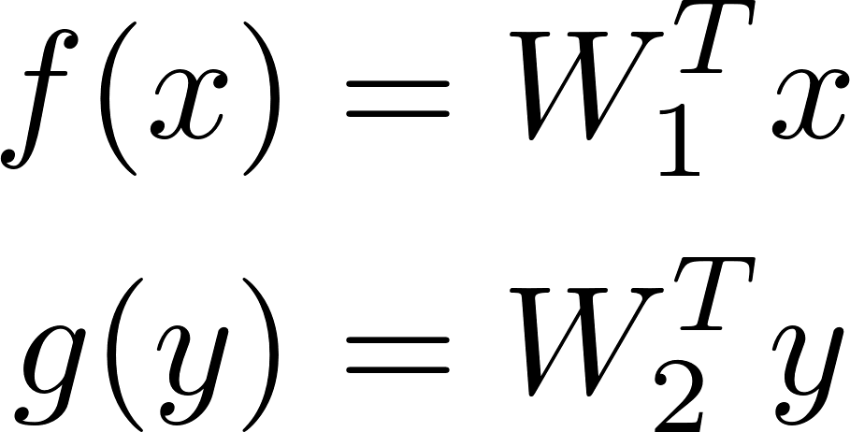
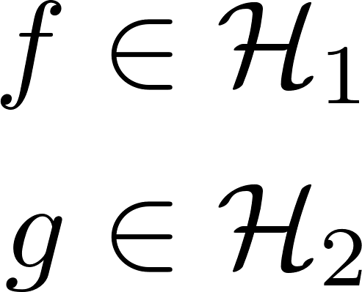

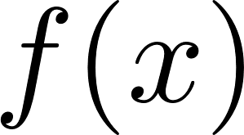

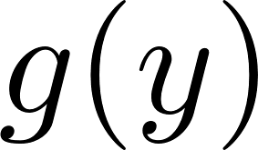
Canonical Correlation Analysis
  CCA
  Kernel CCA
  Deep CCA
  Nonparametric CCA
View 1
View 2
f(x)
g(y)

Slide 5
Query Images
[Yan & Mikolajczyk, 2015]
#30
#3
#24

Slide 6
Query Caption
Gold Image
#30
#4
#137

Slide 7
Multi View Dimensionality Reduction

