Slide 1

Rigorous Analysis of Optical Emission from Organic Light-emitting diodes
הפקולטה להנדסת חשמל
אלקטרוניקה
מחשבים
תקשורת
A. Epstein, N. Tessler, and P. D. Einziger, IEEE J. Quantum Elect., 46, 9, pp. 1388-1395 (2010).
A. Epstein, N. Tessler, and P. D. Einziger, Opt. Lett., 35, 20, pp. 3366-3368 (2010).
Research status and directions
Ariel Epstein, June 2010
Research status and directions
Prof. Nir Tessler, Prof. Pinchas D. Einziger

Slide 2
Outline
Motivation
Formulation
Exciton ensemble characteristics
Closed-form solution
Results and Discussion
Future research directions
Recent results –
  Extracting electrical properties from optical measurements

Slide 3
Outline
Motivation
Formulation
Exciton ensemble characteristics
Closed-form solution
Results and Discussion
Future research directions
Recent results –
  Extracting electrical properties from optical measurements

Slide 4
Motivation
Organic Light-Emitting Diodes (OLEDs) potential
  Thin and flexible displays
  Low-cost lasers
  Efficient clean-energy lighting
  Integrated optoelectronic devices
Device quantum efficiency (QE)
  Internal QE – close to 100% using triplet harvesting
  External Coupling Efficiency (ECE) – limited outcoupling efficiency ~20%
R. H. Friend et al., Nature, 397, 6715, 121 (1999).
N. Tessler et al., Science, 295, 5559, 1506 (2002).
N. Tessler et al., Nature, 382, 6593, 695 (1996).
D. Reineke et al., Nature, 459, 7244, 695 (2009).
H. Sirringhaus, N. Tessler, et al., Science, 280, 5370, 1741 (1998).
ECE limits device efficiency
Y. Sun, et al., Nature Photonics, 2, 8, 483 (2008).

Slide 5

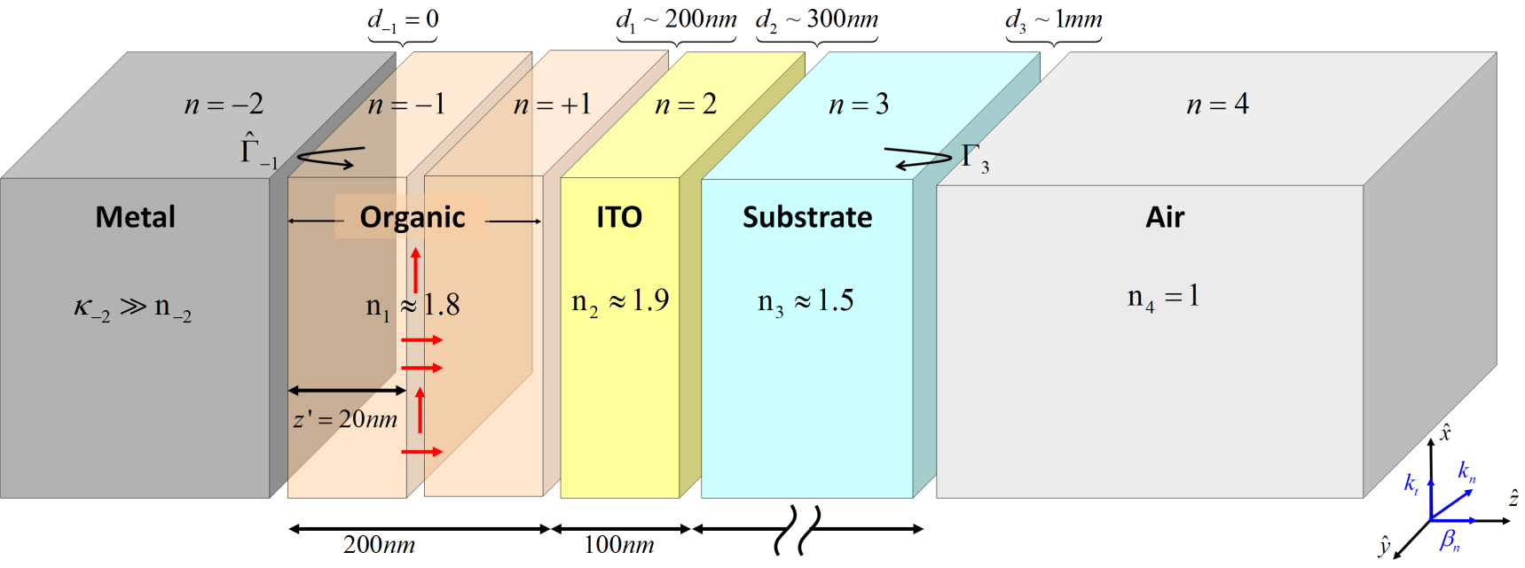
Motivation (2)
Light trapping
  Waveguiding in organic/ITO/Substrate
  Total internal reflection (TIR) in Substrate/Air interface
S. Mladenovski, et al., Opt. Express, 17, 9, 7562 (2009).

Slide 6
Motivation (3)
Lack of optical engineering tools
  Design and optimization rely on numerical simulations or heuristic approaches
  Cumbersome formulae obscure the underlying physics
The research goal – The analytical approach
  Allows analytical formulation of optimization problems
  Simplifies design calculations
  Offers clear physical observation
  Relation between device structure, material composition, electrical and optical properties
K. Celebi, et al., Opt. Express, 15, 4, 1762 (2007).

Slide 7
Motivation (4)
The analytical approach ➔ Engineering tools
  Allows analytical formulation of optimization problems
  Offers clear physical observation
  Relation between device structure, material composition, electrical and optical properties
➔Should provide insight on novel
methods for ECE improvement
➔Extracting electrical properties
from optical measurements

Slide 8
Outline
Motivation
Formulation
Exciton ensemble characteristics
Closed-form solution
Results and Discussion
Future research directions
Recent results –
  Extracting electrical properties from optical measurements

Slide 9
Formulation
General stratified media (N+M+2 layers)
2D excitation (line source)
Electric (TE) and Magnetic (TM) current sources
Harmonic sources
D. Razansky, D. F. Soldea, and P. D. Einziger, J. Appl. Phys., 95, 12, 8298 (2004).

Slide 10
Formulation method
2D Maxwell equations in frequency domain
2D and 1D Green’s functions
  Plane-wave spectral decomposition
Boundary conditions
  Recursive formalism
  Reflection and Transmission coefficients
  Multiple reflection series expansion
Far-field emission
  Saddle point evaluation
P. D. Einziger, et al., Biomathematics: modelling and simulation. World Scientific, 2006, ch. 12, pp. 315–358
L. B. Felsen and N. Marcuvitz, Radiation and Scattering of Waves, Englewood Cliffs, Prentice-Hall, 1973.

Slide 11
Field equations
Wave equation
Radiation condition
Boundary conditions
Field relations
Wave number and impedance

Slide 12
Green functions
2D Green function
1D Green function (Spectral decomposition)
Constraints
Wave numbers
  Propagation
  Transverse

Slide 13
Recursive formalism
1D Green function – solution
Reflection coefficients
Transmission coefficients
Local (Fresnel) reflection coefficients

Slide 14
Dominant processes
Direct-Ray
Propagation/Reflection
in n-th layer
Spatial factor
Image-Source
Weak- Microcavity

Slide 15
Far-field emission
Emission pattern
Variable transformation
Saddle point evaluation

Slide 16
Series expansion
The Green function (and thus the emission pattern) can be expressed as a sum of multiple reflections
Multiple reflection combination

Slide 17
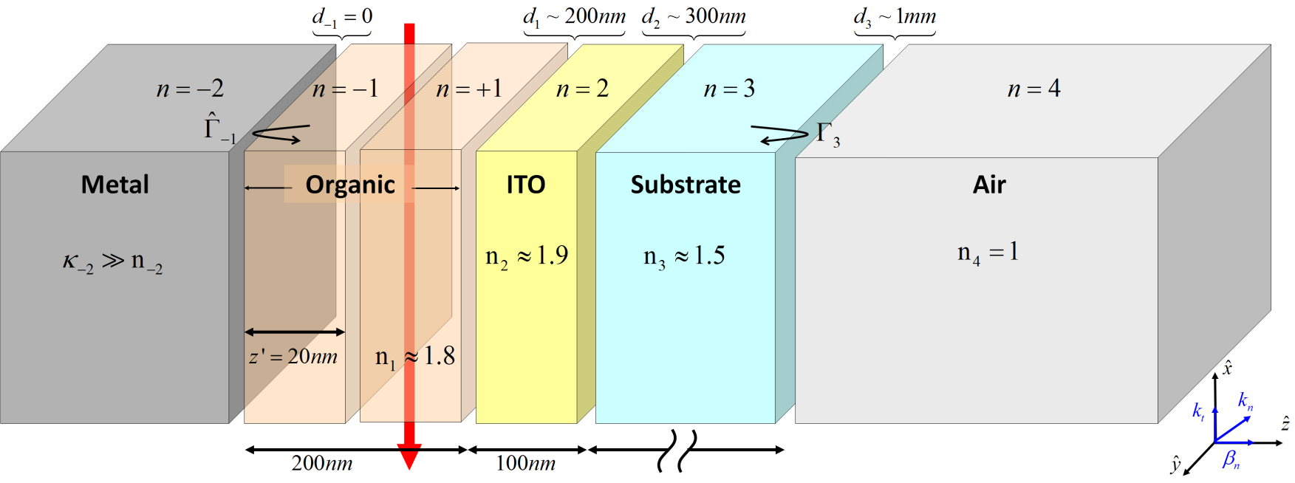
Formulation Summary
Plane-wave decomposition (Fourier)
Boundary conditions (Reflection coefficients)
Stationary phase (Snell’s law )
Dominant processes

Slide 18
Formulation Summary (2)
Plane-wave decomposition (Fourier)

Slide 19
Formulation Summary (3)
Plane-wave decomposition (Fourier)
Boundary conditions (Reflection coefficients)
Multiple Reflection Series

Slide 20
Formulation Summary (4)
Plane-wave decomposition (Fourier)
Boundary conditions (Reflection coefficients)
Stationary phase (Snell’s law )

Slide 21
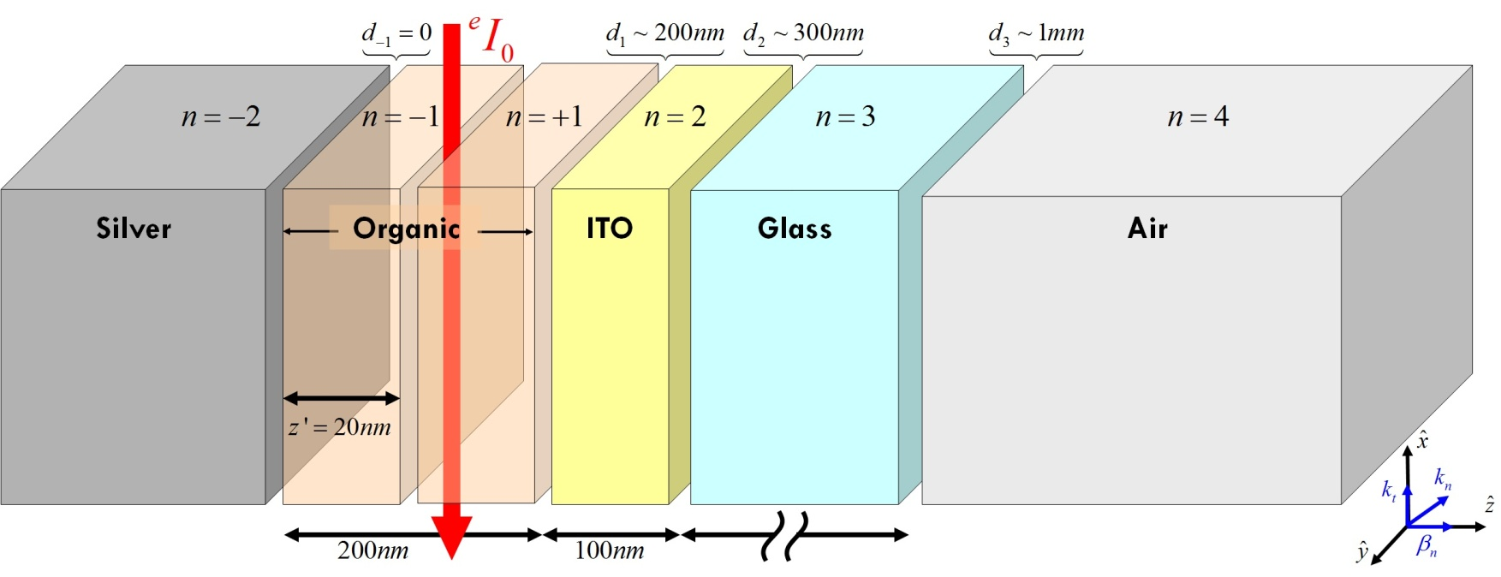
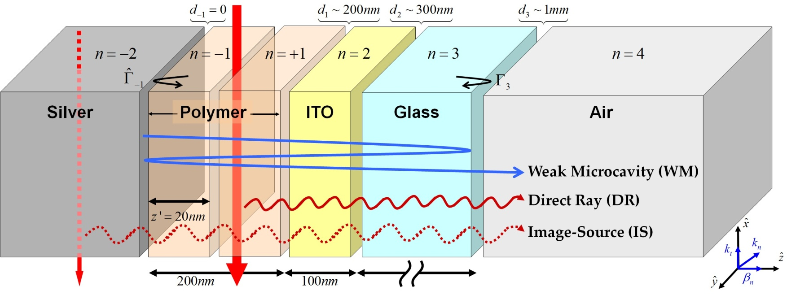
Formulation Summary (5)
Plane-wave decomposition (Fourier)
Boundary conditions (Reflection coefficients)
Stationary phase (Snell’s law )
Dominant processes

Slide 22
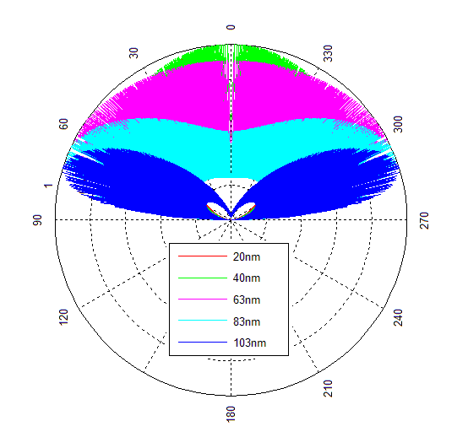
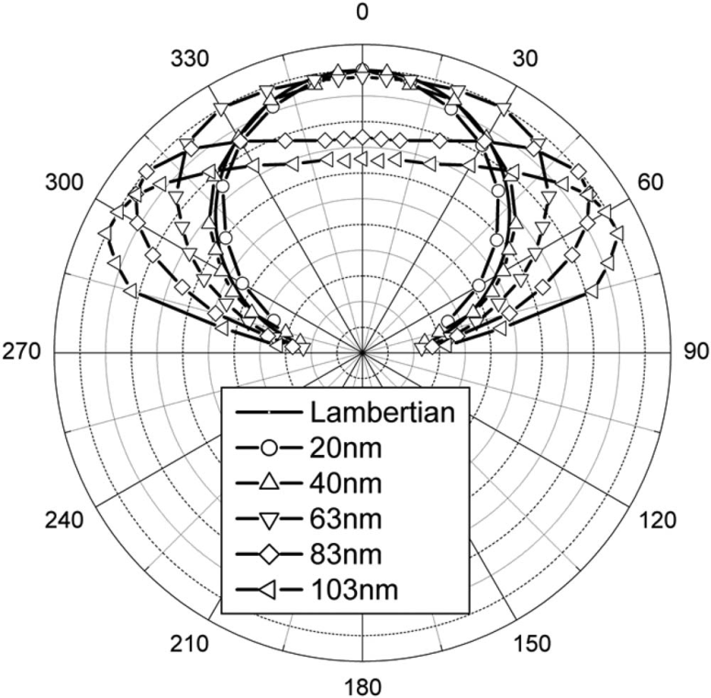
Preliminary results – Inconsistency?
Analytical expression
Experimental results
Where is the catch?
J. Lee, et al., Appl. Phys. Lett., 92, 033303 (2008).

Slide 23
Outline
Motivation
Formulation
Exciton ensemble characteristics
Closed-form solution
Results and Discussion
Future research directions
Recent results –
  Extracting electrical properties from optical measurements

Slide 24
Exciton ensemble properties
Not a single source! ➔ Exciton ensemble
Incoherent emission
Incorporation of spatial and spectral exciton distributions ➔ Averaging of the emission pattern
K. Saxena, et al., J. Appl. Phys., 89, 6, 061124 (2006).

Slide 25
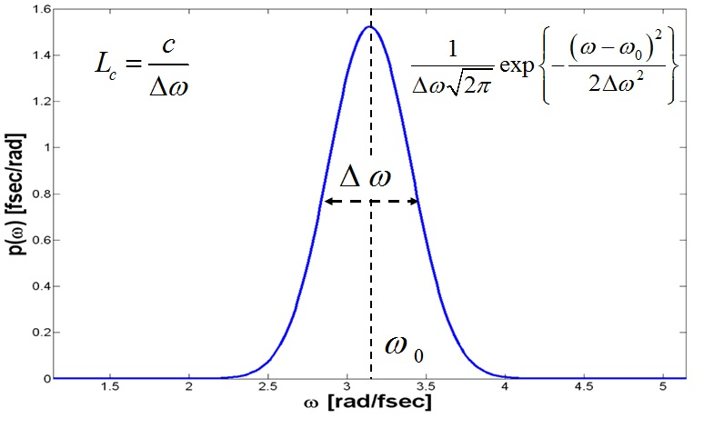
Spectral distribution
A. Epstein, N. Tessler, and P. D. Einziger, IEEE J. Quantum Elect., in press (2010).
Spectral broadening factor
Proportional to photoluminescence spectrum
Usually approximated with a set of Gaussians
The phase terms with large optical length are strongly attenuated
V. Bulovic, et al., Phys. Rev. B., 58, 7, 3730 (1998).
Multiple Reflection Series

Slide 26
Spectral distribution Effect
The weak-microcavity interference practically disappear

Slide 27
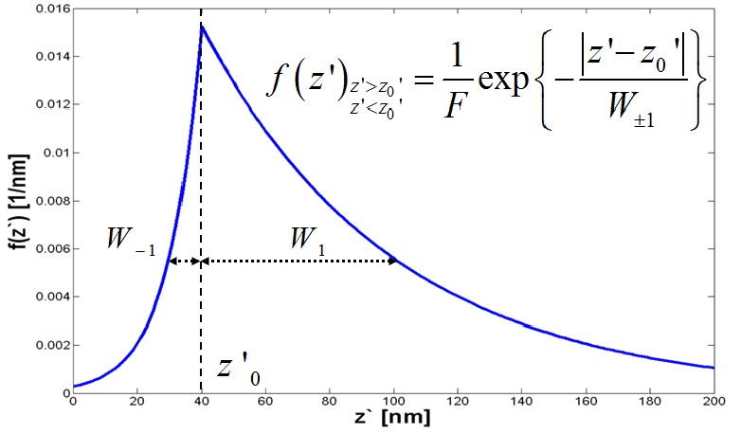
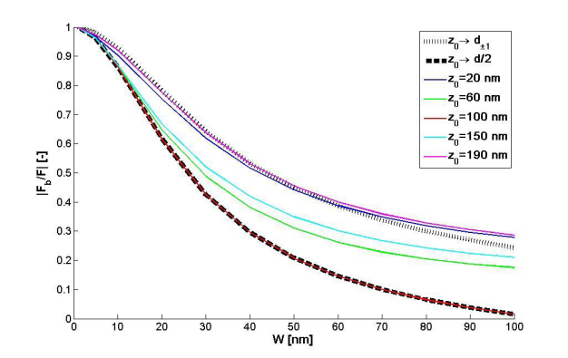
Spatial Distribution
A. Epstein, N. Tessler, and P. D. Einziger, IEEE J. Quantum Elect., in press (2010).
Spatial broadening factor
Follows exciton distribution (recombination zone)
According to simulations, best modeled as the sum of decaying exponentials
N. Tessler, Appl. Phys. Lett., 77, 12, 1897 (2000).
Multiple Reflection Series

Slide 28
Spatial distribution Effect
Diminishes image-source interference

Slide 29
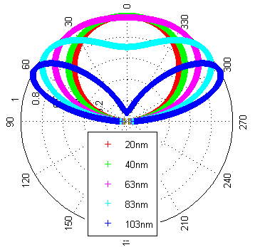
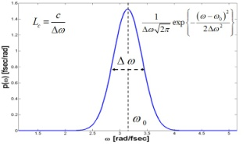

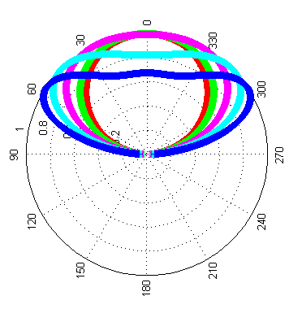


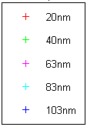
Exciton ensemble effect
Spectral Broadening
Spatial Broadening
Spectral broadening ↔
Fast-varying response
Spatial broadening ↔
Slow-varying response

Slide 30
Outline
Motivation
Formulation
Exciton ensemble characteristics
Closed-form solution
Results and Discussion
Future research directions
Recent results –
  Extracting electrical properties from optical measurements

Slide 31

Closed-form solution for
Prototype Device
Weak-microcavity: finite significant terms in series

Slide 32
Closed-form solution for
Prototype Device (2)
Weak-microcavity: finite significant terms in series
Thin-film: image-source interference only affect slow-varying component of emission pattern

Slide 33
Closed-form solution for
Prototype Device (3)
Weak-microcavity: finite significant terms in series
Thin-film: image-source interference only affect slow-varying component of emission pattern
Coherence length: thick substrate diminishes weak-microcavity interference effects

Slide 34
Closed-form solution for
Prototype Device (4)
Image-Source
Spatial broadening factor
Weak-microcavity
Spectral broadening
A. Epstein, N. Tessler, and P. D. Einziger, IEEE J. Quantum Elect., 46, 9, pp. 1388-1395 (2010).

Slide 35
Outline
Motivation
Formulation
Exciton ensemble characteristics
Closed-form solution
Results and Discussion
Future research directions
Recent results –
  Extracting electrical properties from optical measurements

Slide 36

Spectral distribution effect
Coherence length variation
Substrate thickness variation

Slide 37
Spatial distribution effect
Inifinite coherence length
Realistic coherence length

Slide 38
Result summary
Spectral Broadening
Spectral broadening ↔
Fast-varying response
Spatial broadening ↔
Slow-varying response
Spatial Broadening
Both effects are essential

Slide 39
Result summary (2)
Rigorous analytical formulation
Dominant optical processes identification
  Image-source interference
  Weak-microcavity multiple reflections
  Direct-ray transmission
Ensemble characteristics must be incorporated
  Spectral broadening ↔ Fast-varying response
  Spatial broadening ↔ Slow-varying response
Simplified expressions allow efficient design and optimization

Slide 40
Outline
Motivation
Formulation
Exciton ensemble characteristics
Closed-form solution
Results and Discussion
Future research directions
Recent results –
  Extracting electrical properties from optical measurements

Slide 41
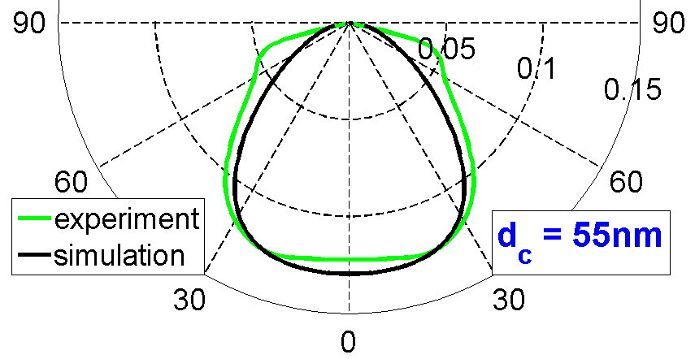
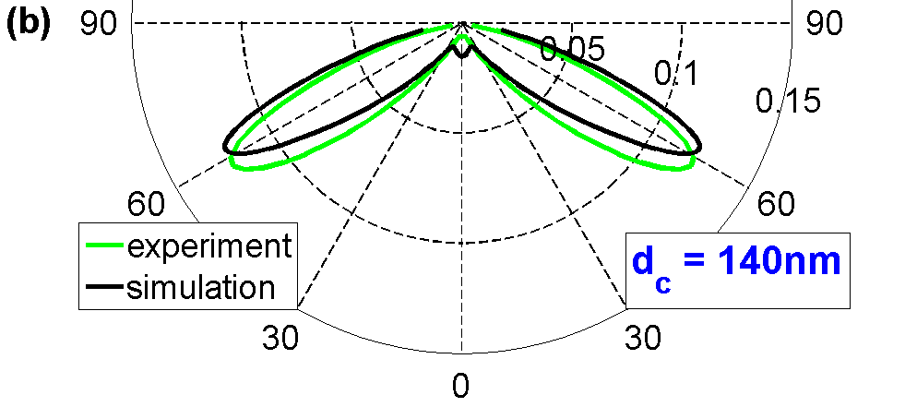
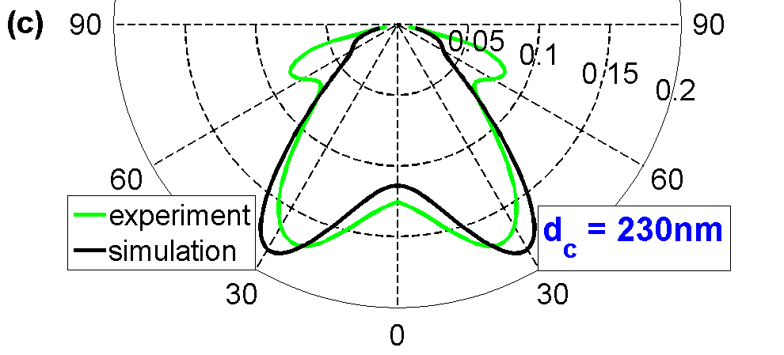

Extracting electrical properties
S. Mladenovski et al., Opt. Express, 17, 9, 7562 (2009)
J. Lee, et al., Appl. Phys. Lett.,
92, 033303 (2008).
The emission pattern extrema vary with the recombination zone location!

Slide 42
Extracting electrical properties (2)
The recombination zone location is a very important parameter that is hard to measure directly
Data: Measured emission pattern
Required: Estimation of the excitons location
What are the emission pattern extrema?
We have analytical expressions ➔ we can derive!
C.-L. Lin, et al., Appl. Phys. Lett., 88, 081114 (2006).
B. Ruhstaller, et al., IEEE J. Sel. Top. Quantum Electron., 9, 723 (2003).

Slide 43

Extrema conditions (2)
Destructive phase matching
Phase accumulated from source to cathode and back
Phase addition due to reflection from cathode
Constructive phase matching
The extrema conditions are in the form of phase-matching conditions
The extrema angles do not depend on the layer dimensions (Small coherence length)

Slide 44
Recombination zone location
For local minima:
For local maxima:
Excitons are far away from metal as extremum angle is larger or metal/organic is more reflective
OR

Slide 45
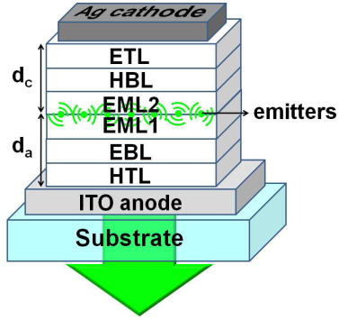
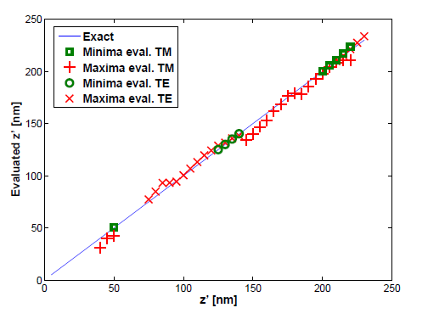
Example
S. Mladenovski et al., Opt. Express, 17, 9, 7562 (2009)
Device properties:
For
A. Epstein, N. Tessler, and P. D. Einziger, Opt. Lett., 35, 20, pp. 3366-3368 (2010).

Slide 46
Summary (Electrical properties)
Analytical expressions allow exact formulation of optimization problems through derivation
Simplified relations between emission pattern extrema and recombination zone location
Extraction of electrical properties from optical measurements
Good agreement with reported experimental results:
  Dominant TE polarization
  2-D model matches measured emission patterns

Slide 47
Thank you!

Slide 48
Extrema conditions
Phase accumulation from source to cathode
Angle of propagation inside active layer
Phase addition due to reflection from cathode
The effect of the direct-ray transmission

Slide 49
Summary of definitions
For the local extremum angle

Slide 50
Direct-ray transmission effect

