Slide 1
An SVM Based Voting Algorithm with Application to Parse Reranking
Paper by Libin Shen and Aravind K. Joshi
Presented by Amit Wolfenfeld

Slide 2
Outline
Introduction of Parse Reranking
SVM
An SVM Based Voting Algorithm
Theoretical Justification
Experiments on Parse Reranking
Conclusions

Slide 3
Introduction – Parse Reranking
Motivation (Collins)
vote | rerank | f-score | Log-likelihood | parses | rank
 | 3 | 92% | -120.0 | P2 | 1
 | 4 | 90% | -121.5 | P3 | 2
x | 1 | 96% | -122.0 | P1 | 3
 | 2 | 93% | -122.5 | P4 | 4

Slide 4
Support Vector Machines
The SVM is a large margin classifier that searches for the hyperplane that maximizes the margin between the positive samples and the negative samples

Slide 5
Support Vector Machines
Measures of the capacity of a learning machine: VC Dimension, Fat Shattering Dimension
The capacity of a learning machine is related to the margin on the training data.
- As the margin goes up, VC-dimension may go down and thus the upper bound of the test error goes down. (Vapnik 79)

Slide 6
Support Vector Machines
SVMs’ theoretical accuracy is much lower than their actual performance. The margin based upper bounds of the test error are too loose.
This is why – SVM based voting algorithm.

Slide 7
SVM Based Voting
Previous work (Dijkstra 02)
- Use SVM for parse reranking directly.
- Positive samples: parse with highest
f-score for each sentence.
First try
-Tree kernel: compute dot-product on the space of all the subtrees (Collins 02)
-Linear kernel: rich features (Collins 00)

Slide 8
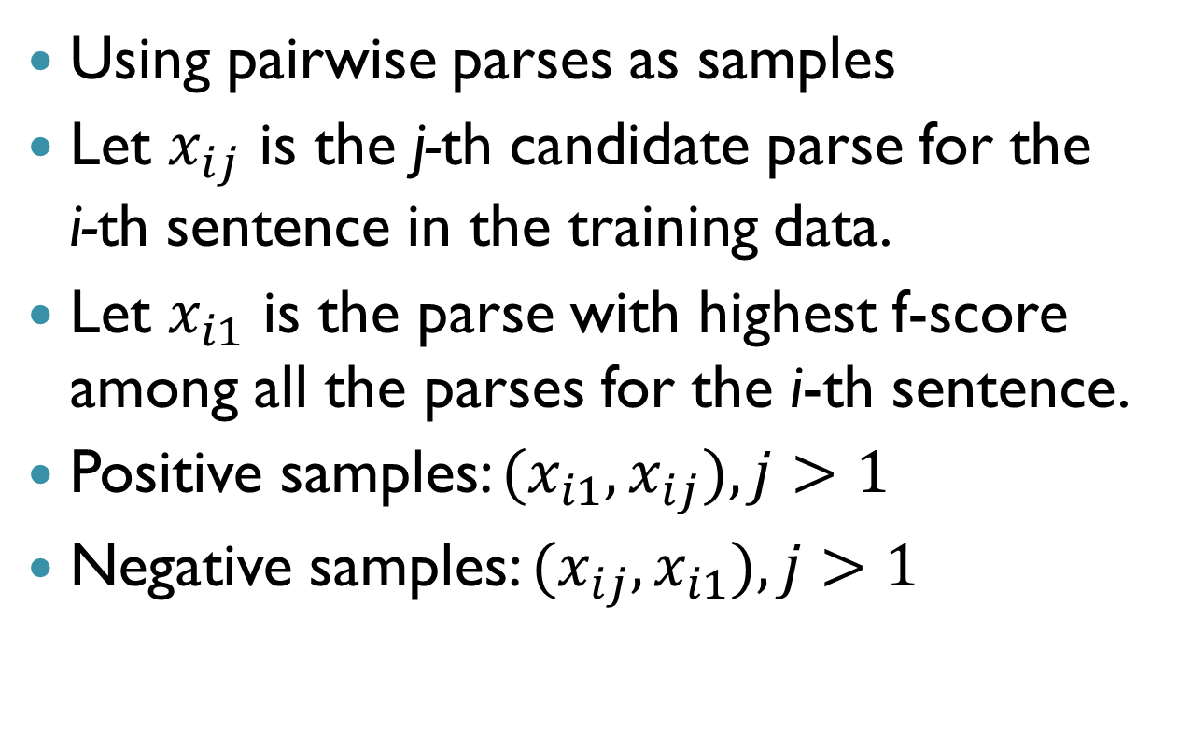
SVM based Voting Algorithm
Using pairwise parses as samples
Let $x_{ij}$ is the j-th candidate parse for the i-th sentence in the training data.
Let $x_{i1}$ is the parse with highest f-score among all the parses for the i-th sentence.
Positive samples: ${(x}_{i1},x_{ij}),j>1$
Negative samples: ${(x}_{ij},x_{i1}),j>1$

Slide 9
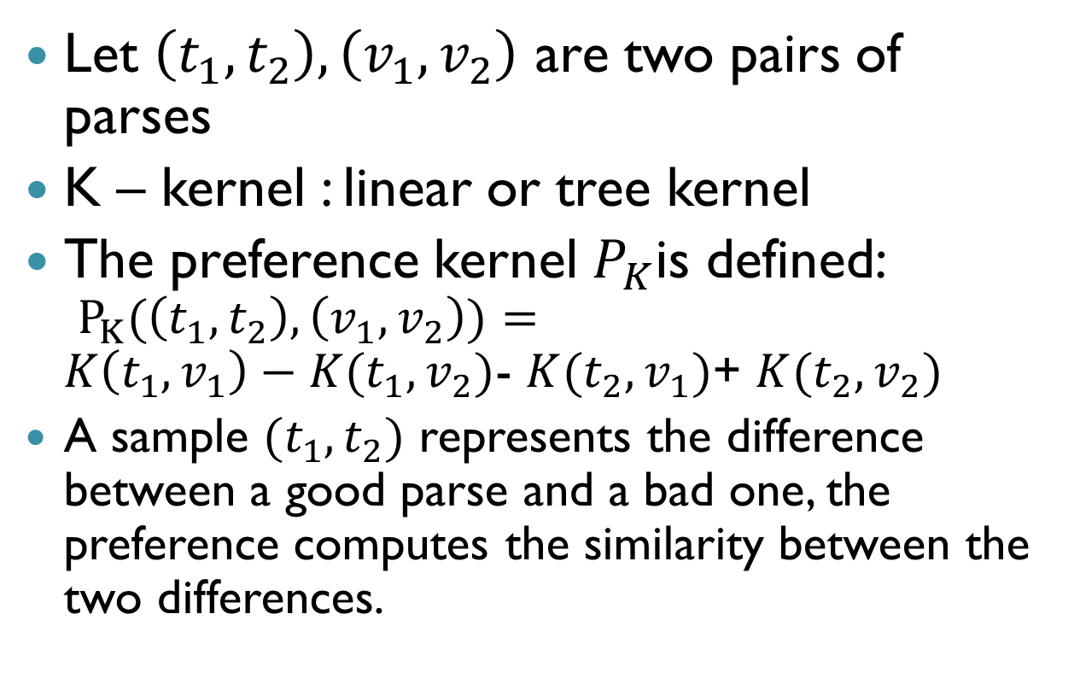
Preference Kernels
Let $\left(t_{1},t_{2}\right),\left(v_{1},v_{2}\right)$ are two pairs of parses
K – kernel : linear or tree kernel
The preference kernel $P_{K}$is defined:
$P_{K}(\left(t_{1},t_{2}\right),\left(v_{1},v_{2}\right))=$
$K\left(t_{1},v_{1}\right)−K(t_{1},v_{2})$- $K(t_{2},v_{1})$+ $K(t_{2},v_{2})$
A sample $(t_{1},t_{2})$ represents the difference between a good parse and a bad one, the preference computes the similarity between the two differences.

Slide 10
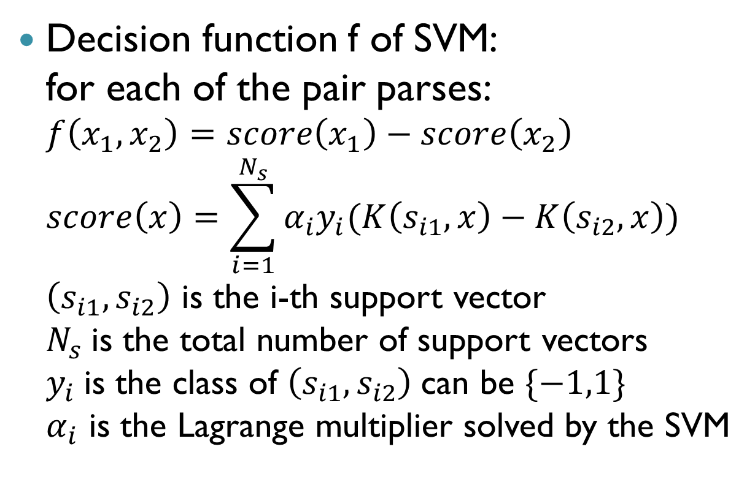
SVM based Voting
Decision function f of SVM:
for each of the pair parses:
$f\left(x_{1},x_{2}\right)=score\left(x_{1}\right)−score\left(x_{2}\right)$
$score\left(x\right)=\sum_{i=1}^{N_{s}}{α_{i}y_{i}(K\left(s_{i1},x\right)−K\left(s_{i2},x\right))}$
$\left(s_{i1},s_{i2}\right)$ is the i-th support vector
$N_{s}$is the total number of support vectors
$y_{i}$is the class of $\left(s_{i1},s_{i2}\right)$can be $\{−1,1\}$
$α_{i}$ is the Lagrange multiplier solved by the SVM

Slide 11
Theoretical Issues
Justifying the Preference Kernel
Justifying Pairwise Samples
Margin Based Bound for the SVM Based Voting Algorithm

Slide 12
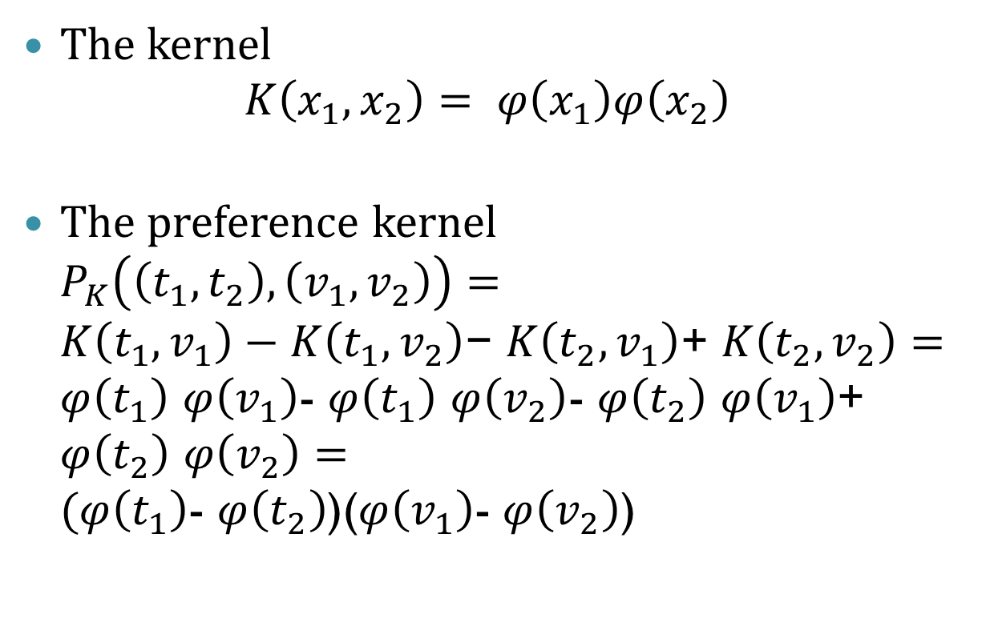
Justifying the Preference Kernel
The kernel
$K\left(x_{1},x_{2}\right)= φ\left(x_{1}\right)φ\left(x_{2}\right)$
The preference kernel
$P_{K}\left(\left(t_{1},t_{2}\right), \left(v_{1},v_{2}\right)\right)=$
$K\left(t_{1},v_{1}\right)−K\left(t_{1},v_{2}\right)\text{− }K\left(t_{2},v_{1}\right)\text{+ }K\left(t_{2},v_{2}\right)=$
$φ\left(t_{1}\right)$ $φ\left(v_{1}\right)$- $φ\left(t_{1}\right)$ $φ\left(v_{2}\right)$- $φ\left(t_{2}\right)$ $φ\left(v_{1}\right)$+ $φ\left(t_{2}\right)$ $φ\left(v_{2}\right)=$
$(φ\left(t_{1}\right)$- $φ\left(t_{2}\right)$)($φ\left(v_{1}\right)$- $φ\left(v_{2}\right)$)

Slide 13
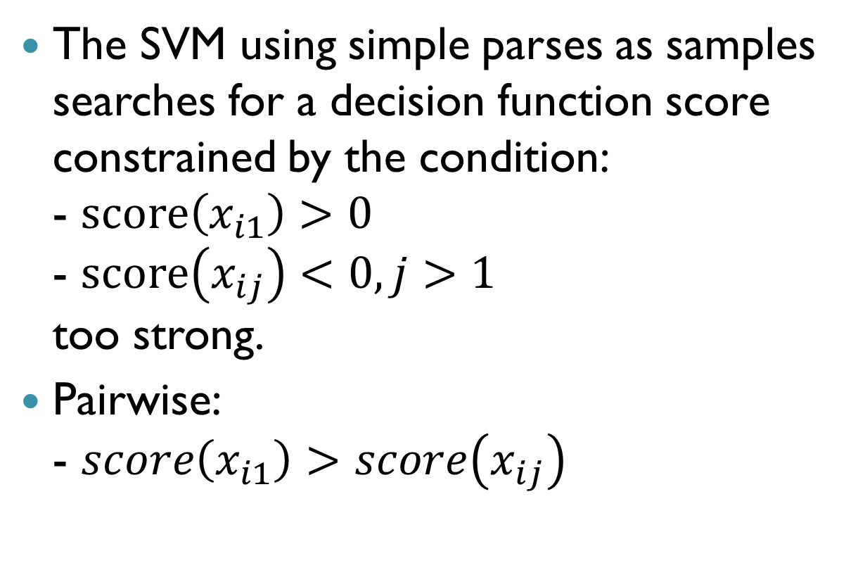
Justifying the Pairwise Samples
The SVM using simple parses as samples searches for a decision function score constrained by the condition:
- $score\left(x_{i1}\right)>0$
- $score\left(x_{ij}\right)<0, j>1$
too strong.
Pairwise:
- $score\left(x_{i1}\right)>score\left(x_{ij}\right)$

Slide 14
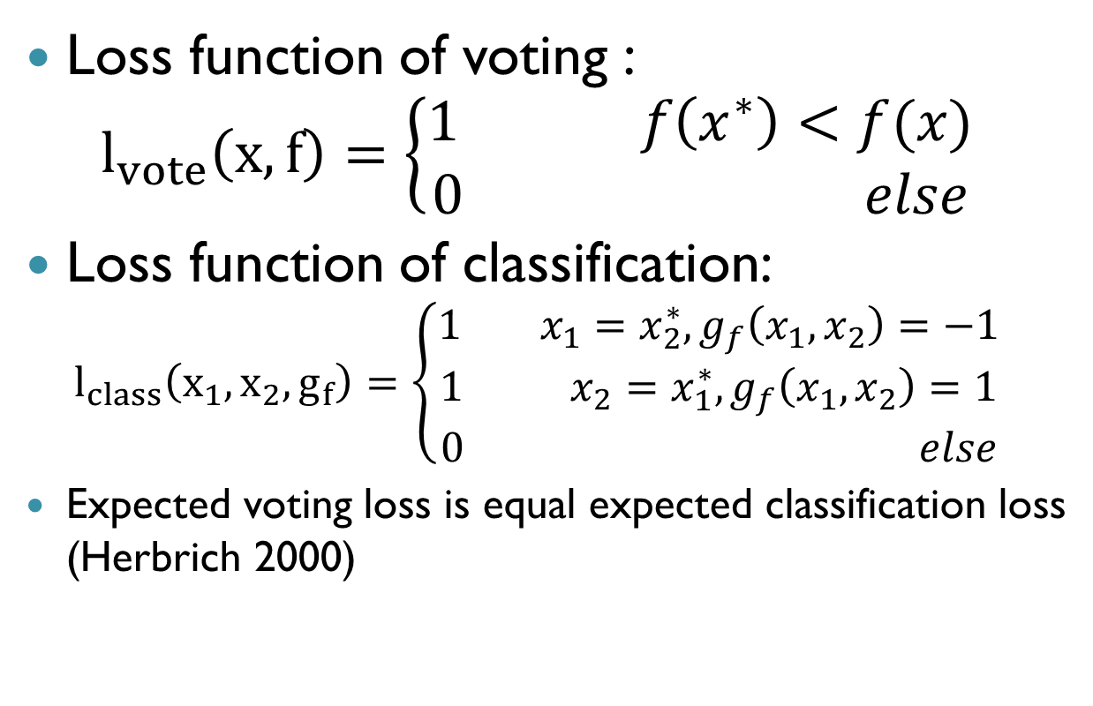
Margin Based Bound for SVM Based voting
Loss function of voting :
$l_{vote}\left(x,f\right)=\left\{\begin{aligned}1 f\left(x^{∗}\right)<f(x) \\ 0 else\end{aligned}\right.$
Loss function of classification:
$l_{class}\left(x_{1},x_{2},g_{f}\right)=\left\{\begin{aligned}1 { x}_{1}=x_{2}^{∗},g_{f}\left(x_{1},x_{2}\right)=−1 \\ 1 { x}_{2}=x_{1}^{∗},g_{f}\left(x_{1},x_{2}\right)=1 \\ 0 else\end{aligned}\right.$
Expected voting loss is equal expected classification loss
(Herbrich 2000)

Slide 15
Experiments – WSJ Treebank
N-best parsing results (Collins 02)
SVM-light (Joachims 98)
Two Kernels (K) used in the preference kernel:
- Linear Kernel
- Tree Kernel
Tree Kernel- very slow

Slide 16
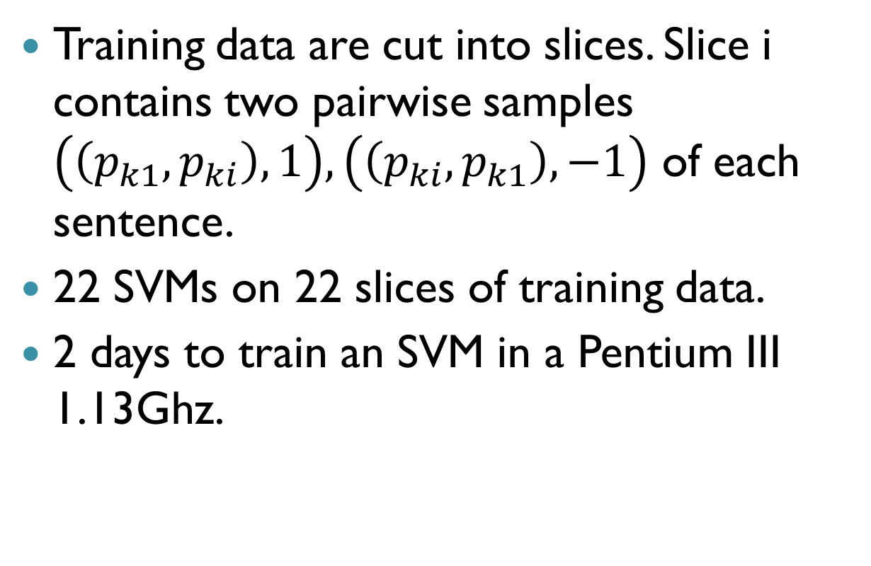
Experiments – Linear Kernel
Training data are cut into slices. Slice i contains two pairwise samples $\left(\left(p_{k1},p_{ki}\right),1\right),\left(\left(p_{ki},p_{k1}\right),−1\right)$ of each sentence.
22 SVMs on 22 slices of training data.
2 days to train an SVM in a Pentium III 1.13Ghz.

Slide 17
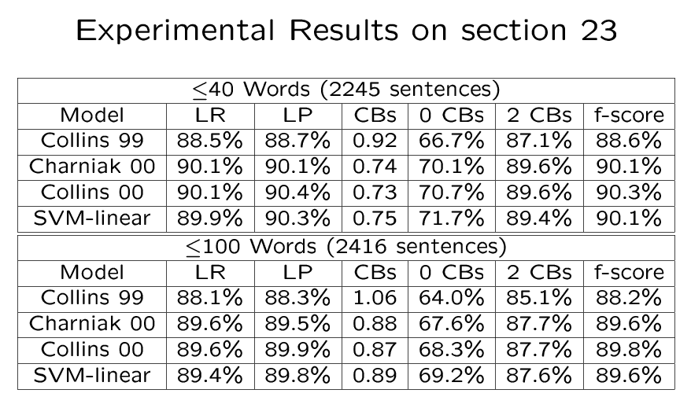
Results

Slide 18
Conclusions
Using an SVM approach :
- achieving state-of-the-art results
- SVM with linear kernel is superior to tree kernel in speed and accuracy.

Slide 19
T
n
o
u
k
h
a
Y
!

