Slide 1
Single Scattering Modeling of
Speckle Correlations
ICCP 2021
Chen Bar, Marina Alterman , Ioannis Gkioulekas and Anat Levin
Technion , Israel
CMU, USA

Slide 2
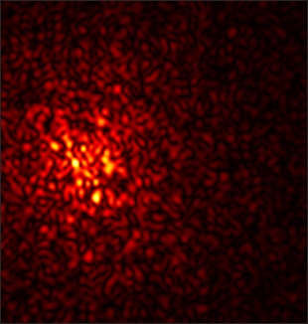
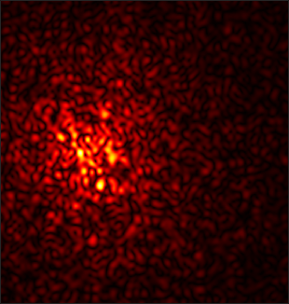
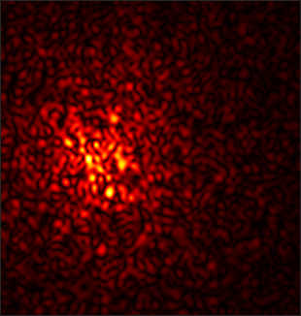
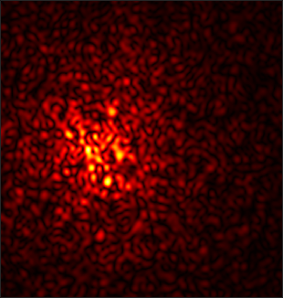
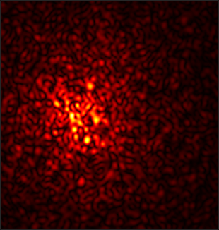
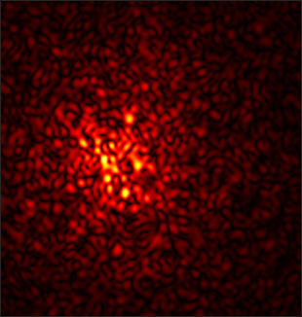
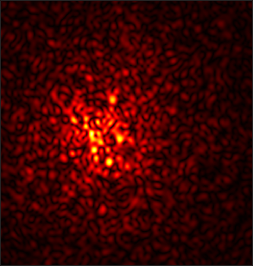
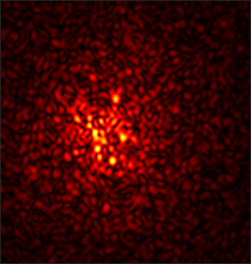
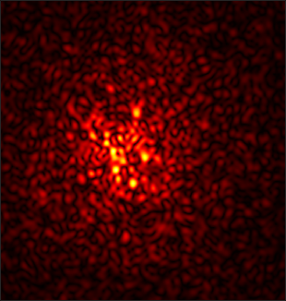
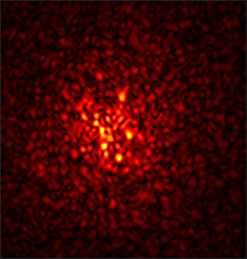
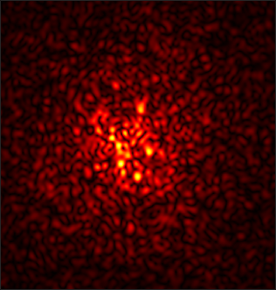
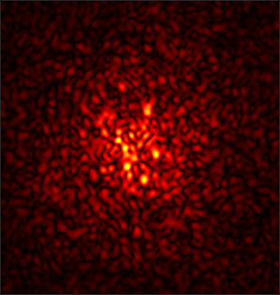
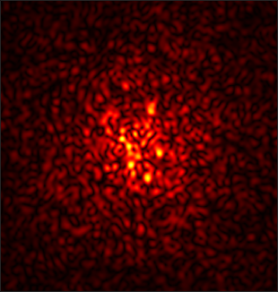
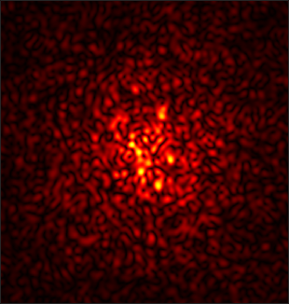
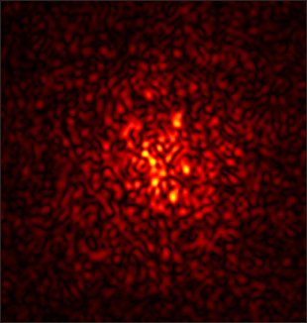
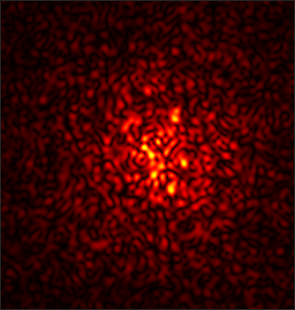
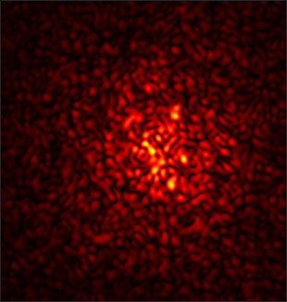
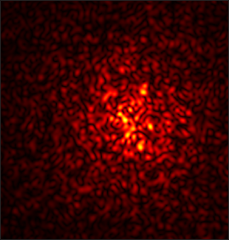
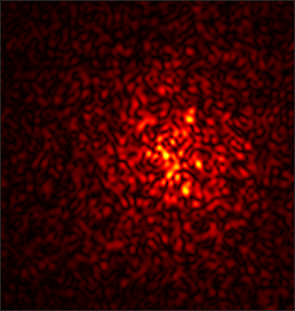
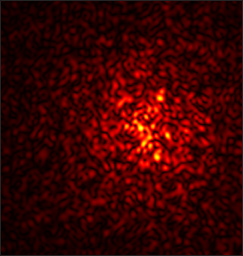
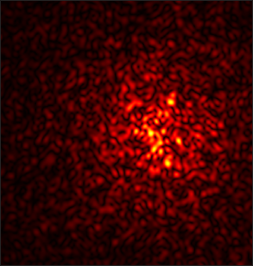
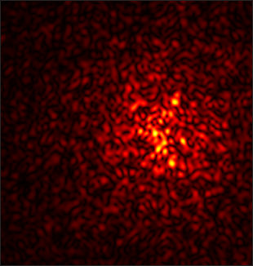
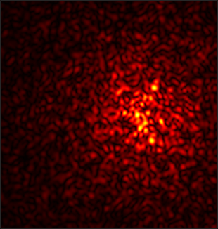
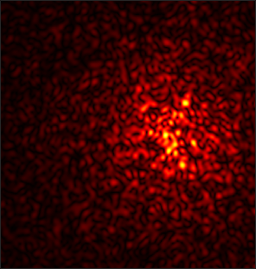
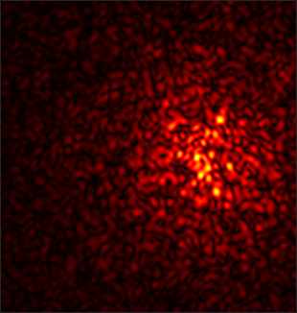
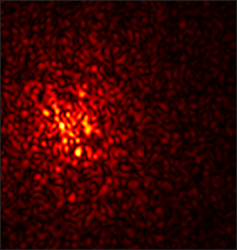
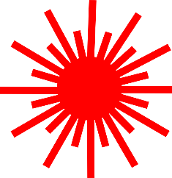
Coherent scattering and memory effect
Speckle Image
In this work: develop a closed-form expression for speckle statistics
Coherent Illumination
Scattering Medium
Notes:
When we shine a laser beam on a scattering material, we get noise-like speckle patterns.
These patterns have strong statistical properties such as the memory effect, meaning that the speckle pattern shifts as we tilt the illumination beam producing it.
These statistical properties are not fully understood, in large part due to the lack of analytically tractable models for simulating them.
In this work we introduce a simple analytical model for speckle statistics, and show that it is much more accurate than previous models.

Slide 3
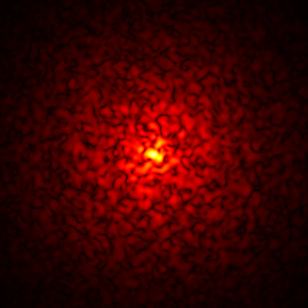
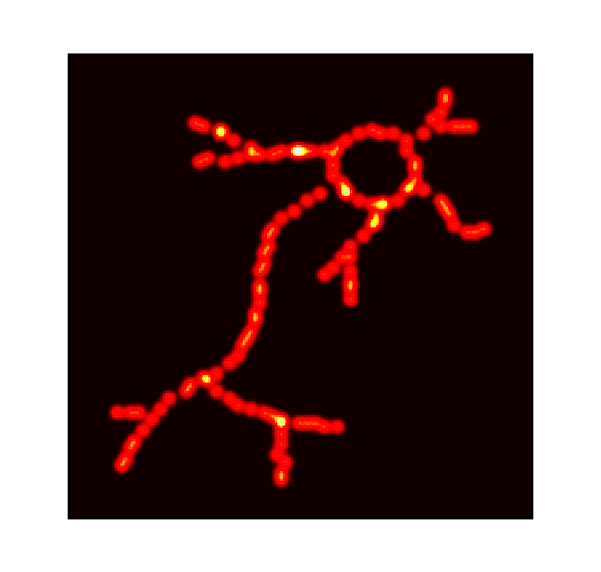
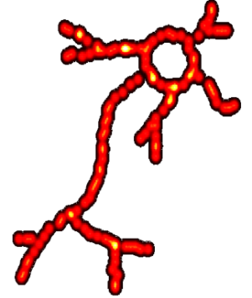
Speckle imaging applications
Seeing through scattering materials [Katz et al. 2014]
Speckle Image
Reconstruction
Hidden Object
Scattering Layer
Our model can help to explain:
For what types of materials does this work?
What kinds of targets can it reconstruct?
Notes:
Modeling speckle statistics is important because of the large variety of speckle-based computational imaging techniques.
One example is the imaging-through-scattering work of Katz and colleagues.
The goal is to recover a clear image of fluorescent sources that are hidden from a camera by a scattering layer such as tissue.
The speckle memory effect makes it possible to remove the effect of scattering by simply computing the autocorrelation of the speckle image.
An analytical model for speckle statistics can help us investigate under what conditions this imaging-through-scattering procedure will succeed, without the need for tedious lab experiments.

Slide 4
Speckle imaging applications
Adaptive optics focusing through scattering material [Judkewitz et al. 2014]
Spatial light modulator
We can focus at nearby points by adjusting the same adaptive pattern
Our model can help explain: how large this refocusing range is? what wavefront adjustments can increase its size?
Notes:
Another application of speckle statistics is in adaptive optics focusing.
The goal is to change the shape of a wavefront so that, when it propagates through a scattering layer, it will focus at a sharp spot, as if the scattering layer were not there.
Finding the wavefront shape needed to achieve focusing is a difficult calibration procedure, which normally needs to be performed separately for each focus point inside the volume.
The speckle memory effect makes it possible to adjust an already-calibrated wavefront shape to refocus to different points within some small range.
An analytical model for the memory effect and other speckle statistics can help us investigate how large this refocusing range is.

Slide 5
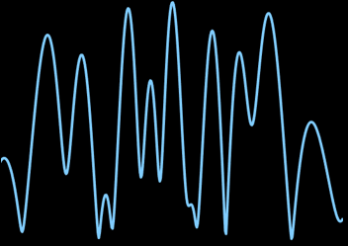
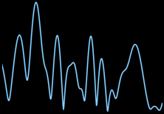
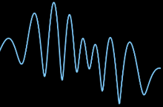
How to study speckle correlations?
Approach 1: Exact simulators
These techniques do not lend themselves to theoretical analysis
computationally expensive
Notes:
These and other important applications have motivated the development of a few techniques for modeling speckle statistics.
One category of techniques focus on exact simulators.
However, exact simulation remains computationally expensive, even when using advanced computer graphics techniques.
Additionally, as simulation is done by numerical techniques, these techniques do not lend themselves to theoretical analysis.

Slide 6
How to study speckle correlations?
Optical Depth (O.D.): average number of scattering events on a path
Approach 2: Analytic approximations
Thick materials
Incoherent illum
Very thick medium
O.D. >> 1
O.D. >> 1
Diffusion
Thin materials
Single Scattering
Very thin medium
O.D. < 1
O.D. < 1
Notes:
Another category of techniques focus on developing closed-form, but approximate, models for speckle statistics.
Our work falls under this category, and draws inspiration from closely-related approximate models for incoherent intensity images.
Let’s focus on two opposite extreme cases: Scattering through very thick and very thin layers.
We will characterize the optical thickness of a scattering layer using its optical depth, which measures the average number of scattering events of light passing through the layer.
With this in mind, the first main analytical model is based on the diffusion approximation: Where the light scatters a very large number of times.
The second such model is based on the single-scattering approximation: assuming that the light scatters only once.

Slide 7
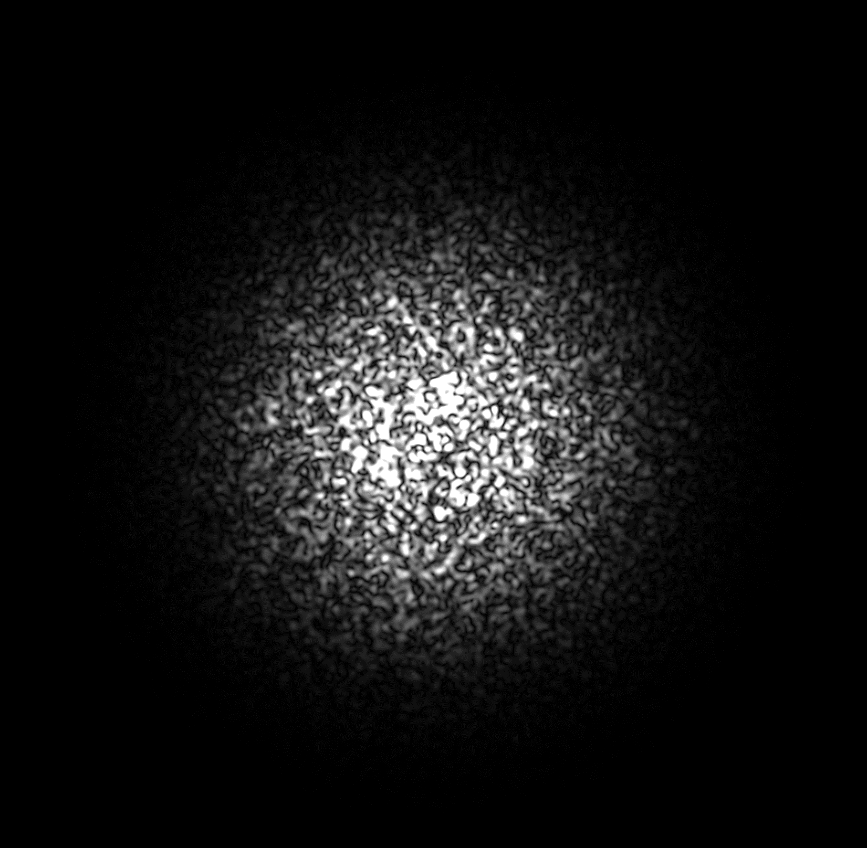
How to study speckle correlations?
Optical Depth (O.D.): average number of scattering events on a path
Approach 2: Analytic approximations
Thick materials
Incoherent illum
Coherent illum
Not much memory effect
Very thick medium
O.D. >> 1
Very thick medium O.D. >>1
O.D. >> 1
Diffusion
Thin materials
Very thin medium
O.D. < 1
Our work: Also for O.D. > 1
Single Scattering
O.D. < 1
Notes:
There has been a lot of prior work towards adapting models based on the diffusion approximation to the case of speckle statistics.
As with incoherent intensity, these models only apply to very optically thick scattering layers.
However, the memory effect there is very weak, and is not very useful in practice.
In this work, we introduce a simple analytical model for speckle statistics, based-on the single scattering approximation.
In contrast to the incoherent case, for the case of speckle statistics, we show that this approximation holds even when considering layers with optical depth much greater than one.

Slide 8
Setup
$$u^{i_{2}}\left(v\right)$$
$$i_{1}$$
$$v_{2}$$
The speckle covariance
$$C_{v_{1},v_{2}}^{i_{1},i_{2}}=Etissue\left[u^{i_{1}}\left(v_{1}\right)∙u^{i_{2}}\left(v_{2}\right)\right]$$
Expectation over different realizations of materials with the same scattering parameters
$$i_{2}$$
$$v_{1}$$
$$u^{i_{1}}\left(v\right)$$
Notes:
To understand what we are trying to evaluate consider the following setup: we illuminate a scattering layer from direction i1, resulting in a scattered field.
We do the same from another direction i2.
According to the memory effect, the two scattered fields should be correlated with each other.
To quantify this correlation, let’s select two viewing directions v1 and v2, and look at the expected product of the field scattered from i1 toward v1 and the field scattered from i2 toward v2.
We call this the speckle covariance.
The expectation is taken with respect to different realizations of volumes with the same scattering parameters.

Slide 9
Setup
$$i_{1}=i_{2}$$
$$i_{1}$$
Intensity
The speckle covariance
$$I_{v_{1}}^{i_{1}}=Etissue\left[{\left|u^{i_{1}}\left(v_{1}\right)\right|}^{2}\right]$$
$$C_{v_{1},v_{2}}^{i_{1},i_{2}}=Etissue\left[u^{i_{1}}\left(v_{1}\right)∙u^{i_{2}}\left(v_{2}\right)\right]$$
Expectation over different realizations of materials with the same scattering parameters
$$i_{2}$$
$$v_{1}$$
$$u^{i_{1}}\left(v\right)$$
Notes:
If the two illuminators and viewing directions are the same, the covariance is just the intensity of the field.

Slide 10
Rendering speckle covariance
$$i_{1}=i_{2}$$
$$Covariance=\int{u\left({path}_{1}\right)∙u^{∗}\left({path}_{2}\right)}$$
$${path}_{1},{path}_{2}$$
Intensity
$$I_{v_{1}}^{i_{1}}=Etissue\left[{\left|u^{i_{1}}\left(v_{1}\right)\right|}^{2}\right]$$
Expectation over different realizations of materials with the same scattering parameters
$$v_{1}$$
$$u^{i_{1}}\left(v\right)$$
Notes:
To understand how we can model this covariance, we can start from classical results in the optics literature, which state that we can express covariance as an integral over pairs of light paths through the scattering layer.

Slide 11
Rendering speckle covariance
$$Covariance=\int{u\left({path}_{1}\right)∙u^{∗}\left({path}_{2}\right)}$$
$$i_{1}$$
$$v_{2}$$
$${path}_{1},{path}_{2}$$
Complex throughput :
$$u=\left|u\right|e^{i∙phase}$$
$$i_{2}$$
$$v_{1}$$
Phase $∝$ Length ( path )
Length ( path1 ) –
Length ( path2 )
Phase difference $∝$
Notes:
To make this concrete, let’s consider two paths, one starting from light 1 and ending at view 1, and another starting from light 2 and ending at view 2.
Each path has a complex contribution u, describing amplitude and phase contribution of the path.
In particular, the phase of a path is proportional to its length.
The product of two such complex path contributions is also a complex number, with a phase proportional to the difference of the two path lengths.
And we have many such path pairs.

Slide 12
Rendering speckle covariance
$$Covariance=\int{u\left({path}_{1}\right)∙u^{∗}\left({path}_{2}\right)}$$
$$i_{1}$$
$$v_{2}$$
$${path}_{1},{path}_{2}$$
Im
Complex throughput :
$$u=\left|u\right|e^{i∙phase}$$
$$i_{2}$$
$$v_{1}$$
Phase $∝$ Length ( path )
Re
Length ( path1 ) –
Length ( path2 )
Phase difference $∝$
Plot of: $u\left({path}_{1}\right)∙u^{∗}\left({path}_{2}\right)$
Notes:
Since the contribution is complex, let’s plot it as a point in the complex plane.

Slide 13
Rendering speckle covariance
$$Covariance=\int{u\left({path}_{1}\right)∙u^{∗}\left({path}_{2}\right)}$$
$$i_{1}$$
$$v_{2}$$
$${path}_{1},{path}_{2}$$
Im
$$i_{2}$$
Integral
$$v_{1}$$
Re
Average over all pairs of paths
Plot of: $u\left({path}_{1}\right)∙u^{∗}\left({path}_{2}\right)$
Notes:
To get the covariance we need to average this pairwise complex contribution over all possible path pairs.
However, as we are averaging complex numbers with highly varying phases, they tend to cancel each other, and thus their average approaches zero.

Slide 14
Rendering speckle covariance
$$Covariance=\int{u\left({path}_{1}\right)∙u^{∗}\left({path}_{2}\right)}$$
$$i_{1}$$
$$v_{2}$$
$${path}_{1},{path}_{2}$$
Im
Integral
$$i_{2}$$
Integral
$$v_{1}$$
Re
Average path pairs with shared vertices
[Bar et al. 2019]
Plot of: $u\left({path}_{1}\right)∙u^{∗}\left({path}_{2}\right)$
Notes:
Based on this observation, we proved in prior work that we can simplify this model, by considering only path pairs that share all their vertices, and differ only in the 4 segments connecting the path to the two illumination and viewing directions.
With this restriction, the central segment of the two paths have the same length, and thus their phases are more consistent.

Slide 15
Rendering speckle covariance
$$Covariance=\int{u\left({path}_{1}\right)∙u^{∗}\left({path}_{2}\right)}$$
$$i_{1}$$
$$v_{2}$$
$$i_{1}=i_{2}$$
$${path}_{1},{path}_{2}$$
$$v_{1}=v_{2}$$
Im
Integral
$$i_{2}$$
Integral
$$v_{1}$$
Re
Plot of: $u\left({path}_{1}\right)∙u^{∗}\left({path}_{2}\right)$
Notes:
In this work we note that even after we restrict our paths pairs to share the same vertices, they still have 4 segments that can differ in length, resulting in complex contributions with highly-varying phase.
One way to ensure that all path pairs have the same phase is to consider a situation where i1=i2 and v1=v2.
In this case, all path pairs contribute zero phase, and the covariance becomes the intensity of the field.

Slide 16
Rendering speckle covariance
$$Covariance=\int{u\left({path}_{1}\right)∙u^{∗}\left({path}_{2}\right)}$$
$$i_{1}$$
$$v_{2}$$
$${path}_{1},{path}_{2}$$
Im
$$i_{2}$$
Integral
$$v_{1}$$
Re
In this work: consider
single scattering paths
Plot of: $u\left({path}_{1}\right)∙u^{∗}\left({path}_{2}\right)$
Notes:
But nonzero covariance exists in other configurations.
In particular, we can identify a large family of path pairs with consistent phases in the following way: we consider illumination and viewing configurations where the difference between i1 to i2 is equivalent to the difference between v1 to v2, and we only consider paths that scatter at a single vertex.
We can show that all these single scattering path pairs contribute a throughput with a fixed phase, and therefore they sum in a constructive way generating non-zero covariance.
What we argue in this work is that we can approximate most of the covariance we observe in practice using only these single scattering paths, and thus we can ignore longer paths.

Slide 17
Closed-form single scattering covariance
$$C\left(τ,Δ\right)=Lρ\left(τ\right)σ_{s}e^{−σ_{t}L−0.5ikL\left(Δ∙τ\right)}sinc\left(0.5kL\left(Δ∙τ\right)\right)$$
$$C\left(τ,Δ\right)=Lρ\left(τ\right)σ_{s}e^{−σ_{t}L−0.5ikL\left(Δ∙τ\right)}sinc\left(0.5kL\left(Δ∙τ\right)\right)$$
$$C\left(τ,Δ\right)=Lρ\left(τ\right)σ_{s}e^{−σ_{t}L−0.5ikL\left(Δ∙τ\right)}sinc\left(0.5kL\left(Δ∙τ\right)\right)$$
$$i_{1}$$
$$C\left(τ,Δ\right)=Lρ\left(τ\right)σ_{s}e^{−σ_{t}L−0.5ikL\left(Δ∙τ\right)}sinc\left(0.5kL\left(Δ∙τ\right)\right)$$
$$v_{2}$$
Illumination and viewing directions:
$$Δ=i_{2}−i_{1}=v_{2}−v_{1}$$
$$τ=v_{1}−i_{1}=v_{2}−i_{2}$$
$$Δ$$
Medium thickness:
$$L$$
$$i_{2}$$
$$v_{1}$$
Material parameters:
$$τ$$
$$σ_{s}$$
$$v_{}$$
Scattering coefficient:
$$i_{}$$
$$τ$$
$$0$$
$$L$$
Extinction coefficient:
$$σ_{t}$$
Phase function:
$$ρ\left(τ\right)$$
Notes:
The main advantage of this approximation is that it allows us to compute covariance in closed-form, without the need for numerical tools such as Monte Carlo rendering.
This closed-form expression can be simplified to depend only on two angles: The angle delta between the two illumination directions; and the scattering angle tau between the illumination and viewing directions.
The expression also depends on the thickness L of the scattering layer, and its material parameters.

Slide 18
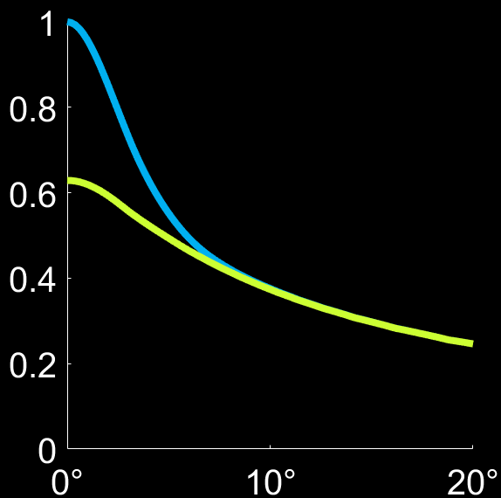
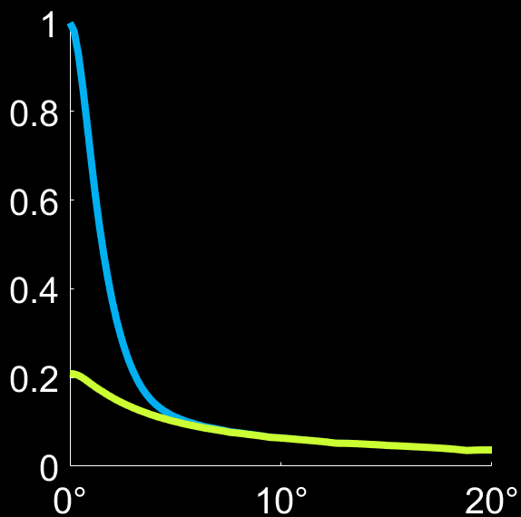
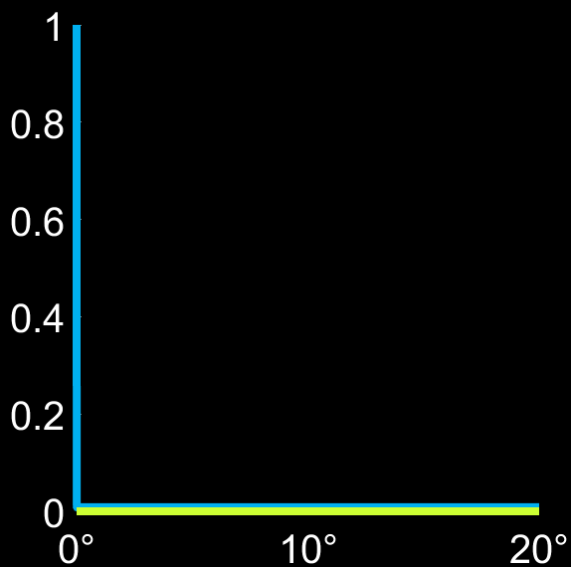
Single scattering covariance evaluation
Exact Single Scattering
O.D. = 1
O.D. = 3
O.D. = 100
$$i_{1}$$
This range is very useful for several applications
$$i_{2}$$
Covariance $C\left(Δ\right)$
$$Δ$$
$$i_{2}$$
$$i_{2}$$
$Δ$ [deg]
$Δ$ [deg]
$Δ$ [deg]
O.D. = average number of scattering events on a path though the volume
$$Δ=i_{2}−i_{1}=v_{2}−v_{1}$$
Notes:
To evaluate the accuracy of this closed-form expression, we compare its predictions with those of an exact Monte Carlo covariance rendering. We plot the covariance as a function of delta, the angle between the two illuminating directions.
When delta is zero, the covariance equals the intensity of the field, and it is well-known that due to multiple scattering, the single-scattering is not a good approximation for intensity.
However, as we increase the angle between the illumination directions, the single scattering approximation becomes accurate, because longer paths have different phases and they do not contribute to the covariance.
This range of delta values is very useful for several applications we list in the paper.
The single scattering model is accurate even for optical depth 3, when light paths have an average of 3 scattering events.
As expected for very thick layers, the covariance is zero..

Slide 19
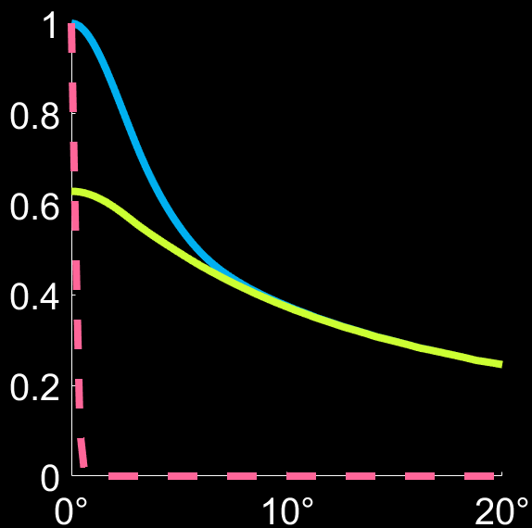
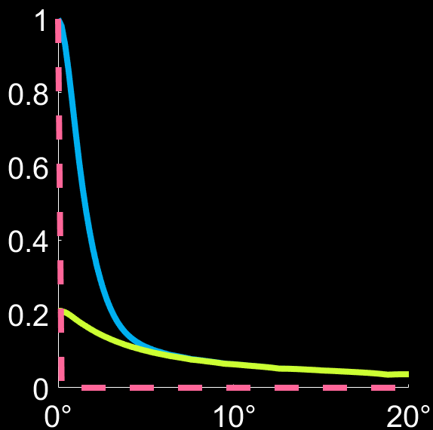
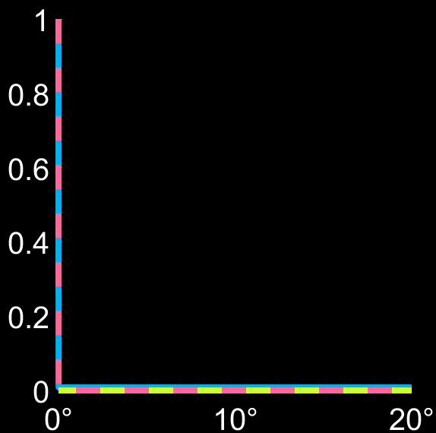
Single scattering covariance evaluation
Exact Single Scattering Diffusion model
O.D. = 1
O.D. = 3
O.D. = 100
$$i_{1}$$
$$v_{2}$$
Covariance $C\left(Δ\right)$
Diffusion is too pessimistic for smaller optical depths
Diffusion is accurate, but there is zero covariance.
$$Δ$$
$$v_{1}$$
$$i_{2}$$
$$τ$$
$Δ$ [deg]
$Δ$ [deg]
$Δ$ [deg]
O.D. = average number of scattering events on a path though the volume
$$Δ=i_{2}−i_{1}=v_{2}−v_{1}$$
$$τ=v_{1}−i_{1}=v_{2}−i_{2}$$
Notes:
We also compare our single-scattering approximation with the diffusion model.
As we’ve seen before, the diffusion theory applies for large optical depths, and its predictions are too pessimistic for smaller optical depths, always predicting zero covariance.
The diffusion-based model becomes accurate only for very large optical depths. However, for such optical depths, there is zero covariance anyway.
We’ve discussed Delta, now let us look at the scattering angle tau.

Slide 20
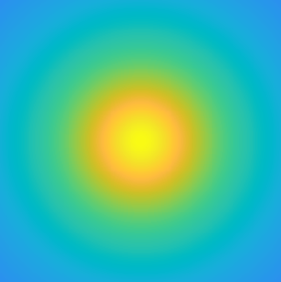
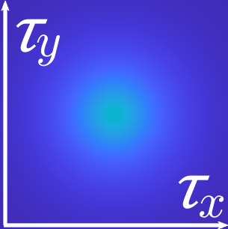
Explaining dependency on scattering angle
$$i_{1}$$
$$v_{2}$$
Our model
$$C\left(τ,Δ\right)=Lρ\left(τ\right)σ_{s}e^{−σ_{t}L−0.5ikL\left(Δ∙τ\right)}sinc\left(0.5kL\left(Δ∙τ\right)\right)$$
Covariance lab
measurements
Δ = 0°
Δ = 5°
Δ = 20°
$$v_{1}$$
Can recover phase function from correlation
$$Δ$$
$τ$_{y}
$$i_{2}$$
$$τ$$
Total Covariance
$τ$_{x}
Δ
See paper for other new properties that our model reveals
$$v_{}$$
Single Scattering Covariance
$$i_{}$$
$$τ$$
$$C\left(τ,Δ\right)∝ρ\left(τ\right)$$
Simulated covariance with O.D. = 5
Correlation decays for larger scattering angles
Notes:
So, diffusion-based and other prior analytical models predict that covariance is only a function of the angle delta between the two illumination directions.
However, in our lab measurements we’ve seen that speckle covariance also depends on the scattering angle tau.
Our model is the first analytical model we know of that can predict this dependency.
To understand this, recall that our closed form expression of correlation depends on the phase function of the material.
In this simulation, we used the phase function of tissue, which is highly forward scattering.
As a result, covariance decays quickly as we look at larger scattering angles.
This observation has a very important implication when we image a material we are not familiar with, because it means that we can read the phase function of the material directly from the speckle correlation.
And this is true even if the optical depth of the material is larger than one, and most light paths scattered multiple times.
In the paper we discuss other new properties of speckle covariance revealed by our model, and their potential utility for computational imaging applications.

Slide 21
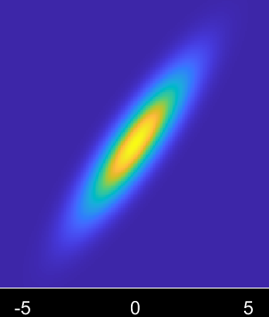
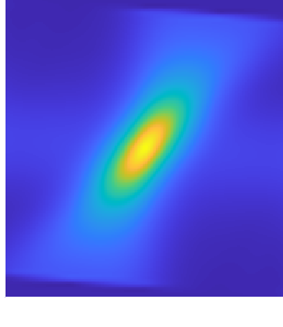
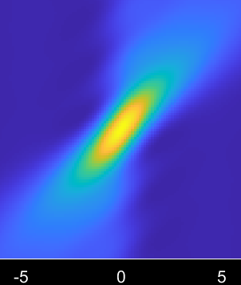
Tilt-shift memory effect
Our single scattering model explains lab measurements by [G. Osnabrugge et al. 2017] more accurately than previous models
Analytic model by Osnabrugge et al. based on a Fokker-Plank approximation
Lab measurement by Osnabrugge et al.
Our single scattering model
$$θ \left[rad\right]$$
$$θ \left[rad\right]$$
$$Δ \left[μm\right]$$
$$Δ \left[μm\right]$$
$$Δ \left[μm\right]$$
Notes:
In particular, our model can better explain the tilt shift memory effect property studied by Osnabrugge et al.
Due to lack of time, I won’t get into details with this,
We just show here some lab measurements of covariance they conducted, producing this double-wedge shape.
Our single-scattering model better matches this double-wedge shape than the analytical model Osnabrugge et al. developed to explain it.

Slide 22
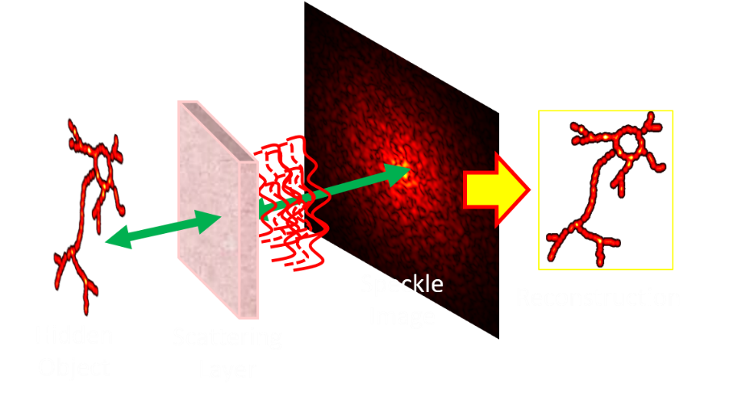
Summary
Speckle Covariance
Single scattering
Better explanation of speckle statistics
Accurate for thick materials!
Applications
$$C\left(τ,Δ\right)∝ρ\left(τ\right)$$
Notes:
To summarize, we introduced an analytical model for speckle covariance based on the single scattering approximation.
Unlike the intensity case, our model can explain speckle covariance even at optical depth greater than 1, where most light paths scatter multiple times.
This is because multiply-scattered paths interfere destructively and do not contribute to covariance.
Our model can explain previously reported statistical speckle properties better than alternative analytical models,
and can be useful for many computational imaging applications.

Slide 23
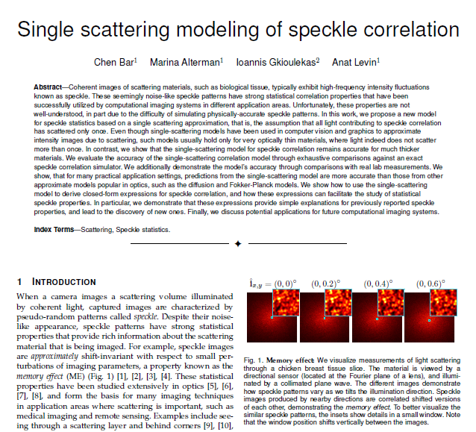
See paper for details
Link to paper
https://webee.technion.ac.il/people/anat.levin/papers/BarEtAl_SingleScattering_ICCP2021.pdf
Notes:
Please see our paper for more details and applications.

