Slide 1
Rendering Near-Field Speckle Statistics in Scattering Media Chen Bar, Ioannis Gkioulekas and Anat Levin Technion, Israel CMU, USA

Slide 2
Coherent scattering and memory effect
Tissue
Microscope objective
Speckle image
Notes:
In fluorescence microscopy, we try to image fluorescent light sources that are deep inside tissue. Because of light scattering, we don’t see sharp images of these sources, but instead images containing speckle patterns. Despite looking like noise, these patterns have strong statistical properties. A well-known one is the memory effect: This means that, if you move the light source, the speckle pattern shifts. As a result, speckle patterns generated by nearby sources are correlated shifted versions of each other. I’ll talk about how to correctly render such speckle patterns---in fact, the ones shown here are not measured in the lab, but they are rendered using our algorithms.

Slide 3
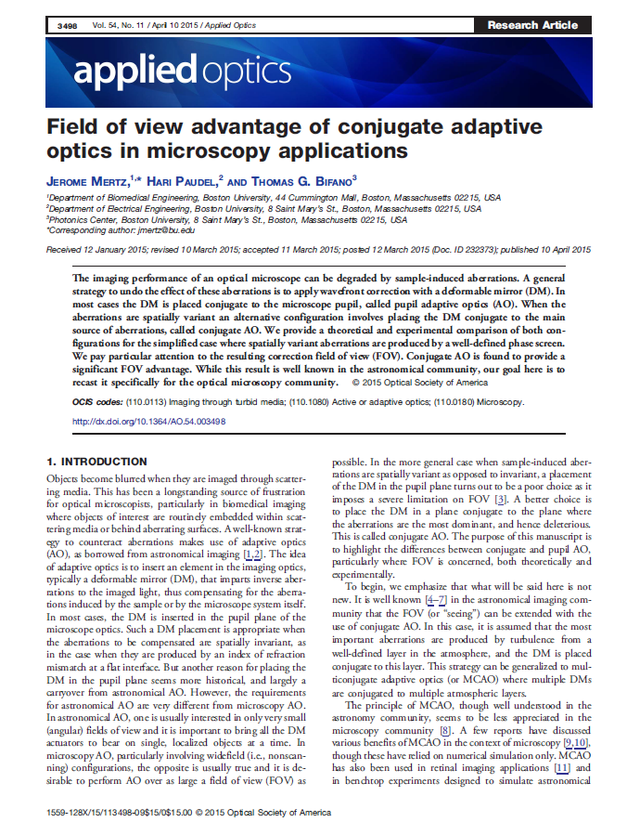
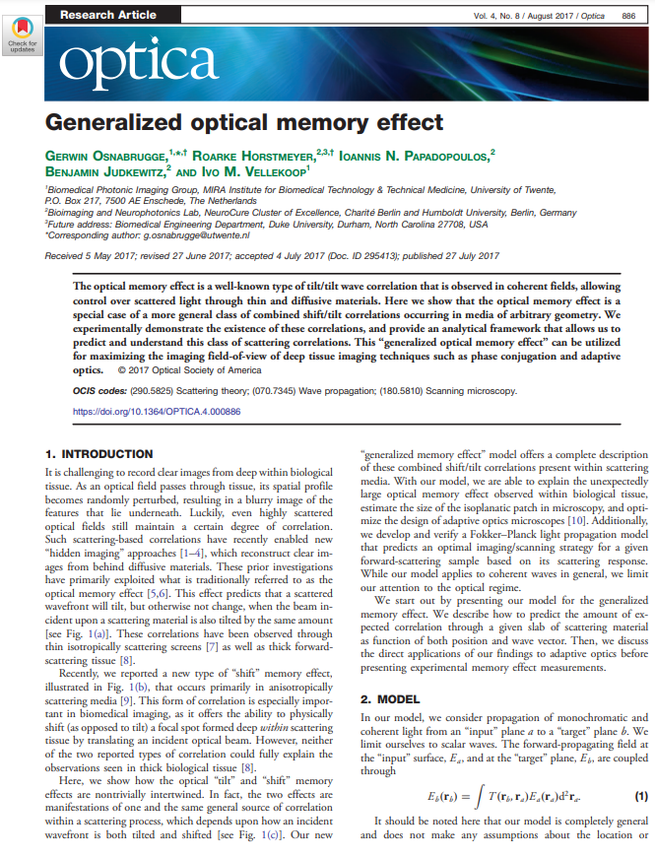
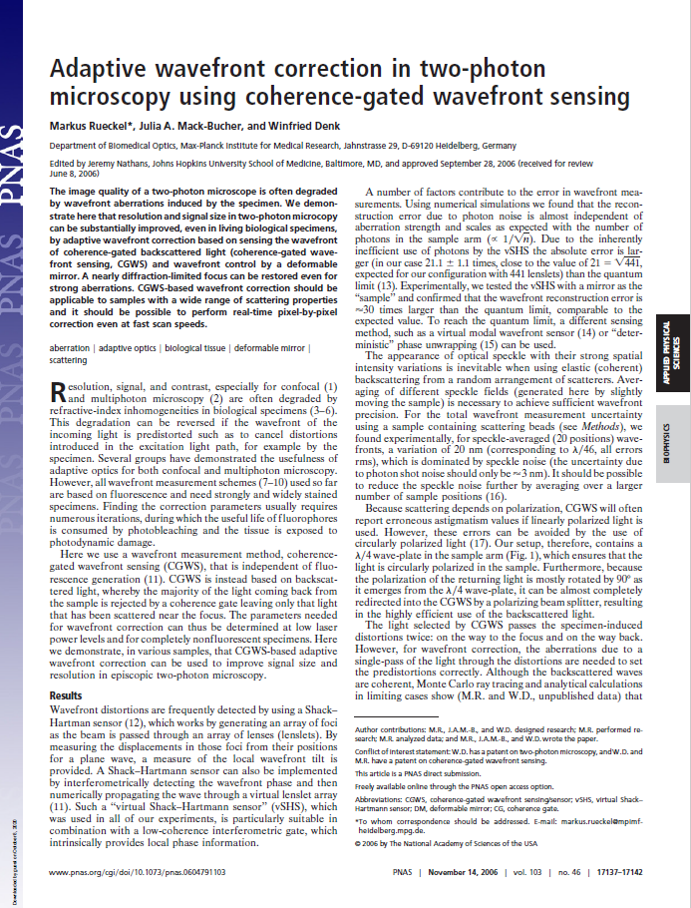
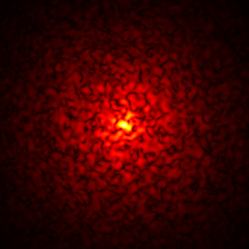
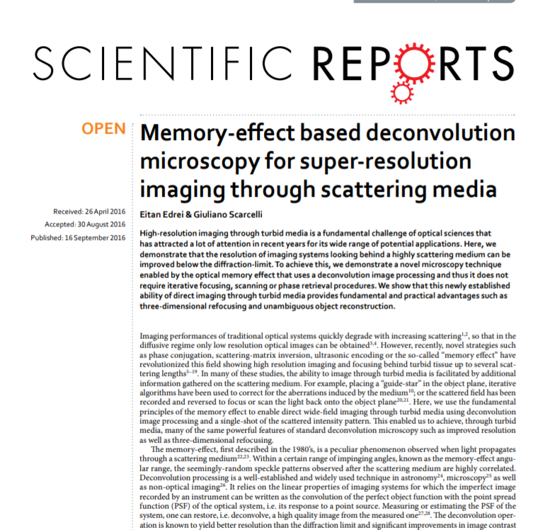
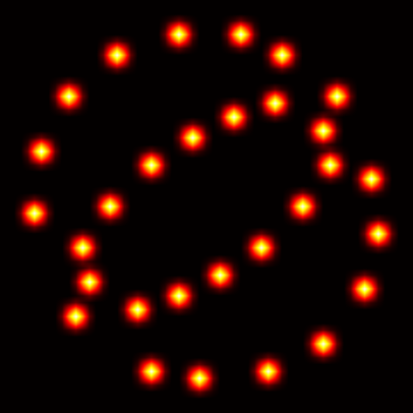
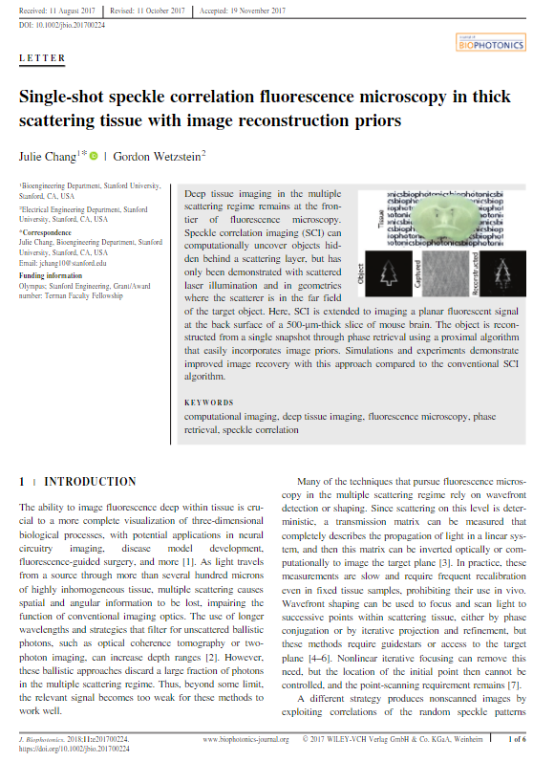
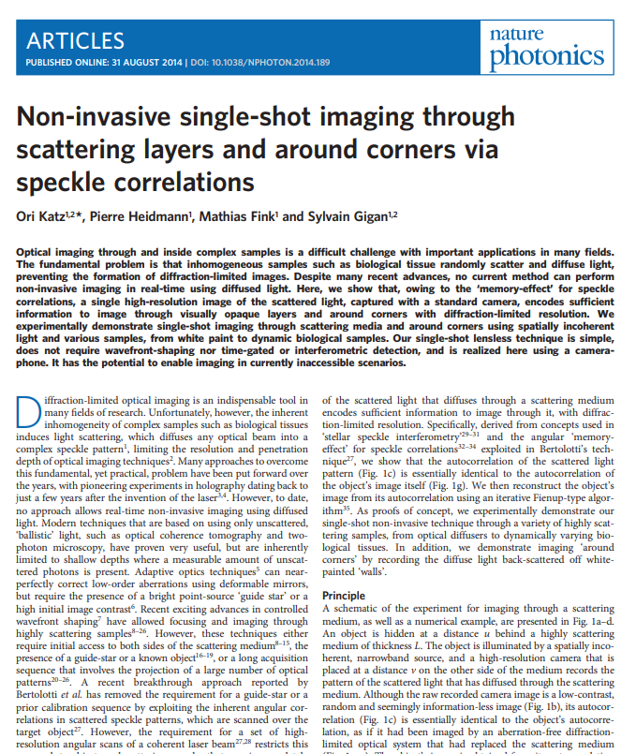
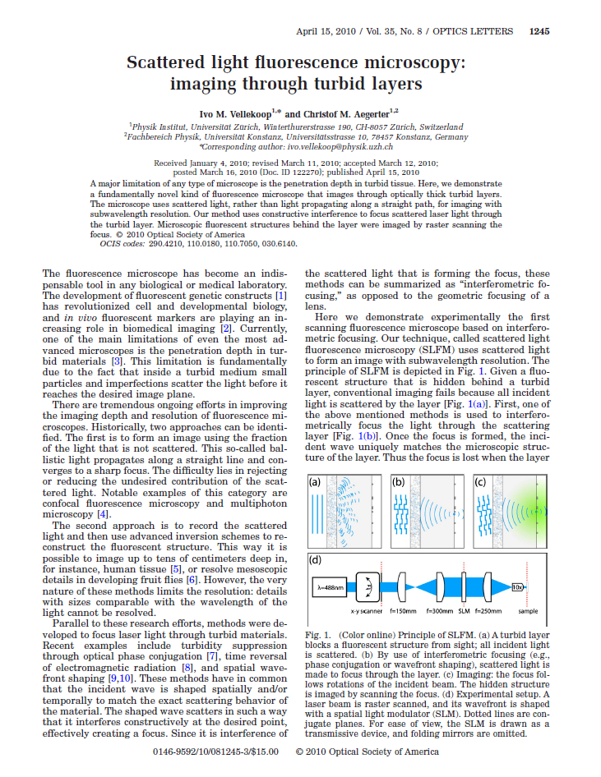
Applications and related work
Speckle imaging applications
Seeing through scattering materials [Katz et al. 2014]
Speckle Image
Hidden Object
Scattering Layer
Notes:
The reason why we care to do this is that there are a lot of medical imaging techniques that use speckle for better imaging.
(slide 4)
One example is the work of Katz and colleagues. The goal is to recover a fluorescent object that is hidden from a camera by a scattering layer.

Slide 4
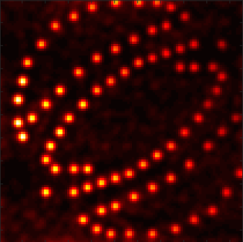
Speckle imaging applications
Seeing through scattering materials [Katz et al. 2014]
Speckle Image
Reconstruction
Hidden Object
Scattering Layer
For what types of materials does this work?
What kinds of targets can it reconstruct?
Notes:
Thanks to the memory effect, we can remove the effect of scattering and recover the object by simply computing the autocorrelation of the speckle image. As this imaging-through-scattering procedure will not always be successful, it is important to understand its limitations. For example, for what types of materials or fluorescent objects will it work? Using a physically-accurate renderer, we can efficiently investigate these limitations, without the need for tedious lab experiments.

Slide 5
Speckle imaging applications
Adaptive optics focusing through scattering material [Judkewitz et al. 2014]
Spatial light modulator
Can we focus at nearby points by reusing the same adaptive pattern?
For what ranges is this possible?
5
Notes:
Another important application of the memory effect is in adaptive optics focusing. Consider the case where we use a lens to focus a beam to a small spot. If we place a tissue layer in front of the lens, light will focus instead to a blurry spot. In adaptive optics, we use a spatial light modulator to change the shape of the wavefront we send through the lens and tissue, so that light again focuses to a sharp spot. Finding the wavefront shape we need to use to achieve focusing is quite expensive, and normally needs to be done separately for each point we want to focus on.
However, using the memory effect, we can adjust the same wavefront shape to refocus to different points within some small range. Using a physically-accurate renderer, we can investigate how large this range is, and how sharply we can refocus.

Slide 6
Rendering speckles, how?
Solve wave optics equations
Monte-Carlo approach
Bar et al. 2019
Impractical
Physically accurate
Orders of magnitude faster
Notes:
The traditional approach for rendering speckle is to use numerical techniques for solving the wave equations. Unfortunately, this approach is prohibitively expensive and only practical for tiny volumes. Last year, we introduced a different approach that uses Monte Carlo techniques to simulate speckle. This approach is orders of magnitude faster, yet produces equivalent speckle statistics. Unfortunately, we still cannot directly use our approach to efficiently simulate the tissue imaging applications we described earlier, and here is why.

Slide 7
Far field v.s. near field
Near field
$${\text{ℓ}}_{}$$
$$i_{}$$
Far field
Point source
Wide collimated illumination
our previous algorithm assumes far-field
Lens
point source inside the material
Imaged point source
Tissue imaging applications are in the near field
$$i_{}$$
$$q_{}$$
Imaged view point
Lens
Directional view
$$q_{}$$
View point
$$v_{}$$
Notes:
Our previous approach assumes far field imaging conditions. What this means is that we consider directional illumination coming from very far away from the source. By contrast, tissue imaging uses near-field imaging conditions. This corresponds to having a point source inside the material. To simplify analysis, we can also consider a point source that is imaged inside the material through a lens. Likewise, we distinguish between far-field and near-field viewpoints. Even though near-field conditions are the ones needed for tissue imaging applications, these are exactly the imaging conditions that are the most challenging for our previous algorithm which was designed for the far field. Before we explain the challenge, we will first explain what exactly we are trying to simulate.

Slide 8
Visualizing near-field covariance
$$i_{1}$$
$$i_{2}$$
Illuminations
$$E_{tissue} \left[ \right]=$$
Viewing objective
Notes:
Our goal is to render not speckle images directly, but rather speckle covariance. Once we have the covariance, we can use it to sample physically-accurate speckle images. To understand what we mean by speckle covariance, let’s consider a source inside the material, which produces this speckle image. If we shift the source, we get a correlated shifted speckle image. To measure speckle covariance, we take the two speckle images, align them, and multiply them. We then average this product over speckle images from many different tissue layers. The resulting smooth pattern is the speckle covariance, which is typically stronger in the center and decays as we move away from it.

Slide 9
Visualizing near-field covariance
$$Δ=0λ$$
$$Δ=3λ$$
$$Δ=6λ$$
$$i_{2}$$
$$i_{2}$$
$$i_{1}$$
$$i_{2}$$
$$i_{1}$$
$$i_{1}$$
Illuminations
$$Δ=0λ$$
$$Δ=3λ$$
$$Δ=6λ$$
Viewing objective
Notes:
The covariance image changes as we change the source displacement, and becomes smaller for larger displacements.

Slide 10
Intensity rendering
Near field
$${\text{ℓ}}_{1}$$
$$i_{1}$$
Far field
$${\text{ℓ}}_{1}$$
$$a_{i_{1}}\left({\text{ℓ}}_{1}\right)$$
$$v_{1}$$
$$a_{q_{1}}\left(v_{1}\right)$$
$$v_{1}$$
$$q_{1}$$
Notes:
Let’s now quickly review our approach for far-field rendering, and see why it is challenging to use it for near-field conditions. To render intensity images of scattering media, we typically start by sampling a path inside the medium. For a directional source at direction ell_1, we then make the first segment of the path a ray at direction ell_1; and similarly we make the last segment a ray at direction v1. We repeat this for multiple sampled paths. By contrast, in the near-field, we need to connect the path to the point source i1 through the lens. Instead of just one ray, this requires tracing all possible rays through the lens aperture. We also need to do the same for the imaging aperture.

Slide 11
Covariance rendering
Near field
$${\text{ℓ}}_{1}$$
$${\text{ℓ}}_{2}$$
$$i_{1}$$
Far field
$$i_{2}$$
Main challenge: efficiently estimating the total throughput through the apertures
$${\text{ℓ}}_{1}$$
$${\text{ℓ}}_{2}$$
$$a_{i_{1}}\left({\text{ℓ}}_{1}\right)$$
$$a_{i_{2}}\left({\text{ℓ}}_{2}\right)$$
$$v_{2}$$
$$v_{1}$$
$$a_{q_{1}}\left(v_{1}\right)$$
$$a_{q_{2}}\left(v_{2}\right)$$
$$v_{2}$$
$$v_{1}$$
$$q_{1}$$
$$q_{2}$$
Notes:
Let’s now look at rendering covariance instead of intensity. For this, we need to add a second light source and a second sensor. As we showed in our previous paper, rendering covariance requires connecting each sampled path to all sources and sensors. In the far-field, this can be done easily by tracing 4 directional segments. However, in the near field, we need to draw all possible rays through four different apertures.
The main challenge here is to find an efficient method for estimating the total throughput through the apertures.

Slide 12
Near-field rendering? Potential solution 1
Bad approach #1: compute multiple tabulated values of far-field covariance, then apply linear transformation to compute the near field covariance
$$i_{1}$$
$$i_{2}$$
$${\text{ℓ}}_{1}$$
$${\text{ℓ}}_{2}$$
$$\begin{aligned}\text{Near}\text{−}\text{f}\text{ield} \\ \text{covariance}\end{aligned}$$
$$a_{i_{1}}\left({\text{ℓ}}_{1}\right)$$
$$a_{i_{2}}\left({\text{ℓ}}_{2}\right)$$
$$\overset{}{\overbrace{C_{i_{1},i_{2}}^{q_{1},q_{2}}}}=$$
$$\int{\underset{}{\underbrace{a\left({\text{ℓ}}_{1},{\text{ℓ}}_{2},v_{1},v_{2}\right)}}\underset{}{\underbrace{C_{v_{1},v_{2}}^{{\text{ℓ}}_{1},{\text{ℓ}}_{2}}}}}$$
Lots of far-field directions to render.
Huge computation and memory requirements
$$\overset{}{\overbrace{C_{i_{1},i_{2}}^{q_{1},q_{2}}}}=$$
$$\int{\underset{}{\underbrace{a\left({\text{ℓ}}_{1},{\text{ℓ}}_{2},v_{1},v_{2}\right)}}\underset{}{\underbrace{C_{v_{1},v_{2}}^{{\text{ℓ}}_{1},{\text{ℓ}}_{2}}}}}$$
$$v_{2}$$
$$v_{1}$$
$$a_{q_{1}}\left(v_{1}\right)$$
$$a_{q_{2}}\left(v_{2}\right)$$
$$\text{Aperture}$$
$$\begin{aligned}\text{Far}\text{−}\text{f}\text{ield} \\ \text{covariance}\end{aligned}$$
$$q_{1}$$
$$q_{2}$$
Notes:
As a first attempt towards rendering near-field covariance, we can use the fact that it can be related to the far-field one through a 4D integral. This corresponds to summing far-field covariance for all possible combinations of directions through the four illumination and imaging apertures. Therefore, theoretically we can evaluate this integral by computing a tabulated version of the far field covariance for all direction combinations, and forming a weighted average of the table entries.
Unfortunately, in practice, this requires running and storing an impractically large number of far-field covariance renderings.

Slide 13
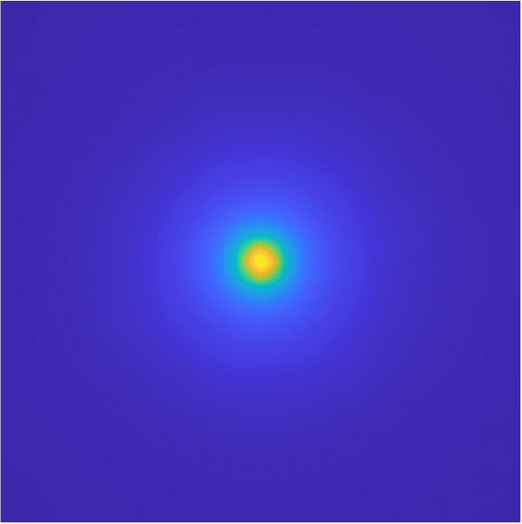
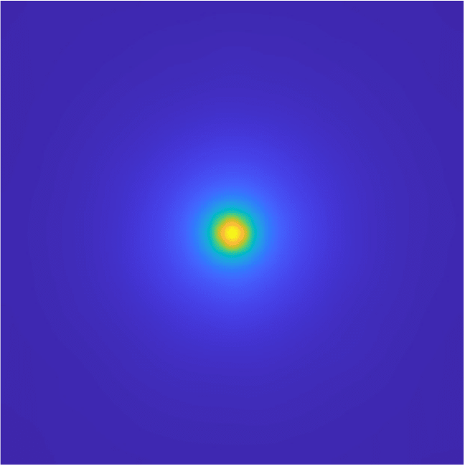
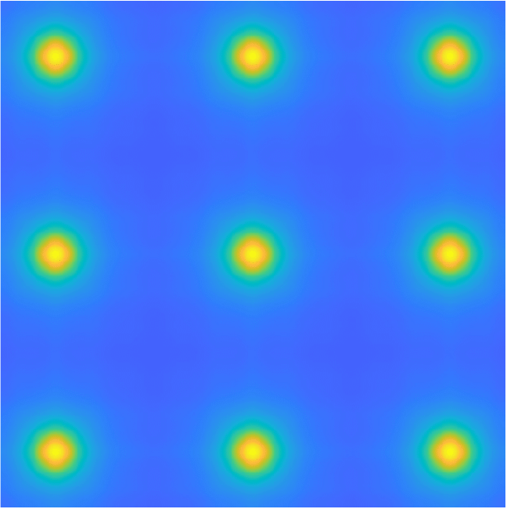
Near-field rendering? Potential solution 1
Bad approach #1: compute multiple tabulated values of far-field covariance, then apply linear transformation to compute the near field covariance
$$i_{1}$$
$$i_{2}$$
Tabulation approach
Our approach
$${\text{ℓ}}_{1}$$
$${\text{ℓ}}_{2}$$
$$\begin{aligned}\text{Near}\text{−}\text{f}\text{ield} \\ \text{covariance}\end{aligned}$$
$$a_{i_{1}}\left({\text{ℓ}}_{1}\right)$$
$$a_{i_{2}}\left({\text{ℓ}}_{2}\right)$$
$$\overset{}{\overbrace{C_{i_{1},i_{2}}^{q_{1},q_{2}}}}=$$
$$\int{\underset{}{\underbrace{a\left({\text{ℓ}}_{1},{\text{ℓ}}_{2},v_{1},v_{2}\right)}}\underset{}{\underbrace{C_{v_{1},v_{2}}^{{\text{ℓ}}_{1},{\text{ℓ}}_{2}}}}}$$
Lots of far-field directions to render.
Huge computation and memory requirements
100 minutes
15 seconds
Fewer samples -> aliasing
$$v_{2}$$
$$v_{1}$$
$$a_{q_{1}}\left(v_{1}\right)$$
$$a_{q_{2}}\left(v_{2}\right)$$
$$\text{Aperture}$$
$$\begin{aligned}\text{Far}\text{−}\text{f}\text{ield} \\ \text{covariance}\end{aligned}$$
$$q_{1}$$
$$q_{2}$$
25 minutes
Notes:
For example, here we compare two near-field covariance renderings produced using this tabulation approach and our approach. They produce the same result, but whereas our approach runs for 15 seconds, the tabulation approach runs for 1.6 hours. If we reduce runtime by reducing the number of far-field tabulated entries, we end up with aliasing artifacts due to undersampling.

Slide 14
Near-field rendering? Potential solution 2
$$i_{1}$$
$$i_{1}$$
$$i_{2}$$
$$C_{i_{1},i_{2}}^{q_{1},q_{2}}\left(Path\right)=\int{a\left({\text{ℓ}}_{1},{\text{ℓ}}_{2},v_{1},v_{2}\right)f\left(Path\right)}$$
$$i_{2}$$
complex-valued integrals -> High variance
Bad approach #2: Monte Carlo sampling
$$a_{i_{1}}\left({\text{ℓ}}_{1}\right)$$
$$a_{i_{1}}\left({\text{ℓ}}_{1}\right)$$
$$a_{i_{2}}\left({\text{ℓ}}_{2}\right)$$
Computation involves integrals over the 4 apertures
$$a_{i_{2}}\left({\text{ℓ}}_{2}\right)$$
$$\sum_{\sim {\text{ℓ}}_{1},\sim {\text{ℓ}}_{2},\sim v_{1},\sim v_{2}}{a\left({\text{ℓ}}_{1},{\text{ℓ}}_{2},v_{1},v_{2}\right)f\left(Path\right)}$$
$$a_{q_{1}}\left(v_{1}\right)$$
$$a_{q_{1}}\left(v_{1}\right)$$
$$a_{q_{2}}\left(v_{2}\right)$$
$$a_{q_{2}}\left(v_{2}\right)$$
Sample directions
$$q_{1}$$
$$q_{1}$$
$$q_{2}$$
$$q_{2}$$
Notes:
We can alternatively write the near-field covariance as a 4D integral in path-space. As we often do in rendering, we can use Monte Carlo integration...
...and approximate this integral by sampling a small number of paths through the aperture.
The problem is that the contributions from these paths are complex numbers with very different phases, and therefore this approach will have a very high variance

Slide 15
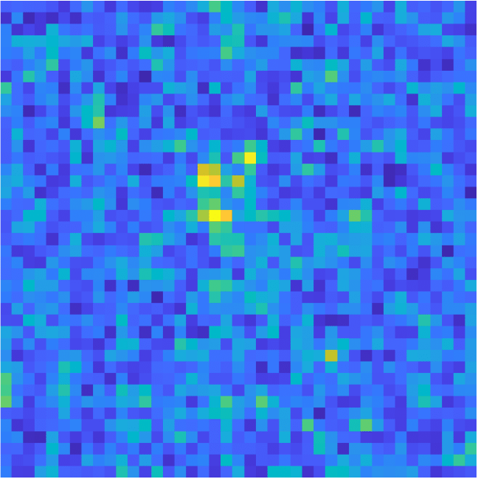
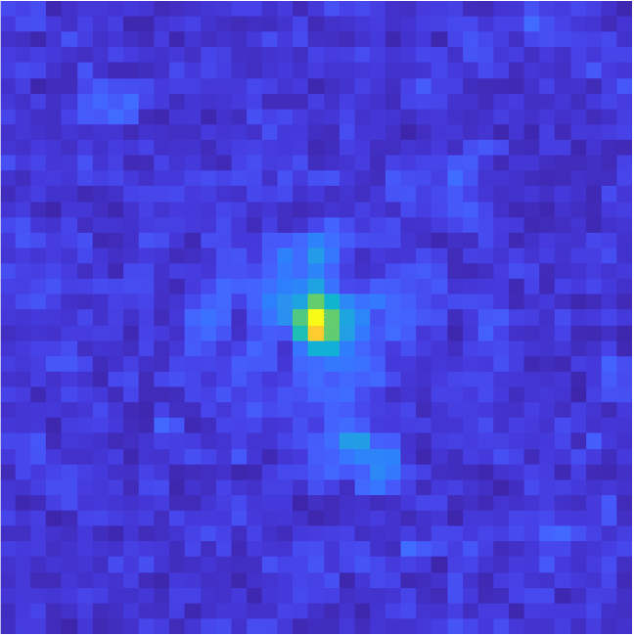
Near-field rendering? Potential solution 2
Monte-Carlo aperture integration approach
$$i_{1}$$
$$C_{i_{1},i_{2}}^{q_{1},q_{2}}\left(Path\right)=\int{a\left({\text{ℓ}}_{1},{\text{ℓ}}_{2},v_{1},v_{2}\right)f\left(Path\right)}$$
$$i_{2}$$
Our approach
complex-valued integrals -> High variance
Bad approach #2: Monte Carlo sampling
$$a_{i_{1}}\left({\text{ℓ}}_{1}\right)$$
$$a_{i_{2}}\left({\text{ℓ}}_{2}\right)$$
$$\sum_{\sim {\text{ℓ}}_{1},\sim {\text{ℓ}}_{2},\sim v_{1},\sim v_{2}}{a\left({\text{ℓ}}_{1},{\text{ℓ}}_{2},v_{1},v_{2}\right)f\left(Path\right)}$$
15 seconds
15 seconds
$$a_{q_{1}}\left(v_{1}\right)$$
$$a_{q_{2}}\left(v_{2}\right)$$
Sample directions
$$q_{1}$$
$$q_{2}$$
150 seconds
Notes:
For example, here is an equal-time comparison between the covariance we compute using Monte Carlo aperture integration and our approach. The Monte Carlo result is very very noisy. Even if we increase the runtime of the Monte Carlo approach by 10x, we still see significantly larger variance compared to our result.

Slide 16
Near-field rendering: our approach
$$i_{1}$$
$$C_{i_{1},i_{2}}^{q_{1},q_{2}}\left(Path\right)=\int{a\left({\text{ℓ}}_{1},{\text{ℓ}}_{2},v_{1},v_{2}\right)f\left(Path\right)}$$
$$i_{2}$$
$$a_{i_{1}}\left({\text{ℓ}}_{1}\right)$$
$$a_{i_{2}}\left({\text{ℓ}}_{2}\right)$$
Closed-form approximation
$$a_{q_{1}}\left(v_{1}\right)$$
$$a_{q_{2}}\left(v_{2}\right)$$
$$q_{1}$$
$$q_{2}$$
Notes:
Our key technical contribution is to develop a closed-form approximation to the 4D aperture integral, which allows us to compute the near-field contribution of each path very efficiently.

Slide 17
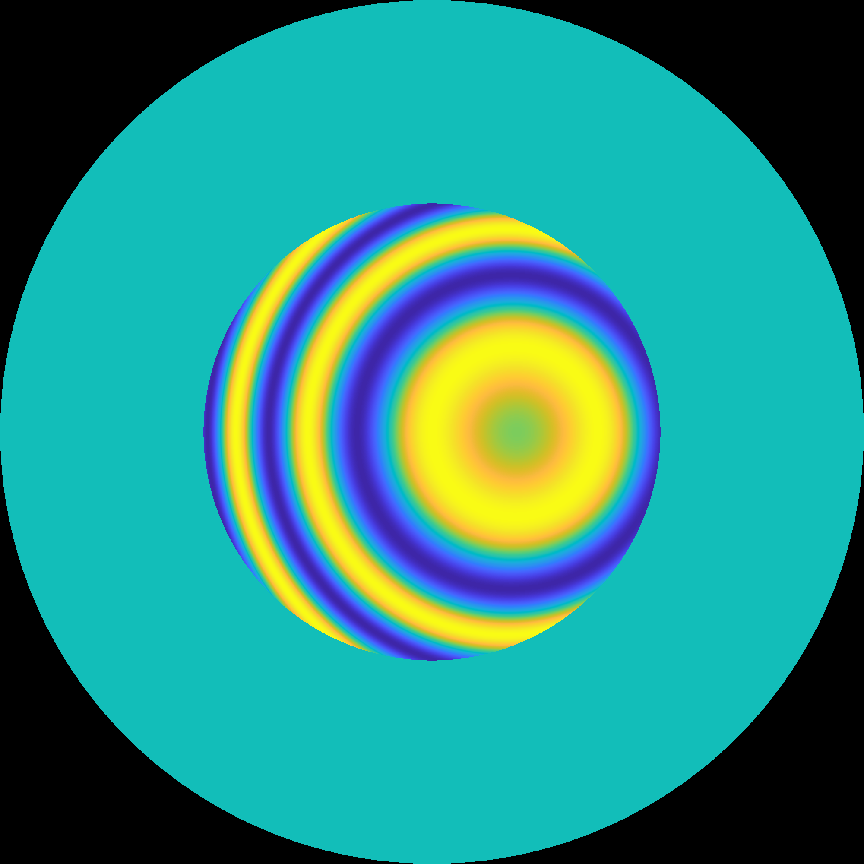
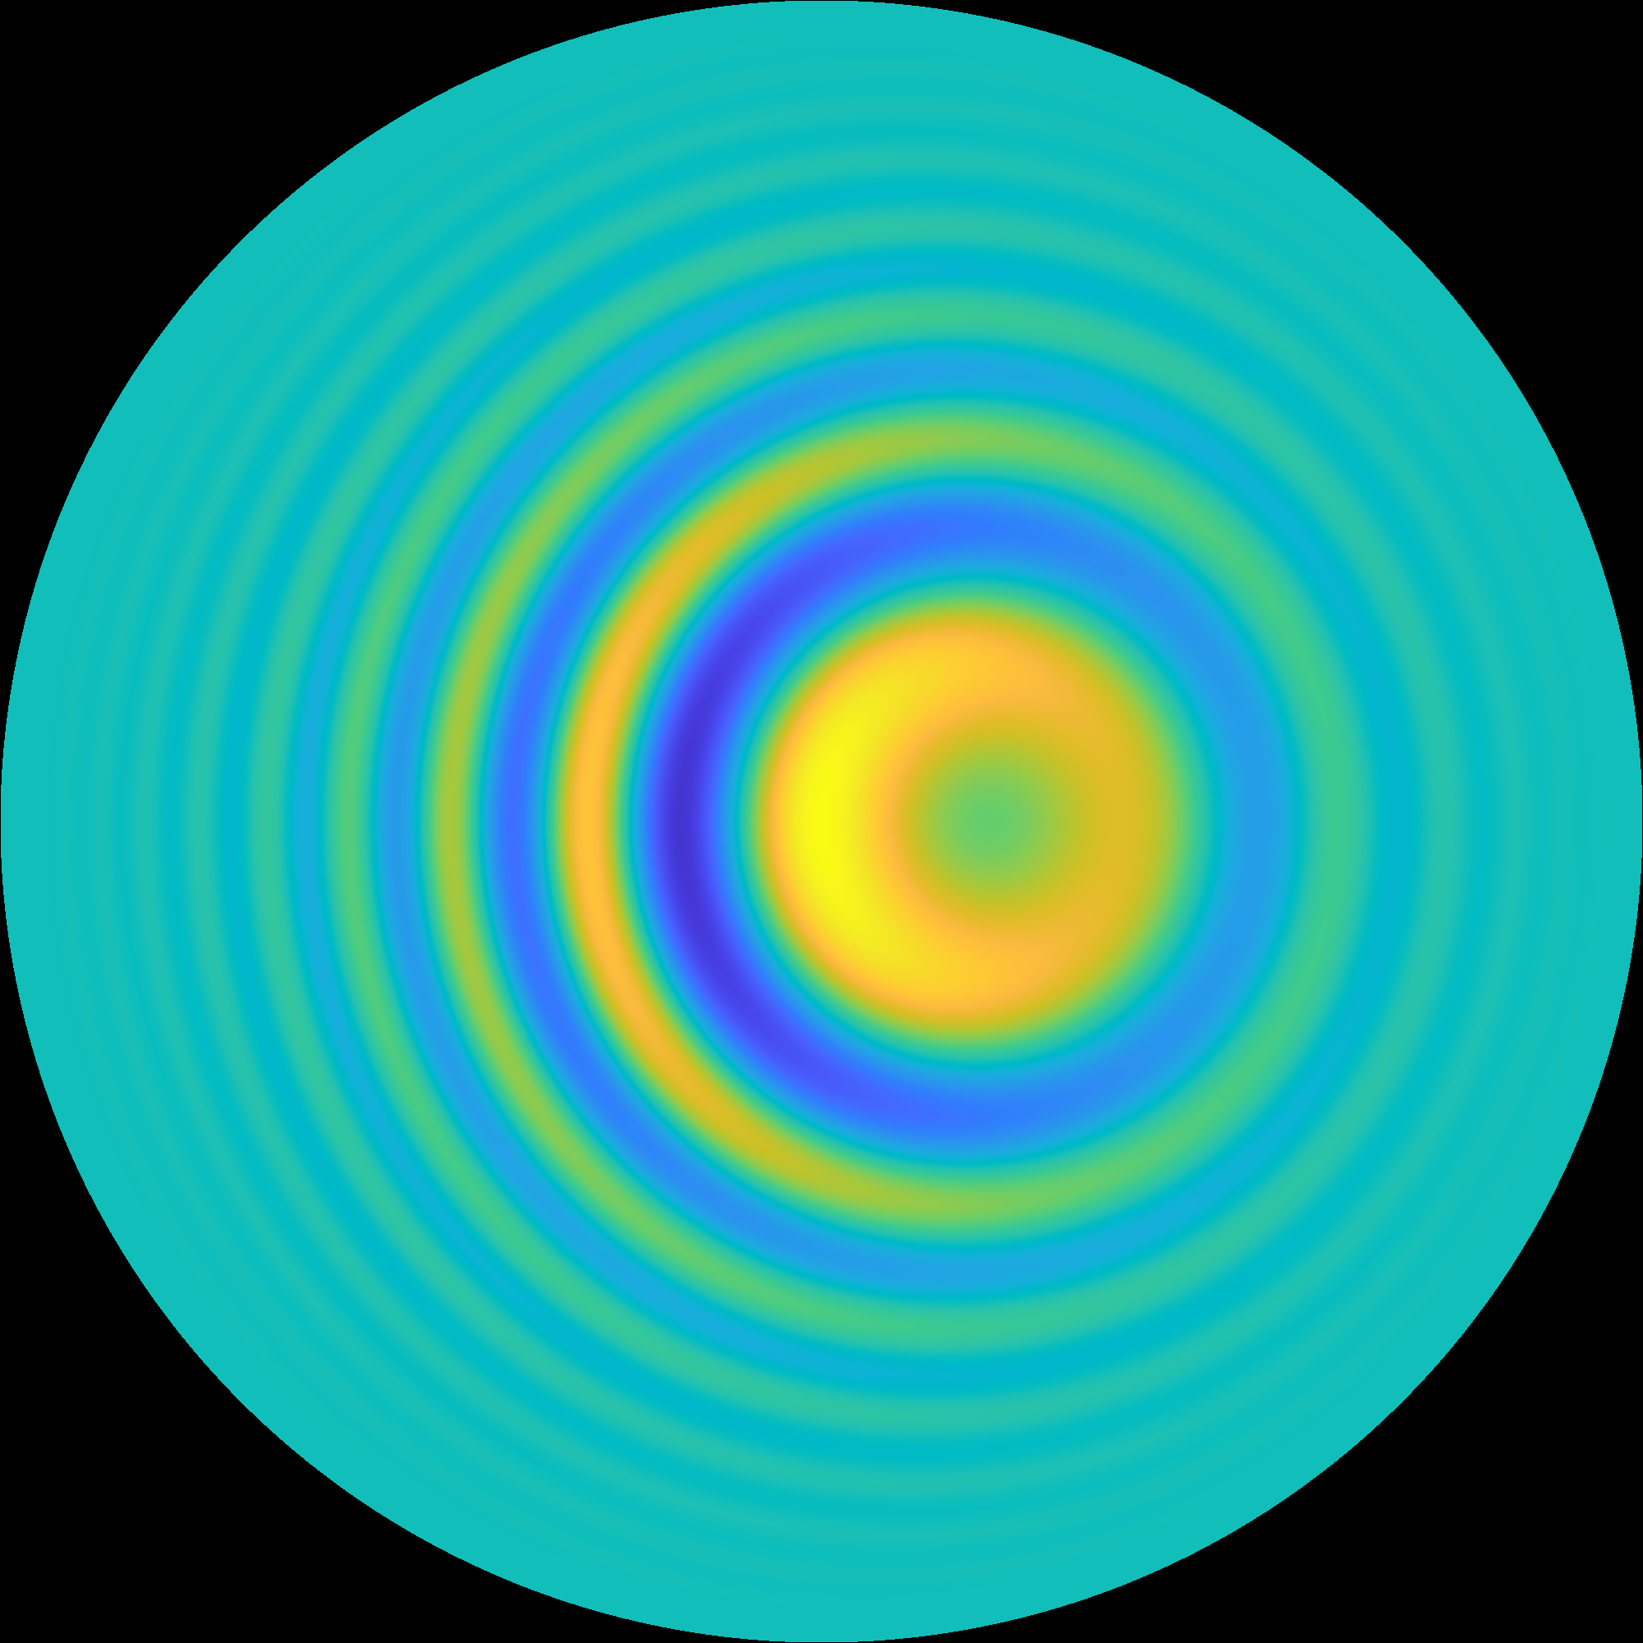
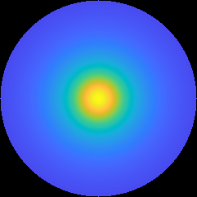
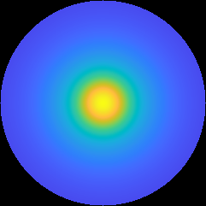
Near-field rendering: contributions
Closed-form spherical integration using von Mises-Fisher (vMF) representation of aperture functions and phase functions
hemisphere projection
Binary aperture
vMF approximation
Tissue phase function
vMF fit
Notes:
To develop such an approximation, we use spherical vMF functions. These are an extension of Gaussian functions to the 3D sphere, with many of the same elegant mathematical properties. In particular, we approximate the, typically binary, lens apertures with continuous apodization that we express as a vMF function. Note that, as the lens has a complex phase, we need to work with complex vMF functions. We additionally approximate the phase function of the scattering material using a mixture of vMF functions.

Slide 18
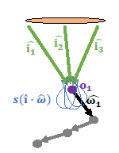
Near-field rendering: contributions
Closed-form spherical integration using von Mises-Fisher (vMF) representation of aperture functions and phase functions
Efficient algorithm
See paper for details
Complex von Mises-Fisher function definition
hemisphere projection
$$h\left(\hat{ω}\right)=η∙e^{\left(μ∙\hat{ω}\right)}$$
Complex von Mises-Fisher function integration
Negligible bias
Binary aperture
$$\int_{\hat{ω}∈{\text{s}}^{2}}{ηe^{\left(μ∙\hat{ω}\right)}}=η∙2π\frac{e^{\sqrt{μ}}−e^{−\sqrt{μ}}}{\sqrt{μ}}$$
vMF approximation
Tissue phase function
vMF fit
Complex von Mises-Fisher function convolution
$$\int_{\hat{ψ}∈{\text{s}}^{2}}{e^{\left(μ∙\hat{ψ}\right)}∙e^{γ_{s}\left(\hat{ω}∙\hat{ψ}\right)}}≈\frac{2π}{β_{0}}e^{\frac{γ_{s}}{β_{0}}\left(μ∙\hat{ω}\right)+c_{0}}$$
Notes:
With these approximations, we show in the paper that path contributions through the four apertures can be expressed as integrations and convolutions of complex vMF functions. We also derive closed-form formulas for computing these integrations and convolutions analytically. our approximations introduce negligible bias, while improving computational efficiency by several orders of magnitude, as I will show in our experiments

Slide 19
Near-field rendering: contributions
Closed-form spherical integration using von Mises-Fisher (vMF) representation of aperture functions and phase functions
Efficient importance sampling strategy
Zero contribution
Imaged point source
High contribution
Where should we sample path starting points?
Notes:
We additionally develop an importance sampling strategy for selecting the start points of paths inside the scattering volume. To see why this is needed, consider the incident focused illumination. It typically illuminates only a double wedge area inside the volume. If we start a path inside the part of the volume that receives no light, the path will have a zero contribution. In the paper, we show how to use importance sampling to start paths only inside the beam, where they contribute to the covariance.

Slide 20
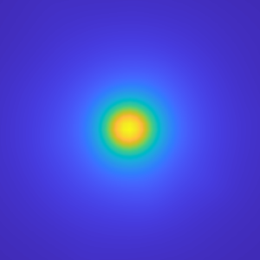
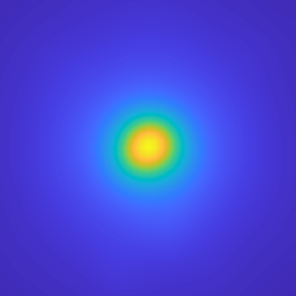
Convergence time comparison
Our near field
Tabulation approach
Monte-Carlo aperture integration approach
$$20λ$$
$$Δ=0λ$$
$$50λ$$
$$Δ=1λ$$
$$Δ=2λ$$
15 seconds
1.6 hours
14 hours
Time to $RMSE<0.005$
Notes:
Let’s now see some more comparisons of rendered near-field covariances. First, we compare renderings for 3 different values of the displacement between the illuminators. We compare our near field rendering approach to the tabulation and Monte Carlo aperture integration approaches we discussed earlier. We record for each algorithm the time it takes to reach convergence. Our approach converges in 15 sec, whereas the tabulation approach requires 1.6 hours and the MC one 14 hours. these comparisons also confirm what I mentioned earlier, namely that our approximations do not introduce significant bias

Slide 21
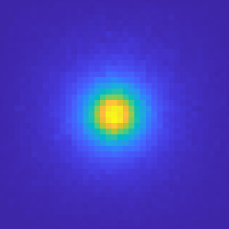
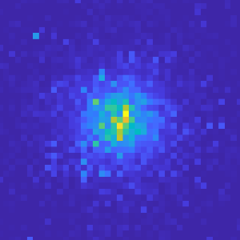
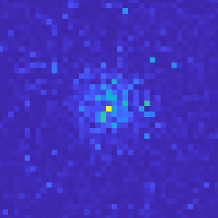
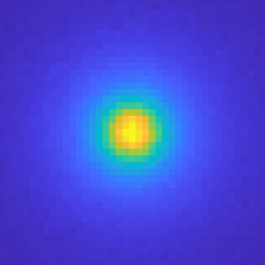
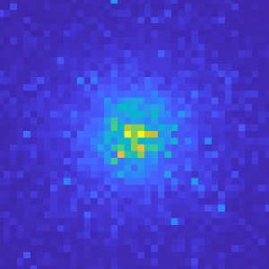
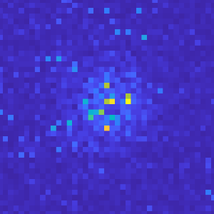
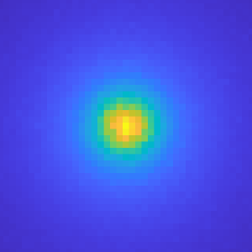
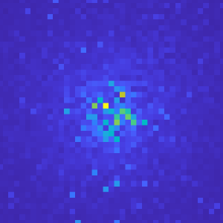
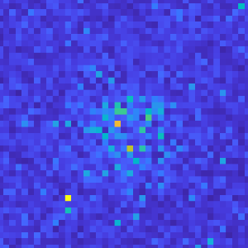
Equal-time comparison
Our near field
Tabulation approach
Monte-Carlo aperture integration approach
Difference scales with the size of the target volume
$$4λ$$
$$10λ$$
1 seconds
$$10λ$$
$$25λ$$
5 seconds
$$20λ$$
$$50λ$$
15 seconds
Notes:
We also show equal-time comparisons. In all cases, our approach significantly outperforms the two alternatives. We also note that the performance difference increases as the size of the simulated scattering volume increases. For this comparison, we only use very small volumes, because for larger ones the alternative approaches become completely impractical.

Slide 22
Comparison with lab measurements
$$i_{1}$$
$$i_{2}$$
Monte Carlo simulation
[Ours]
Analytical model
[Osnabrugge et al. ]
Lab measurement
[Osnabrugge et al. ]
$$−θ/2$$
$$θ/2$$
$$Δ$$
Tilt $θ$
Shift $Δ$
Notes:
In previous work, Osnabrugge et al proposed an analytical model based on Fokker-Planck approximations for near-field covariance. This model takes as input two imaging parameters, which they define as the tilt and the shift between the two input beams. Here we show the covariance they compute with this model. We also show speckle covariance measurements they captured in the lab. The results from the model resemble the lab measurements, but do not match them completely. Here is the covariance we compute with our MC simulator, which better captures the shape of the measured covariance.

Slide 23
Focusing through turbid media: range predictions
Adaptive optics focusing through scattering material [Judkewitz et al. 2014]
For what ranges $Δ$ is this possible?
$$Δ$$
Spatial light modulator
Notes:
If you remember we mentioned earlier in this talk the application of adaptive optics
In this case we try to apply a phase modulation to an incoming wavefront such that after it passes through a scattering material it will focus sharply at one point.
Finding such a correction is very expensive and therefore it will be good if we can use small perturbations of one pattern to focus at nearby points.
It was suggested by Judkovitz et al, that using the memory effect, we can indeed find such perturbations of the wavefront correction pattern.
A very important practical question is for what range of displacement delta we can do this reliably.

Slide 24
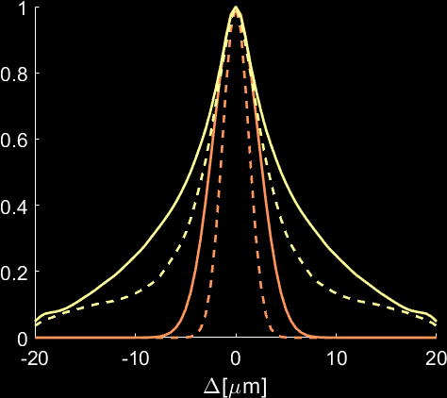
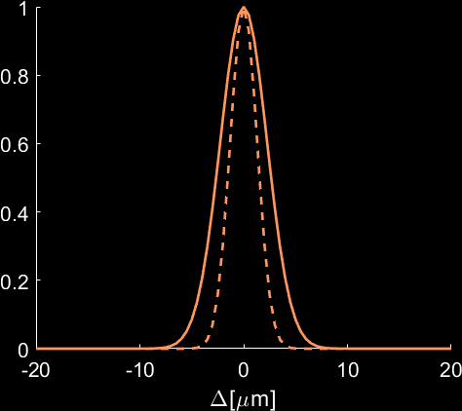
OD 3
Focusing through turbid media: range predictions
Adaptive optics focusing through scattering material [Judkewitz et al. 2014]
For what ranges $Δ$ is this possible?
O.D. 1
O.D. 3
$$Δ$$
Spatial light modulator
Analytical Model
Our simulation
Notes:
Osnabrugge tried to answer this question by using their approximated analytic model.
For example, here is a prediction of the scan range by their model for tissue layers at two thicknesses.
On the other hand, here is a prediction of this scan range for the same materials with our physically accurate simulator, which does not involve the approximations they had to apply.
We can see that in practice the scan range is much wider than what they predict.

Slide 25
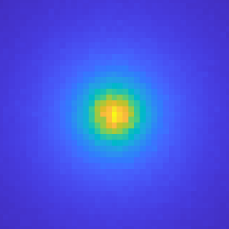
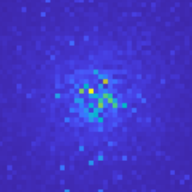
Summary
Critical tissue imaging applications require near-field simulations rather than far field.
Speckle Image
Reconstruction
Hidden Object
Scattering Layer
Efficient adaptation of far-field rendering algorithms to the near-field based on closed-form von Mises-Fisher integration.
Orders of magnitude improvement compared to alterative techniques.
Evaluation on focusing through scattering applications.
Notes:
To summarize, our work is motivated from the fact that understanding and simulating speckle statistics is essential for developing and improving tissue imaging techniques. However, whereas tissue imaging requires near field simulations, only far field simulations are practical using previous simulation techniques, including our own Monte Carlo algorithm. We develop computationally efficient techniques for the near field case, based on approximating relevant spherical functions using VMF functions, and developing analytic rules for their integration and convolution. Our techniques provide orders of magnitude improvement compared to previous approaches. We use these new techniques to evaluate focusing through scattering applications.

Slide 26
Thank you!
Rendering Near-Field Speckle Statistics in Scattering Media
Open source code is available online
Sensor
Tissue
This work was supported by:
https://github.com/chabner/gaussianBeam-field
Notes:
Many thanks to our sponsors, and please make sure to check out our publicly available implementation. Thanks a lot!

