Slide 1
Imaging with local speckle intensity correlations: theory and practice
Marina Alterman, Chen Bar, Ioannis Gkioulekas and Anat Levin
Technion, Israel
CMU, USA
Notes:
In this video, we introduce our work on Imaging with local speckle intensity correlations. This is a joint work from the Technion and Carnegie Mellon university.

Slide 2
Imaging with local speckle intensity correlations:
theory and practice
Marina Alterman, Chen Bar, Ioannis Gkioulekas and Anat Levin
Technion, Israel
CMU, USA
Notes:
In this video, we introduce our work on Imaging with local speckle intensity correlations. This is a joint work from the Technion and Carnegie Mellon university.

Slide 3
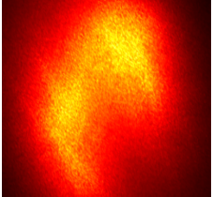
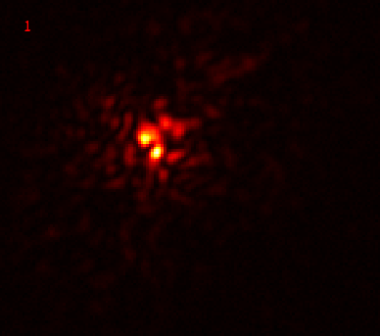
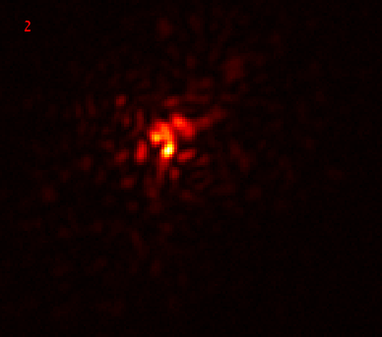
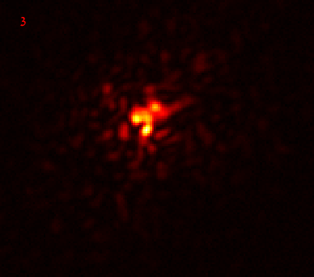
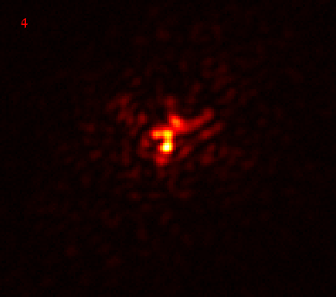
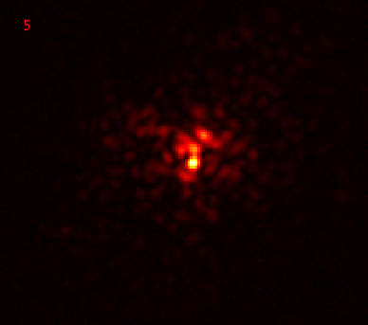
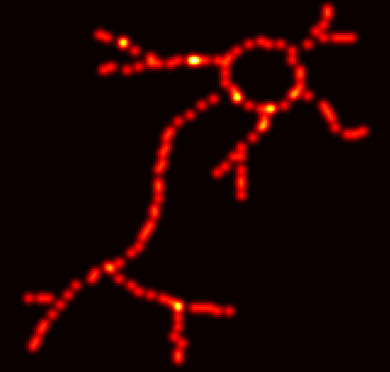

Coherent scattering and memory effect (ME)
See through
Microscope objective
Clear image
Hidden illuminators
Speckle image
Scattering layer
Notes:
We are interested in imaging algorithms for seeing through scattering. This means creating clear images of an illumination pattern that is hidden from the camera by a scattering layer, such as tissue.
This is a difficult problem because, as emitted light propagates through the scattering layer, it scatters multiple times, producing speckle images on the camera sensor.
We focus on seeing-through-scattering algorithms that work by taking advantage of the memory effect property of these speckle images.
This means that, as we shift a single point illuminator behind the scattering layer, the resulting speckle images

Slide 4
Coherent scattering and memory effect (ME)
Correlation
Microscope Objective
Hidden illuminators
Speckle image
Scattering layer
Notes:
are correlated shifted versions of each other.
The correlation decays as the shift between the illuminators increases.

Slide 5
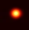
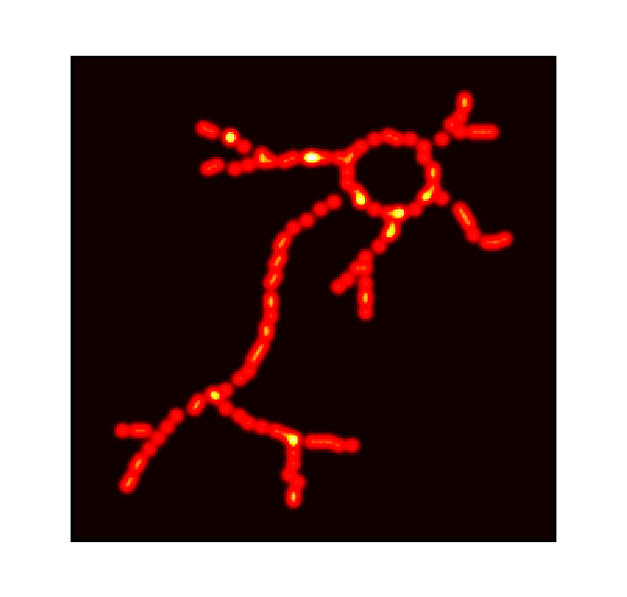
Problems with classical see-through approach
Limited range: Only illuminators within the ME range can be recovered.
Limited density: Only a small number of illuminators can be recovered.
Unrealistic setup: Far-field imaging conditions do not apply to tissue imaging.
Sparse
Scattering layer
Camera image
Reconstruction
Hidden illuminators
Auto correlation + phase retrieval
Near field
ME range
[Katz et al. 2014]
Far field
Notes:
A well-known imaging-through-scattering algorithm was proposed by Katz and colleagues. It recovers a clear image of the hidden illuminators from the auto-correlation of the speckle image.
This general approach is very promising for tissue imaging applications, but applying it in practice is challenging for three reasons:
First, the size of the illuminator patterns it can recover is very limited, because it assumes that the ME property holds between any two points on the pattern, and the ME range is very small.
Second, the density of illuminators the algorithm can recover is very limited, because as illuminator density increases, speckle contrast decays.
Third, most previous experimental realizations of this approach operated in far-field conditions, placing the hidden illuminators several cm away from the scattering layer. This is very different from the near-field conditions required in medical imaging applications, where fluorescent sources are located inside the layer rather than far behind it.
In this work we look to better understand and overcome these three challenges.

Slide 6

Our contributions
1
( i ) Theoretical and rendering based analysis of ME in near and far-field settings
0
$$Δ_{i}$$
[μm]
10
( ii ) Develop a better algorithm for imaging though scattering:
1. higher density
2. wider range
3. near sources
( iii ) Real Lab experiments in near and far fields
Notes:
To this end, we first use theory and physics-based rendering simulations to study the properties of the memory effect. We focus on near-field conditions, which are representative of tissue imaging applications, and are little studied in prior work:
We aim to understand similarities and differences with far-field conditions, as well as discover new properties of speckle that we can use for imaging through scattering.
We then use our findings to develop a new algorithm for imaging through scattering based on the memory effect. Our algorithm is much more robust then the original algorithm of Katz et al.
In particular, we will show that it can reconstruct illumination patterns that are an order of magnitude denser and larger. Additionally, it can work under both far-field and near-field conditions.
Lastly, we show results from lab experiments using tissue samples, for near and far field settings.

Slide 7
Theory and simulation analysis
Notes:
We will start with our theoretical and simulation-based analysis.

Slide 8
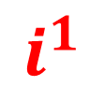
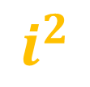
Problem setting and memory effect
Illumination plane
Scattering tissue
sensor
Change illumination plane
$$i^{2}$$
$$i^{1}$$
Far-field
Near-field
Notes:
First, let me describe our imaging setup.
We have two illuminators i1 and i2 placed on a plane at some distance behind a tissue layer.
Light emitted by the two illuminators scatters through the tissue and gets detected at some sensor plane.
We want to study how the gap between the illuminator plane and the layer affects the memory effect.
The memory effect is the correlation between the speckle images produced by the two illuminators.

Slide 9
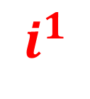

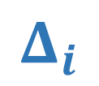


ME correlation in near-field vs. far-field
Scattering tissue
1
Far-Field
Illumination plane
Bar et al. A Monte Carlo Framework for Rendering Speckle Statistics in Scattering Media. SIGGRAPH, 2019.
Bar et al. Rendering Near-Field Speckle Statistics in Scattering Media.
SIGGRAPH Asia, 2020.
$$i^{2}$$
$$i^{1}$$
Correlation
$$Δ_{i}$$
Far-field has higher ME correlation than Near-field
$$i^{1}$$
Near-field
Zero correlation
0
Far-field
30
Near-field
$$Δ_{i}$$
[μm]
source displacement
Notes:
For that we use a physically accurate Monte Carlo rendering algorithm we published in prior years, to simulate speckle correlation values under different conditions.
For material parameters, our simulations use tissue parameters previously reported in the literature.
In this graph we plot the correlation as a function of the displacement between the two illuminators.
For example, when two illuminators are at the same location, the displacement between them is zero and we get the highest correlation of 1.
When we increase the displacement between the illuminators, we increase \Delta and move to the right on the x axis of our graph.
Note that correlation decays very slowly as the illuminator displacement increases, and remains large for all displacements.
It is important to consider how this graph changes as we vary the distance between the illuminator plane and the tissue layer.
If we move the illuminator plane closer to the layer, we observe smaller correlations that decay to zero at much smaller illuminator displacement.
And if we move the sources exactly at the edge of the layer, as in near-field imaging conditions, the correlation is even weaker.
Therefore, we observe that far-field imaging conditions result in a stronger memory effect than near-field conditions.

Slide 10
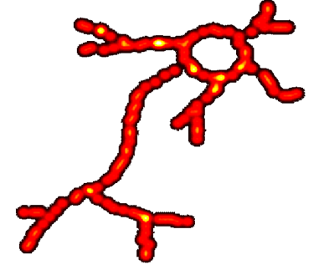
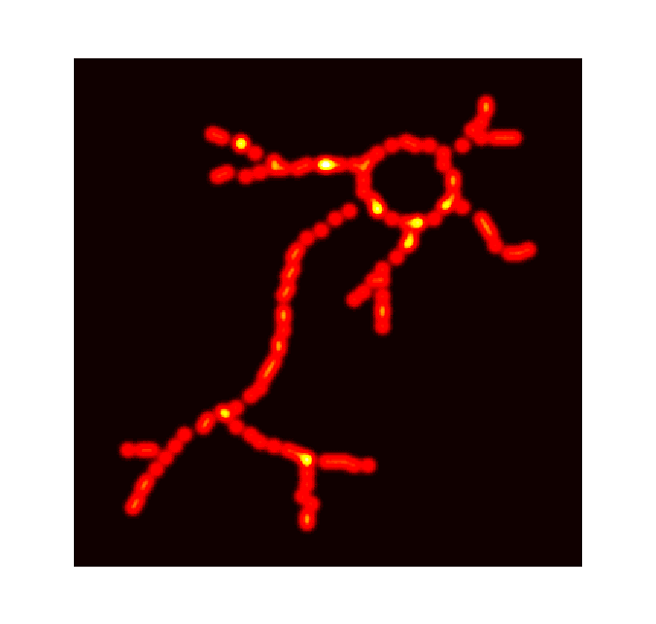


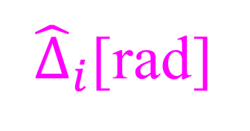





Aligning ME correlation in the near and far fields
Scattering tissue
1
Illumination plane
Imaging plane
- Theorem: ME range depends only on angular displacement.
$$i^{2}$$
$${\hat{Δ}}_{i}$$
Correlation
$$Δ_{i}$$
$$Δ_{i}$$
$$Δ_{i}$$
- Moving the illumination plane farther away, scales the ME range to cover larger patterns.
$$i^{1}$$
- Imaging-through-scattering is easier in far-field than near-field
0
30
Far-field
${\hat{Δ}}_{i}$[rad]
Near-field
$$Δ_{i}$$
[μm]
Notes:
To get some intuition and more easily quantify the differences between near field and far field we show in the paper that it is useful to reparametrize how we measure the memory effect.
In particular, we prove a theorem that we can remove the dependence of the ME on the distance between the illuminator plane and tissue layer, by expressing it as a function of the illuminator angular displacement, rather than their spatial displacement.
By angular displacement, we mean the angle the two illuminators form with a point at the center of the tissue layer.
For the same angular displacement, if we move the illuminator plane closer to the layer, we get smaller spatial displacements.
With this in mind, we can change the 3 previous graphs so that the x axis is angular displacement. This change makes the 3 plots nearly identical.
We can now use this to easily explain the differences in the memory effect between near-field and far-field conditions. For any fixed correlation value, the size of the illuminator pattern for which this correlation holds is magnified proportionally to the distance between the illuminator plane and the tissue layer.
For example, when the illuminator plane is close to the layer, here is the largest pattern we can fit inside the ME range. And when we move the illuminator plane further back, the pattern that we can reconstruct is this.
This makes it obvious that the near field case is harder than the far field one because the pattern we can reconstruct gets minified by a large amount.

Slide 11





ME correlation in the near-field
1
Scattering tissue
Practical only for
modest thickness
$$50\text{[}\text{μ}\text{m}\text{]}\text{, }\text{OD}\text{=}\text{1}$$
$200\text{[}\text{μ}\text{m}\text{]}$, OD=4
$$500\text{[}\text{μ}\text{m}\text{]}\text{, }\text{OD}\text{=}\text{10}$$
$1\text{[}\text{m}\text{m}\text{]}$, OD=20
- As the thickness increases, ME correlation decreases.
10
0
$$Δ_{i}$$
[μm]
Notes:
Another important parameter that the ME depends on is the thickness of the tissue layer. Previous work has established that correlation values decay as the thickness increases.
We used our simulator to quantify this effect for near-field conditions. We found that non-negligible correlation exists only for layers of modest thickness, say up to about 5 mean free paths, and that correlation very quickly decays to zero for thicker layers.
This suggests that, under near-field conditions, algorithms for imaging through scattering based on the memory effect are only applicable for tissue layers of these modest optical thicknesses. This is still of practical interest, because even these modest thicknesses produce significant scattering, and are way beyond the depth penetration of a standard microscope.

Slide 12
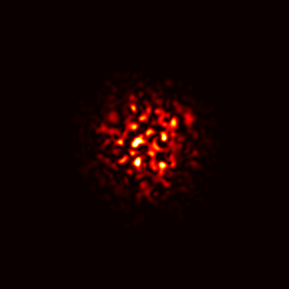
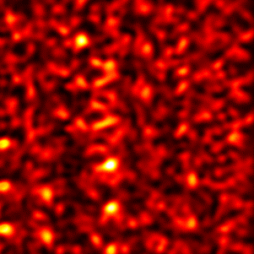

Speckle Local Support
Tissue is forward scattering
Modest thickness
Focusing on illumination
Illumination plane
Sensor
plane
Modest
Thick
$$z_{i}$$
Local support is key for enhancement of
seeing-through-scattering algorithms.
Tissue imaging
Other applications
Notes:
Based on this observation, we will be focusing our efforts on layers of modest thickness, and trying to find speckle properties in this regime that we can use to improve imaging through scattering algorithms.
To this end, we note that tissue has a predominantly forward scattering phase function. In tissue layers of modest thickness, where the number of scattering events is small, this means that most scattered light continues to propagate close to its original direction.
As a consequence, speckle patterns formed in such tissue layers do not spread over the entire sensor, but have local support. We will show later that this local support property is the key property we use to improve imaging through scattering capabilities.
Before we do so, we want to draw attention to another simple mechanism we can use to improve memory-effect-based algorithms.
In most prior work, speckle patterns were imaged using a bare sensor placed at the side of the tissue layer opposite from the illuminator plane. However, we can easily use optics, such as a lens, to focus the sensor.
In the paper, we show that it is optimal to set the lens properties such that, in the absence of a scattering layer, the sensor would focus on the illuminator plane.
Doing so not only maximizes the memory effect correlation, but also further reduces the local support of the observed speckle patterns.
Overall, the local-support speckle images that we capture under the tissue imaging conditions I described, are very different from those captured in prior work, where speckle patterns covered the entire sensor.

Slide 13

Summary of theoretical contributions
( i ) Theoretical and rendering based analysis of ME in near and far-field settings
Improve
locality + ME
by focusing
Far-Field
1
modest thickness
Local support
Far-field has higher ME than near-field
Correlation
Near-field
0
source displacement
$$z_{i}$$
Notes:
To summarize the findings of our theoretical and simulation-based analysis: We have seen that far-field imaging conditions result in stronger memory-effect properties than near-field conditions.
Under near field conditions, we can use the ME to image through layers of only modest thickness. In turn, this small thickness results in speckle patterns characterized by local support.
Lastly, we can further improve both support locality and ME strength by focusing the sensor used to measure the speckle patterns.

Slide 14
Our algorithm
Notes:
We will now show you how we can use these observations, and especially the local support property, to develop better imaging-through-scattering algorithms.

Slide 15
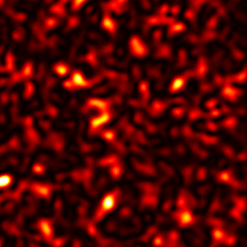
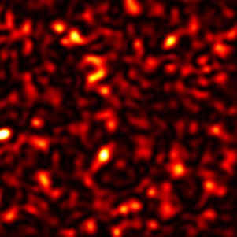
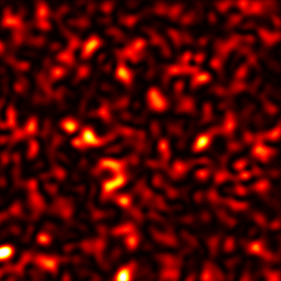
Seeing though scattering using ME
$$I^{i^{1}}$$
Scatter free image
I=∑ $I^{i^{k}}$
S
O
$$I^{i^{2}}$$
=
*
$$i^{1}$$
I⋆I=S⋆S⋆O⋆O$≈$
$$i^{2}$$
Overlay
O⋆O
$$i^{3}$$
$$I^{i^{3}}$$
S⋆S$≈δ$
full-frame
Scattering Layer
O = Phase Retrieval$(\text{I}\text{⋆}I)$
Notes:
Before introducing our approach, we briefly review the original method of Katz et al. for imaging through scattering using the ME.
Consider a point illuminator behind a scattering layer. Due to multiple scattering, a camera placed at the opposite side of the layer will measure a speckle image. If we consider other illuminators placed on nearby locations on the same plane, they also produce speckle images.
The memory effect property of speckle images implies that, when the displacement between the illuminators is small enough, the speckle images are shifted versions of each other.
If the illuminator plane contains 3 incoherent illuminators, the camera measures the incoherent summation of their individual speckle intensity images.
Then, the memory effect property means that the total image I is approximately equal to the correlation of the clear image O of the illuminator plane, with the speckle image S produced by a single illuminator.
We can now consider the auto-correlation of the total speckle image I. As the speckle pattern S is approximately zero-mean independent noise, its auto-correlation is approximately an impulse. As a result, auto-correlation of I approximately equals to the auto-correlation of the clear image O.
This means that we can recover O from the auto-corr of I using phase retrieval algorithms.
We will be referring to this algorithm as the full-frame auto-correlation algorithm in the rest of the talk.

Slide 16
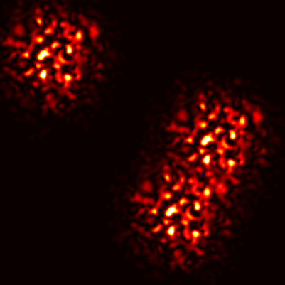
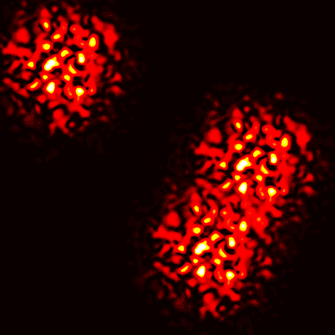
Reconstruction using local speckle correlation
Correlation(Δ)= ∑I_{x}·I_{x+Δ}
What illuminators produce this image?
Correlation= ∑I_{x}·I_{x+Δ}
_{x}
_{x}
Just noise
Previously: sum over full frame
Noisy
Theorem: order of magnitude increase in SNR
Ours:
sum over local window
Notes:
This algorithm was originally developed for applications where speckle images cover the entire sensor. We argue that if speckle images have local support, as they do under tissue imaging settings, we can use this property to significantly improve over the full-frame auto-correlation algorithm.
To see this, let’s revisit how speckle correlation is computed.
We have a speckle image like that, and we attempt to detect which sources are present.
We consider different shifts of the image and compute the correlation between the original and the shifted copy, which basically involves multiplying them and summing.
However, here is the key difference: previous algorithms summed over the entire image.
But if we know the speckle spread is local, we also know that the correlation emerges only from this local region.
On the other hand, the pixels in this blob are only noise which will not contribute to the correlation.
So, if we sum only inside this green window, we can reject the other noise.
In the paper, we prove that this seemingly simple change results in an order-of-magnitude improvement in signal to noise ratio.

Slide 17


Optimization with local support
Full-frame algorithm
I
O
$$\min_{O}{\sum{||}}$$
$${||}^{2}$$
All local windows
Notes:
We translate this intuition into an algorithm as follows:
Given a speckle image I, to recover the latent illuminator pattern O producing it, we solve this optimization problem.
It searches for a latent image O such that the autocorrelation in its local windows matches the auto-correlation in the local windows of the input image I.
For example, let’s take this window of O and correlate it with the big image O. We want this correlation to be the same as the correlation of this local window from I with the big image I.
This is the result of the local correlation.
We sum the error over all local windows in the image.
If we take a window whose size is equivalent to the entire frame, this cost is equivalent to the original full frame auto-correlation algorithm. However, we show in our results that by using local windows approximately matching the speckle local support in size, we can significantly improve reconstruction quality.

Slide 18
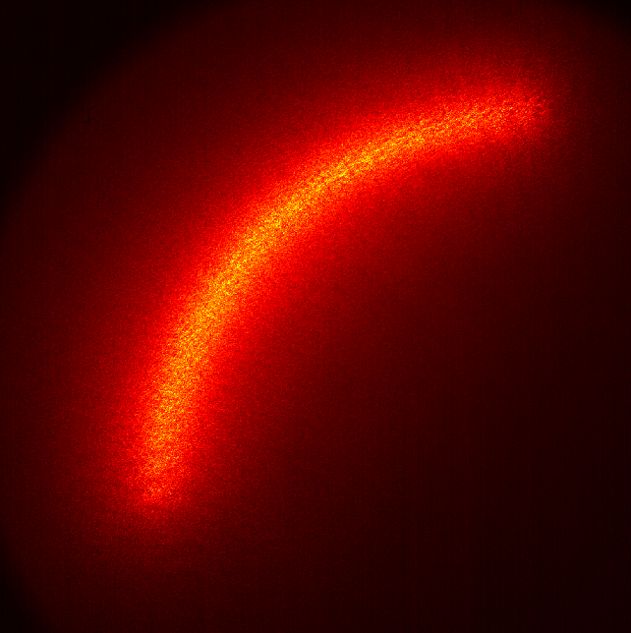
Local vs. global correlation
Ground truth
Input
Full frame
auto-correlation
Local auto-correlation
Noisy
Local correlation: less noisy and reveals some information about the desired shape
Notes:
To see the difference between local and global correlation, consider this example.
We can compute the full frame auto-correlation (click) but it is noisy.
By contrast, here is the local auto-correlation in 3 windows. (click)
It is less noisy, and it also provides some information on the latent illuminator pattern:
In particular, we can see the local orientation of the illuminator arc in each region.

Slide 19
Lab Results
Notes:
Let’s now move to some experimental results.

Slide 20


Lab setup
Far-field
Object mask
Sensor
Light source
Slice of chicken breast.
Near-field
Obj
Obj
Tube lens
Tube lens
Sensor
Notes:
We built two imaging setups corresponding to far and near field imaging configurations.
We used them to capture speckle images produced by illuminator patterns occluded by chicken breast tissue layers of different thicknesses.

Slide 21
Lab results: far-field
Chicken breast thickness 200 μm
Ground truth
Input
Full frame
Our local
Dense
ME range
2.5 mm
Sparse
1:4
Notes:
We show first results from the far-field setup. Even under far-field conditions, when the tissue layer has modest thickness, we can take advantage of the local support of the produced speckle patterns.
Our local-autocorrelation approach successfully recovers this image, whereas the original full frame autocorrelation approach is unsuccessful.
For the full-frame algorithm we show the densest pattern that it can reconstruct. For this example, it is 4 times sparser than the pattern reconstructed by our approach.
Note that in this case the illuminator pattern is small enough to fit inside the ME range. (click)
The reason the full-frame approach fails is not that correlation does not exist, but the fact that the SNR of the correlation it can detect is very low, because of the high illuminator density
(click)To see this better, we can zoom in on a small window from the input image. When there are fewer illuminators, the speckle patterns have higher variance. This makes the auto-correlation less noisy, so the phase retrieval and ultimately reconstruction is easier.

Slide 22
Lab results: far-field
Chicken breast thickness 340 μm
Ground truth
Input
Full frame
Our local
ME range
Dense
12 mm
Thicker sample →
Smaller ME range
Sparse
1:16
Notes:
Let us now look at thicker samples.
Here the illuminator density for which our algorithm produces correct reconstructions is even higher compared to what the full frame algorithm can handle.
We note that in this example, the pattern we recover is much wider than the memory effect range.

Slide 23


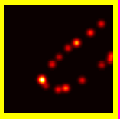
Lab results: far-field
Ground truth
Input
Full frame
Our local
Dense
what range can it recover?
12 mm
order of magnitude increase in both the
range and the density
Really small range
Notes:
So, on the full image, the full frame approach fails completely.
We tried to see what portion of this image it can actually reconstruct, and we ended up with this small region.
The reason our algorithm can recover patterns wider than the ME range is that it only relies on local correlations between nearby illuminators. Importantly, and unlike the full-frame algorithm, our algorithm does not require that correlation exists between every pair of illuminators in the latent pattern, including illuminators that may be very far from each other.
Overall, we see that our algorithm can increase both the density and the size of recoverable patterns.

Slide 24
Chicken breast thickness 170 μm
Lab results: far-field
Ground truth
Input
Full frame
Our local
- More results for denser and wider patterns
5 mm
BUT far field setting is unrealistic in practice!
→ near-field results are coming next…
Notes:
Here are a couple of more results for the far-field setting, where we get correct reconstructions for wide and dense patterns.
But, recall that this far-field configuration is unrealistic for biomedical imaging applications where the sources may be inside the tissue.
So I will now move on to near-field results, which are more challenging.

Slide 25
Chicken breast thickness 140 μm
Lab results: near-field
Ground truth
Input
Full frame
Our local
Dense
Sparse
1:16
Notes:
This near field example images a thinner tissue layer, where scattering is modest, and the latent pattern may be recognizable from the speckle image.
Even this modest degradation is challenging for the full-frame approach, which fails unless applied on a very sparse set of illuminators. By contrast, our approach produces a correct reconstruction for both illuminator densities.

Slide 26
Lab results: near-field
Chicken breast thickness 140 μm
Ground truth
Input
Full frame
Our local
Dense
17 μm
Sparse
1:16
Notes:
Here is another example, which highlights that the full-frame algorithm is only applicable for illuminator patterns of very low density.

Slide 27
Larger degradation
Chicken breast thickness 200 μm
Lab results: near-field
Ground truth
Input
Full frame
Our local
Numbers
Letters
1:16
Notes:
Now let us see a few more challenging experiments.
You can see that the degradation due to multiple scattering is much stronger.
Our local algorithm still outperforms the full-frame approach.
However, you can notice artifacts even in our reconstruction.
We zoom in on a couple of digits to show reconstructions for different illuminator densities.

Slide 28
Lab results: near-field
Chicken breast thickness 200 μm
Ground truth
Input
Full frame
Our local
Dense
Sparse
1:2
Sparse
1:8
Notes:
Here are the digits for a few densities.
Our local approach performs worse for denser patterns, but still outperforms the full-frame approach.
The full frame approach here is only successful at considerably sparser patterns.

Slide 29
Lab results: near-field
Chicken breast thickness 100 μm
Ground truth
Input
Full frame
Our local
Beads
Reconstructing fluorescent beads
Thanks to Dr. Lucien Weiss from Schechtman lab for preparing the fluorescent samples
Notes:
We also made some attempts to recover fluorescent beads placed at the back of a tissue layer.
This is much harder because, given how weakly the beads fluoresce, the measured images contain a lot of noise and the speckle contrast is very weak. Still here is one result.

Slide 30
Summary of our contributions
Modest thickness
Modest thickness
Local support
1
( i ) Theoretical and rendering based analysis of ME in near and far-field settings
0
10
( ii ) Develop a better algorithm for imaging though scattering:
1. higher density
2. wider range
3. near sources
( iii ) Real Lab experiments in near and far fields
Notes:
To summarize this talk:
First, we performed a theoretical and simulation-based analysis of the memory effect, and characterized the similarities and differences between imaging-through-scattering applications under far-field and near-field imaging conditions.
For the near-field case, we showed that we can use ME to image through layers of only modest thickness. In turn, such layers produce speckle images with local support.
We used this local support property to develop a new algorithm for imaging through scattering. Our algorithm is applicable under both far-field and near-field settings, and is much more robust compared to the original full frame algorithm of Katz et al.
In particular, our algorithm provides an order of magnitude improvement in both the size and density of recoverable illuminator patterns.
We have demonstrated the improved performance of our new algorithm through multiple lab experiments under both near-field and far-field settings.

Slide 31
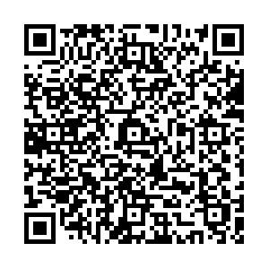
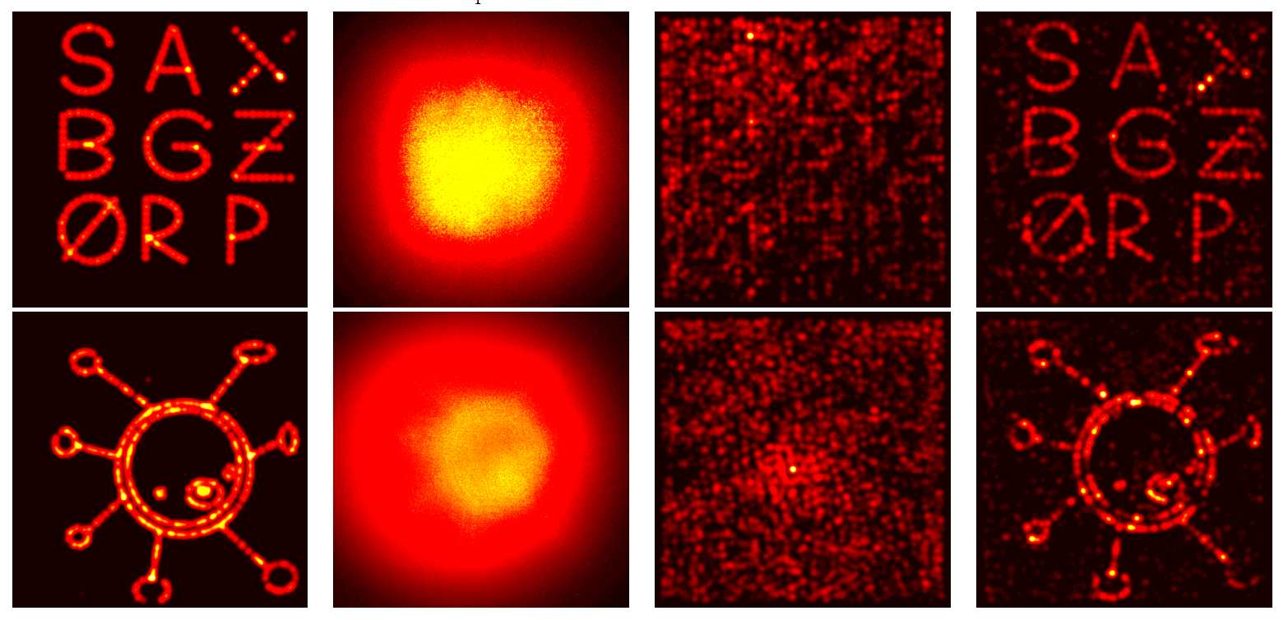
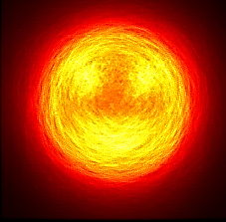
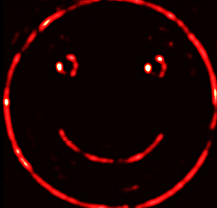



See paper for details
M.Alterman, C.Bar, I.Gkioulekas, A.Levin,
"Imaging with local speckle intensity correlations: theory and practice”, TOG 2021
We tank
our sponsors:
Notes:
Thanks for your attention and please see the paper for more details.

