Slide 1
Fluorescent wavefront shaping using incoherent iterative phase conjugation
Anat Levin
Department of Electrical Engineering
Technion
Joint work with Dror Aizik and Ioannis Gkioulekas
Notes:
My name is Anat Levin and I will tell you today about a novel and fast approach for wavefront shaping.

Slide 2
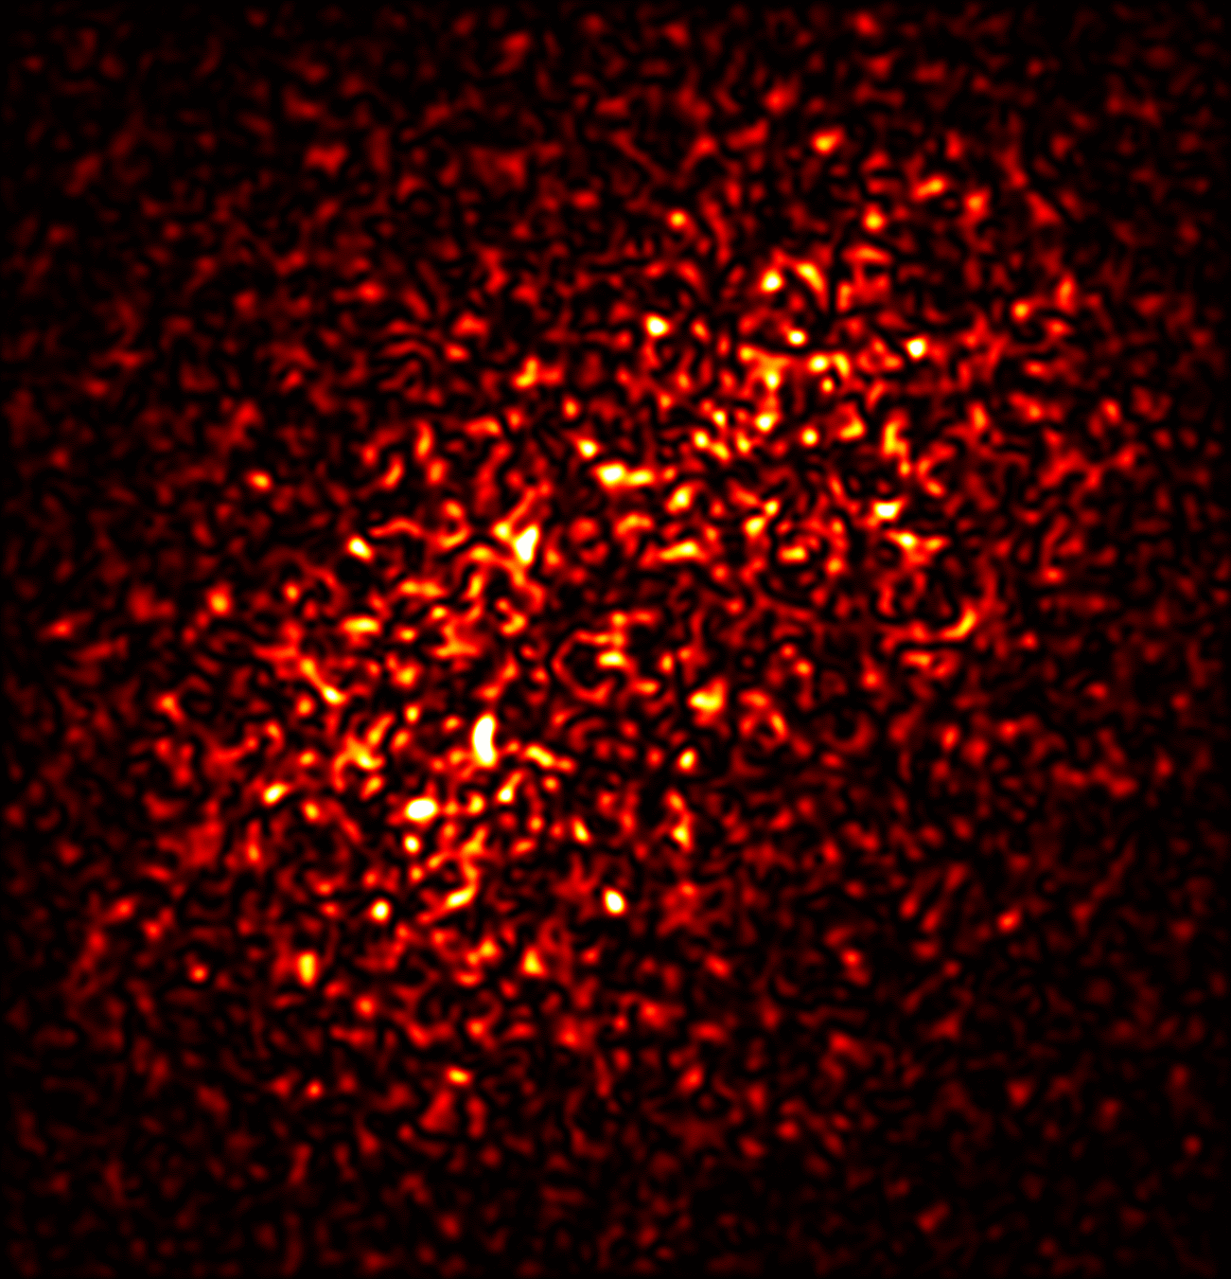
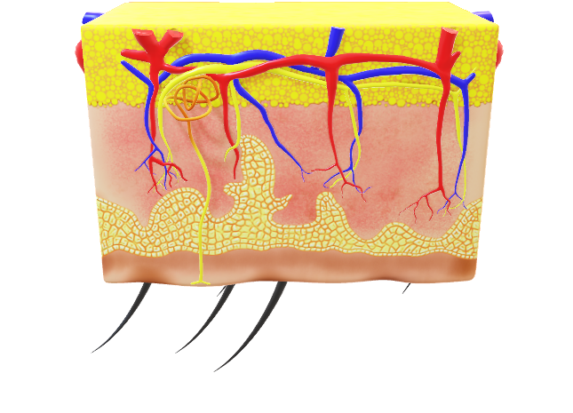
Scattering: the largest barrier to tissue imaging
Camera
incident laser illumination
Tissue
Camera image
Cannot see inside
Notes:
Imaging inside our body is very hard because incident illumination is scrambled by the internal components of the tissue. As a result, a camera will only see a noisy scattered pattern rather than the actual structure.
A lot of research efforts were devoted to the problem, and today we are going to talk about a particularly attractive approach, known as wavefront shaping.
And let me start by explaining what is wavefront shaping.

Slide 3
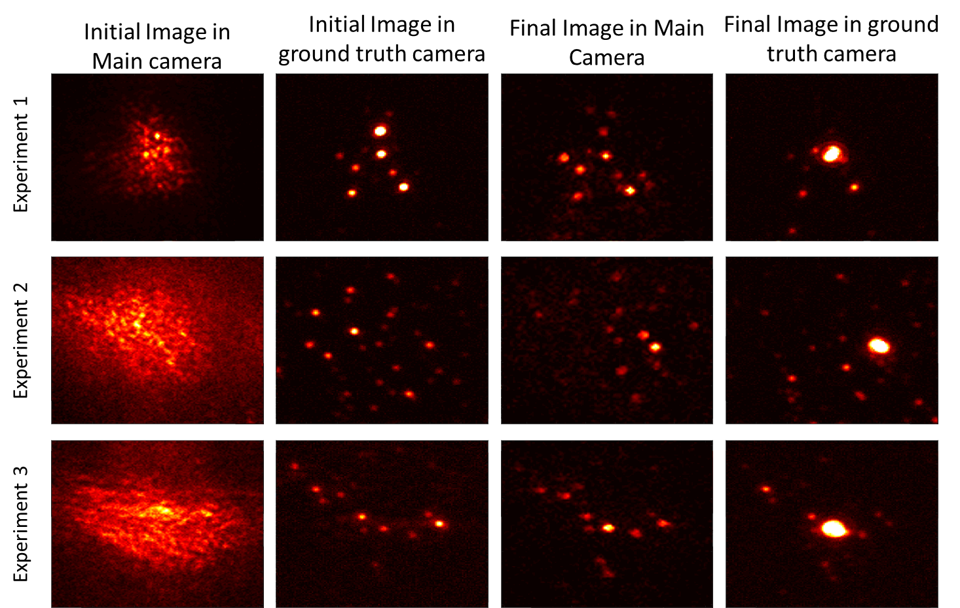

Wavefront shaping principles
Excitation wave
Excitation laser source
Focus through thin slice
Emission wave
Tissue
Fluorescent Beads
Image through thin tissue
Main system Camera
Notes:
We want to see fluorescent cell components inside tissue.
When we illuminate tissue, such fluorescent components are excited and emit light at a different wavelength. This new color allows biologists to distinguish them from the rest of the tissue.
In this talk we are going to address single photon fluorescence, meaning that the amount of energy emitted from a fluorescent point is scaled linearly with the excitation energy arriving it.
If the tissue is thin, the camera can see the fluorescent sources crisply.
We can also control the illumination and bring all of it into a single spot for laser treatment therapy.

Slide 4
Wavefront shaping principles
Excitation wave
Excitation laser source
Cannot focus
Emission wave
Tissue
Fluorescent Beads
Image through thin tissue
Main system Camera
Image through thick scattering tissue.
Notes:
However, if the tissue layer is thick, we cannot focus the excitation beam in a single spot, as it scatters before it gets there.
Also the light emitted from the sources, scrambles quite a lot in the tissue and the camera sees just a noisy speckle pattern.

Slide 5
Wavefront shaping principles
Excitation wave
Excitation laser source
Emission wave
Tissue
Fluorescent Beads
Modulation element
Image through thin tissue
Same pattern
Undo scattering
Main system Camera
Image through thick scattering tissue.
Image thr. thick tissue + correction element
Notes:
The idea of wavefront shaping is that we can place a computer controlled modulation element between the tissue and the camera, that will correct the tissue aberration and will allow us to see a sharp image of the sources.

Slide 6
Wavefront shaping principles
Excitation wave
Excitation laser source
Focus through thick slice
No practical algorithm for finding correction element.
Very costly optimization.
Emission wave
Tissue
Fluorescent Beads
Modulation element
(SLM)
A. Boniface et al “Noninvasive light focusing in scattering media using speckle variance optimization,” Optica. (2019)
T. Yeminy and O. Katz, “Guidestar-free image-guided wavefront-shaping,” Sci. Adv. (2021).
G. Stern and O. Katz, “Noninvasive focusing through scattering layers using speckle correlations,” Opt. Lett. (2019).
A. Daniel et al. “Light focusing through scattering media via linear fluorescence variance maximization, and its application for fluorescence imaging,”Opt. Express (2019).
Image through thin tissue
Same pattern
Undo scattering
Main system Camera
Image through thick scattering tissue.
Image thr. thick tissue + correction element
Notes:
In the same way we can place a modulation element in the illumination path that will aberrate the illumination wavefront in a way which is exactly the inverse of the aberration process in the tissue, so that when this aberrated wavefront propagates through the tissue it will actually focus into one spot.
Wavefront shaping is a very exciting idea because if this can be done any scattering process can be inverted.
But in practice there are no good algorithms for finding the desired modulation.
Existing approaches rely on iterative algorithms which need to image thousands of trial modulation patterns before they converge.

Slide 7
This work: fast wavefront shaping
From laser
Excitation wave
Focus through thick slice
No practical algorithm for finding correction element.
Very costly optimization.
Emission wave
Fluorescent Beads
Modulation element
(SLM)
Our approach: fast, non invasive computation of correction element.
Image through thin tissue
Same pattern
Undo scattering
Main system Camera
Image through thick scattering tissue.
Image thr. thick tissue + correction element
Notes:
In this research, for the first time, we suggest a fast algorithm that can recover the modulation element with a very small number of iterations.

Slide 8
Results
From laser
Excitation wave
Validation Camera
Emission wave
Tissue
Fluorescent Beads
Validation camera
Excitation
Main system Camera
initialization
Itr 1
Itr 2
Itr 3
Itr 4
Notes:
Before I talk on how to do that, let me start by showing some results.
In order to better show you what is happening here I put the fluorescent beads at the back of the tissue layer and not really inside it, and I put another validation camera behind the tissue, which can image the beads directly. The validation camera does not provide any feedback to the algorithm and is only used to assess its success.
So we start with some random modulation pattern and when this pattern scatters through the tissue we get a wide speckle pattern at the back layer. But based on the image we capture at the main camera we update our modulation and with as little as 4 iterations, the modulated illumination focuses into a single spot behind the tissue.

Slide 9
Results
From laser
Excitation wave
Validation Camera
Emission wave
Tissue
Filter emission wavelength
Validation camera
. . .
Excitation
Main system Camera
initialization
Itr 4
Notes:
Now to save space I will squeeze this sequence and show only the first and last iterations.
To show you the fluorescent beads themselves I put a bendpass filter so we only see the emission light and not the excitation.

Slide 10
Results
From laser
Excitation wave
Validation Camera
Emission wave
Tissue
Filter emission wavelength
Emission
. . .
Validation camera
Excitation
. . .
Main system Camera
initialization
Itr 4
Notes:
So you can see that there is a spread of beads here, in the beginning many of them are excited, but as we proceed the excitation light is focused into one spot and as a result only one of the beads emits light.
Now the decision on how to update the modulation is not based on what the validation camera is seeing but on what the main camera from the other side sees, and let’s have a look at what this camera can image

Slide 11
Results
From laser
Excitation wave
Main camera
Validation Camera
. . .
Emission wave
No mod.
Tissue
Emission
. . .
Validation camera
Excitation
. . .
Main system Camera
initialization
Itr 4
Notes:
We note that even if we manage to focus all the light and excite a single bead, the light will scatter on its way back to the camera, and in the main camera we see yet another speckle pattern.

Slide 12
Results
From laser
Excitation wave
Main camera
Validation Camera
. . .
Emission wave
No mod.
Tissue
Emission
. . .
Validation camera
Excitation
. . .
Main system Camera
initialization
Itr 4
Notes:
However if we take the modulation used in the illumination arm and also place the same pattern in the imaging arm we can correct the aberration.

Slide 13
Results
From laser
Excitation wave
Main camera
Validation Camera
. . .
Emission wave
No mod.
Tissue
Emission
. . .
Validation camera
Excitation
. . .
Main system Camera
initialization
Itr 4
Notes:
we can correct the aberration.
So let’s see what this gives us.

Slide 14
Results
From laser
Excitation wave
With mod.
. . .
Main camera
Validation Camera
. . .
Emission wave
No mod.
Tissue
Rapid convergence
Emission
. . .
Validation camera
Excitation
. . .
Main system Camera
initialization
Itr 4
Notes:
As the iteration proceed and the excitation focus into a single bead, the emission is also corrected and we see a sharp spot on the main camera.
So this algorithm converges into a focusing modulation within a very small number of iterations, and this is a big improvement over previous approaches.

Slide 15
Results: imaging a wider area
From laser
Excitation wave
Validation Camera
Emission wave
same modulation for imaging
Tissue
Excite a wide area
Undo scattering of emitted light
Material acquisition
Seeing inside tissue
Temporal correlations
speckle correlations=> same modulation can correct neighboring sources
Optical coherent tomography
Main system Camera
Notes:
Now once we found the modulation for one spot, we want to use it to image a bigger area of beads behind the tissue and not just this one spot.
For that we use the modulation only in the imaging arm. This means that the illumination is not corrected and it excites a wide group of beads. However the light which is scattered from each bead is corrected on its way to the camera.
Now the memory effect property of speckles implies that the same modulation can help us to correct a local area of fluorescent sources behind the tissue and not only the single bead from which it was computed.

Slide 16
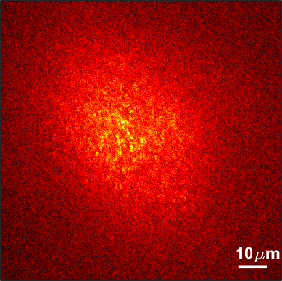
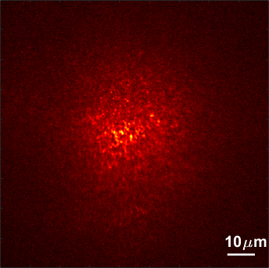
Results: imaging a wider area
Main camera with our modulation
Reference (validation camera)
Conventional image
From laser
Excitation wave
Validation Camera
Emission wave
same modulation for imaging
Tissue
Excite a wide area
Undo scattering of emitted light
Material acquisition
Seeing inside tissue
Temporal correlations
Optical coherent tomography
Main system Camera
Notes:
So let’s see what we can get with that.
Here are two input speckle images
And here are the beads we managed to image with the main camera using the modulation we have recovered,
and for a reference, here is a direct image of the beads from the validation camera.
Let me mark some regions so you can better compare the result to the ground truth.
Note that the area we can image with one modulation has a limited extent. The further beads are not imaged, and you can also see that in the periphery of this region we start to get aberrations.
So after we have seen some nice things we can do, I want to move and talk about how we do it.

Slide 17
Coherent iterative phase conjugation
From laser
Input wavefront
Validation Camera
modulation element
Output wavefront
C. Prada et al. “The iterative time reversal process: Analysis of the convergence,” The J. Acoust. Soc. Am. (1995).
H. C. Song, et al. “Iterative time reversal in the ocean,” The J. Acoust. Soc. Am. (1999).
K. Si et al. “Breaking the spatial resolution
barrier via iterative sound-light interaction in deep tissue microscopy,” Sci. reports (2012).
H. Ruan et al. “Iterative time reversed ultrasonically encoded light focusing in backscattering mode,” Sci. reports (2014).
Tissue
Reflective particles
Fluorescent Beads
Main system Camera
Notes:
So we use an algorithm called iterative phase conjugation. This algorithm was classically derived for coherent illumination. But fluorescent sources emit incoherent illumination. I will start by explaining the coherent case and then I will discuss the challenges and the benefits in adapting it to the incoherent case.
So let’s assume that instead of fluorescent beads we have behind the tissue some gold particles which reflect a lot of light.

Slide 18
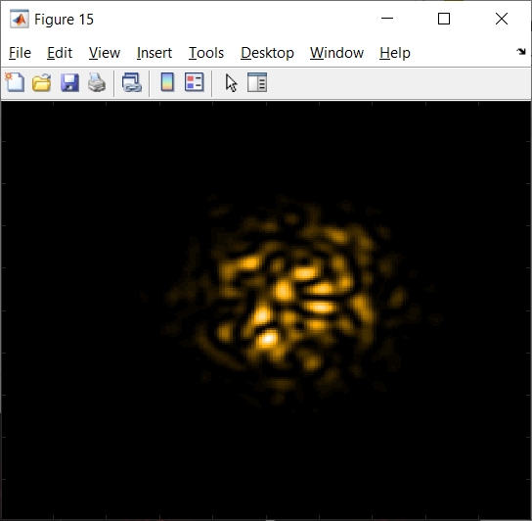
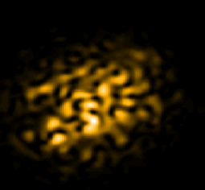
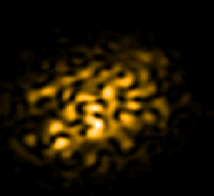
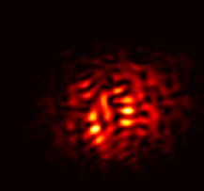




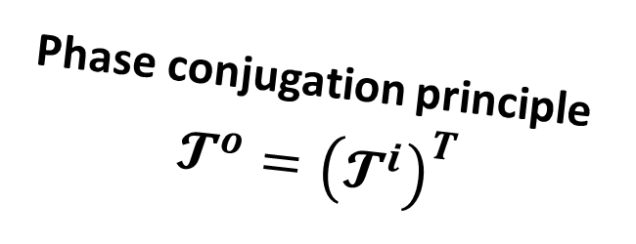







Coherent iterative phase conjugation
From laser
Input wavefront
back-plane
Transmission matrices
Back-plane wave
$𝓣^{i}$
$$=$$
$$⋅$$
input wave
Validation Camera
input wave
Output wavefront
back-plane wave
Tissue
Reflective particles
$$𝓣^{i}$$
output wave
$𝓣^{o}$ $⋅$
$$=$$
$$⋅$$
Back-plane wave
Even with focus: output=speckle
⇒ How can we know we have focused?
output wave
output wave
$$𝓣$$
$$⋅$$
input wave
$$𝓣^{o}$$
$$=$$
Phase conjugation principle
$$𝓣^{o}={\left(𝓣^{i}\right)}^{T}$$
$${𝓣=𝓣}^{o}⋅𝓣^{i}$$
Main system Camera
Notes:
With our computer controlled light modulator we can send in various illumination wavefronts. And each such wavefront generates some other wavefront at the back of the tissue.
To model the problem mathematically we consider the transmission matrix of the medium, which describes how each incoming wavefront is mapped into the back plane of the tissue.
Once the wavefront gets to the reflective particles at the back of the tissue it is reflected and scatters back through the tissue, and it generates an outgoing wavefront at the main camera.
We consider another transmission matrix To that maps between wavefront at the back plane, to wavefonts at the main camera.
For ease of visualization I use a different color for each of the 3 wavefronts but in practice the coherent case they are all at the same wavelength.
Overall we will be describing the mapping between incoming illumination to outgoing wavefront at the camera, by a transmission matrix T, which is the multiplication of Ti and To.
This model involves some approximation, and we will come back to what we have neglected here in a few slides.
So assuming this Ti To model, we use the principle of optical wave conjugation. It tell us that the wavefront coming out of a point, is the conjugate of the wavefront focusing at it, or namely that To is the transpose of Ti.

Slide 19
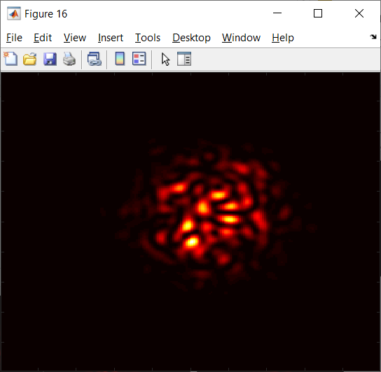



Coherent iterative phase conjugation
Phase conjugation principle:
From laser
Input wavefront
For a focusing illumination,
input wavefront
=
output wavefront
Focus
Focusing wavefront is an eigenvector of transmission matrix
Excitation wave
Output wavefront
Tissue
Reflective particles
$$⋅$$
$$=𝓣$$
Same pattern
Emission wave
Problem: we don’t know $𝓣$.
Measure eigenvectors directly!
Main system Camera
Notes:
We can show that this also means that if we managed to focus than the outgoing wavefront is equal up to a scale factor to the incoming wavefront.
In a mathematical terminology this means that the focusing wavefront is an eigenvector of the transmission matrix T
This is a nice result, but every tissue layer has a different transmission matrix and this transmission matrix is very complex and we don’t know it.
But, I will show that we can directly measure the eigenvectors without knowing T.

Slide 20
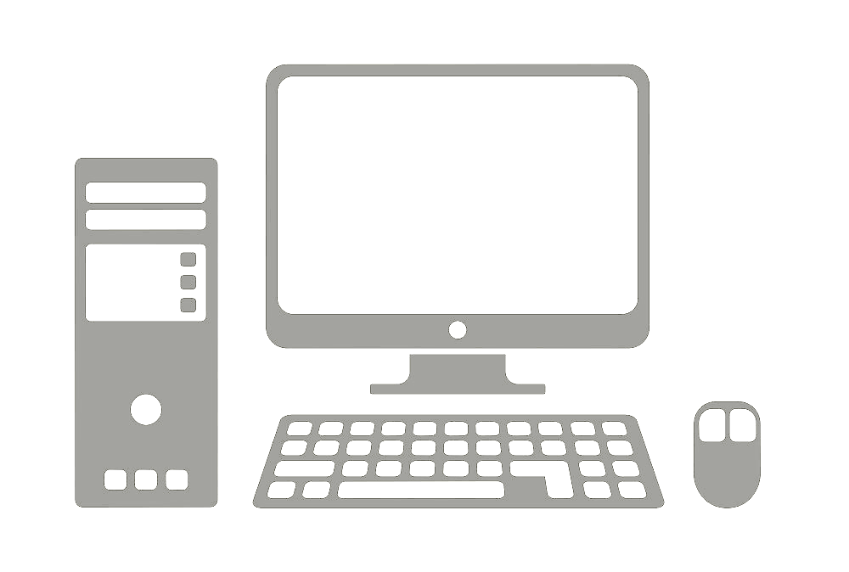
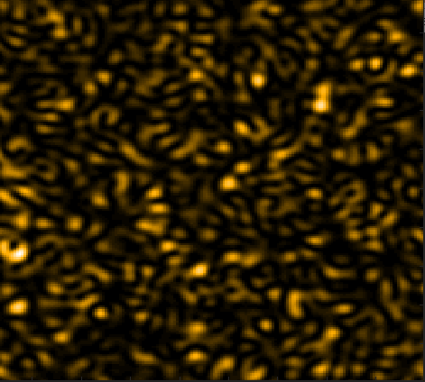
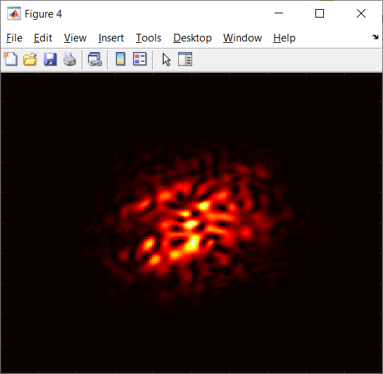








Coherent iterative phase conjugation
Phase conjugation principle:
From laser
Input wavefront
Focusing wavefront is an eigenvector of transmission matrix
$$⋅$$
$$=𝓣$$
Output wavefront
$${u_{1}=T(u}_{o})$$
$$u_{o}$$
Tissue
Reflective particles
Use power algorithm to compute eigenvectors.
$$u_{o}\text{,}\text{we}$$
$$T\left(u_{o}\right), \text{we}$$
$$T(T(u_{o})\text{),}…\text{: }\text{we}$$
Computation performed in optics
Initial random excitation wave
Main system Camera
$${T(u}_{o})$$
Notes:
For that we exploit the power algorithm, which is widely used to compute eigenvectors numerically. It starts with a random vector and apply T iteratively on it. One can show that this sequence converges exponentially fast to the largest eigenvector of T.
We do the same here, and moreover, we leverage the optics to do the computation for us.
We start by illuminating the tissue with a random wavefront u_0 and measure the output. And by that, the optics has computed for us T of u_0. This output will be our input in the next iteration.

Slide 21
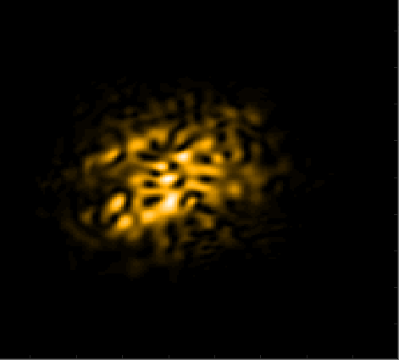



Coherent iterative phase conjugation
Phase conjugation principle:
From laser
Input wavefront
Focusing wavefront is an eigenvector of transmission matrix
$$⋅$$
$$=𝓣$$
Output wavefront
$${u_{2}=T(u}_{1})$$
$${u_{1}=T(u}_{o})$$
Tissue
Reflective particles
Use power algorithm to compute eigenvectors.
$$u_{o}\text{,}\text{we}$$
$$T\left(u_{o}\right), \text{we}$$
$$T(T(u_{o})\text{),}…\text{: }\text{we}$$
Computation performed in optics
Next excitation wave
Main system Camera
$${T(u}_{1})$$
Notes:
We take the next output and reuse it again. And so on.

Slide 22


Coherent iterative phase conjugation
Phase conjugation principle:
From laser
Input wavefront
Focusing wavefront is an eigenvector of transmission matrix
Focus
$$⋅$$
$$=𝓣$$
Output wavefront
$${u_{3}=T(u}_{2})$$
Tissue
Reflective particles
Use power algorithm to compute eigenvectors.
Rapid convergence
$$u_{o}\text{,}\text{we}$$
$$T\left(u_{o}\right), \text{we}$$
$$T(T(u_{o})\text{),}…\text{: }\text{we}$$
Computation performed in optics
Next excitation wave
Main system Camera
Eigenvector=
focusing wavefront
$${T(u}_{2})$$
Notes:
This algorithm converges to the largest eigenvector of the tissue transmission matrix.
And by that we managed to focus all the light in one spot.
This algorithm is known as iterative phase conjugation. And its main advantage is that it converges very fast.

Slide 23
Problems with coherent approach
From laser
Input wavefront
Transmission matrices
Back-plane wave
$𝓣^{i}$
$$=$$
$$⋅$$
input wave
Validation Camera
input wave
Output wavefront
Back-plane wave
Tissue
$$𝓣^{i}$$
$𝓣^{o}$ $⋅$
Applies for thick layers
output wave
$$⋅$$
Back-plane wave
Applies only to thin layers
$$=$$
In this work:
Use fluorescent particles rather than reflective ones
Emitted light does not excite tissue again
As we filter only the emission wavelength, even in thick tissue backscattering from the tissue itself is not measured
Model assumes:
No multiple scattering between reflective particles
No backscattering from tissue structures
output wave
output wave
$$𝓣$$
$$⋅$$
input wave
$$𝓣^{o}$$
$$=$$
$${𝓣=𝓣}^{o}⋅𝓣^{i}$$
Main system Camera
Notes:
So far I have discussed iterative phase conjugation assuming a fully coherent illumination.
But the coherent case has a problem that I have ignored earlier, and I now want to explain it.
To model the transmission of light in the tissue we considered a transmission matrix Ti, from the input wavefront to the particles behind the tissue, and another transmission matrix To, from the particles back to the sensor. And we assumed that the total propagation of light in the tissue can be described as the product of Ti and To. This model effectively assumes that there is no multiple scattering between the particles. And moreover, that there is not a lot of backscattering from other components of the tissue. This has limited previous experimental applications of this idea to thin and sparse scenes, where light scatters only once.
To overcome this problem, in this work we aim to focus at fluorescent sources and not at arbitrary reflective particles.
This relax the problem, because the emitted light does not excite the neighboring fluorescent sources again. Also, since the light emitted from the fluorescent sources have a different wavelength, we can filter only this wavelength and we do not measure all the scattering from the tissue itself.
Therefore, with fluorescence, the model can apply for thick tissue layers.

Slide 24


Challenges in the incoherent case
Coherent
Linear light transmission
$u_{out}=$ $𝓣^{o}⋅𝓣^{i}⋅u_{in}$
Camera measures ${I=|u_{out}|}^{2}$
Incoherent
Non-linear light transmission
Excitation light at fluorescent spots
$$v=𝓣^{i}⋅u_{in}$$
Camera measures emission
$$I=\sum_{k}{{\left|𝓣_{k}^{o}\right|}^{2}}⋅{\left|v_{k}\right|}^{2}$$
Our contribution: incoherent iterative phase conjugation, despite non-linearity
Notes:
But using fluorescent sources pose a different problem. In the coherent case we can describe the propagation of light using a linear transmission matrix. But in the fluorescent case the wavefronts sums incoherently and that breaks the linear model.
Power iterations are designed for linear operators and if light propagation is no longer linear, it is not clear how they can be applied.
Our contribution is in showing that despite the non-linearity, we can apply iterative phase conjugation using incoherent sources.
Moreover, we show that perhaps surprisingly, this non-linearity actually accelerates the convergence.

Slide 25

Convergence rate
Theorem
Coherent iterative phase conjugation converges as an exponential series
$$e_{k}^{(t)}={\left(λ_{k}\right)}^{t}$$
Incoherent iterative phase conjugation converges as a doubly exponential series
$$e_{k}^{(t)}={\left(λ_{k}\right)}^{2^{t}}$$
where $e_{k}^{(t)}$denotes power at the k^{th} particle at the t^{th} iteration.
Notes:
We prove the following theorem showing that in the coherent case the process converges as an exponential series. But in the incoherent case it converges asymptotically faster, as a doubly exponential series.

Slide 26
Convergence rate
Typically, 2-6 iterations
Total convergence: 10-30 images
Previous wavefront shaping approaches: thousands of images
Emission
Each iteration uses 5 images to estimate phase
Validation camera
Excitation
initialization
Itr 1
Itr 2
Itr 3
Itr 4
Notes:
In our implementation this converged within about 2-6 iterations.
Now there is another issue, which is that to update the modulation we need the phase of the wavefront and not only intensity. To address this, we capture 5 different variants of the same excitation pattern and use a phase diversity optimization to compute phase.
This phase acquisition approach is not optimal, and it is well possible that it can be accelerated.
As each update iteration requires 5 images, overall, we need to capture about 10-30 images in order to recover the wavefront shaping modulation pattern.
This is orders of magnitudes faster than previous wavefront shaping approaches which captured thousand of trial images before they managed to focus.

Slide 27
Challenges in our approach
Emission
Validation camera
Excitation
initialization
Itr 1
Itr 2
Itr 3
Itr 4
Currently applies only for a sparse set of incoherent sources.
Notes:
I would like to acknowledge one limitation of our approach. Which is, that currently, the set of fluorescent sources it can handle should be rather sparse, and we explain the problem in detail the paper.

Slide 28
Summary
Fast estimation of wavefront shaping modulation
Modulation: eigenvector of transmission matrix, use power iterations
Incoherent emission accelerates convergence
Orders of magnitude speed up compared to previous strategies
Can use one modulation to image a region behind the tissue
Image with our modulation
Reference (validation camera)
Conventional image
Notes:
So we got to the end of this talk and let me summarize the main contributions.
In this work we have proposed an extremely fast approach for computing a wavefront shaping modulation. It relies on the observation that the desired modulation is an eigenvector of the transmission matrix of the tissue, and it uses power iterations to compute it quickly.
While power iterations usually apply to linear operators, we adapt them to the incoherent case which is not linear. And we show that perhaps surprisingly, this non-linearity actually accelerates convergence.
Overall, this algorithm is orders of magnitude faster than previous approaches.
Another thing I have shown earlier is that due to the memory effect, once we found a wavefront shaping modulation, we can use it to image a modest region of beads behind the tissue, and not only a single spot.

Slide 29

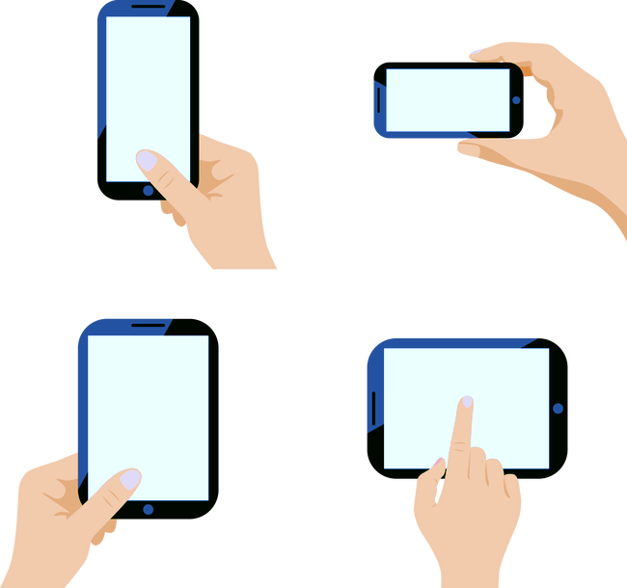
Paper
Fluorescent wavefront shaping using incoherent iterative phase conjugation
Dror Aizik, Ioannis Gkioulekas, Anat Levin
Scan me
Image with our modulation
Reference (validation camera)
Conventional image
Notes:
Thanks for your attention, and you can scan this QR code to get to the paper.

Slide 30
Application example: adaptive optics
Tissue
Fluorescent Beads
From laser
Excitation wave
Adaptive optics =
overcoming the
fundamental challenge
of optics
No practical algorithm for finding correction element.
Validation Camera
Emission wave
Correction element
Image through thin tissue
Same pattern
Existing approaches: invasive camera from the other side, costly optimization.
Undo scattering
Main system Camera
Image through thick scattering tissue.
Image thr. thick tissue + correction element
Notes:
And then they invasively placed a camera at the back of the tissue to provide feedback to the algorithm. But in a real biomedical imaging setting, if we could place a camera inside the tissue we could image the fluorescent sources directly, and we wouldn’t need a correction element. Even with this invasive feedback finding the correction element is a very costly process which usually relies on trying thousand intermediate correction elements. And what if the subject is alive? And it is moving?

Slide 31
Results
Tissue
Fluorescent Beads
From laser
Excitation wave
Validation Camera
Emission wave
Correction element
Main system Camera
Notes:
In this research, for the first time, we suggest an algorithm that can recover the correction element non-invasively, and it can do so very very fast.
To do so we need to model the problem analytically. And let me tell you a bit on how we do that.

Slide 32
Results
Tissue
Fluorescent Beads
From laser
Excitation wave
Validation Camera
Emission wave
Correction element
Main system Camera
Notes:
In this research, for the first time, we suggest an algorithm that can recover the correction element non-invasively, and it can do so very very fast.
To do so we need to model the problem analytically. And let me tell you a bit on how we do that.

Slide 33
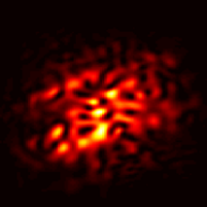
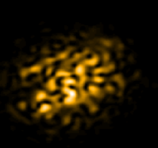

Adaptive optics: analytical model
Tissue
Fluorescent Beads
Control correction element
From laser
Excitation wave
Excitation wave
Emission wave
Transmission operator
$=𝓣$( )
Emission wave
Main system Camera
Notes:
and get a different noise pattern out.

Slide 34
Adaptive optics: analytical model
Tissue
Fluorescent Beads
Control correction element
From laser
Excitation wave
Focus
Excitation wave
Emission wave
Transmission operator
$=𝓣$( )
Emission wave
Problem: how to obtain feedback on focusing?
Output is yet another speckle pattern.
Main system Camera
Notes:
Now our goal is to find an illuminating wavefront that focuses into a single point inside the tissue. But note that even if we found such a wavefront, the emission from it still scatters on its way out and we get yet another noisy speckle pattern.
So the main challenge here is how can we know we have focused?
Is there any feedback we can still obtain from its noisy emission?

Slide 35
Results
Tissue
Fluorescent Beads
From laser
Excitation wave
With mod.
. . .
Main camera
Validation Camera
. . .
Emission wave
No mod.
Rapid convergence
Emission
. . .
Validation camera
Excitation
. . .
Main system Camera
initialization
Itr 4
Notes:
we can correct the aberration.
So let’s see what this gives us
As the iteration proceed and the excitation focus into a single bead, the emission is also corrected and we see a sharp spot on the main camera.
So this algorithm converges into a focusing modulation within a very small number of iterations, and this is a big improvement over previous approaches.

Slide 36
Results
Tissue
Fluorescent Beads
From laser
Excitation wave
Validation Camera
Emission wave
Validation camera
Excitation
Main system Camera
initialization
Itr 1
Itr 2
Itr 3
Itr 4
Notes:
Before I talk on how to do that, let me start by showing some results.
In order to better show you what is happening here I put fluorescent beads at the back of the tissue layer and not really inside it, and I put another validation camera behind the tissue, which can image the beads directly. The validation camera does not provide any feedback to the algorithm and is only used to assess its success.
So we start with some random modulation pattern and when this pattern scatters through the tissue we get a wide speckle pattern at the back layer. But based on the image we capture at the main camera we update our modulation and with as little as 4 iterations, the modulated illumination focuses into a single spot behind the tissue.

Slide 37
Results
Tissue
Fluorescent Beads
From laser
Excitation wave
Validation Camera
Emission wave
Filter emission wavelength
Validation camera
. . .
Excitation
Main system Camera
initialization
Itr 4
Notes:
Now to save space I will squeeze this sequence and show only the first and last iterations.
To show you the fluorescent beads themselves I put a bendpass filter so we only see the emission light and not the excitation.

Slide 38
Results
Tissue
Fluorescent Beads
From laser
Excitation wave
Validation Camera
Emission wave
Filter emission wavelength
Emission
. . .
Validation camera
Excitation
. . .
Main system Camera
initialization
Itr 4
Notes:
So you can see that there is a spread of beads here, in the beginning many of them are excited, but as we proceed the excitation light is focused into one spot and as a result only one of the beads emits light.
Now the decision on how to update the modulation is not based on what the validation camera is seeing but on what the main camera from the other side sees, and let’s have a look at what this camera can image

Slide 39
Results
Tissue
Fluorescent Beads
From laser
Excitation wave
Main camera
Validation Camera
. . .
Emission wave
No mod.
Emission
. . .
Validation camera
Excitation
. . .
Main system Camera
initialization
Itr 4
Notes:
We note that even if we manage to focus all the light and excite a single bead, the light will scatter on its way back to the camera, and in the main camera we see yet another speckle pattern.

Slide 40
Results
Tissue
Fluorescent Beads
From laser
Excitation wave
Validation Camera
Emission wave
Main system Camera
Notes:
However if we take the modulation used in the illumination arm and also place the same pattern in the imaging arm we can correct the aberration.

Slide 41



Coherent iterative phase conjugation
Tissue
Reflective particles
back-plane
From laser
Input wavefront
Transmission operators
Back-plane wave
$𝓣^{i}$( )
$$=$$
input wave
Validation Camera
input wave
Output wavefront
back-plane wave
$$𝓣^{i}$$
output wave
$𝓣^{o}$( )
$$=$$
Back-plane wave
Even with focus: output=speckle
⇒ How can we know we have focused?
output wave
output wave
$𝓣$( )
$$=$$
input wave
$$𝓣^{o}$$
Phase conjugation principle
$$𝓣^{o}={\left(𝓣^{i}\right)}^{T}$$
$${𝓣=𝓣}^{o}⋅𝓣^{i}$$
Main system Camera
Notes:
With our computer controlled light modulator we can send in various illumination wavefronts. And each such wavefront generates some other wavefront at the back of the tissue.
To model the problem mathematically we consider the transmission matrix of the medium, which describes how each incoming wavefront is mapped into the back plane of the tissue.
Once the wavefront gets to the reflective particles at the back of the tissue it is reflected and scatters back through the tissue and it generates an outgoing wavefront at the main camera.
We consider another transmission matrix To that maps between wavefront at the back plane to wavefonts at the main camera
Overall we will be describing the mapping between incoming illumination to outgoing wavefront at the camera by a transmission matrix T, which is the multiplication of Ti by To.
This model involves some approximation, and we will come back to what we have neglected here in a few slides.
So assuming this Ti To model, we use the principle of optical wave conjugation. It tell us that the wavefront coming out of a point, is the conjugate of the wavefront focusing at it, or namely that To is the transpose of Ti.

