Slide 1
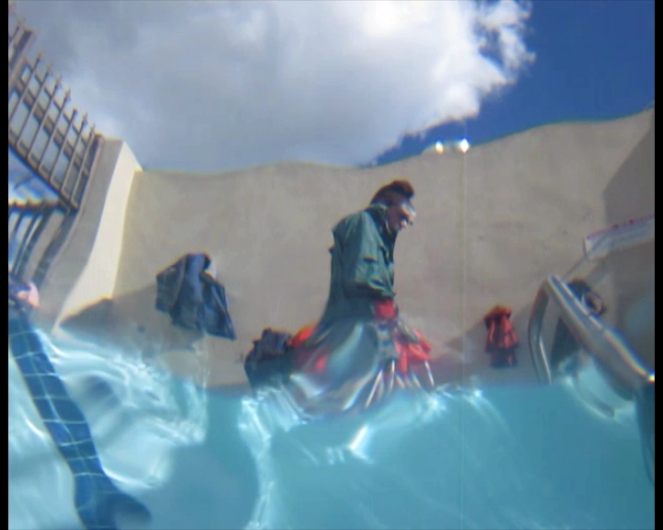

Vision through Random Refractive Distortions
Marina Alterman, Yoav Y. Schechner, Yohay Swirski
Electrical Engineering, Technion, Israel
Notes:
Thank you.
I will present you our work – “Triangulation in Random Refractive Distortions”. You can see an example of such distortions in this image.

Slide 2
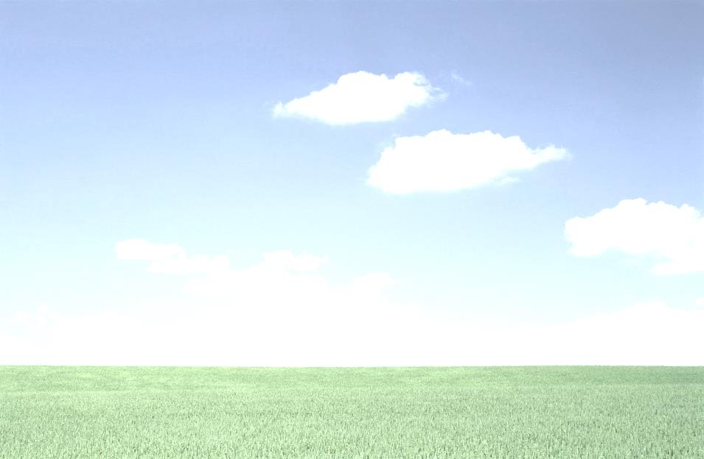

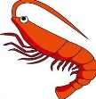
2
Weak distortions
Strong distortions
Weak distortions
Deep sea volcanic vents

Slide 3
Refraction at Water Surface
camera

Slide 4
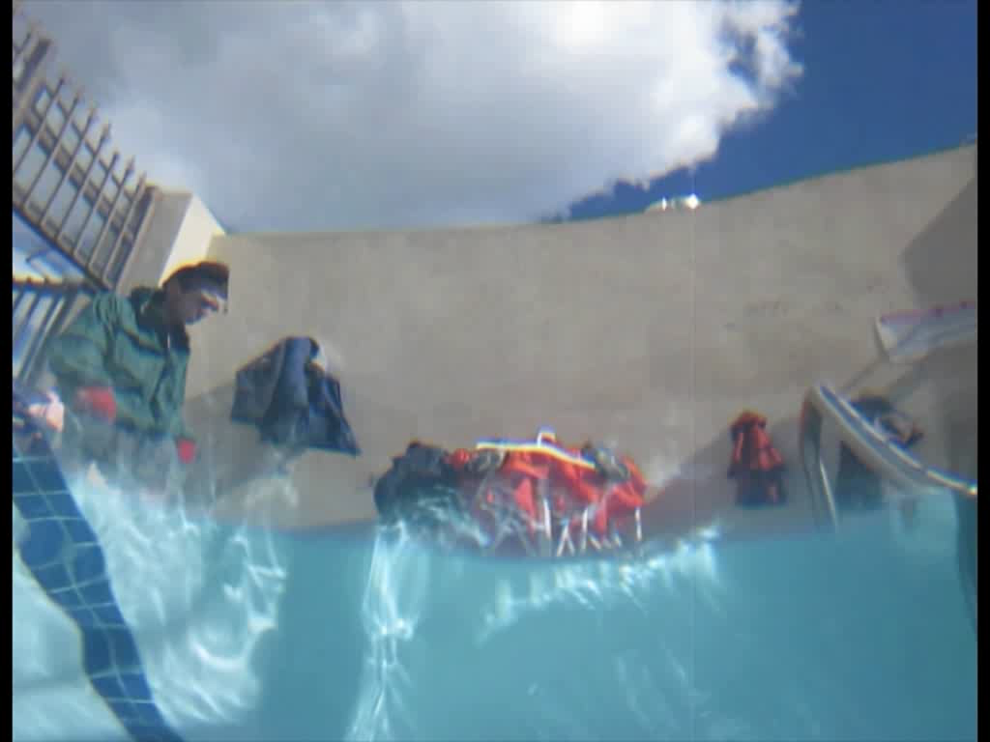
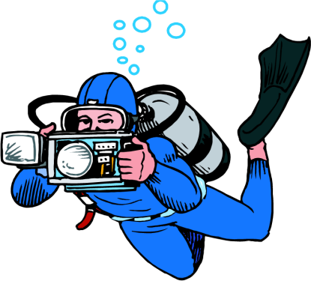
Random Refractive Distortions
Undistort?
difficult - moving objects
Activity?
Notes:
Please look at this movie. It was acquired from below the water surface in the Jacuzzi of Caltech using an upward looking underwater camera.
You are familiar with this natural phenomenon of random distortions from the swimming pool or from the sea.
Now, think of applying some computer vision tasks on this challenging video.
What is the first thing you would want to do?
The first thing that comes to mind is to undistort these images. However, it is difficult if there are moving objects in the scene as you can see here.
So, what else can we do? The subject of interest here is actually the person walking. This is interesting because it reveals activity.

Slide 5
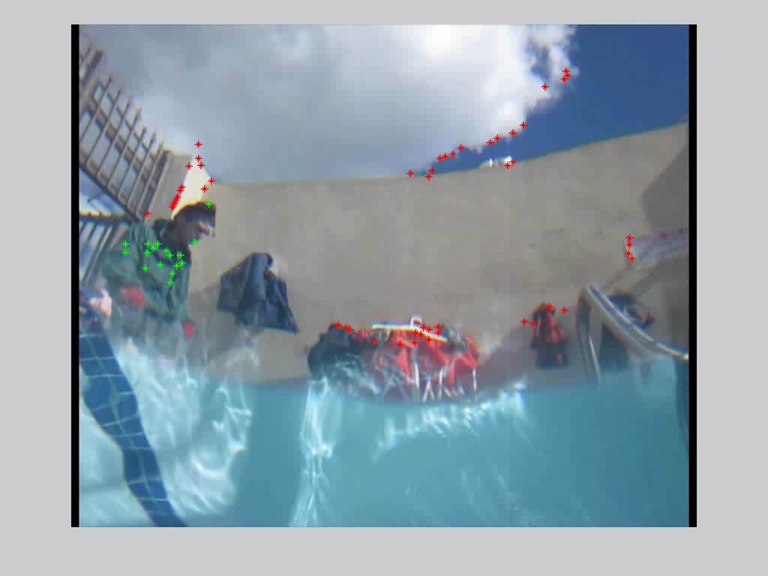
Motion Detection
tracking
Comaniciu et al., 2003
Kalal et al.,
2009
Brox & Malik, 2011
Oron et al., 2012
Dynamic vs. Static
Alterman, Schechner, Perona, Shamir TPAMI 2013
Notes:
This movie is the result of automatic discrimination between dynamic and static objects. The red points are static and the green points are dynamic. This is actually a difficult problem because nothing is static here.
But, there are good news. There are off-the-shelf trackers that can handle it. Tracking enable us to study statistics for example.
This is our work on motion detection through water that was published this year in PAMI.

Slide 6
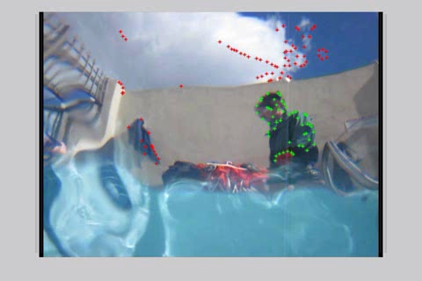
Dynamic vs. Static
Details in the paper
Automatic Classification
2000
1500
Motion Detection Through Random Refractive Distortions TPAMI 2013
1000
Theoretic
Physics-based Classifier
500
0
0
1000
2000
3000
4000
5000
6000
7000
Notes:
These interest points are shown here in our motion variance feature space. The axes are variances in x and y directions.
To separate dynamic and static points, we derived a physics-based classifier. This is this blue line here.
You can see the details in our PAMI paper.

Slide 7
Random Refractive Distortions
Where is it? 3D Location?
Notes:
So, we can also ask where the object of interest is located?
In this presentation, I will concentrate on localization.

Slide 8
Motivation in Nature
Seal avoids polar bear
Archer fish shooting at prey
Penguin diving for food
Cormorant diving for food
Notes:
This scenario is related to biological vision: It is experienced by submerged animals seeking to detect prey or avoid predators .
The archer fish, for example, shoots down airborne prey using a water jet, aiming while being submerged.
It has also been hypothesized that seals watch for ambushing polar bears, prior to surfacing for air.
There are also airborne and land animals such as cormorants and penguins, that detect and hunt fish by looking down through the WAI.

Slide 9
Periscope
real
virtual
STELLA MARIS ICCP 2014
Notes:
When a submarine needs to look outside the water, it uses a periscope.
Submarines have been using this technology for over 100 years already.
However, it may draw attention.
What if we had a virtual periscope? A periscope that contrary to a true periscope, is completely submerged underwater, and therefore does not draw any attention.

Slide 10
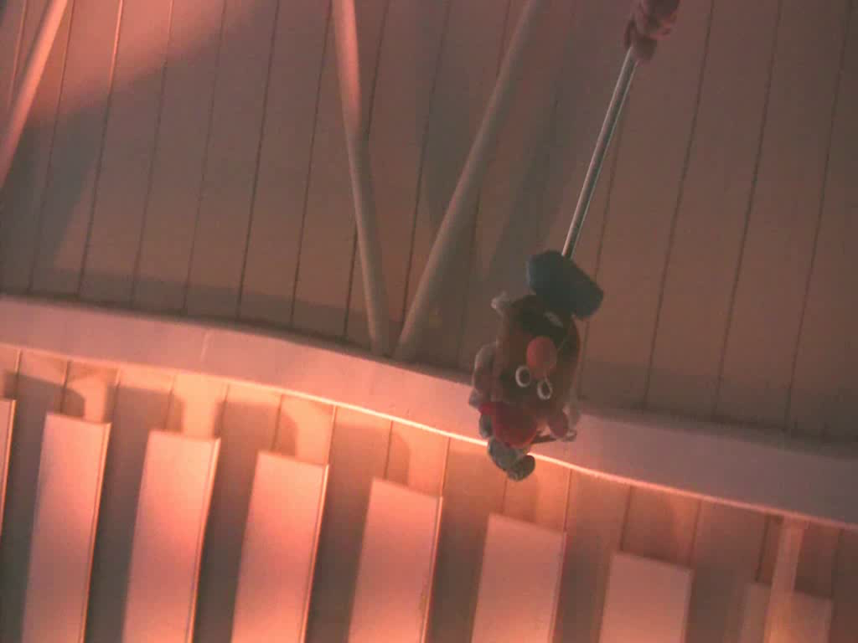
Where is the Potato-Head?
Alterman, Schechner, Swirski ICCP 2013
Notes:
So, our task is estimation of object location (here the potato head) under random refractive distortions such in this example here.
More specifically…

Slide 11
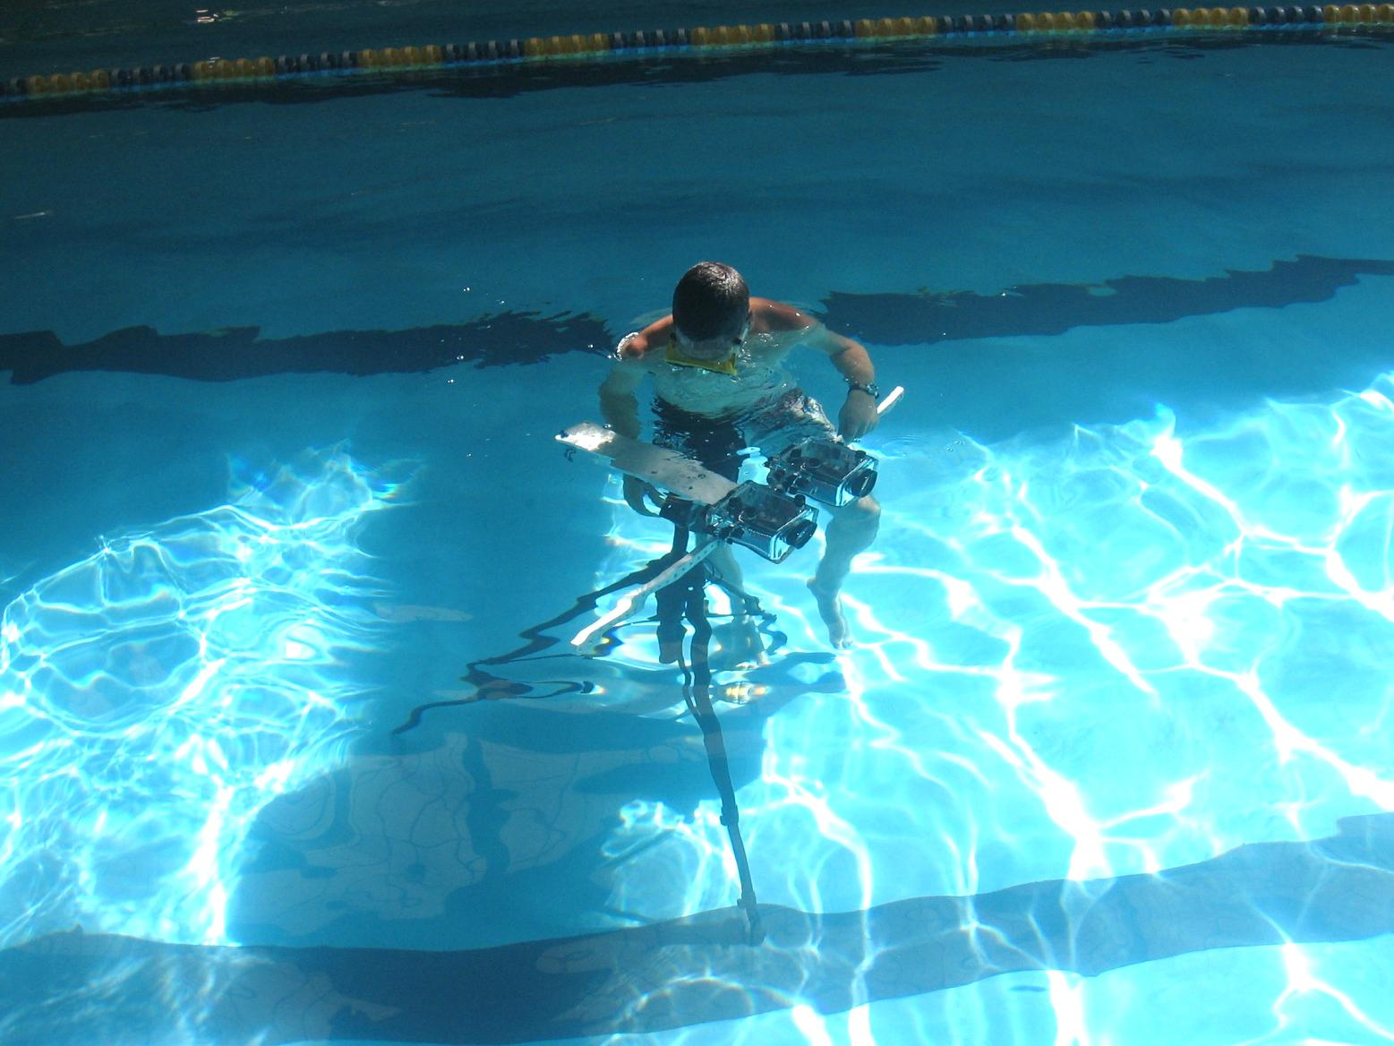
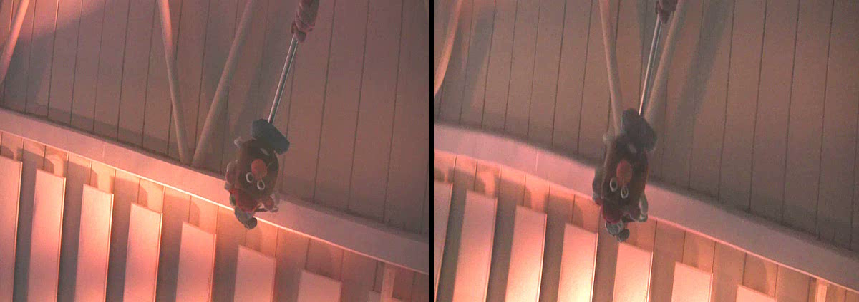
Triangulation
Z
?
Y
X
Left view
Right view
Notes:
We take a multi view approach to this task. Both cameras are underwater looking up.
Given two views of the object, our task is triangulation to estimate the location of the object.
In this presentation, I’ll show you how it is done.

Slide 12
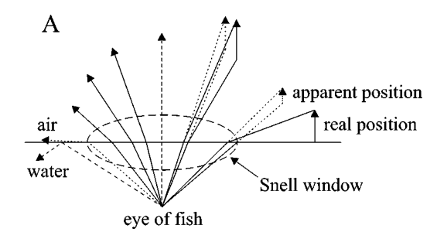
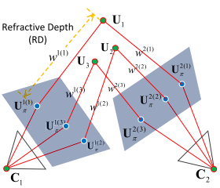
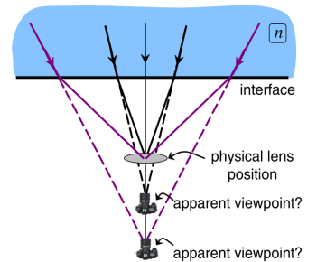
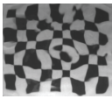
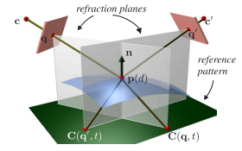
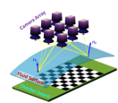
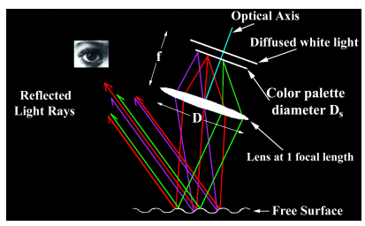
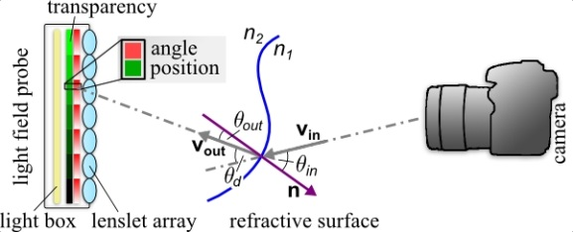
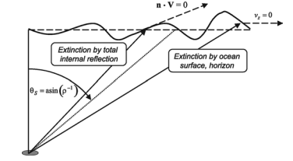
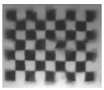
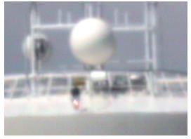

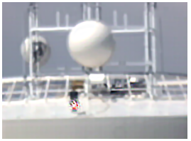
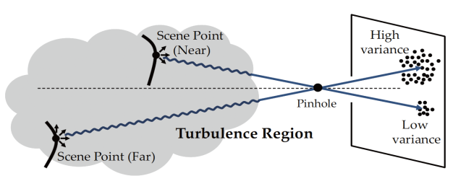
Related Work
Flat known interface
Flat water-air interface
[Treibitz et al. 2011]
[Barta & Horvath 2003]
[Kang et al. 2012]
Wavy water-air interface
[Tian & Narasimhan 2009]
known pattern,
structured light
Milder et al. 2006.
Many frames – static scenes
[Dabiri & Charib 2000]
[Wetzstein et al. 2011]
[Morris& Kutulakos 2005]
[Ding et al. 2011]
Atmospheric Turbulence
Weaker distortions
[Zhu & Milanfar 2013]
[Oreifej et al. 2012]
[Tian & Narasimhan 2012]
Notes:
Now, let’s look at some of the related work.
Distortions and scene reconstruction through a flat water surface have been thoroughly studied. But in our problem there is a challenge of unknown random dynamic distortions.
There is also much work dealing with wavy water interface. There are video-based methods to “ﬂatten” monocular images taken through a wavy WAI. These methods require a large number of frames and thus used for static scenes.
There are multi-camera methods dedicated to recovering a wavy WAI. These methods, however, often rely on a known calibration target or a structured light. They are thus not intended to triangulate unknown objects behind a WAI.
Random dynamic distortions are also present when imaging through atmospheric turbulence.
There are works on image undistortion, motion detection and also triangulation.
However, the distortions there are much weaker than in WAI.

Slide 13
Refraction at Water Surface
pinhole
flat
camera
CCD
Notes:
Now, lets dive into some details.
When the water is ﬂat, this point projects to this pixel. Lets call it x_flat.

Slide 14
Refraction at Water Surface
wavy
Notes:
When the water is wavy, the same point now projects to a different pixel. Lets call it x.

Slide 15
Wave Slope Statistics
Notes:
Lets look at the wavy water surface as it varies in time.
Pay attention to this surface point and its surface normal which corresponds to surface slope.

Slide 16
Wave Slope Statistics

Slide 17
Wave Slope Statistics

Slide 18
Wave Slope Statistics

Slide 19
Wave Slope Statistics

Slide 20
Wave Slope Statistics

Slide 21
Wave Slope Statistics

Slide 22
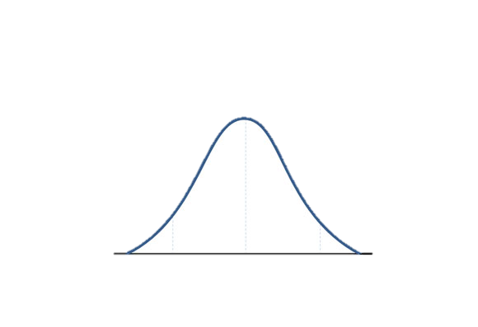
Wave Slope Statistics
Gaussian
Distribution
Cox & Munk 1954
Notes:
Following Cox and Munk from 1954 , the WAI normal N is random in space and time and has a Gaussian distribution.
The variance of N depends on meteorological parameters.

Slide 23
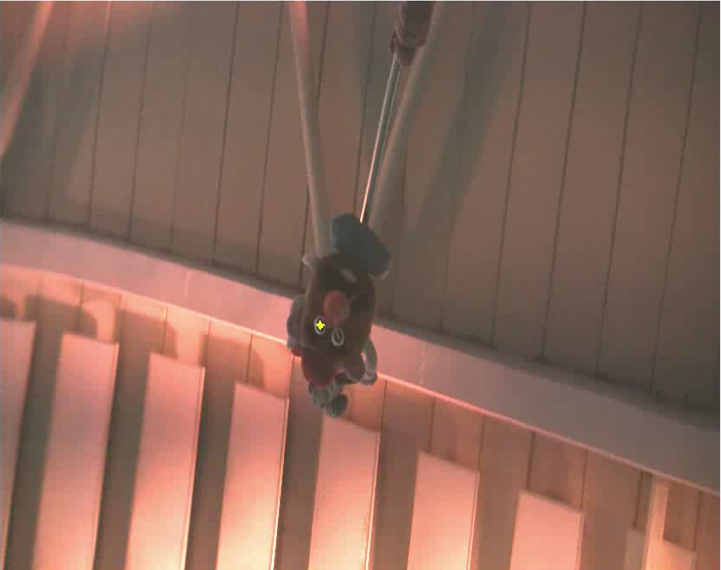
Image Pixel Statistics
Alterman, Schechner, Swirski ICCP 2013
Notes:
Therefore, in the image plane, over time, the projection of the observed object fluctuates.

Slide 24
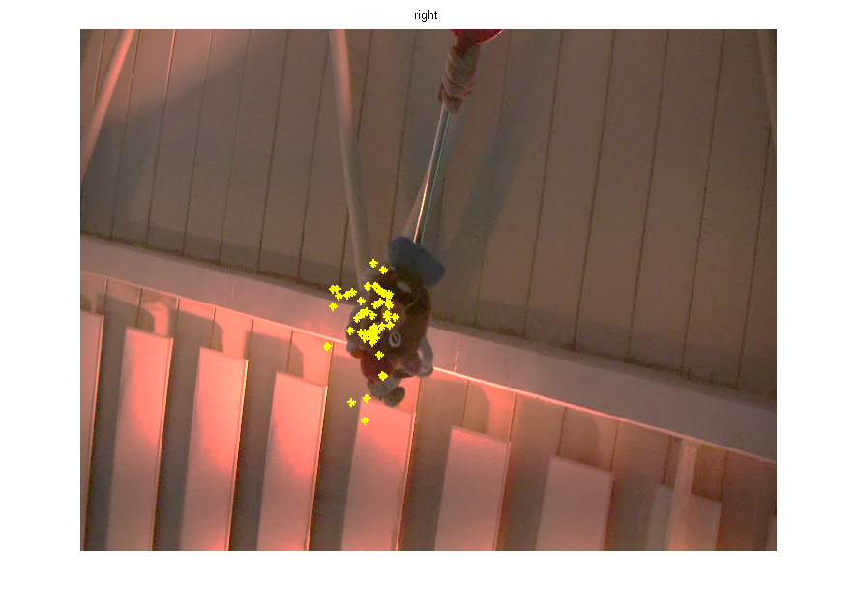
Image Pixel Statistics
24
Notes:
Showing all the pixels where we have observed the object together, gives the following distribution.
By averaging these positions we obtain x_flat.

Slide 25
Distortion distribution
24
2D Gaussian
Alterman, Schechner, Swirski, ICCP’13
Notes:
In a single viewpoint, the distribution of “x” is approximately normal, given x_flat.
Red means high probability and blue low probability.
But, x_flat is un-known.
25

Slide 26
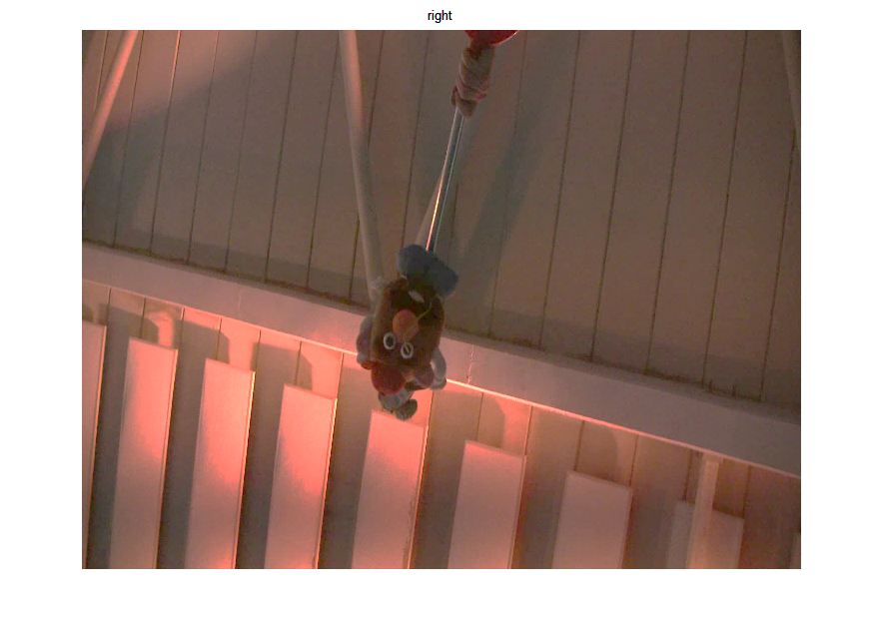

Flat-location probabilty
25
x_{flat} is unknown!
Bayes’ rule:
no preference
Alterman, Schechner, Swirski, ICCP’13
Notes:
We only have x.
So, we use Baye’s rule.
Which means that the distribution of x around x_flat, provides the distribution of x_flat around x.
This means that, given a distorted pixel x, we can say that the flat pixel is somewhere in the vicinity of x, with this distribution.
The prior of x_flat is set to constant since there is no preference of imaging at any particular location.
26

Slide 27
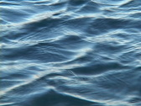
3D Position
27
water surface is unknown!
wavy water surface
pinhole
Notes:
Now, this is our image plane. We have only, the pixel x.
If I knew the water surface, I would back project.
BUT, I don’t know the water surface. So I do something that is probabilistic.

Slide 28
3D Position Likelihood
28
Position likelihood
flat water surface
wavy water surface
pinhole
Notes:
Now, this is our image plane. Given, the pixel x, we know that the flat pixel is nearby with this probability.
Lets back-project all the pixels around x with matching weights.
Now we replace the unknown wavy water surface with a flat surface, there is refraction and therefore,…
Then, this cone represents the position likelihood of the object imaged at x.
How do we narrow the support of this likelihood? To narrow the support, we need additional measurements so that we could multiply the likelihoods. Thus, we need these measurements to be uncorrelated.

Slide 29
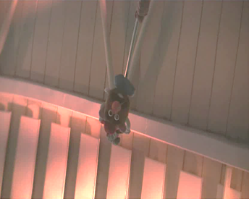
Uncorrelated Measurements
temporal statistics
wait
time
Notes:
One way to obtain uncorrelated measurements, is to wait to collect temporal statistics.

Slide 30
Uncorrelated Measurements
triangulation
views
Notes:
Another efficient way, is by introducing additional views.
The byproduct of multiple views is actually triangulation.

Slide 31
Correlated views
No correlation
Short baseline
Wide baseline
Notes:
What about correlation between views?
Correlation between water waves slopes at two different surface points depends
on the lateral distance between the points – this corresponds to the distance between views – the baseline.
If the baseline is signiﬁcantly shorter than the typical WAI-slope correlation length, then, distortions in the two views are mutually highly correlated, as illustrated here. Notice that both cameras view through the same wave slope.
As opposed to this, we prefer to work in another domain, where distortions across views are uncorrelated.
Beyond a certain distance, we can assume that there is no correlation between the water slopes.
So we prefer a wider baseline.
You can see this here in the submarine illustration. Both cameras are viewing though significantly different shapes of the water surface.
This means that any new view adds more information about the object location.

Slide 32
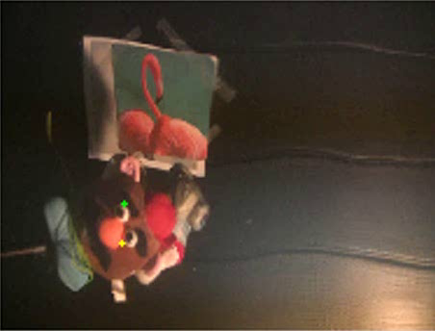
Time / View Correlation
Right View
Notes:
Now lets look at this example. Look at these two points in the right view tracked over time.
Notice that both points are correlative.
Similarly in the right view.

Slide 33
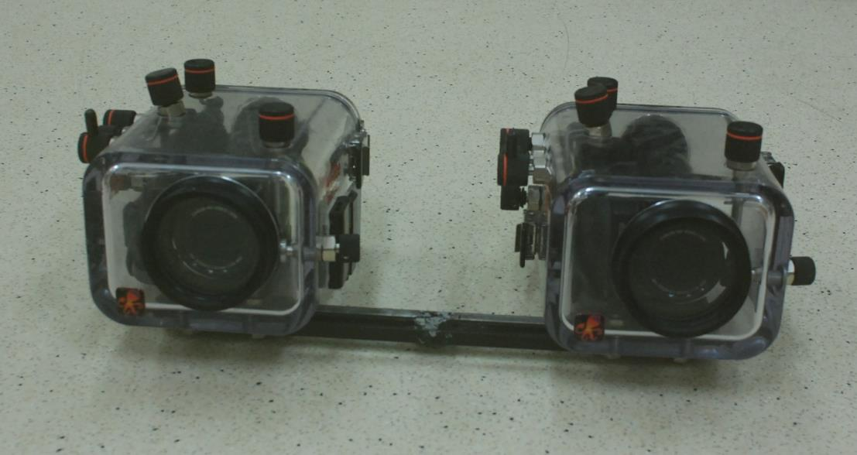
Time / View Correlation
27.5 cm
Notes:
We wanted verify that there is a low correlation across views. This is our setup in the lab. These are the cameras. Tour baseline is 27.5 cm.

Slide 34
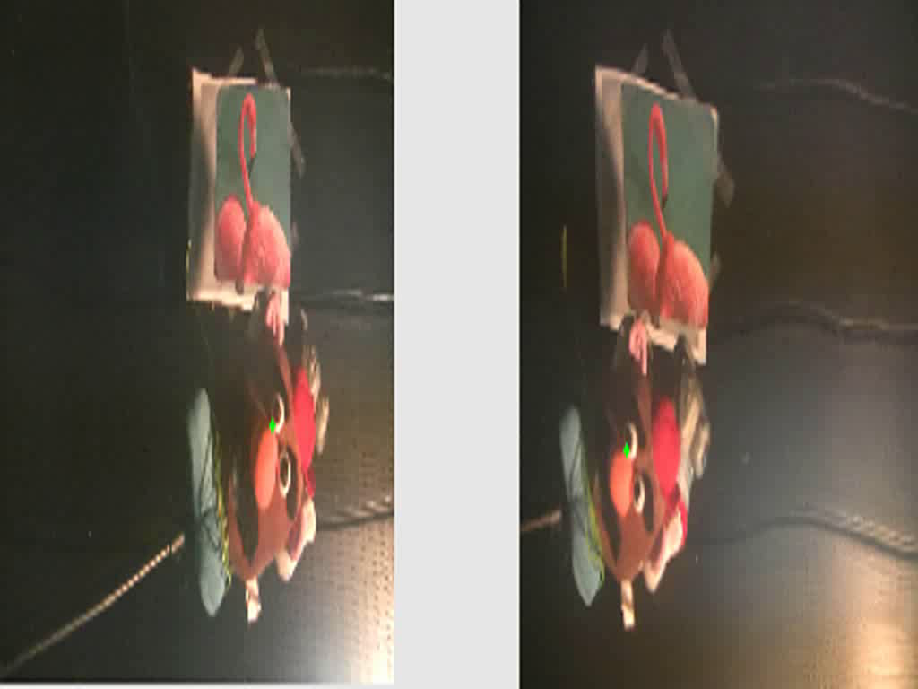
Time / View Correlation
Left View
Right View
use multiple views
Correlation between views
~0.14
Multiple views
=
efficient low correlated data
Temporal correlation
~0.6
Notes:
Now observe both views simultaneously. You cannot see any correlation between the trajectories across views.
The average correlation coefﬁcient between views was around 0.14. This result points to low correlation between views.
Between consecutive frames, the correlation coefﬁcient was around 0.6 .
Multiple views offer less correlated data, signiﬁcantly faster than sequential monocular imaging.
This strongly supports the use of multiview imaging, irrespective of triangulation, even if we only want to know the direction of distant objects or even to undistort object locations.

Slide 35
Multi- View Motivation
multi-view
Vi tual periscope
Notes:
There are biological motivations and engineering applications to study vision in such scenarios in multi-view settings.
For example, you remember the birds? Birds ﬂy in search of submerged ﬁsh to hunt.
You remember the fish? Fish swim to hunt airborne ﬂies .
In all cases, predators need to assess the 3D location of the prey prior to charging.
Maybe this is done by triangulation as the predator changes its position during its path, thus obtaining multi-views.
A multi-view virtual periscope can help submarines localize objects above water, without using physical periscopes which revel their presence.

Slide 36

Correspondence is known
Left
view
Right
view
Alterman, Schechner, Swirski ICCP 2013
Notes:
Now, to triangulate, we use stereo.
So, there are a pair of submerged cameras, looking upward throught the water surface.
When the water surface is flat, this object point is imaged at x_flat at both views.
In this work, we assume that the correspondence is known.

Slide 37
x_{flat} is unknown!
Left
view
Right
view
t = 1
Notes:
Wavy water causes the same object point to be imaged at 2 different pixels at the left and right views.
Recall that x_flat is not known.

Slide 38
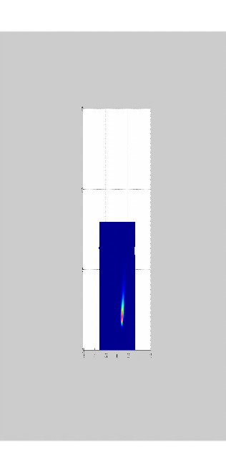
Likelihood
intersection
ML
Uncertainty region
Left
view
Right
view
Wave statistics
t = 1
Alterman, Schechner, Swirski ICCP 2013
Notes:
But, we know that x_flat is somewhere around the distorted pixel x based on wave statistics.
By Back-projecting from both views through the flat surface, we obtain the possible region for object 3D location at the intersection.
Since we have a distribution around x, we actually obtain a likelihood function in 3D. The estimated location is the location of the maximum likelihood.

Slide 39
intersection
ML
Additional temporal frames narrow uncertainty
Uncertainty region
Likelihood
Left
view
Right
view
t = 2
Notes:
Now, we received another pair of frames with different wavy surface.
Again, By backprojecting in a similar way, through the flat surface, we obtain another region.
And the possible object location is at the intersection of both frames. This region is narrower.
Again, the estimated location is at the location of maximum likelihood.
Additional frames will narrow this uncertainty.

Slide 40
Additional views narrow uncertainty
Uncertainty region
Likelihood
Temporal frames trade-off
for more viewpoints
Moving objects
Notes:
What happens if the object is moving? We cannot wait for more temporal frames.
You can see here that using more views narrows the uncertainty without additional temporal frames.
This is good because we can obtain more accurate estimation in less time. Meaning that this approach can be generalized for moving objects.

Slide 41
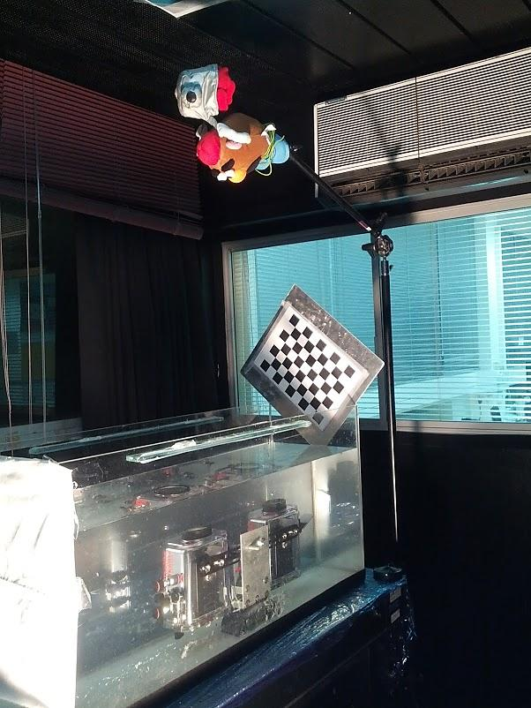
Experimental Setup
Swimming pool
Lab water tank
Notes:
We tested our method both at the lab and in the swimming pool.
Our experimental setup includes 2 video cameras in a water proof housings as you can see over here.

Slide 42
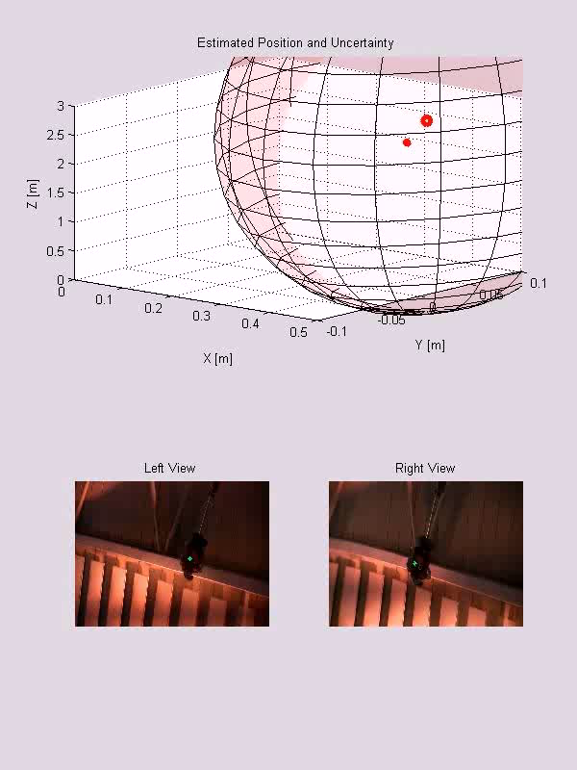
Results
Input
Notes:
Now, I’ll show you some results.
This scene was captured in a swimming pool using 2 video cameras. These are the input frames.
What you see here is the estimated 3D location of the green object point by using our triangulation method.
The ellipsoids around the estimation, are the uncertainty regions which are the effective support of the obtained likelihood function.
Notice that uncertainty shrinks with time.

Slide 43
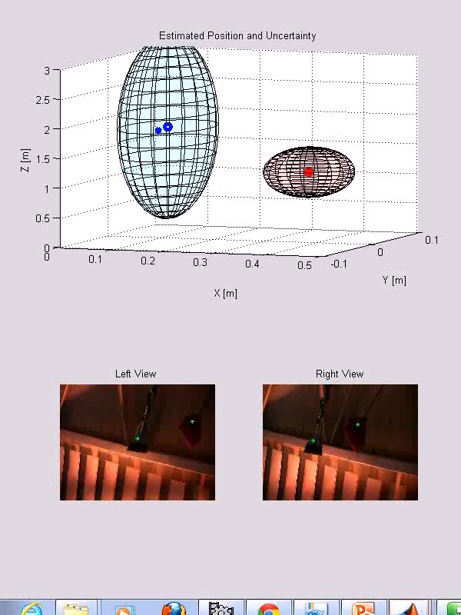
Results
Input
Notes:
Here you can see another example of 2 brooms. Recall that we assume that the correspondence is known.
This one is closer to the cameras then the other.

Slide 44
Limitation
Error grows with range
many
pixels
Notes:
Now, lets say a few words about limitations.
As you can see in this sketch, for a regular stereo system, as a result of pixel discretization, there is an error in range estimation.
Notice, that the uncertainty in depth estimation, grows with range. The diamonds get bigger as we go further away from the cameras.
In our setting, each such slot represents many pixels, thus, we have the same limitation, just with a different scaling.

Slide 45
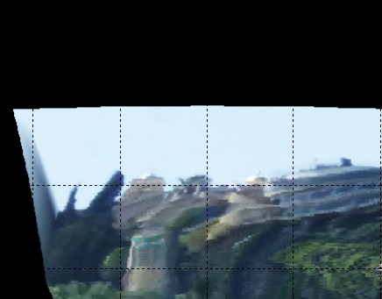
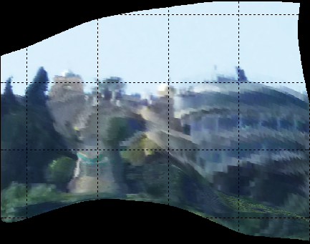
Stella Maris
Single instant
Distorted
Reduced Distortions
Water surface
Sun Light Field
Alterman, Swirski, Schechner, ICCP 2014
Notes:
So we propose a novel virtual periscope system.
The input is a distorted image. The output is an image with reduced distortions.
All this in a single instant using an estimation of the water surface.
An additional input to our system, is the Sun light field, which I will soon explain about.

Slide 46

Analogy to ground-based astronomy
target
target
turbulence layers
wavy water
imaging optics
CCD
CCD
STELLA MARIS, Alterman, Swirski, Schecher, ICCP 2014
Notes:
Ground-based astronomy is affected by turbulence in the air.
Thus the image is degraded by random refractions.
In analogy, images taken by a submerged camera are degraded by the random refractive WAI.

Slide 47
Analogy to ground-based astronomy
target
guide star
target
turbulence layers
wavy water
imaging optics
wavefront sensor
CCD
CCD
STELLA MARIS, Alterman, Swirski, Schecher, ICCP 2014
Notes:
To partly correct for atmospheric random refractions, telescopes use a wave-front sensor.
It senses the atmosphere by imaging a distant known guide star through an array of lenslets or pinholes.
From deviations of the guide star imagelets, the instantaneous refractive disturbance is spatially sampled and estimated.
Then, this disturbance can be countered, e.g., using adaptive optics.

Slide 48
Analogy to ground-based astronomy
target
guide star
guide star
target
turbulence layers
wavy water
imaging optics
wavefront sensor
wave sensor
CCD
CCD
STELLA MARIS, Alterman, Swirski, Schecher, ICCP 2014
Notes:
The analogy of the problem points to our solution: the WAI can be estimated by measuring a known guide star through the WAI, simultaneously with viewing the scene of interest.
Our stellar guide is obvious: the Sun.
From deviations of the resulting Sun imagelets, the instantaneous refractive water surface is spatially sampled and estimated.
This enables signiﬁcant reduction of distortion, using physics based geometric computations, per frame.

Slide 49
STELLA
MA
R
I
STELLAr MArine Refractive Imaging Sensor
S
guide star
STELLA MARIS
STELLA MARIS, Alterman, Swirski, Schecher, ICCP 2014
Notes:
So our system is a stellar marine refractive imaging sensor and we call it stella maris, which is Latin for “star of the sea”.
It comprises a Shack-Hartmann sensor and a viewing part.
This is the viewing part of the system. This is the wave sensor.
Now let us concentrate on the wave sensor.

Slide 50
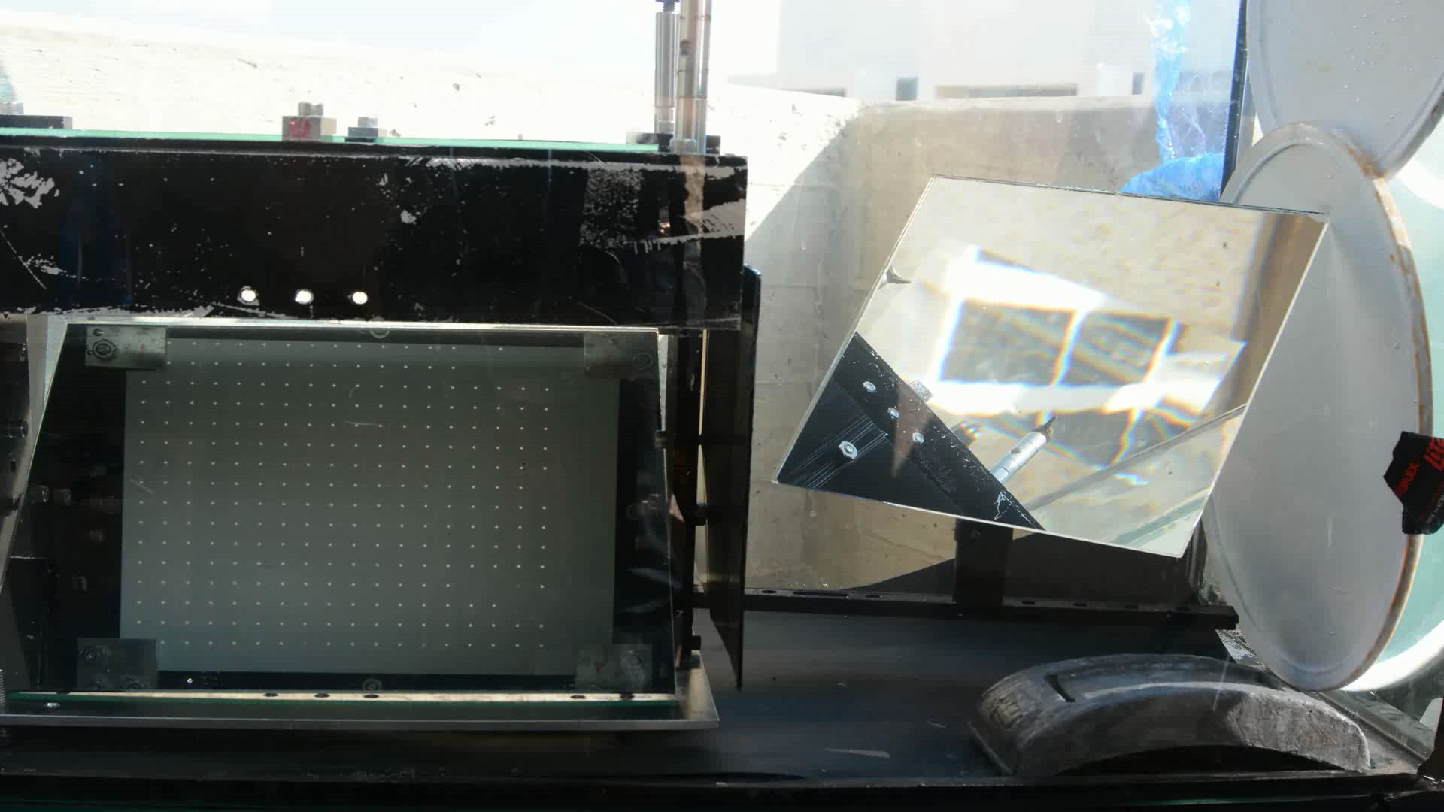
Sun Light-Field
From real experiment
Notes:
Here is an example from a real experiment of the sun light field under varying water waves.
Each blob is an image of the sun corresponding to one pinhole.
You can see how random waves cause random displacements in the grid.

Slide 51




Wave Sensor
Snell’s law:
$$s^{air}$$
1.33
$$s^{air}×\hat{N}=n∙s^{water}×\hat{N}$$
known
known
$$s^{water}$$
$$\hat{N}$$
pinhole array
Solar image plane
Alterman, Swirski, Schechner, ICCP 2014
Notes:
Let us look at a single sun ray.
The vector s^water is the direction of a sunray in the water. In air, the unit vector pointing to the Sun is s^air.
Our goal is to estimate the water surface, and thus we seek the normal N.
This is a vector form of Snell’s law.
The vector pointing to the Sun is always known, given the time and geographic location.
The vector inside the water is extracted from the sensor image data.
So, we can compute N.
We repeat this process for each pinhole.

Slide 52
Wave Sensor
for each pinhole
pinhole array
Solar image plane
Alterman, Swirski, Schechner, ICCP 2014

Slide 53
Water Surface Reconstruction
Normal field
Water Surface
integration
Moisy et al. A synthetic Schlieren method for the measurement of the topography of a liquid interface. Exper. in ﬂuids, 46(6):1021–1036, 2009.
Notes:
And we obtain the normal field, seen here.
Surface estimation from its sampled normals is related to photometric stereo.
The WAI is typically smooth and integrable.
Thus, we perform numerical integration of the WAI gradient ﬁeld to obtain the water surface.

Slide 54
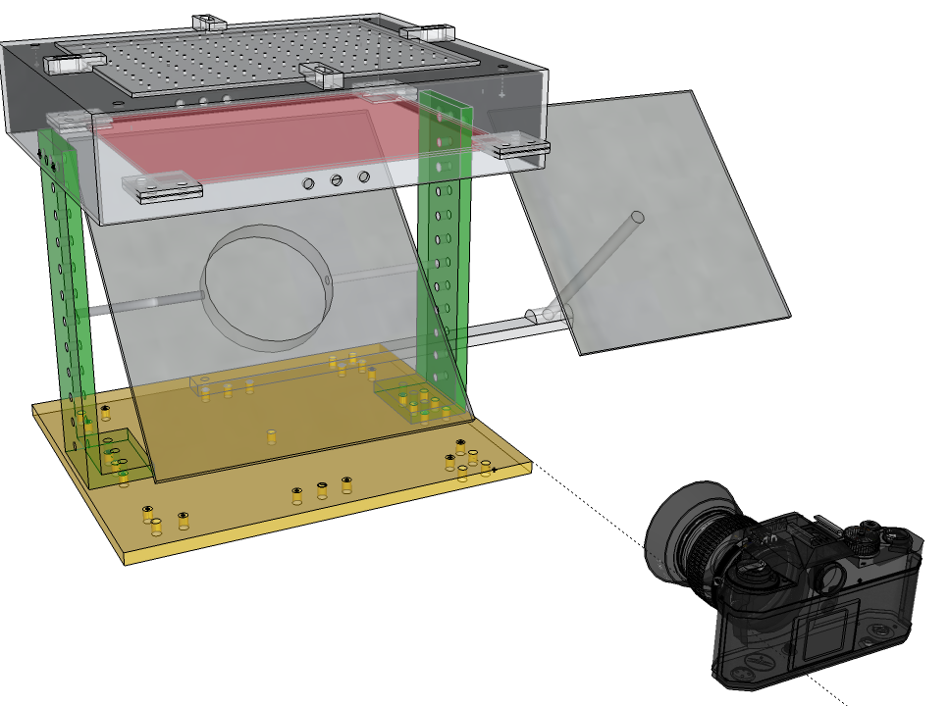
System Implementation
Alterman, Swirski, Schechner, ICCP 2014
Pinhole array
Diffuser
Alterman, Swirski, Schechner, ICCP 2014
Notes:
Here is the actual implementation of our system. This is the pinhole array and below is the diffuser.
We use a mirror here to observe the diffuser with this camera placed in front of the sensor.
Sun rays refract by the WAI, irradiate the diffuser, reflect in the mirror and imaged by the camera.
And we have an area on the water surface that we thus estimate.
Now, recall that the image of an airborne scene should be acquired simultaneously with the sunlight field.
For synchronization, we use the same camera and another mirror.
The object is imaged through the mirror reflection.
A single image contains both the sunlight filed and a distorted airborne scene.

Slide 55

Design Trade-off
Limitations?
pinhole array
Solar image
plane
$$Δp$$
STELLA MARIS, Alterman, Swirski, Schechner
Notes:
So, what are the limitations of the method?
Now let us look at some design dradeoffs.
Here you see the pinhole array with distance between the pinholes.
The sensor focal length, is the distance between the pinholes plane and the image plane.
When the water surface is flat, this sunray passes through this pinhole and forms this sun blob of size delta p.

Slide 56
Design Trade-off
pinhole array
Increase
Solar image
plane
STELLA MARIS, Alterman, Swirski, Schechner
Notes:
When the water surface is wavy, this is the obtained sun-blob. Notice that it is almost impossible to detect this slope from this displacement.
The size of the displacement is affected by the slope and by the focal length.
So to increase the displacement and to be more sensitive we would want to increase the focal length.

Slide 57
Design Trade-off
pinhole array
Solar image
plane
STELLA MARIS, Alterman, Swirski, Schechner
Notes:
By increasing the focal length, the two blobs get separated.

Slide 58
Design Trade-off
Better separation → more sensitive
pinhole array
Solar image
plane
STELLA MARIS, Alterman, Swirski, Schechner
Notes:
Increasing it even more, results in good separation and a more sensitive system.

Slide 59
Design Trade-off
pinhole array
Increase
Solar image
plane
STELLA MARIS, Alterman, Swirski, Schechner
Notes:
BUT! Look at two sunrays in wavy water.

Slide 60
Design Trade-off
pinhole array
Solar image
plane
STELLA MARIS, Alterman, Swirski, Schechner

Slide 61
Design Trade-off
pinhole array
Solar image
plane
overlap
STELLA MARIS, Alterman, Swirski, Schechner
Notes:
Increasing the focal length too much will eventually cause the rays to overlap and we won’t be able to know which ray came from which pinhole.

Slide 62
Design Trade-off
aliasing
Reduce
pinhole array
Solar image
plane
STELLA MARIS, Alterman, Swirski, Schechner
Notes:
Now, suppose that we have short wavelength waves with high slopes.
If we do not sample densely enough we’ll get aliasing,
To sample more densely we should reduce the distance between pinholes.

Slide 63
Design Trade-off
pinhole array
Solar image
plane
STELLA MARIS, Alterman, Swirski, Schechner
Notes:
Now we sample more densely

Slide 64




Design Trade-off
max slope
$$Θ$$
$$Δθ$$
wavelength
Uncertainty principle:
$$λ$$
$$\frac{Δθ}{Θ}⋅λ>4Δp$$
overlap
pinhole array
Solar image
plane
$$Δp$$
STELLA MARIS, Alterman, Swirski, Schechner
Notes:
reducing the pinhole distance too much, also caused the rays to overlap,
The slope is changed by delta theta, Suppose that the maximum slope is denoted by capital theta.
the wavelength is lambda, and the size of the blob is delta p.
Then, we derive this tradeoff formula.
The relative wave slope angular resolution can be traded-off for spatial resolution ( 𝜆 ) of the wave, before errors from aliasing and correspondence take effect.
The details are in the paper.

Slide 65
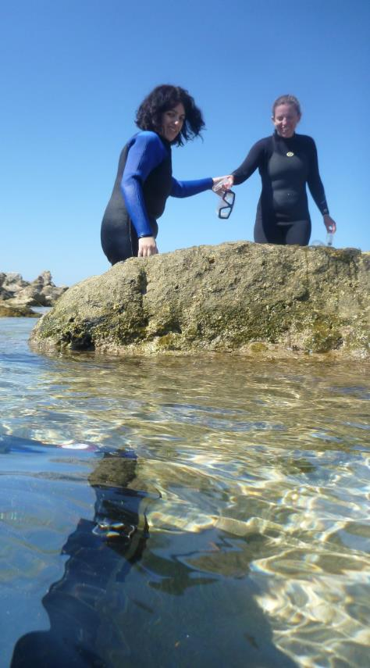
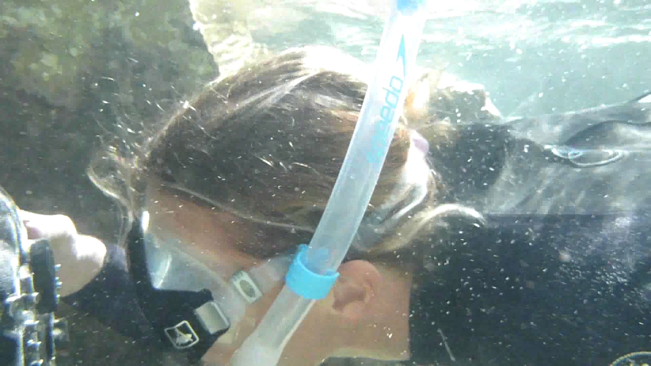
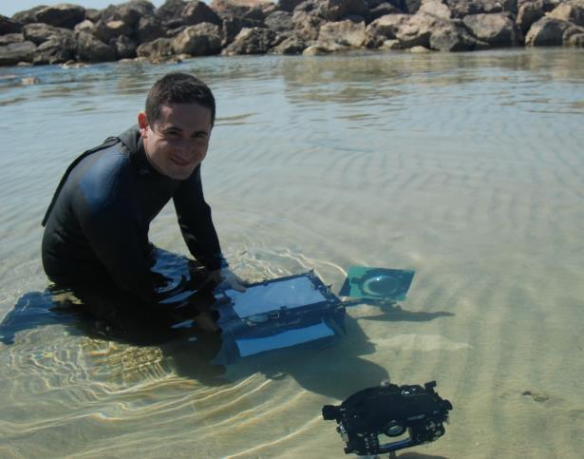
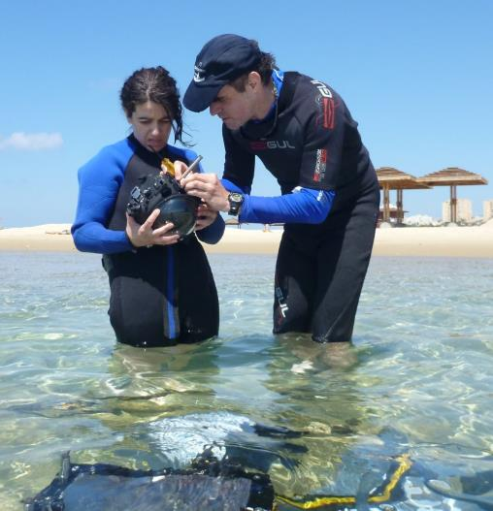
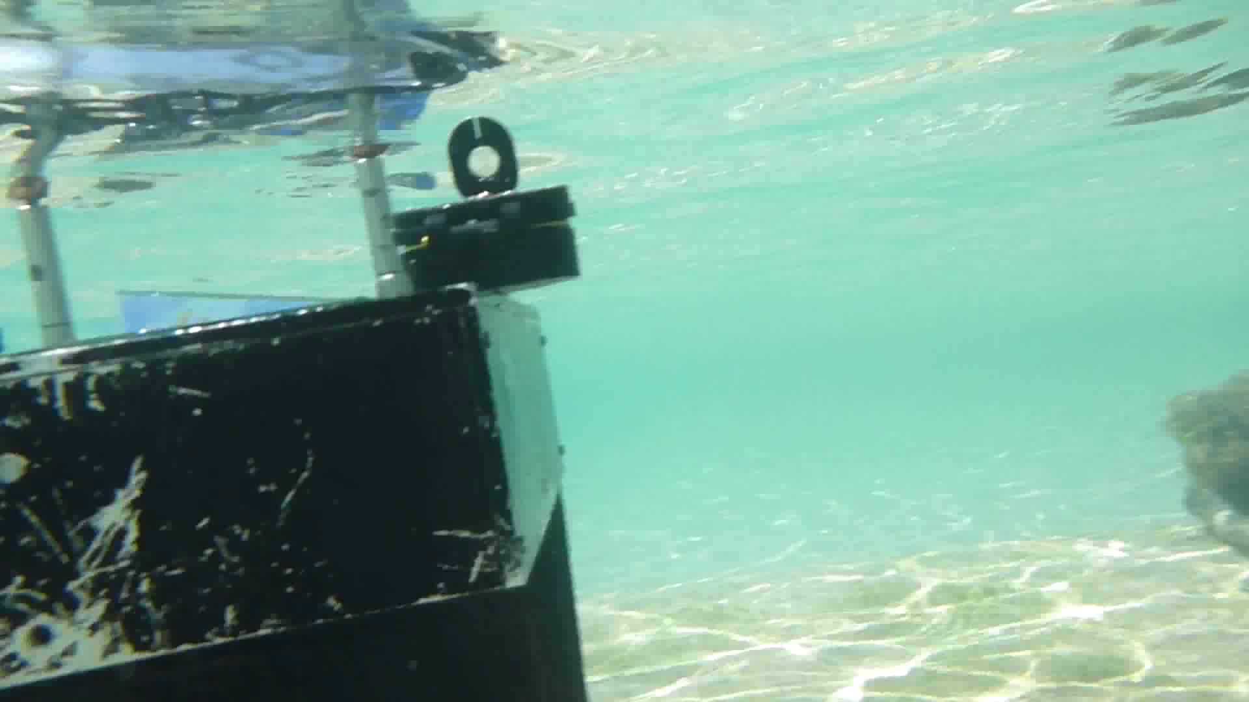
In the Sea
Notes:
This is us working hard at the Haifa beach.
Here you see the system submerged.

Slide 66
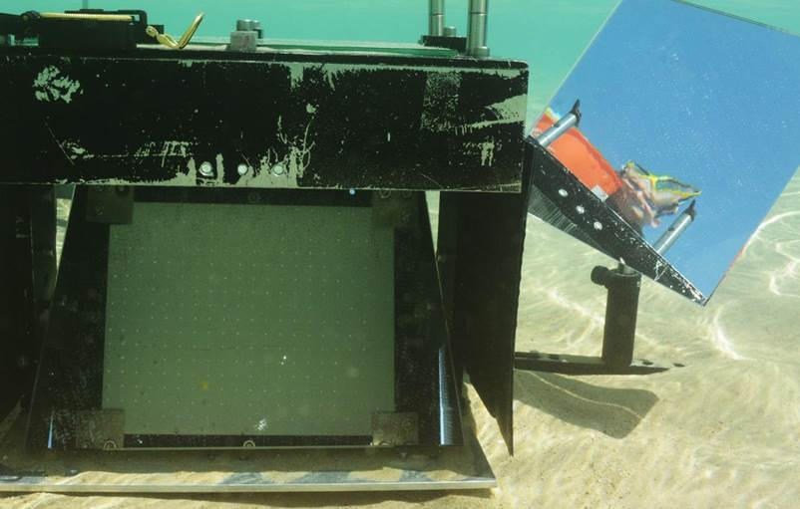
Sea Experiment
Ack: Tali Treibitz, Danny Veikherman
Notes:
Here is the image taken by the camera capturing both the sensor and the outside image. We imaged a person standing outside.

Slide 67
System Implementation
Alterman, Swirski, Schechner, ICCP 2014
Pinhole array
Diffuser
Notes:
Here is the actual implementation of our system. This is the pinhole array and below is the diffuser.
We use a mirror here to observe the diffuser with this camera placed in front of the sensor.
Sun rays refract by the WAI, irradiate the diffuser, reflect in the mirror and imaged by the camera.
And we have an area on the water surface that we thus estimate.
Now, recall that the image of an airborne scene should be acquired simultaneously with the sunlight field.
For synchronization, we use the same camera and another mirror.
The object is imaged through the mirror reflection.
A single image contains both the sunlight filed and a distorted airborne scene.
Here is a photo of the actual system.

Slide 68
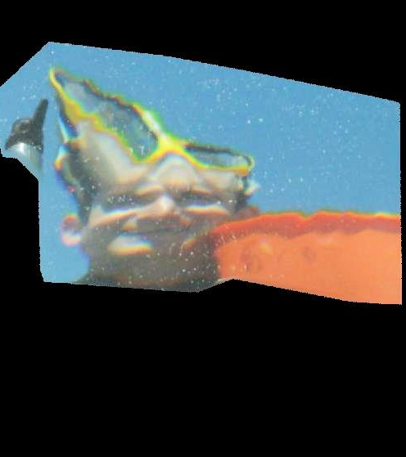



Sea Experiment
Ex 1
distorted
Ex 2
Mark features and compute score based on face geometry
www.anaface.com
 | Distorted | Corrected
1 | 0.76 | 6.37
2 | 0 | 6.78
on a scale of 0-10
corrected for waves
Leyvand et al. “Data-Driven Enhancement of Facial Attractiveness”, SIGGRAPH, 2008
Eisenthal et al. “Facial attractiveness: Beauty and the machine”, Neural Computation, 2006
Notes:
Here are two results. Notice how the water mask is corrected.
There are algorithms that can give you a beauty score based on the geometry of your face.
You can see that based on their score, the corrected faces are way more attractive comparing to the distorted ones.

Slide 69

Lab Experiment
Ack: Vadim Holodovsky, Aviad Levis, Amit Aides, Roy Or-El, Yahel David, Guy Nir
Notes:
For more quantitative results we performed an experiment in the lab.
We captured a checkerboard pattern.
Here is the sensor and the checkerboard pattern captured together by the camera.

Slide 70




Quantitative Results
distorted
line curvature
12
l_{y} [cm]
STD = 0.45
$$9.8⋅{10}^{−4}$$
STD = 0.2
10
8
6
ground truth
4
line curvature
2
l_{x} [cm]
$$3.3⋅{10}^{−4}$$
2
4
6
8
10
12
14
corrected for waves
STELLA MARIS, Alterman, Swirski, Schechner
Notes:
Here I show a quantitative result.
This is the distorted checkerboard.
The ground truth square size is 5cm in the x and y directions.
So, we measure line-lengths crossing at adjacent corners of the squares in the x and y directions and plot them in this scatter plot.
For example this line and this line, give this point in the scatter plot.
Another point is this one. Here are all the distorted points.
We computed the spread of these points and the curvature of grid lines.
Here is our result of the corrected checkerboard.
The checkerboard is much more uniform.
Similarly, we overlay the points of the corrected grid in this scatter plot.
You can see that the corrected pattern is closer to the real size and has lower standard-deviation and curvature.
So, correction for the waves by our method signiﬁcantly lowers the spread and curvature.

Slide 71
Failure Case
distorted
“corrected”
Ack: Tali Treibitz, Danny Veikherman
Notes:
Here I show you a failure case from the sea experiment.
Clearly, small scale wave ripples are responsible for this image.
Our existing implementation does not sample the wave slopes densely enough to measure such high frequency waves, yielding wrong result.

